Slide 1
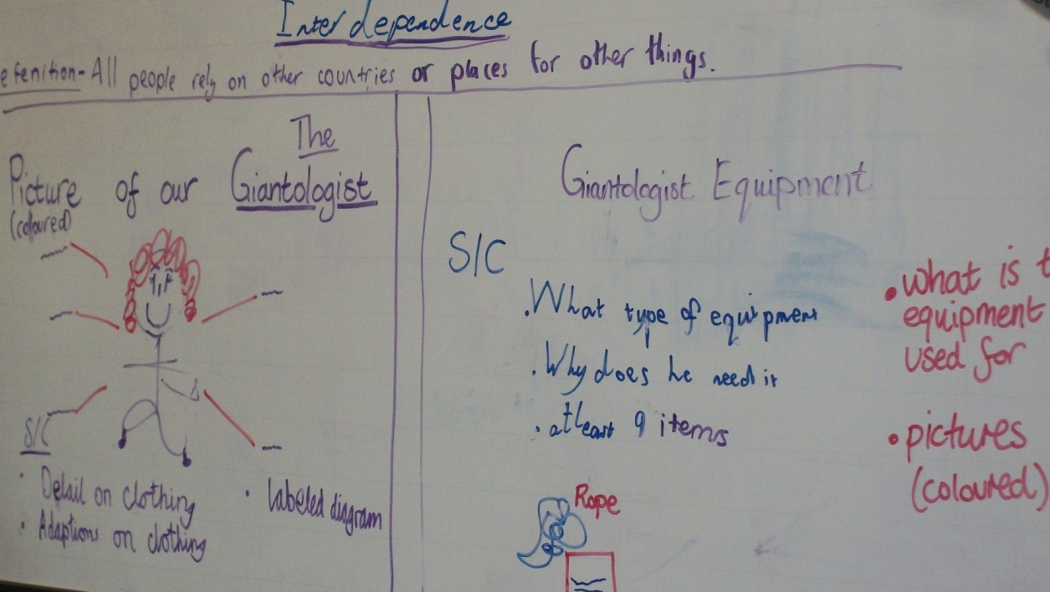
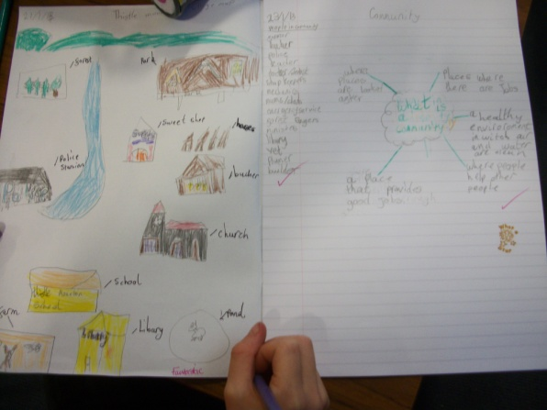
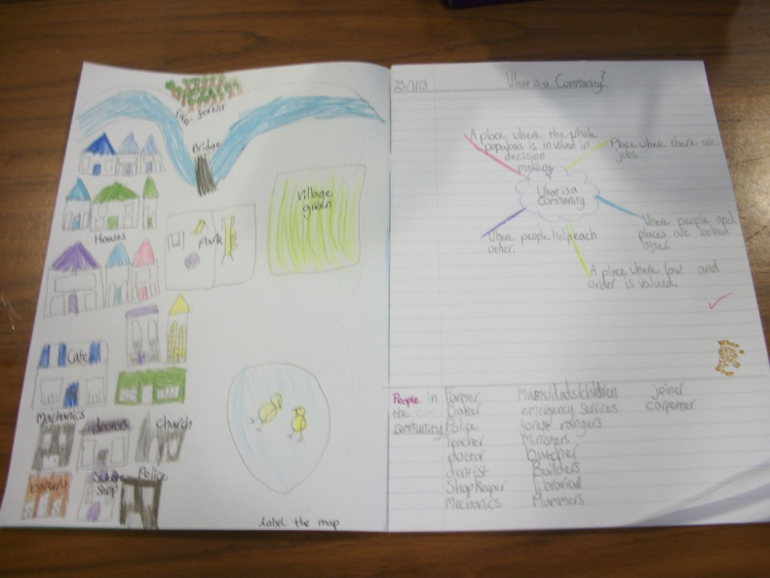
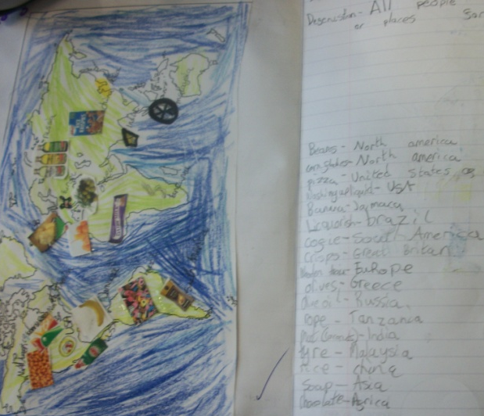
What is a community?

Slide 2
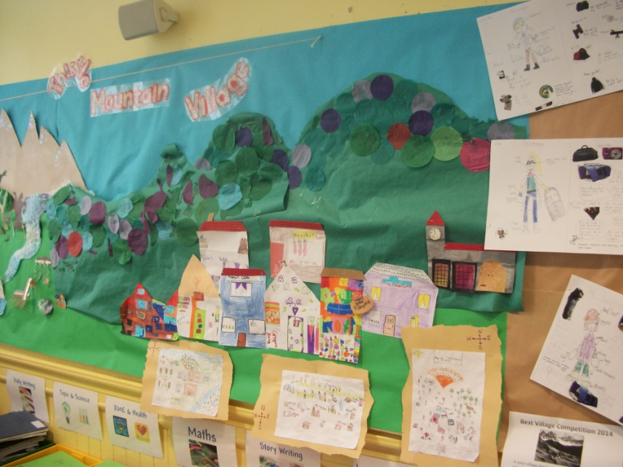
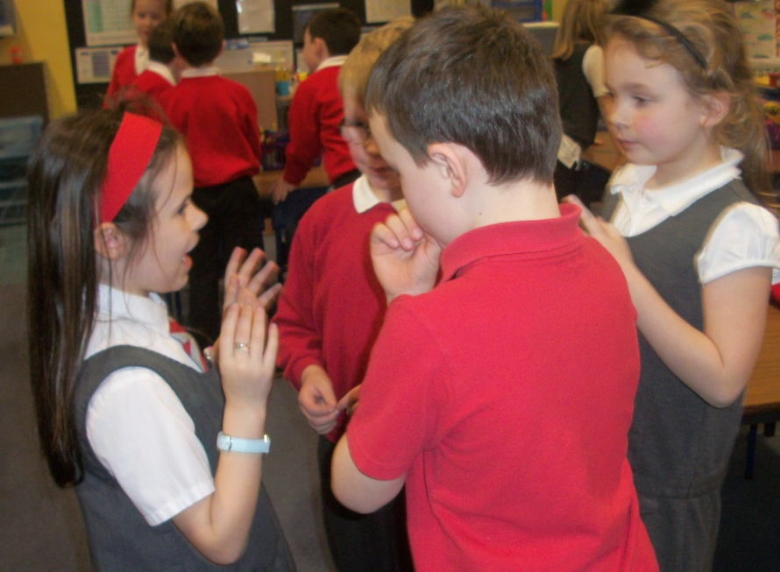
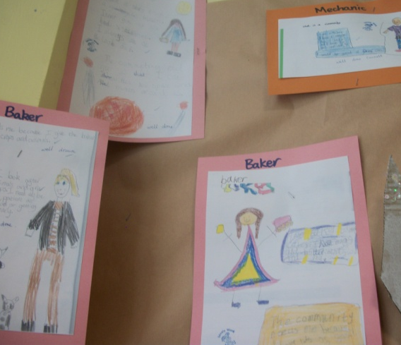
The Village map
Deciding what to do about the giant
Creating characters from Thistle Mountain Village

Slide 3
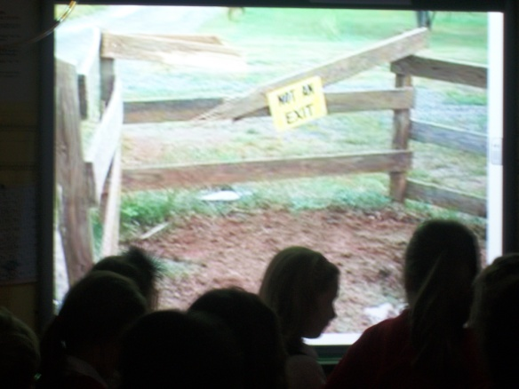
A giant problem – Apseky Snooper (Giantologist) visits the class

Slide 4
What is a community?
A ‘Walking Debate’ to consider the arguments for and against believing the Giant’s claim. This was a precursor to creating a list of negotiations' with the Giant.
(SOC 1-15a, S OC 1-18a, LIT 1-08a, LIT 1-09a, HWB 1-10a)

Slide 5
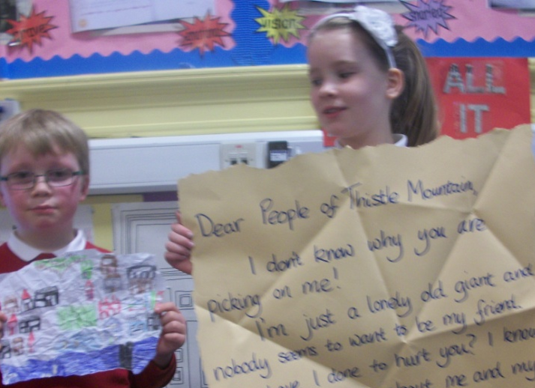
The Giant has written to the villagers

