Slide 1
Developing Pupils as Digital Leaders St Bernadette’s Primary School Victoria Primary School
John Cloherty Acting Principal Teacher john.cloherty@falkirk.gov.uk
Emma Hedges
Class Teacher
emma.hedges@Falkirk.gov.uk

Slide 2
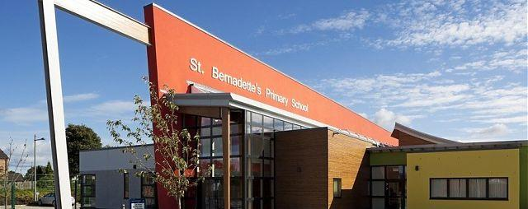
Digital Leaders at St Bernadette’s Primary, Falkirk

Slide 3
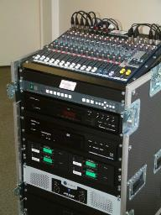
We needed…
Help teachers with ICT problems during the school day
Responsibility of taking care of the laptops
Set up for assemblies and whole school events
Advise staff on new technologies and programmes including Glow
Make better use of pupils ICT skills

Slide 4
The answer…
ICT Co-ordinators meeting
National Pupil Digital Leader Network
NGFL Digital Leader pack
Pupils as Digital Leaders

Slide 5
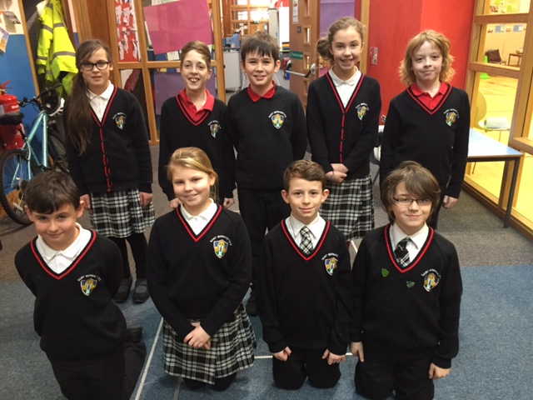
Our Digital Leaders

Slide 6
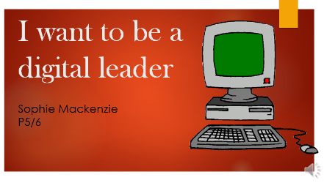
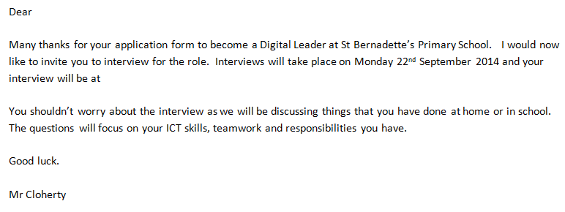
The Interview Process

Slide 7
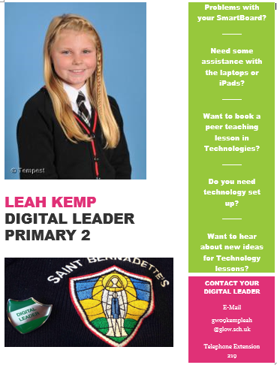
Responsibilities

Slide 8
Assist class teachers with day to day ICT problems

Slide 9
Setting up technology for assemblies/
whole school events

Slide 10
Planning and delivering training sessions for staff

Slide 11
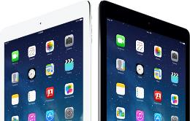
Research new technologies and software and report back

Slide 12
Responsibility for taking care of laptops, numbering and charging

Slide 13
Planning and delivering lessons to other classes

Slide 14
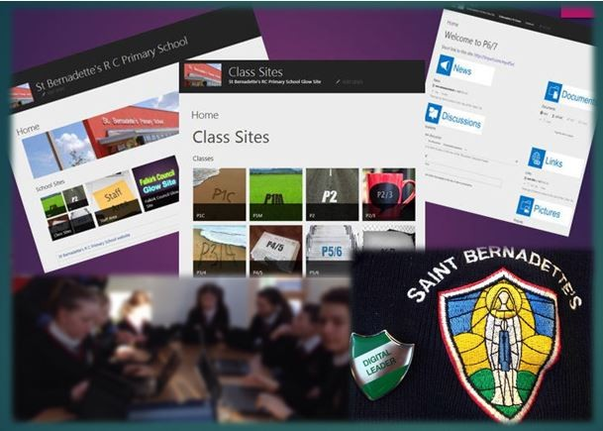
Class Sites
Discussion

Slide 15
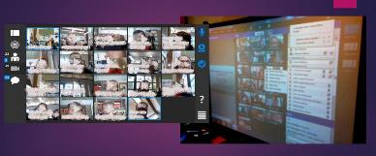
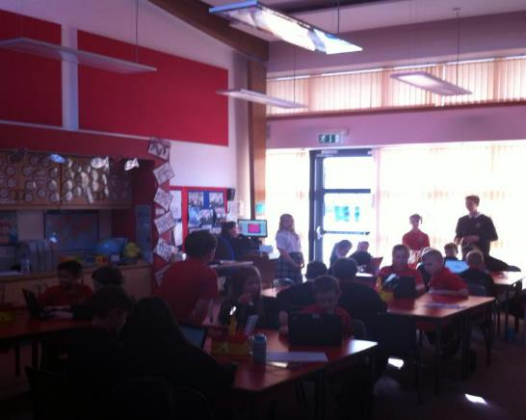
Collaborative
Story Writing
Online Homework

Slide 16
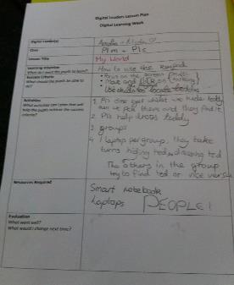
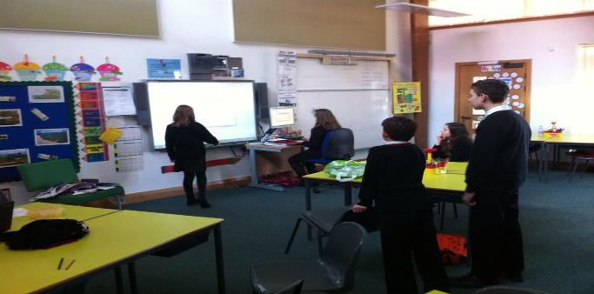
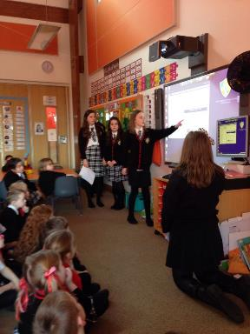
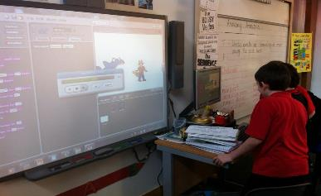
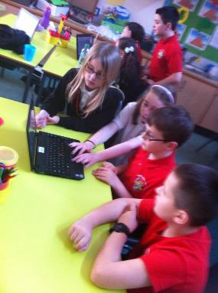
Digital Learning Week at St Bernadette’s

Slide 17
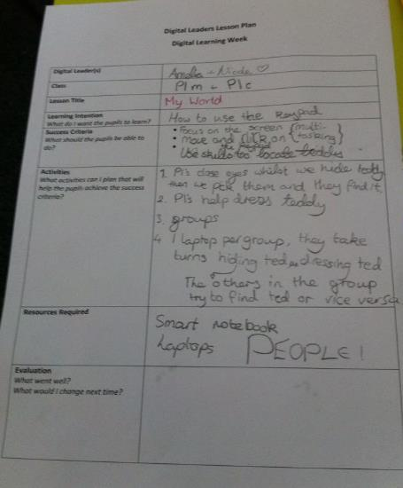
Learning Intention
Success
Criteria
Feedback

Slide 18
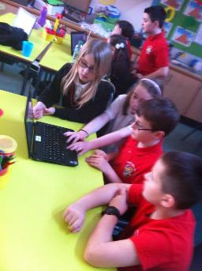

Slide 19
Staff workload reduction
Responsibility
Pupil Leadership
Pupil Voice
Staff Development
IMPACT
ICT Development
Peer Teaching
Engaged

Slide 20
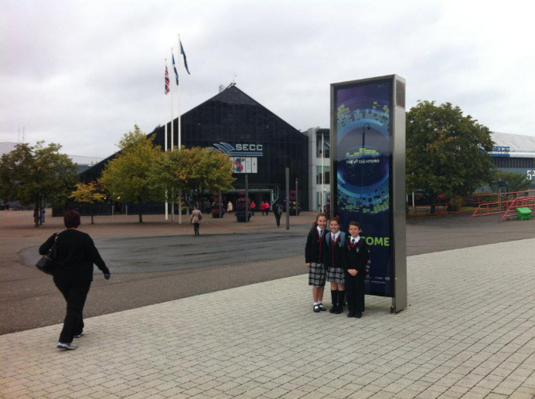
Scottish Learning Festival

Slide 21
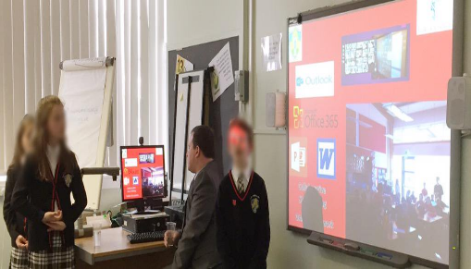
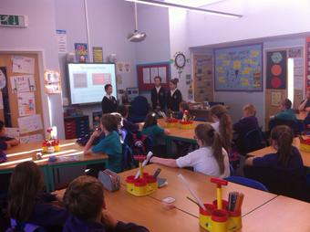
CPD Session
Kinnaird PS
Victoria PS
Stenhousemuir PS
Bowhouse PS

Slide 22
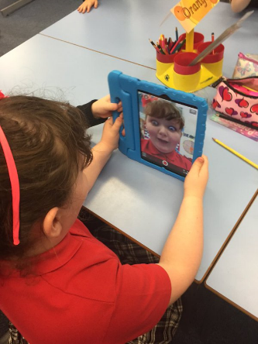
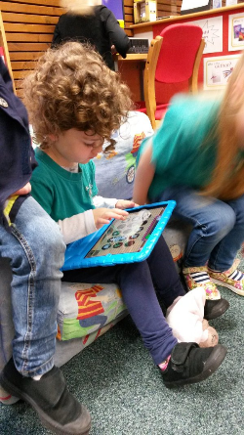
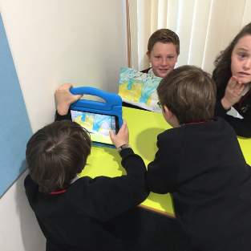
iPads

Slide 23
Helping to write the ICT planner for the school
Work with Digital Leaders across Scotland
Help teachers with the iPads
Plan our joint Internet Safety Week with Victoria PS

Slide 24
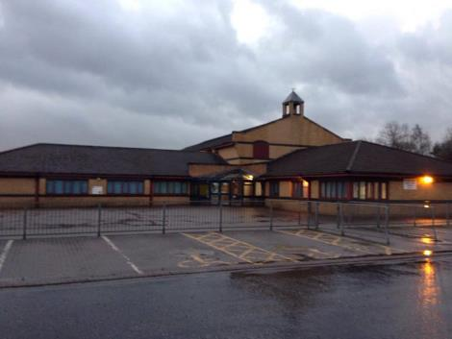
Digital Leaders at Victoria Primary School, Falkirk

Slide 25
I.C.T had not been a priority within our school and so there were a lot of issues. Miss Hedges wanted to improve it but knew that she would need help. She went to a course about Digital Leaders. The St Bernadette’s Digital Leaders presented and inspired her to start the process. Victoria Primary School started to use Digital Leaders in November 2015.

Slide 26
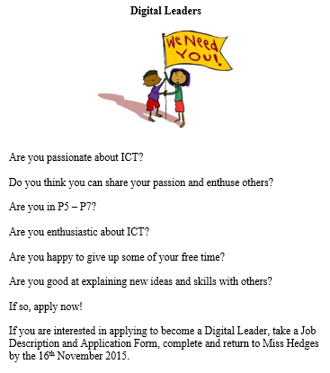
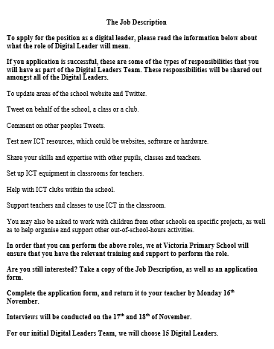
The application process
The position of Digital Leader was advertised within the school.

Slide 27
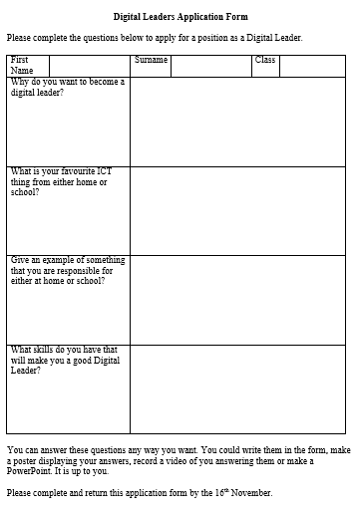
If pupils wanted to apply then they had to answer questions on why they thought that they
would be good digital leaders. We could answer the questions any way that we wanted to.
Some people did power points and some people filled in an application form.

Slide 28
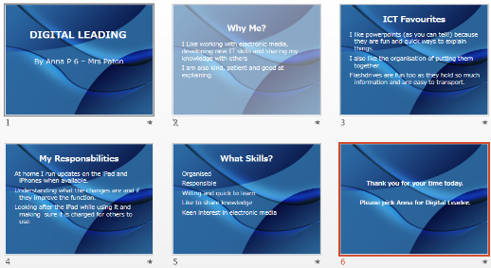
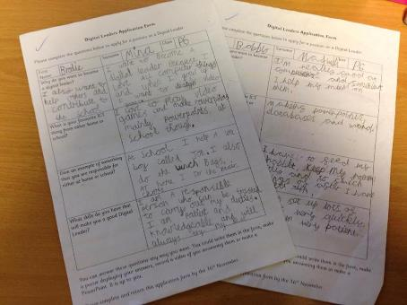

Slide 29
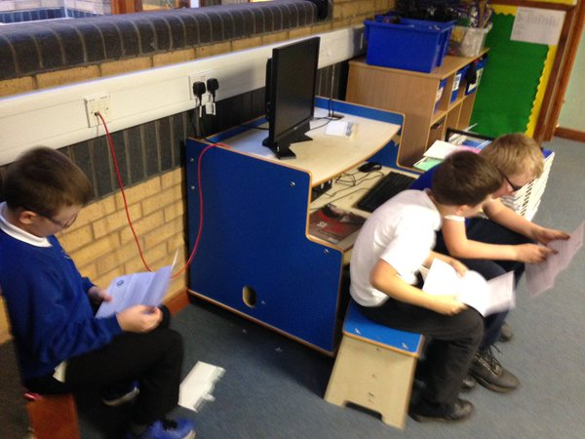
We all got a letter telling us if we were successful or unsuccessful.

Slide 30
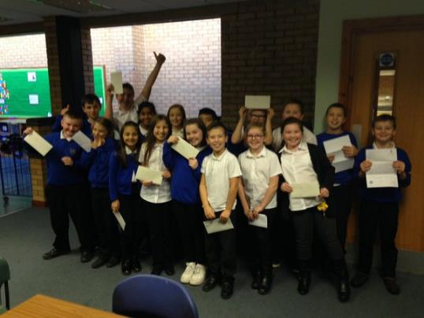
Miss Hedges believes that we can help to transform ICT in our school.
We are the pupils who were chosen to be the first Digital Leaders in Victoria Primary School.

Slide 31
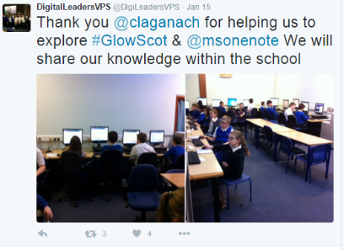
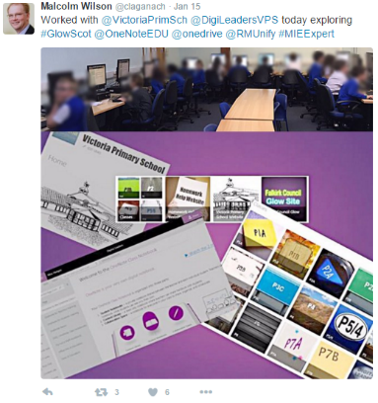
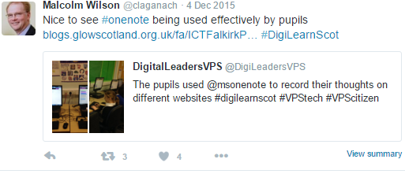
We meet once a fortnight during the school Citizenship Group time. We make check lists of what we need to do at each meeting using OneNote. Malcolm Wilson came to visit us. He showed us how to use OneNote and Glow.

Slide 32
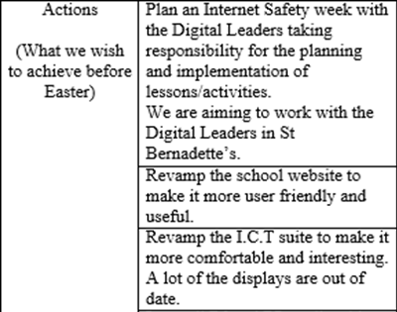
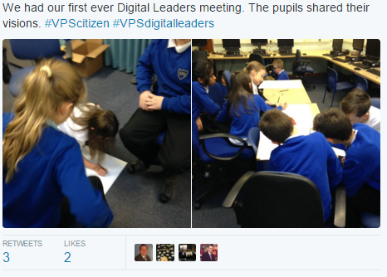
At our first meeting we had to think of what we want to achieve by being a Digital Leader. We worked in groups to think of our aims. We want to plan an Internet Safety Week, revamp the school website and improve the ICT suite.

Slide 33
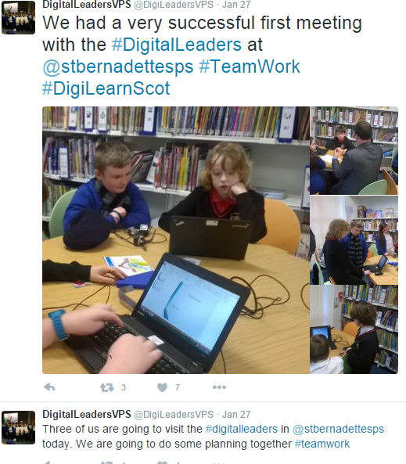
Internet Safety Week
We have recently helped to organise an Internet Safety Week with St Bernadette’s Primary.

Slide 34
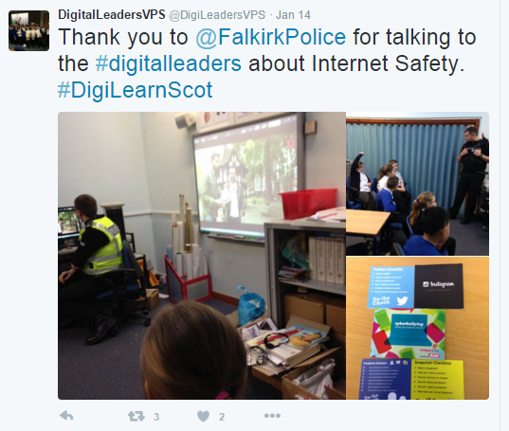
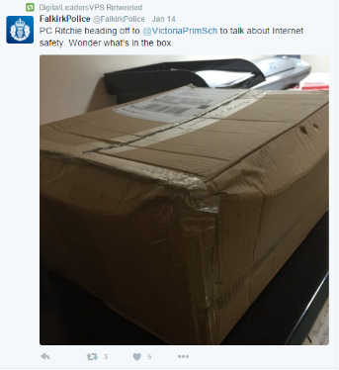
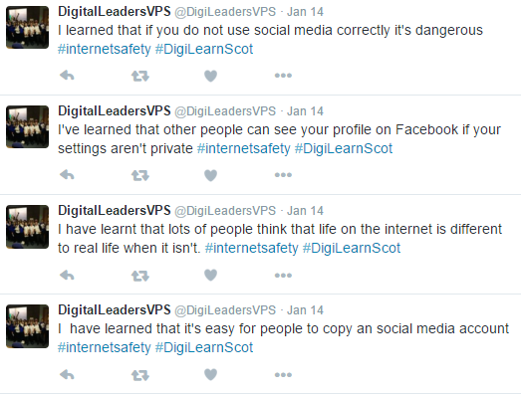
Our Community Police Officer, Michael Ritchie, met with us to give us more information about staying safe online.

Slide 35
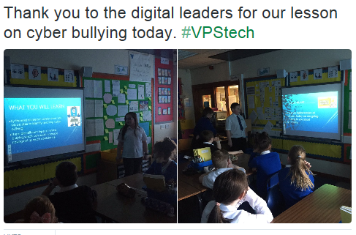
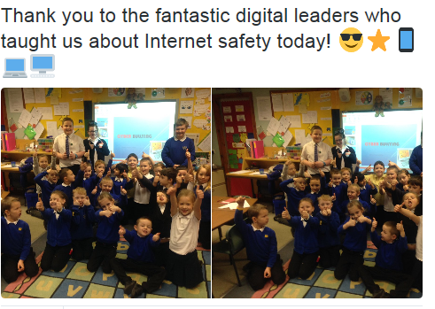
We have been going into classes and teaching them about how to stay safe online.

Slide 36
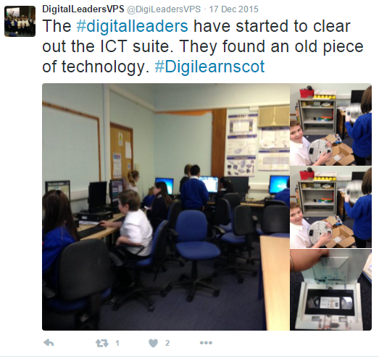
Revamping the ICT suite
Our ICT suite was very outdated. Some displays were from when we were in P1!! It was also very cluttered.
We have taken all of the old displays down and are working on making new displays.

Slide 37
Here are our ideas for wall displays. They have been recorded on our Digital Leader OneNote.

Slide 38
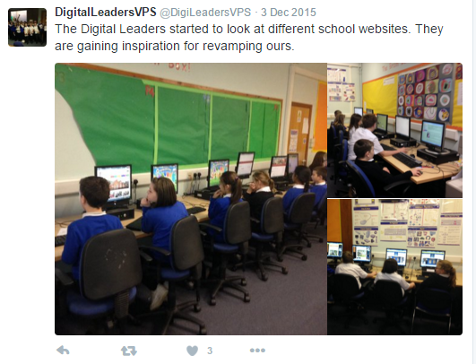
School website
Our school website also needs to be updated. We have started the process of making improvements by looking at different school websites.

Slide 39
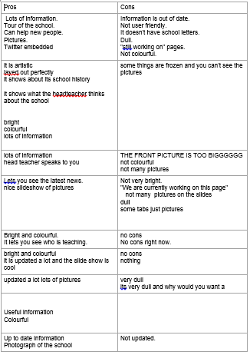
We recorded pros and cons of different school websites using OneNote. We will use this to help us to design the new school website.

Slide 40
Tubs for Tablets
In order to help improve the ICT facilities our school took part in the Flora Tubs4Tablets scheme. Tablets are useful at schools they help educate students.
We managed to get 8 tablets. They will be used when teaching I.C.T skills, as well as for supporting the online aspect of the Bug Club reading scheme.
As part of our role as Digital Leaders we will be researching apps to help support learning.

Slide 41
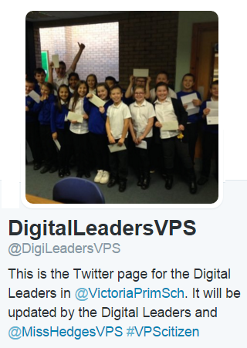
Our school uses Twitter to update parents on what is happening.
We have our own Digital Leader account. We post pictures of what we do as well as share our thoughts and opinions.
We will soon be teaching parents, pupils and staff about how to stay safe online using social media, including Twitter.

Slide 42
What is next for us?
Our head teacher gave us a £50 budget. We plan to spend it on organising a fundraiser to help us to raise more money. We will use the money to improve ICT facilities in school. We also want to buy some Digital Leader badges.
We are looking forward to doing more work with St Bernadette's.
We will carry on working together to improve ICT in the school for pupils and staff.
We will continue to learn new skills, such as setting up projectors and using Scratch, before going in to classes to teach them.

Slide 43
Questions
John Cloherty Acting Principal Teacher john.cloherty@falkirk.gov.uk
Emma Hedges
Class Teacher
emma.hedges@Falkirk.gov.uk

