Slide 1
Using the Model for Improvement to support clear and measureable impact
Wendy Toner
CYPIC Improvement Advisor
&
Falkirk CYPIC QI Faculty

Slide 2
By the end of this session you will…….
Be able to explain the model for improvement and have knowledge of other QI tools.
Have a knowledge of some practical examples of how to use the MfI to support your work
Have enhanced knowledge of how to align aims, measures and ideas for change
Know where to go for further information and support.

Slide 4
‘Not all change is improvement, but all improvement requires change’
Don Berwick
Notes:
MFI gives you a set of tools to help understand whether change is an improvement or not

Slide 5
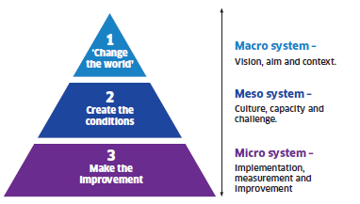
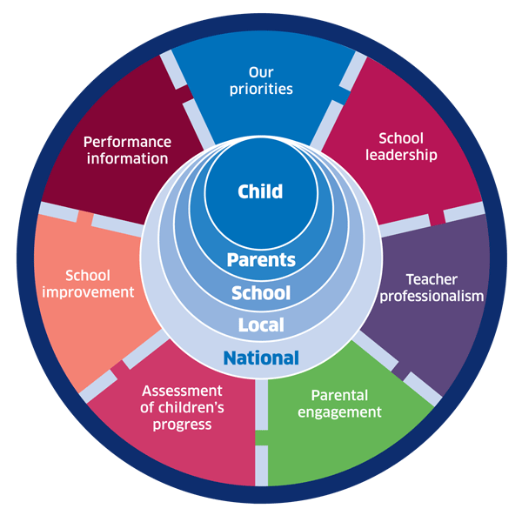
Notes:
A vision – capable of stirring the heart of the community and able to serve as a constant
reference and anchor point as the change moves forward.
A story – to enable people to recognise where they have been and where they are going.
A set of actions – to take us to the next steps towards releasing the vision.
A clear framework for improvement.
A strategy to engage and empower the workforce - to provide the stimulation,
development and opportunity our staff need to fully release their deep commitment to public
service.
An understanding of how change will work locally (everywhere) – recognising
communities are different and creativity should be nurtured and released at a local level.
A guiding coalition – a team of key people to drive the change when the going gets tough,
and to sustain support.
Aim- Is there an agreed aim that is understood by everyone in the system?
Correct changes - Are we using our full knowledge to identify the right changes and priorities those that are likely to have the biggest impact on our aim?
Clear change method- Does everyone know and understand the method(s) we will use to improve?
Measurement- Can we measure and report progress on our improvement aim?
Capacity and capability - Are people and other resources deployed in the best way to enable improvement?
Spread plan- Have we set out our plans for innovating, testing, implementing and sharing new learning to spread the improvement everywhere it is needed?

Slide 6
The six questions to be asked of EVERY change programme:
Step 2 –Creating the Conditions
1
Aim
Is there an agreed aim that is understood by everyone in the system?
2
Correct changes
Are we using our full knowledge to identify the right changes and priorities those that are likely to have the biggest impact on our aim?
3
Clear change method
Does everyone know and understand the method(s) we will use to improve?
4
Measurement
Can we measure and report progress on our improvement aim?
5
Capacity and capability
Are people and other resources deployed in the best way to enable improvement?
6
Spread plan
Have we set out our plans for innovating, testing, implementing and sharing new learning to spread the improvement everywhere it is needed?

Slide 7
Reflect
What is in our current improvement plan?
What are the priorities?
What will better look like?
By how much? By when?
How will we know if we’re improving?

Slide 8
Fundamental Principles of Improvement
Knowing why you need to improve
Having a feedback mechanism so you know if a change is an improvement
Developing effective changes
Testing changes before attempting to implement
Knowing when and how to make a change permanent

Slide 9
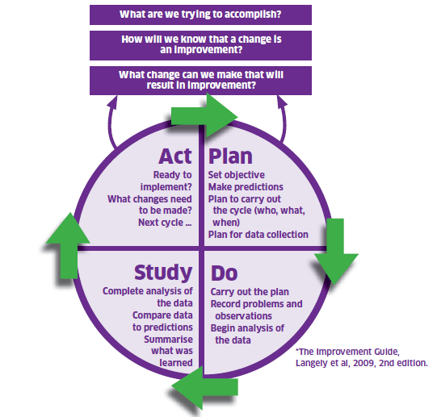
The Model For Improvement
The Thinking Part
The Doing Part
Notes:
The model is split into two parts. The first being the thinking part and the second being the doing part. We will now take you through the two distinct parts in some detail with practical exercises to get everyone used to using the model and be able to describe and direct others in terms of our support function as a Unit.
.

Slide 10
Improvement Journey
Understand current system
Develop aim and change theory
Develop change ideas
Test and refine ideas, building knowledge
Start to implement
Building will
Measurement, project management and understanding people
Notes:
We are going to structure the two days to take you through an improvement journey, introducing tools, ideas and approaches as we go. Much may be familiar as you have all been involved in various types of projects and change management.
Understand the system – look at data – listen to the people – use the available improvement tools. Might involve data analysis, comparisons, process mapping, cause and effect analysis etc., also understanding people and why things work as they do. Do the conditions exist for change? E.g. leadership buy-in, will to change,
This will help identify what to improve – prioritise what might have the most impact. Can refer to example on CPOs – make sure you’re solving the right problem
Might be obvious how to change it, or may need to think of creative solutions. Copy from others if they’ve done something that works.
Start testing on a small scale, and measure as you go along. It’s the people who do the work who need to own the change and test it.

Slide 11
Improvement Journey
Understand current system
Develop aim and change theory
Develop change ideas
Test and refine ideas, building knowledge
Start to implement
Building will
Measurement, project management and understanding people
Notes:
We are going to structure the two days to take you through an improvement journey, introducing tools, ideas and approaches as we go. Much may be familiar as you have all been involved in various types of projects and change management.
Understand the system – look at data – listen to the people – use the available improvement tools. Might involve data analysis, comparisons, process mapping, cause and effect analysis etc., also understanding people and why things work as they do. Do the conditions exist for change? E.g. leadership buy-in, will to change,
This will help identify what to improve – prioritise what might have the most impact. Can refer to example on CPOs – make sure you’re solving the right problem
Might be obvious how to change it, or may need to think of creative solutions. Copy from others if they’ve done something that works.
Start testing on a small scale, and measure as you go along. It’s the people who do the work who need to own the change and test it.

Slide 12
Appreciation of a System
Do we understand our current state?

Slide 13
Notes:
Extremely useful way of thinking about the system in which you work.
When you break the system into parts then you can sharpen the lens to help you drill down into the problem

Slide 14
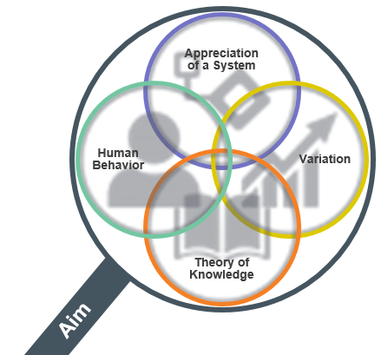
Appreciation of a System
Common Aim
Understand how things link together
People, process and items
Simple, Complicated or Complex
Profound
Knowledge
Psychology
Relationships between people
Motivation, intrinsic /extrinsic
Beliefs, assumptions
Will to change
Theory of Knowledge
Develop a theory
Use PDSA to test
Bring knowledge into the system
Understanding Variation
The world is not deterministic
Variation is expected
Understand when to improve
Understand when not to tamper
Notes:
Appreciation for a System
Interdependence, dynamism
World is not deterministic
Optimization, interactions
System must have an aim
Whole is greater than sum of the parts
Theory of Knowledge
Prediction
Learning from theory, experience
Operational definitions
PDSA for learning and improvement
Understanding Variation
Variation is to be expected
Common or special causes
Ranking, tampering
Potential mistakes
Psychology
Interaction between people
Intrinsic motivation, movement
Beliefs, assumptions
Will to change

Slide 15
Notes:
Subject matter knowledge is achieved through formal and informal learning and reinforced with experiences – Health care workers should be able to improve health care, sales people should be able to improve sales. Links with systems

Slide 18
Driving Forces
1 (weak) to 5 (strong)
Restraining Forces
1 (weak) to 5 (strong)
5
4
3
2
1
1
2
3
4
5
Unpredictable work demands - FW
Communication
Timing of visit
Families engaging
Families moving in/out of area
First time pupils
English not 1st language
By September , 70% of “eligible” S1 learners at Seaview High School will receive a home visit from the family support worker at 2 – 4 weeks of starting first year
Domestic abuse
Adequate staffing levels
Content of visit – too prescriptive
Staff motivation
& commitment
Where concerns identified –
fosters a hostile environment
Geographical Model
Poor management communication –
especially around change
Total: 20
Total: 28

Slide 19
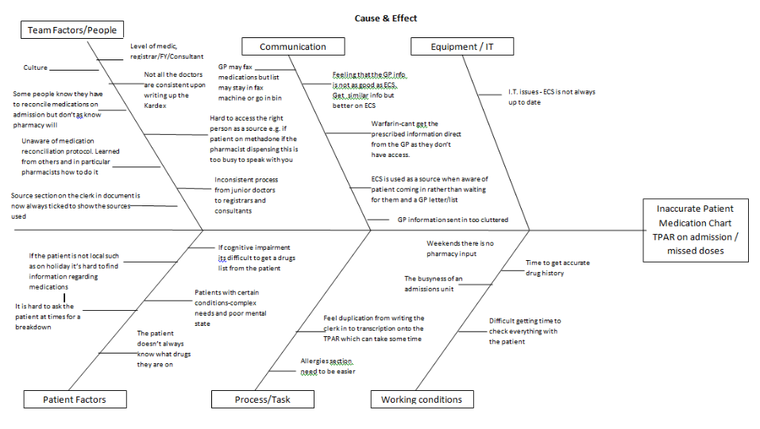
Cause & Effect – Non Accuracy TPAR
Notes:
This is my cause and effect diagram which was an eye opener and great method of capturing the problems, reasons why med rec isn't done correctly on admission and hence patients charts incorrect.
Some issues can be realities such as patients having cognitive impairments and not being able to clarify their meds, others can be passed down habits, failure to try to speak with patients and taking easy options of using an IT system/screen to find out info without thinking of the other sources that would make their medication list right. Some admit they know the pharmacist will pick up their work and they don't always do things consistently. In other words culture.
I was horrified to hear that whilst GPs send in a home visit by fax often it can sit there for days or be put in the bin as it takes time to pick it up, go to fax in the same room. They would rather use an It system for speed, even though its not always up to date.

Slide 20
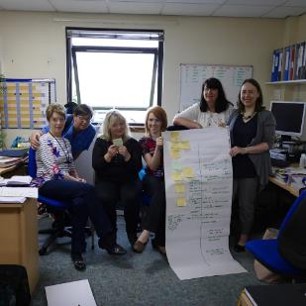
HV Admin Team forwards Antenatal Record to appropriate HV Team
MW completes Antenatal Record at FPOC
Based on EDD, HV Admin Team calculates date to send out introductory letter to HV service at 19 weeks gestation and date of 32 – 34 week HV antenatal visit
Phone call from pregnant woman to Midwife (MW) requesting First Point of Contact (FPOC)
Booking appointment with MW
MW emails Antenatal Record to Generic HV Mailbox
HV Admin Team receives Antenatal Record
HV Admin Team log Antenatal Record on Database
Is an Unborn Baby (UBB) Referral required?
Start
No agency
involvement
HV Admin Team log dates of 19 weeks and 32 – 34 weeks gestation on database
Joint visit to pregnant woman by HV & MW or HV/MW & SW
Yes
What is outcome of P&K UBB MASG?
Follow Child Protection
Protocol
Concern for Unborn Babies
Agency
involvement
MW & HV
to attend all agency meetings regarding woman
Has a non-continuing pregnancy been notified to the HV Admin Team?
Yes
HV Admin Team remove Antenatal Record from Database
Forward information to appropriate HV Team
No
HV records 32 – 34 week visit in maternal health record on emis Web
Introductory letter to HV service sent to woman at 19 weeks gestation
HV undertakes 32 – 34 week antenatal visit
HV contacts woman to arrange 32 – 34 antenatal visit
End

Slide 21
First Define Your Rationale and Scope
What’s the problem?
How do you know?
How big is the gap?
Who will be affected?
Strategic fit?
Expected impact?
Realistic timescale -why?

Slide 22
Reflect
What is in our current improvement plan?
What are the priorities?
What will better look like?
By how much? By when?
How will we know if we’re improving?

Slide 23
What am I trying to accomplish?

Slide 25
Constructing an Aim Statement
Specific
Timebound
Aligned
Numeric

Slide 27
Falkirk : Aim Statements
Attendance will improve
All children p.1 – 7 will achieve at least 85% attendance by June 2018. (Attainment)
There is a shared understanding of what a good lesson looks like.
By January 2019, 95% of children and 95% of teachers will rate lessons in Maths as good or very good. (Self-Evaluation)
More children will be read to at home
90% of children will receive a bedtime story 3 times a week by the end of the summer term (Family Support)

Slide 28
Reflect
What is in our current improvement plan?
What are the priorities?
What will better look like?
By how much? By when?
How will we know if we’re improving?

Slide 29
My brain hurts……………..

Slide 30
Theory of Learning

Slide 31
A helpful method…
As a group consider the following question:
“To achieve our aim the things we need to change/improve are…….”
Record each idea on separate post-it notes

Slide 33
Secondary Drivers
Change ideas
Primary drivers
Aim
Ideas to make
this
happen
We need to
ensure …
Which requires…
In order to achieve this aim…
Notes:
Look at all the information you have gathered from using the improvement tools and start to put them into big buckets.
What are the primary drivers – fundamental to achieve the aim
Secondary drivers – further breakdown of the primary drivers
Change ideas – what are all the things you think you could do to make the aim happen – offshoots of the primary and secondary drivers

Slide 34
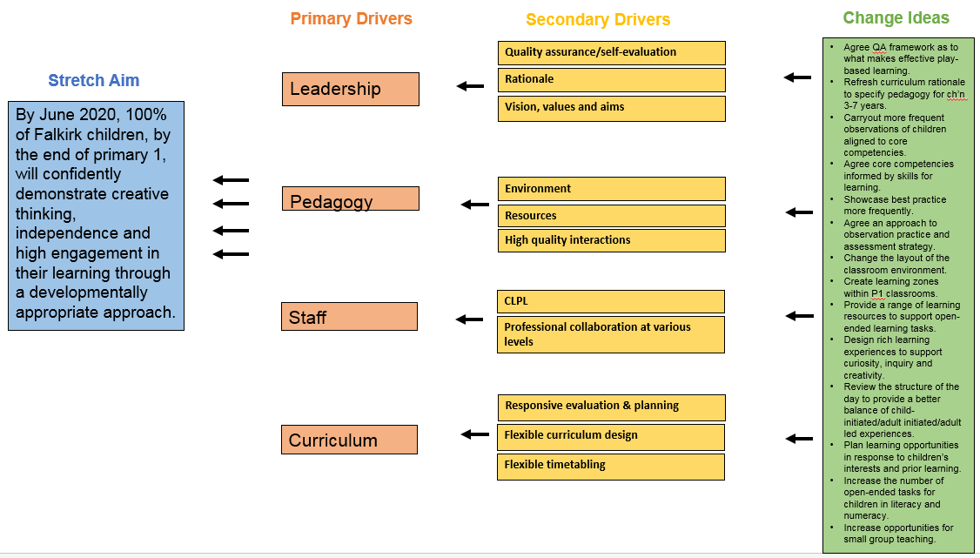
Play is the Way

Slide 35
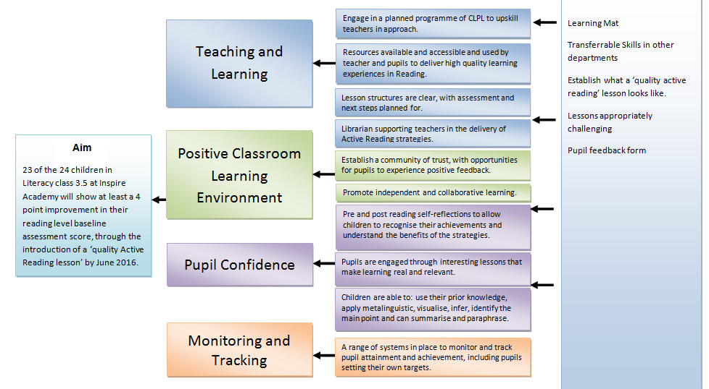

Slide 36
Notes:
When you have prioritised then it is easier to focus and sharpen the lens on what you are trying to do

Slide 37
Reflect
What is in our current improvement plan?
What are the priorities?
What will better look like?
By how much?
By when?

Slide 38
Let’s talk about measures!
Don’t ask “what will we measure?”
Ask “what do we need to know?” then figure out if you can measure it.

Slide 40
“Not everything that can be measured counts and not everything that counts can be measured”

Slide 42
“Information is a source of learning. But unless it is organised, processed, and available to the right people in a format for decision making, it is a burden, not a benefit.” (William Pollard 1828-1893)

Slide 43
Is the young person getting the right outcome?
Is the system working as planned?
What about the bigger picture?
Outcome Measures
Are we making things better?
Are we on track to achieve our Aim?
Process
Measures
Are we doing the right things at the right time, every time?
Is the process reliable?
Balancing Measures
Looking at the system from different dimensions.
Does improving one thing cause problems elsewhere?
Dave Williams, IHI
Notes:
Process measures are about the how
The outcomes measures are about the impact, the so what
The balancing measures are the unintended consequences and can be negative or positive

Slide 44
Types of measures
Aim : To decrease the number of “No award” for pupils in 3rd set National 5 class by 25% by August 2018

Slide 45
Types of measures
Number of pupils returning completed Maths homework
Number of “no awards” in National 5 for children in 3rd set
Number of pupils attending supported study classes per week
Number of pupils attending all mandatory Maths classes per week
Number of pupils scoring 4 or above on a “confidence” Likert scale
Number of pupils attending all English study support per week
Notes:
There might be lots of different things you can measure in relation to your improvement project. However, you don’t have to measure all of them – measure what is useful and gives you the best information

Slide 46
Types of measures
Number of “no awards” in National 5 for children in 3rd set (Outcome measure)
Number of pupils returning completed Maths homework (Process measure)
Number of pupils attending supported study classes per week (Process measure)
Number of pupils attending all mandatory Maths classes per week (Process measure)
Number of pupils scoring 4 or above on confidence Likert scale (Process measure)
Number of pupils attending all English study support per week (Balancing measure)
Notes:
There might be lots of different things you can measure in relation to your improvement project. However, you don’t have to measure all of them – measure what is useful and gives you the best information

Slide 47
Likert Scale
“Pupil confidence to pass National 5 Maths”
Not at all confident
Slightly confident
Moderately confident
Very confident
Confident
Notes:
When using a scale like this, think about what you want to know. Provide clear instructions and keep the order of choices (e.g., from low to high or negative to positive) the same throughout the questionnaire.
Consider your respondents’ age, literacy level, and cultural background to make the scale understandable
Odd or even point scale. There is no preferred or better choice. An odd number of points allows people to select a middle option. An even number forces respondents to take sides. An even number is appropriate when you want to know what direction the people in the middle are leaning. However, forcing people to choose a side, without a middle point, may frustrate some respondents.
Unipolar – Satisfied to dissatisfied, Brave to not at all brave – not brave to shy.
Avoid using just numbers to indicate the points on the scale. Providing a word label over each point better ensures that everyone interprets the points similarly reducing measurement error. Also, few people express their opinions in numerical terms so numbers have less meaning to respondents. Numbers may confuse respondents or have unintended meaning so numbers can be removed from the scale.
Providing a word label over each point better ensures that everyone interprets the points similarly reducing measurement error.

Slide 48
Pupil confidence in unit 3 of Practical Craft skills

Slide 49
Create a measurement plan that matters
Notes:
If your aim was an increase in attainment of Pulling the data together in a dashboard format

Slide 50
Reflect
What is in our current improvement plan?
What are the priorities?
What will better look like?
By how much? ,By when?
How will we know if we’re improving?

Slide 51
It’s important!
Data
Information
Insights
Action
Notes:
Visualisation of your data is vitally important to convey your message.
Our aim is that we want ACTION caused by COMMUNICATING insights gained from DATA.
Best way is to turn DATA into INSIGHT is then by using visual displays such as charts.
Charts can be complicated. We need to make them as easy
to understand without losing the insights

Slide 52
Pattern Recognition

Slide 53
Change Made Between Weeks 7 & 8
Langley, G.J., Nolan, K.M., Nolan, T.W, Norman, C.L., & Provost, L.P. (2009). The improvement guide: A practical approach to enhancing organizational performance (2nd Ed.). San Francisco: Jossey-Bass.

Slide 54
Case 1
Change

Slide 55
Case 2

Slide 56
Case 3

Slide 57
Aggregated Data
Tells us very little
about the
improvement journey

Slide 58
Week beginning | Number of children
21-Jan | 5
25-Jan | 8
04-Feb | 7
11-Feb | 8
18-Feb | 9
25-Feb | 7
04-Mar | 10
11-Mar | 6
18-Mar | 9
25-Mar | 12
01-Apr | 4
08-Apr | 5
15-Apr | 9
22-Apr | 11
29-Apr | 18
06-May | 17
13-May | 19
20-May | 20
27-May | 19
Tells us very little
about the
improvement journey
Notes:
Even though it is over time – very little information

Slide 59
Notes:
Plot your data on a chart and use annotations to tell the story of what was tested and explain reasons for data activity - engages everyone in the improvement journey.

Slide 60
Notes:
Data+ Story = Learning

Slide 62
The Power Of A Story
Notes:
Data are stories but even the best chart cant tell the whole story as well as people,
Facts tell, stories sell
You can PUSH information out
You can PULL them in w/STORY
Could easy spend a day on this but we dont have time. Idea is change requires data but data is part of the story not the whole story.

Slide 63
Reflect
What is in our current improvement plan?
What are the priorities?
What will better look like?
By how much?
By when?
How will you know?

Slide 64
Support options
Improvement by subject
Improvement - a whole school approach
Improvement as a cluster
Developing capacity using improvement coaches
National Improvement practicums
Sharing practice in Regional Improvement Collaborative

Slide 65
Support Sessions
11th Oct: Run charts and learning from data
5th Nov: Change ideas and PDSA testing
6th Dec: Collaborative learning
10th Jan: Data and tracking, our story so far
4th Feb: Sharing our stories
March: Review of progress and next steps

Slide 66
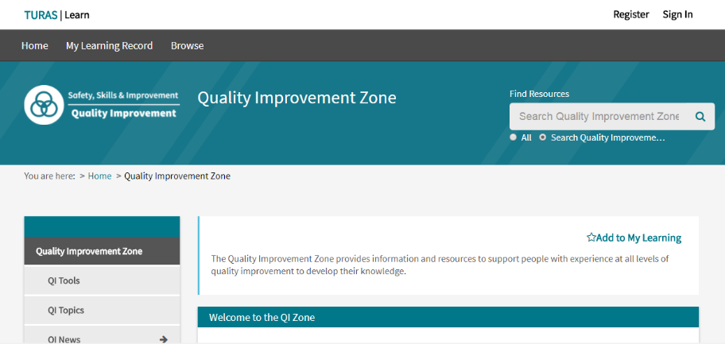
Baseline Knowledge - Resources Available
https://learn.nes.nhs.scot/741/quality-improvement-zone

Slide 67
GIRFEC Falkirk Practitioner Pages

Slide 68
By the end of this session……
Be able to explain the model for improvement and have a knowledge of other QI tools
Have a knowledge of some practical examples of how to use the MfI to support your work
Have enhanced knowledge of how to align aims, measures and ideas for change
Can access QI Zone and GIRFEC Falkirk practitioner pages to further enhance your knowledge.

