Slide 1

Early Years Collaborative
FALKIRK
Home Team Event 31st March 2014
3pm – 5pm
St Bernadette’s RC Primary School

Slide 2
Refresh
What is the Early Years Collaborative?
Where did it come from?
Who is involved?
What is happening in Falkirk?
What is expected of practitioners?
Where is it going?

Slide 3
EYC Video – An Introduction
http://youtu.be/_ZcUM-_7kEE

Slide 4
Falkirk’s EYC Aim Statement
We will ensure that all
Falkirk children have the best possible start in life

Slide 5
What is the early years collaborative?
The World’s first national multi-agency quality improvement programme
Based on the improvement science and collaborative approach used in infection control in health sector
Objective:
The objective of the Early Years Collaborative (EYC) is to accelerate the conversion of the high level principles set out in GIRFEC and the Early Years Framework into practical action.

Slide 6
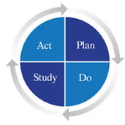
Introduction to Improvement

Slide 7
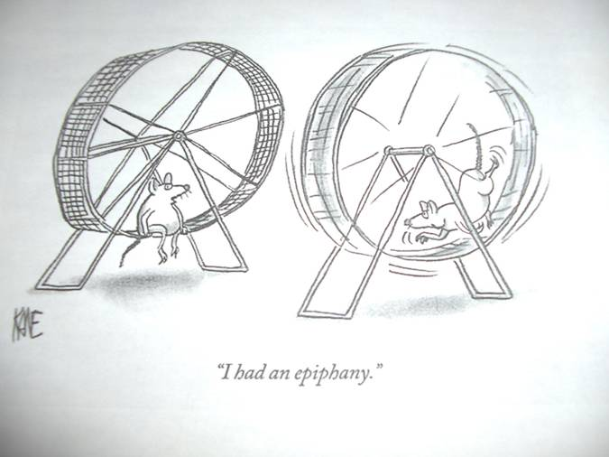

Slide 8

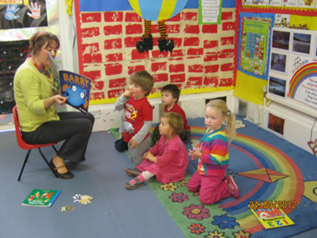


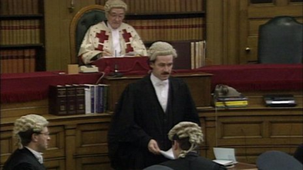
The Typical Approach…
APPROVE
DESIGN
DESIGN
DESIGN
DESIGN
Real World
IMPLEMENT

Slide 9
The Improvement Framework Approach
DESIGN
APPROVE
IF NECESSARY
Real World
TEST & MODIFY
TEST & MODIFY
TEST & MODIFY
START TO IMPLEMENT

Slide 10

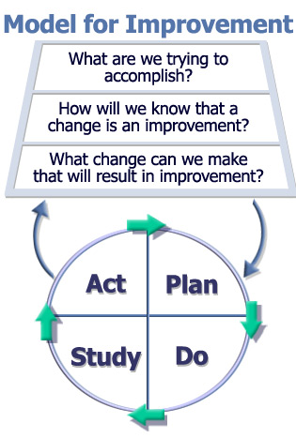

Aim
Measures
Changes
Execution

Slide 11

Question 1: What are we trying to accomplish?
Aim Statement
“100% of 27-30 month olds will receive an effective health review on their 1st appointment by April 2014”

Slide 12


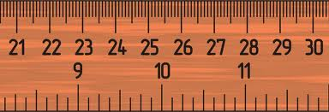


Check points - developing an Aim Statement
AIM Content
  Explicit over arching description
  Specific actions or focus
  Unachievable by hard work alone
AIM Characteristics
  What ?
  By How Much? (percentage/numeric)
  By When? (short term deadlines: weeks/months/terms not years)
12
Notes:
12

Slide 13

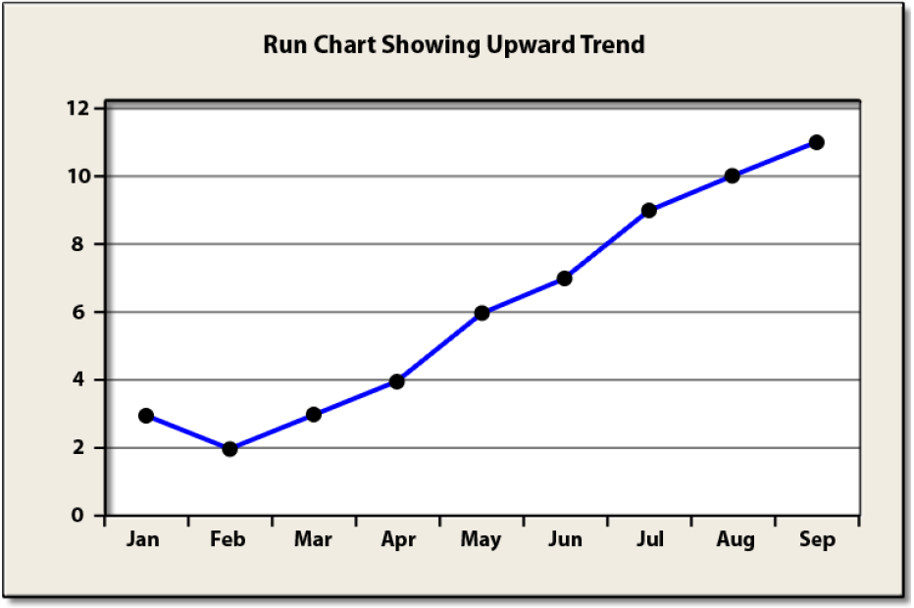
Question 2: How will we know that a change is an improvement?
Improvement is not
just about measurement
However… without measurement you will never be able to answer the question!

Slide 14

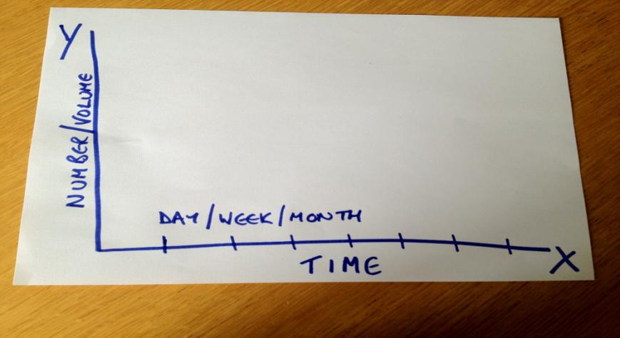
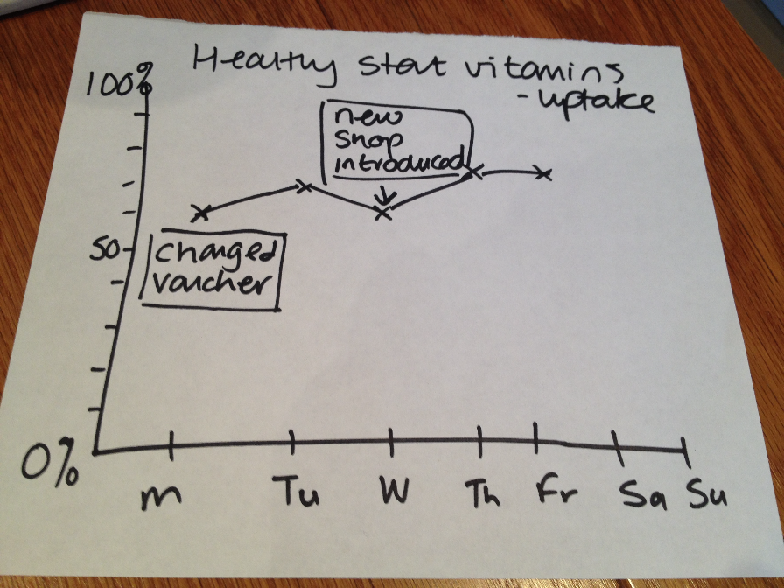

Slide 15
Question 3: WHAT CHANGE CAN WE MAKE THAT WILL RESULT IN AN IMPROVEMENT?
Fixing something or innovative change?
Where are changes sourced from: evidence, experience, hunches
What changes do you choose: what is going to have the biggest impact?

Slide 16
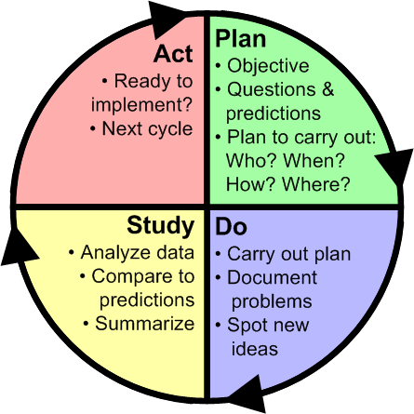
➔ Do ➔ Study ➔ Act ➔ Plan ➔ Do ➔ Study ➔ Act
“What will happen if we try something different?”
“What’s next? ”
“Did it work?”
“Let’s try it!”
Notes:
Northwest Improvement Initiative
© R. Scoville & I.H.I.

Slide 17
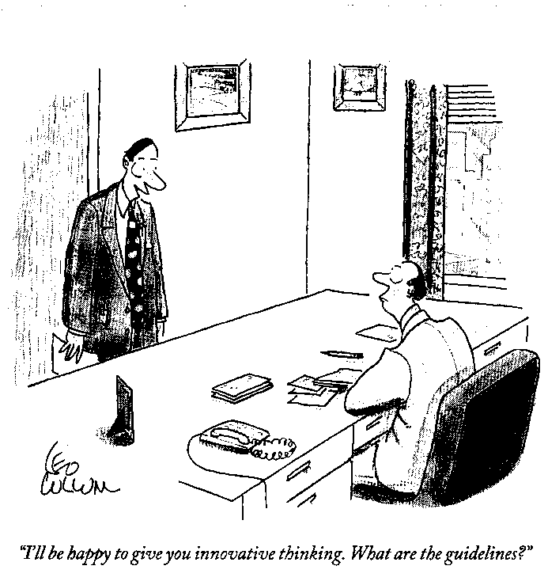
Innovative thinking....!

Slide 18
Cycles of Tests Build Confidence
Changes that will result in improvement
Learning from data
Proposals, theories, hunches, intuition
Notes:
Northwest Improvement Initiative
© R. Scoville & I.H.I.
31

Slide 19
Measurement and Data Collection
During PDSA Cycles
Collect useful data, not perfect data –
data for learning, not evaluation
Use a pencil and paper until the information system is ready
Use sampling as part of the plan to collect the data to reduce workload
Use qualitative data (feedback) rather than wait for quantitative data
Record what went well and what didn’t work so well during the test of change

Slide 20
Start Small
1 client
1 day
1 case
1 worker
Move to 3,5,7…. as confidence grows

Slide 21


Slide 22
Key Changes

Slide 23
Key Changes: “Big Rocks”
Collected data
Looked at similar aims
Themed them
Still need small tests to carry on

Slide 24
Key Changes
Early Years Aim
Early Intervention in Maternity Services
Attachment and Child Development Beyond Maternity Services
Continuity of Care in Transitions Between Services
27 - 30 Month Child Health Review
Developing Parents' Skills
Family Engagement to Support Early Learning
Income Maximisation
Nutrition
Workforce Development
Sharing Best Practice
Improved mental of mother
Communication
Identifying Key Changes for Workstream 4 (Age 5-8)

Slide 25
Key Change Exercise:
Using the Key Change grids on Tables, discuss the following:
  Work you do that fits in with these topics
  Work you know about
  Work that could be developed/tested – who would be responsible?

Slide 26
Plenary - Feedback
Your thoughts and Ideas
Blue Spots: Words to describe how you feel about all you have learned.

Slide 27
Thank you for coming take a look at the storyboards
If you want more information:
Visit our Blog: https://blogs.glowscotland.org.uk/fa/FEYC/
Contact us:
E-mail: eyc@Falkirk.gov.uk
Tel: 01324 506656 eyc video link: http://youtu.be/_ZcUM-_7kEE

