Slide 1
Primary 7 Bankier PS
13th June 2014

Slide 2
Our learning intention today:
We are developing our ability to use our understanding, skills, and knowledge
Notes:
The work you have done so far has helped you realise what you understand and perhaps where some of the gaps in your understanding might be. Today we are going to try to get better at seeing how and where to use the things we know and can do. CfE wants us to understand things so deeply that we can use them in their part of the curriculum, but also notice when they could be useful in other areas of the curriculum. The people who developed CfE really want us to notice how one bit of learning connects up with another. They call this interdisciplinary learning and they think this is one of the ways that we can get ready for whatever jobs we might need to do in the future.

Slide 3
How will we know that we’ve done this?
Success Criteria
I can:
Describe things I understand
Say how I know I understand these things
Explain how I use these things in everyday life
Notes:
Give time for pupils to study – can be revised later if we need to

Slide 4
Think, Pair, Share
Think of something that you feel you really, really understand or are very good at?
How do you know you really, really understand this thing?
How did you come to understand this thing so well? 2 mins
Pair up and tell your partner your thoughts.
Note your ideas on the Post its provided
2 mins
Notes:
Remind pupils of simple homework thinking task and ask them to recall their thing now. Share my own example – drawing
Use questioning to check their understanding of the task on the slide.
Give out pairs of cards to randomise pairs if required – it may be better to stick with known partnerships to keep pupils comfortable. Make sure timings clear – use stopwatch or clock if required.

Slide 5
Share
Join up with another pair to share your notes
Work together to finish these sentences:
We know we really understand something when …
We think we got better at understanding this by…
10 mins
Notes:
Use questioning to check understanding of the task. Organise the joining of pairs or ask pupils for suggestions.
Check pupil thinking of how to get task done in time available. Ask for suggestions for sharing these with whole class – displaying sheets on wall? Walking tour of groups?

Slide 6
What else do you really, really understand?
How can you show the other things in your life which you really understand?
Any ideas?
Notes:
Encourage pupils to be as creative as possible with the method they use – mind map, drawing/chart, list

Slide 7
Let’s look at what we understand
What have you learned from doing this?
Can you see any links or patterns?
How could you organise all of these things that you understand?
If you had to make a summary or communicate what the whole class understand, how would you do it?
Let’s take some thinking time & gather your ideas!
Notes:
We are now trying to guide pupils towards understanding that some of the things they understand belong to what we call The Curriculum – things which our society thinks they need to know. Traditionally this would be the subjects we are familiar with English, geography, etc. Use questioning to ascertain whether children are aware of these subjects and gather a list if applicable. Use group time to allow children to record prior knowledge of the curriculum

Slide 8
What are we learning today?
We are developing our ability to use our understanding, skills, and knowledge
Do you feel you can now:
Describe things you understand?
Say how you know you understand these things?
Explain how I use these things in everyday life?
Notes:
Wee thinking and learning pause. Check progress so far. Reminder of what we are doing today and link to moving onto how chn use their learning and why it is useful.

Slide 9
Next big questions about what you learn and how it helps you:
What is a curriculum?
What is special about curriculum for excellence?
Home groups
Numbered pairs
1 question per pair
How long to write your ideas?
Notes:
Tell pupils these are very difficult questions – don’t worry if you don’t feel you know the answers – we just want to give you a chance to record your ideas just now so that you can compare how your thinking develops during the lesson. Aim to end with a diagram of the curriculum co-created

Slide 10
The Curriculum
Curriculum for Excellence
The 4 capacities or purposes of the curriculum
How is it different?
Educating you for a future which isn’t here yet – how do we know what skills, knowledge and understanding you will need?
Helping you become independent in your learning – how can we do this?
Notes:
Share the green folder and washing machine diagram and Learning to Achieve. If traditional curriculum has been established using previous slide, we can now discuss what is different about CfE. Give pupils time to discuss this before revealing bullet points. Gather prior knowledge using round robin at each group – passing pen on until group have run out of ideas. Take a walking tour to tick those you also have – this will help us pin point the common themes. Hopefully these will match with the rest of the bullet points – teach/share those which have not arisen naturally.

Slide 11
Study those big questions again – add to your answers if you want to:
What is a curriculum?
What is special about curriculum for excellence?
Let’s look at our curriculum chart
Notes:
2 minutes study time, 2 minutes to discuss. Revise group answer on sheet using different colour pen.

Slide 12
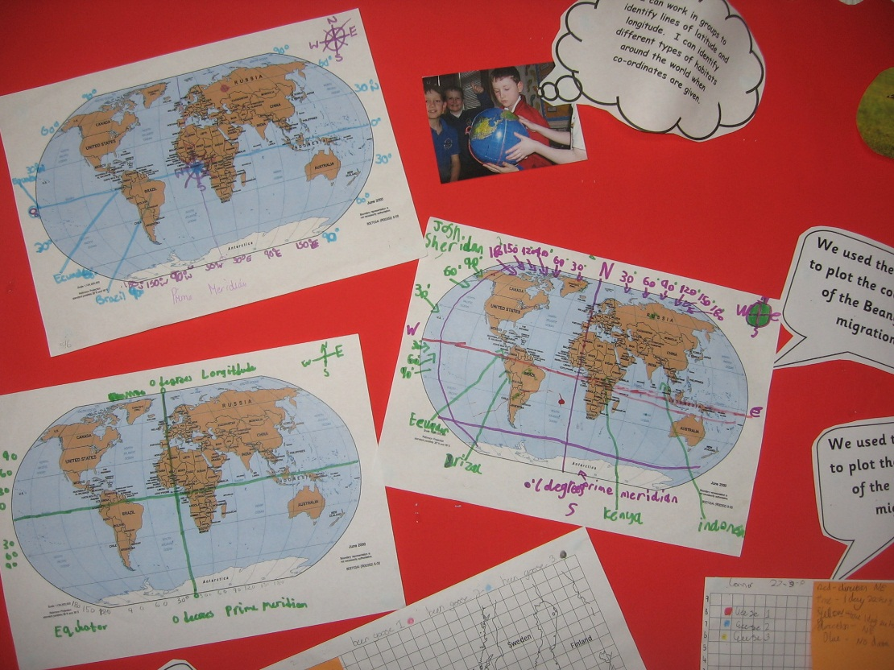
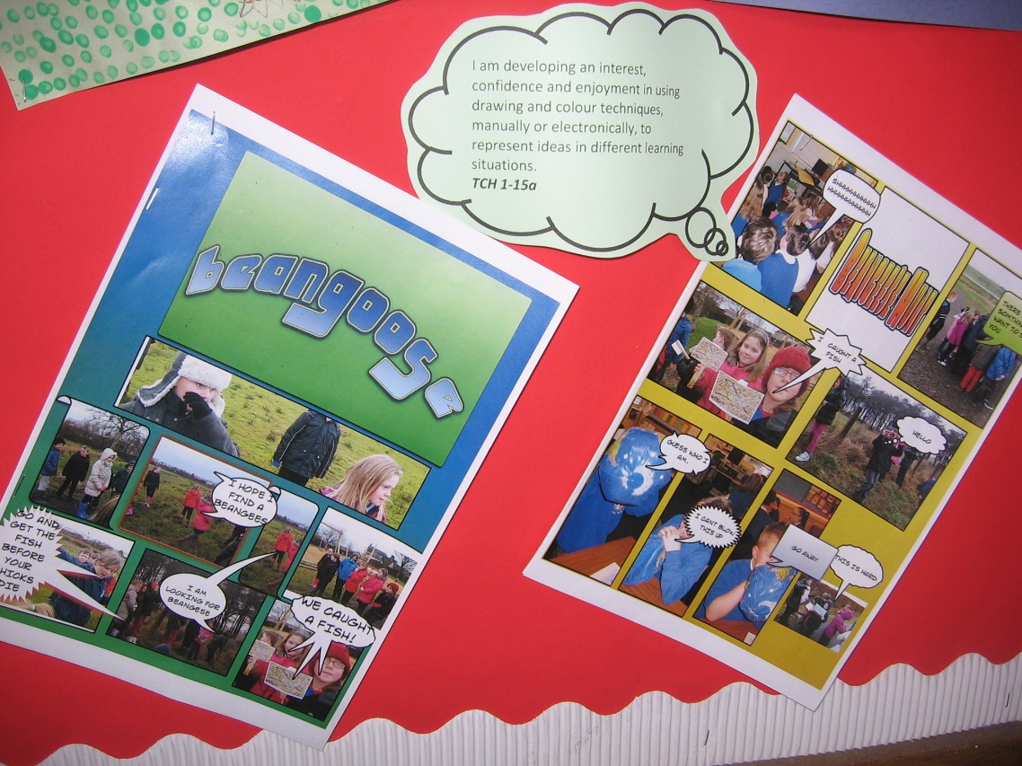
Slamannan Bean Geese
Canyon netting
Observing birds
Fitting birds with transmitters
Plotting the birds’ journey
Learning about the weather &
landscape in these places
Notes:
Identifying learning in different areas of the curriculum. Slamannan project. Pupils worked with RSPB & Scottish Natural Heritage to find out where the bean geese go to breed and spend the summer. Which subjects or areas of the curriculum do these tasks fit with? Draw a line between these subjects on your curriculum map. Peer assessment monitored by me – give feedback. All write “Slamannan Been Goose project connects” on this line ** Check whether pupils realise that science splits into biology, etc AND social studies splits into geography/people, place & environment

Slide 13
Look at your understanding chart.
ELLIS said PS3 Games
“understand sport more”
Choose something you understand really well.
Does this understanding connect 2 or more areas or subjects in the curriculum? If so, draw a line between them.
Write what your connected learning was on that line.
CARA said “Technology
To help you communicate
with others
Notes:
Let’s look at what you understand now. Give pupils time to read task. Check understanding by random lolly stick or fist of 5. 10 minute task, give some verbal feedback from observations of work in progress.

Slide 14
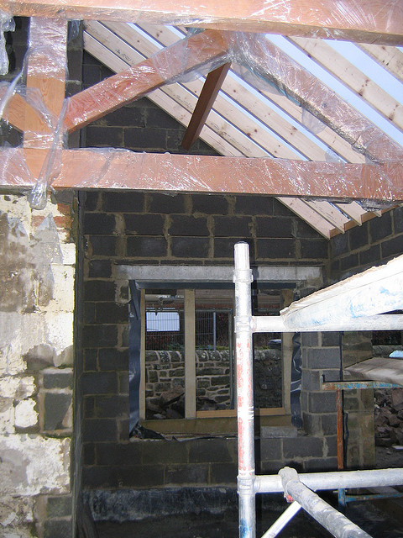
When have you USED connected learning?
Mrs McBlain’s
kitchen ceiling problem:
How much timber &
plasterboard do I need?
How can I work this out?
What curriculum
understanding could
I use?
http://www.mathsisfun.com/pythagoras.html
Notes:
Share story of using maths (geometry – Pythagoras Theorem) to work out how much material was needed for new kitchen roof. Share anecdote about lack of cash and wet weather – great pressure to get it right, and great relief when my maths education proved useful. Emphasise that we are searching for a real life example if possible.

Slide 15
When have you USED your curricular learning in a new way?
Write a sentence for each example you can think of.
Your understanding chart might give you some ideas
You might want to make your list like this:
I used my learning in ???? to ????
Notes:
Demonstrate with my ceiling example – make it clear that this is applying knowledge, understanding and skills in a new or unusual way. See next slide for examples

Slide 16
Some examples from charts…
I use my drama skills to build my self-confidence
Holly G
I use my knowledge of food hygiene when I make truffles at home
Rosie
Notes:
These are simple examples. We are also aiming for specific examples like the Pythagoras roof problem – use the word apply as well as use to begin to convey the dual meaning.

Slide 17
Which subjects or areas of the curriculum did you connect?
Add in new lines and words to your curriculum record
These will show how you connect the curriculum so far
Who knows how you will connect it up throughout the rest of your life
Who knows if one subject or area of the curriculum might become more important in the future – the curriculum changes to become what the people using it think it should be
“The curriculum is everything a society thinks should be passed on to its young people”
Notes:
Pupils could take a walking tour, or could turn the sheets into a physical book or pdf document available in shared area. Pupils could keep on adding to theirs if they like? Explore how useful or interested pupils would be in this, and their feedback from the task if time allows before moving on to the assessment task.

Slide 18
Have we met our learning intention?
Success Criteria
Can you:
Make a list or diagram of the curriculum
Say how tasks you have done link 2 or more areas of the curriculum
Give examples of when you have used your skills, knowledge and understanding in a new way
Notes:
Give time for pupils to complete the table – explain that the top two are new and we are measuring our progress in the last one for the first time. This is our way to check how good this learning experience has been for pupils. If most of them mark green then it has been successful – check whether pupils can suggest this as a way to measure success for me and any teacher using this lesson to help their pupils learn better.

