Slide 1
Your Planning Process - How effective is it? The Return Session
Curriculum Support Team
10th December 2013

Slide 2
Learning Intention
We are analysing and evaluating our planning processes

Slide 3
Success Criteria
Participants will be able to:
Identify where the key elements of effective planning are addressed in their planning systems
State where and how their planning systems relate to the NAR planning flow chart
Make informed judgements and decisions about areas for development in their establishment

Slide 4
What will we do?
Julie McKenna – Creating Learning Journeys
Jill Stocks and Andrew Watson – Realistic Record Keeping and Powerful Planning
Sharing planning systems
Self-evaluation & Identifying next steps – for establishments and for the authority
Notes:
Check whether anyone has brought any plans with them to share?

Slide 5
Briefing Paper 11
No matter the sector or context, planning for learning is a means to an end. It is a design process that makes sure learning has breadth, is challenging, and enables learners to develop and apply their learning in relevant ways.
Page 2

Slide 6
The NAR Planning Flowchart
Notes:
Defined elements required of the totality of the planning process – show TACLAN document for collegiate learning and development of this

Slide 7
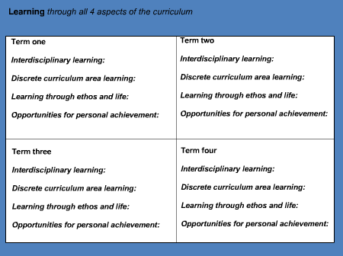
From unit plans to framework
Notes:
G Logan slide to demonstrate need for balance across 4 contexts for learning over each session. Need for schools to be able to track learning in and across these contexts – whole school planning overview which enables tracking of progression for all learners.

Slide 8
Planning in schools
Notes:
G Logan description of possible layers or planning priorities which could be considered

Slide 9
Briefing Paper 11
At times, planning approaches take up too much time because they are complicated and seek to do too much. For example, sometimes planning that seeks to reflect progress through every individual E & O can lead to a fragmentation of learning and insufficient depth of study. Sometimes planning has too many layers that, whilst intended to serve different purposes, are too cumbersome to be wholly useful.
Notes:
Watch out for too many layers – watch out for overly complex systems. Acknowledge that you can’t cover all experiences and outcomes but should aim for coherence and relevance – principles take priority coupled with breadth, challenge and application

Slide 10
The Planning Triangle
Notes:
Explain Curriculum = what children are learning, L & T = how we will deliver this learning, Assessment = how they will show that/whether they have learned it. Make sure we stress that you don’t have to “do” all of the principles, all of the time.

Slide 11
Where are we with this?
How do your systems and processes support planning?
National CfE implementation plan letter Aug 2013 – “the emphasis will be on ensuring that processes are effective but are also manageable and do not take valuable time away from learning and teaching.”
Notes:
What is working and what could we improve within our establishments – strips paper or write directly on wall

Slide 12
Transformative Systems?
Let’s play with some statements:
Person 1 choose a card, give your response then listen to the responses of your group (follow timer)
Appoint scribe to record significant actions derived from discussion
Repeat until everyone has had a turn.
Display these for whole group to see
Notes:
Statements taken from Briefing paper 11 to help us explore the issues in depth if required.

Slide 13
Actions?
Who?
How?
When?
Notes:
Define common goals and potential next steps

Slide 14
Further information:
National Assessment Resource
http://glo.li/wxiydo
Taclan Resource http://glo.li/18iuc0p
Briefing Paper 11 http://glo.li/18wGSeU

Slide 15
Next Steps
Mob Team – grouping E&Os that are naturally connected.
Blog?? Sharing good practice Larbert – Commonwealth example
IDL grid – skeleton only!!

