Slide 1
Building the Higher Order Skills into Classroom Practice
Yvonne McBlain
November 2013

Slide 2
Learning Intentions
Participants will:
Develop their knowledge of the higher order skills & taxonomies
Deepen understanding of how these transferable skills can be built into learning experiences

Slide 3
Success Criteria
How would you like to measure the success of this session?
?
?
?
Notes:
Group formation – use names in boxes to form level specific groups. Give 5 minutes to introduce selves. Discuss what they would like to get out of the session. Phrase as SC which are process based if possible

Slide 4
Success Criteria
Participants will:
Have increased knowledge of the Higher Order Skills
Analysed how skills taxonomies can impact on planning
Identified how the HOS are built into the E & Os
Increase their ability to integrate HOS into learning intentions within their teaching
Have increased awareness of relevant next steps in their application of the HOS

Slide 5
What will we do?
What are the Higher Order Skills?
Sharing of practice and thinking
Looking at Bloom’s Taxonomy & its revision
Finding the skills in the E & O s
What are taxonomies for?
Planning with a taxonomy
Assessment and HOS
What do your learners need to know about HOS?
Notes:
Check whether anyone has brought any plans with them to share? Video, group work, individual reflection, tasks which demonstrate each of the higher order skills in action.

Slide 6
Skills Focus – why?
http://glo.li/1iHw95Q - A range of people describe the importance of skills
CfE & 4 Capacities are designed to develop young people who:
Are aware of which skills they are developing
Have the ability to describe and measure their own skills progression.
Can see how (& when) these skills will be useful to them
Notes:
This awareness is essential for social and economical success for our young people and our country. Learning how to learn is a pivotal element of CfE which makes it different from previous curricula. The other “new” element is the ability to transfer and apply skills in different contexts. All of this reflected in 4 capacities.

Slide 7
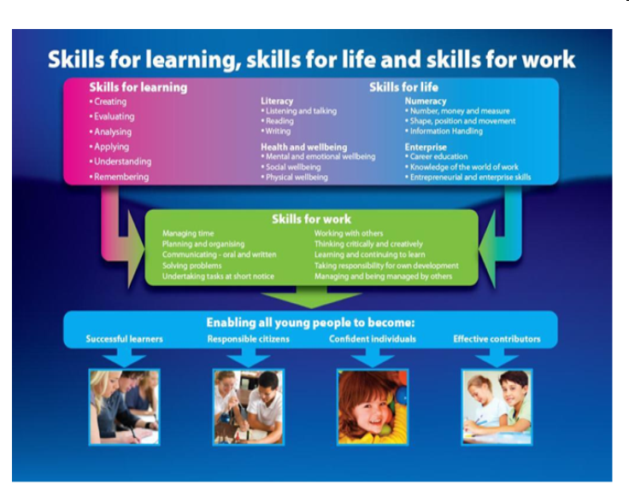
Notes:
Angus Council, lots of work on Skills Development Skills for learning can include more- critical skills etc Huge overlap between sections LOOK at Food for Thought resource – 2 mins – an example of building HOS into practice

Slide 8
What are the Higher Order Skills?
What is a taxonomy? How might a taxonomy be useful?
Keir Bloomer explains http://glo.li/Hws8FX
“Using a taxonomy of thinking skills to plan and reflect on learning opportunities can ensure that learners are challenged. Exploring these skills can help learners to develop a set of generic or transferable skills that will help them cope with the challenges of future learning, life and work.” Education Scotland
Notes:
Question to gather existing understanding of taxonomies.
Show video clip.
Lead into Looking at Bloom’s revision initially – is simplest for learners of all ages to access

Slide 9
Higher Order Skills
Not just aiming for low order recall to pass exams and assessments
Aiming for deep understanding – the ability to transfer and apply flexibly to any context
Metacognition and self-awareness in our learners
Notes:
Problem of lots of terms for the same thing- thinking skills, critical skills, critical thinking skills etc
Higher Order Skills- term they use, maybe we want skills for learning?
Idea that we should equip young people to understand and to do as well as to know is important at every stage
Skills required for learning, life and work. We all know the commonly used quotes about preparing children for jobs that don’t exist etc etc

Slide 10
Higher Order Skills Excellence Paper
Highlighting the skills component in every learning situation
• Emphasising the importance of skills to learning, life and work
• Using a common language to describe skills across the curriculum
Challenging learners to value and advance their own skills
Equipping learners to evaluate and take ownership of their skills
Assessing and recording skills in a way that enables learners to demonstrate what they can do and plan for further development
http://www.scotland.gov.uk/Resource/Doc/920/0121113.pdf
Notes:
Show papers – HOS Ex Paper and Developing Skills pack
Asking us to make skills explicit to learners in every learning situation
Also to create an ethos of positivity about learning – a culture where mistakes are welcomed as powerful learning opportunities
Where every care is taken to reinforce the idea of independence, agency and control over own learning – it is not something which is done to you, it is something which is there for you to grab
Using taxonomy as a tool for tracking, moderating and evaluation learning and next steps

Slide 11
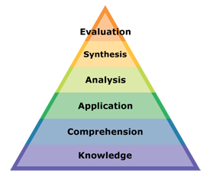
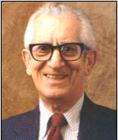
Bloom’s Taxonomy 1956
Notes:
Took 8 years to create with a team of other v v clever educationalists
Is a taxonomy which categorises AND orders – was originally meant to ease assessment and moderation

Slide 12
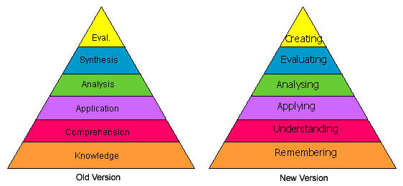
Anderson and Krathwohl 2001
Revision of Bloom’s taxonomy
More relevant for planning, delivery and assessment
Breaks Bloom’s categories down into a wider range of verbs
Notes:
Lorin Anderson revised version 2001

Slide 13
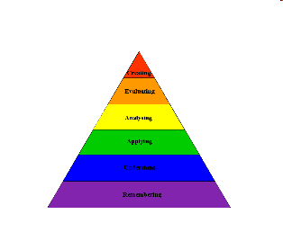
Activity
Take out the Bloom’s Taxonomy Triangle and the set of activities
In your groups discuss each activity and match it to a skill
Notes:
Working in level groups – if you’ve used the activity in a TfDL session – just observe and then lead the discussion for your group. If not, just enjoy and explore!
Gather thoughts and reactions

Slide 14
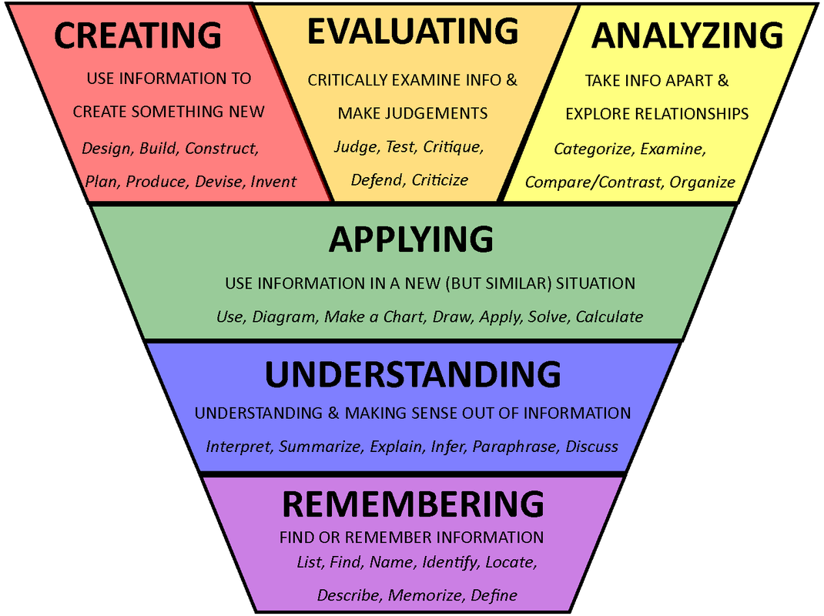
Notes:
This version now reflects latest thinking about how these skills for learning can support awareness of how cognitively demanding a task is. The previous top 3 are now placed so that it is easier to see that in order to do these, you have to be able to demonstrate the ones below- each “lower” skill is included in the one above.
Personal views on viability of this one – doesn’t demonstrate that true creating usually involves evaluating and analysing, but does show that these 3 are higher in cognitive demand.

Slide 15
Things to remember
They are not:
Hierarchical – early level learners are just as capable of developing HOS as more sophisticated learners – provided the learning is planned and paced properly.
Sequential – learning experiences don’t necessarily have to address every stage/skill. Learning experiences using these skills may not always be in order.
Notes:
Examples –
- nursery children are habitually required to analyse and evaluate in order to classify objects in the world around them. The constantly operate at a high level of cognitive connection and judgement which they store away, recall and connect when they see its relevance.
– maths context involving the analysis of facts and figures on world populations in an international education context might stimulate pupils into carrying out simple recall and understanding or applying their calculations.

Slide 16
Bloom’s Question Starter Fans
Do these help us ask “good” questions?
How could they help your planning?
How do you already use these in your classroom? Let’s collect & record ideas
Notes:
Give time to look at fans and consider how these might be useful, OR share how you are already using them – 4 mins
Share FHS application

Slide 17
Let’s Build a Bloom’s
Notes:
Use the coloured strips provided to write down examples of your work. Fit them into the big triangle – note which level they are for. Consider new ideas and add those too – put a light bulb on those to show that they’re new

Slide 18
So how useful is Bloom’s?
Yes or No?
How and when?
Why?
Notes:
Groups or pairs choose a question to answer and record on wall boards – I will make a panel for each section.

Slide 19
Reasons for using a taxonomy
Helps educators:
examine objectives from the student’s point of view
consider the panorama of possibilities… learning how to learn
see the integral relationship between knowledge & cognitive processes inherent in objectives
(Research Report 10, SQA – Using Taxonomies in Assessing Higher-Order Skills 2008)
Notes:
Helps teachers verbalise what is being learned and communicate these to learners – VERBS REMIND US OF LEARNER FOCUS
Appreciate the wide range of ways in which your learning intention could be delivered – MAKES US REALISE THE POSSIBILITIES
Understand how the assimilation of knowledge and understanding is developed through metacognition and a range of processes – REMEMBERING LOOKS DIMINISHED COMPARED TO ALL OF THE OTHER SKILLS IN THE HEIRARCH AND THIS REMINDS US TO AIM HIGHER AND WIDER

Slide 20
Reasons for using a taxonomy 2
Makes life easier – examiners can easily identify the “demand” of a question…
Makes more readily apparent the consistency, or lack of it, among the stated objectives for a unit, the way it was taught, and how learning was assessed
Helps educators make better sense of the wide variety of terms that are used in education – the precision in the taxonomy improves communication and understanding of what is to be taught and assessed.
Notes:
Helps us identify how hard or easy the tasks are – FOR ASSESSMENT AND TEACHING GUIDANCE WHICH CAN BE GIVEN TO PUPILS IN ACTION
Shows us how well our learning intentions, tasks and assessment methods and evidence fit together or link up – LOOKING AT OUR PLANNED IDEAS THROUGH A TAXONOMY FORCES US TO REFLECT ON ITS RELEVANCE
Clarifies the wide range of terms for thinking skills and makes it easier to work out how these relate or mean the same things. This helps us share thinking and practice much more effectively – with other practitioners and with pupils – GIVES US AN ORGANISER TO HELP US UNDERSTAND OUR TASK AND GIVES US A WAY OF SHARING THIS WITH OTHERS

Slide 21
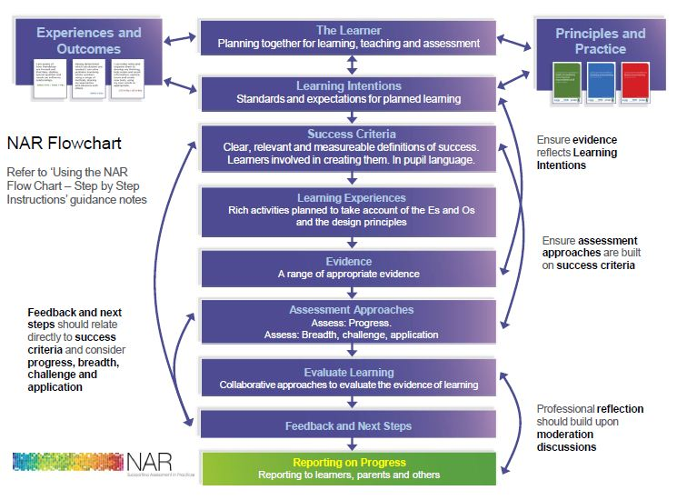
The NAR Planning Flowchart
Notes:
Planning with HOS – NAR guidance – essential elements of planning – these link very well with previous two slides

Slide 22
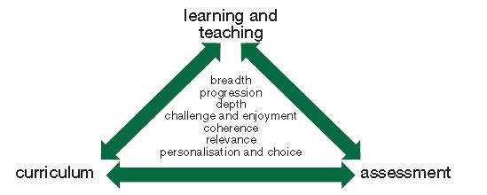
The Planning Triangle
Notes:
Explain Curriculum = what children are learning, L & T = how we will deliver this learning, Assessment = how they will show that/whether they have learned it. Make sure we stress that you don’t have to “do” all of the principles, all of the time. Refer back to S for LL & W and Food for Thought resource again for structuring the curriculum using skills for learning

Slide 23
(E + O) ÷ HOS = ELT?
Let’s find an E or O which “contains” a higher order skill
THEN analyse it to pinpoint:
Action/Verb – what will pupils do?
Knowledge/Content – what are they learning?
Skills development and transfer?
Context – how is the learning being “packaged”?
Notes:
Use highlighters with booklets

Slide 24
((E + O) ÷ HOS) + AfL = ELT
LI = We are developing understanding of HOS
Task = Write a learning intention for your E & O which would enable your pupils to develop one of the higher order skills
SC – Product - I can write a learning intention which explains which HOS is being developed
Process SC -
Has no context
Selects & develops a relevant part of your E & O
Uses language your pupils can understand
Notes:
Use hand out 2 from HOS session 7 of TfDL

Slide 25
How do we assess HOS?
What do you do already?
What could you do as well – or instead?
How do these actions fit with your existing processes?
How would they impact on your work load?
Notes:
Time to talk and share thinking

Slide 26
HOS Taxonomy
What is synthesis?
http://glo.li/1gr8zO2 Keir Bloomer
What is systems thinking?
http://glo.li/187hAnj Keir Bloomer
http://glo.li/187huvW Skills taxonomy
Notes:
Add task for each pair during video

Slide 27
Other taxonomies
Skills Pathway
HOS Excellence Group
SOLO http://glo.li/1gtPRWe
SQA Framework
Notes:
Have a look at the materials provided – briefly discuss if time allows 5 min max – leave for further reading if time short

Slide 28
Further reading?
SQA paper
http://glo.li/18a01Tv
Learning Intentions & Success Criteria http://glo.li/VICKSN
High Order Skills Excellence Group Report
http://glo.li/qqIpnR
Developing Skills Pack
http://glo.li/18a09ma

Slide 29
Further information:
National Assessment Resource
https://www.narscotland.org.uk/IntraLibrary?command=external-shib-login
Education Scotland IDL advice
http://www.educationscotland.gov.uk/learningteachingandassessment/learningacrossthecurriculum/interdisciplinarylearning/index.asp
Education Scotland Approaches to Learning advice
http://www.educationscotland.gov.uk/learningteachingandassessment/approaches/index.asp

