Slide 1
I can name parts of my body. I can talk about the different parts of my body and what they do. I can describe the changes that take place with puberty. I understand how to maintain personal hygiene.
Menstruation

Slide 2
Periods
Periods are also called menstruation.
Most girls start their period between the age of 10 and 16.
Some girls start earlier, some later.
It’s important to remember that not all girls have periods.
All girls are different and unique.

Slide 3
When a girl goes through puberty her ovaries release an egg every month.
For a few days each month blood and other fluids pass out through the girl’s vagina.
There can be some fluids called pre-period discharge before the period starts.

Slide 4
When a girl has her period she wears a sanitary towel or tampon or menstrual cup to absorb the fluid.

Slide 5
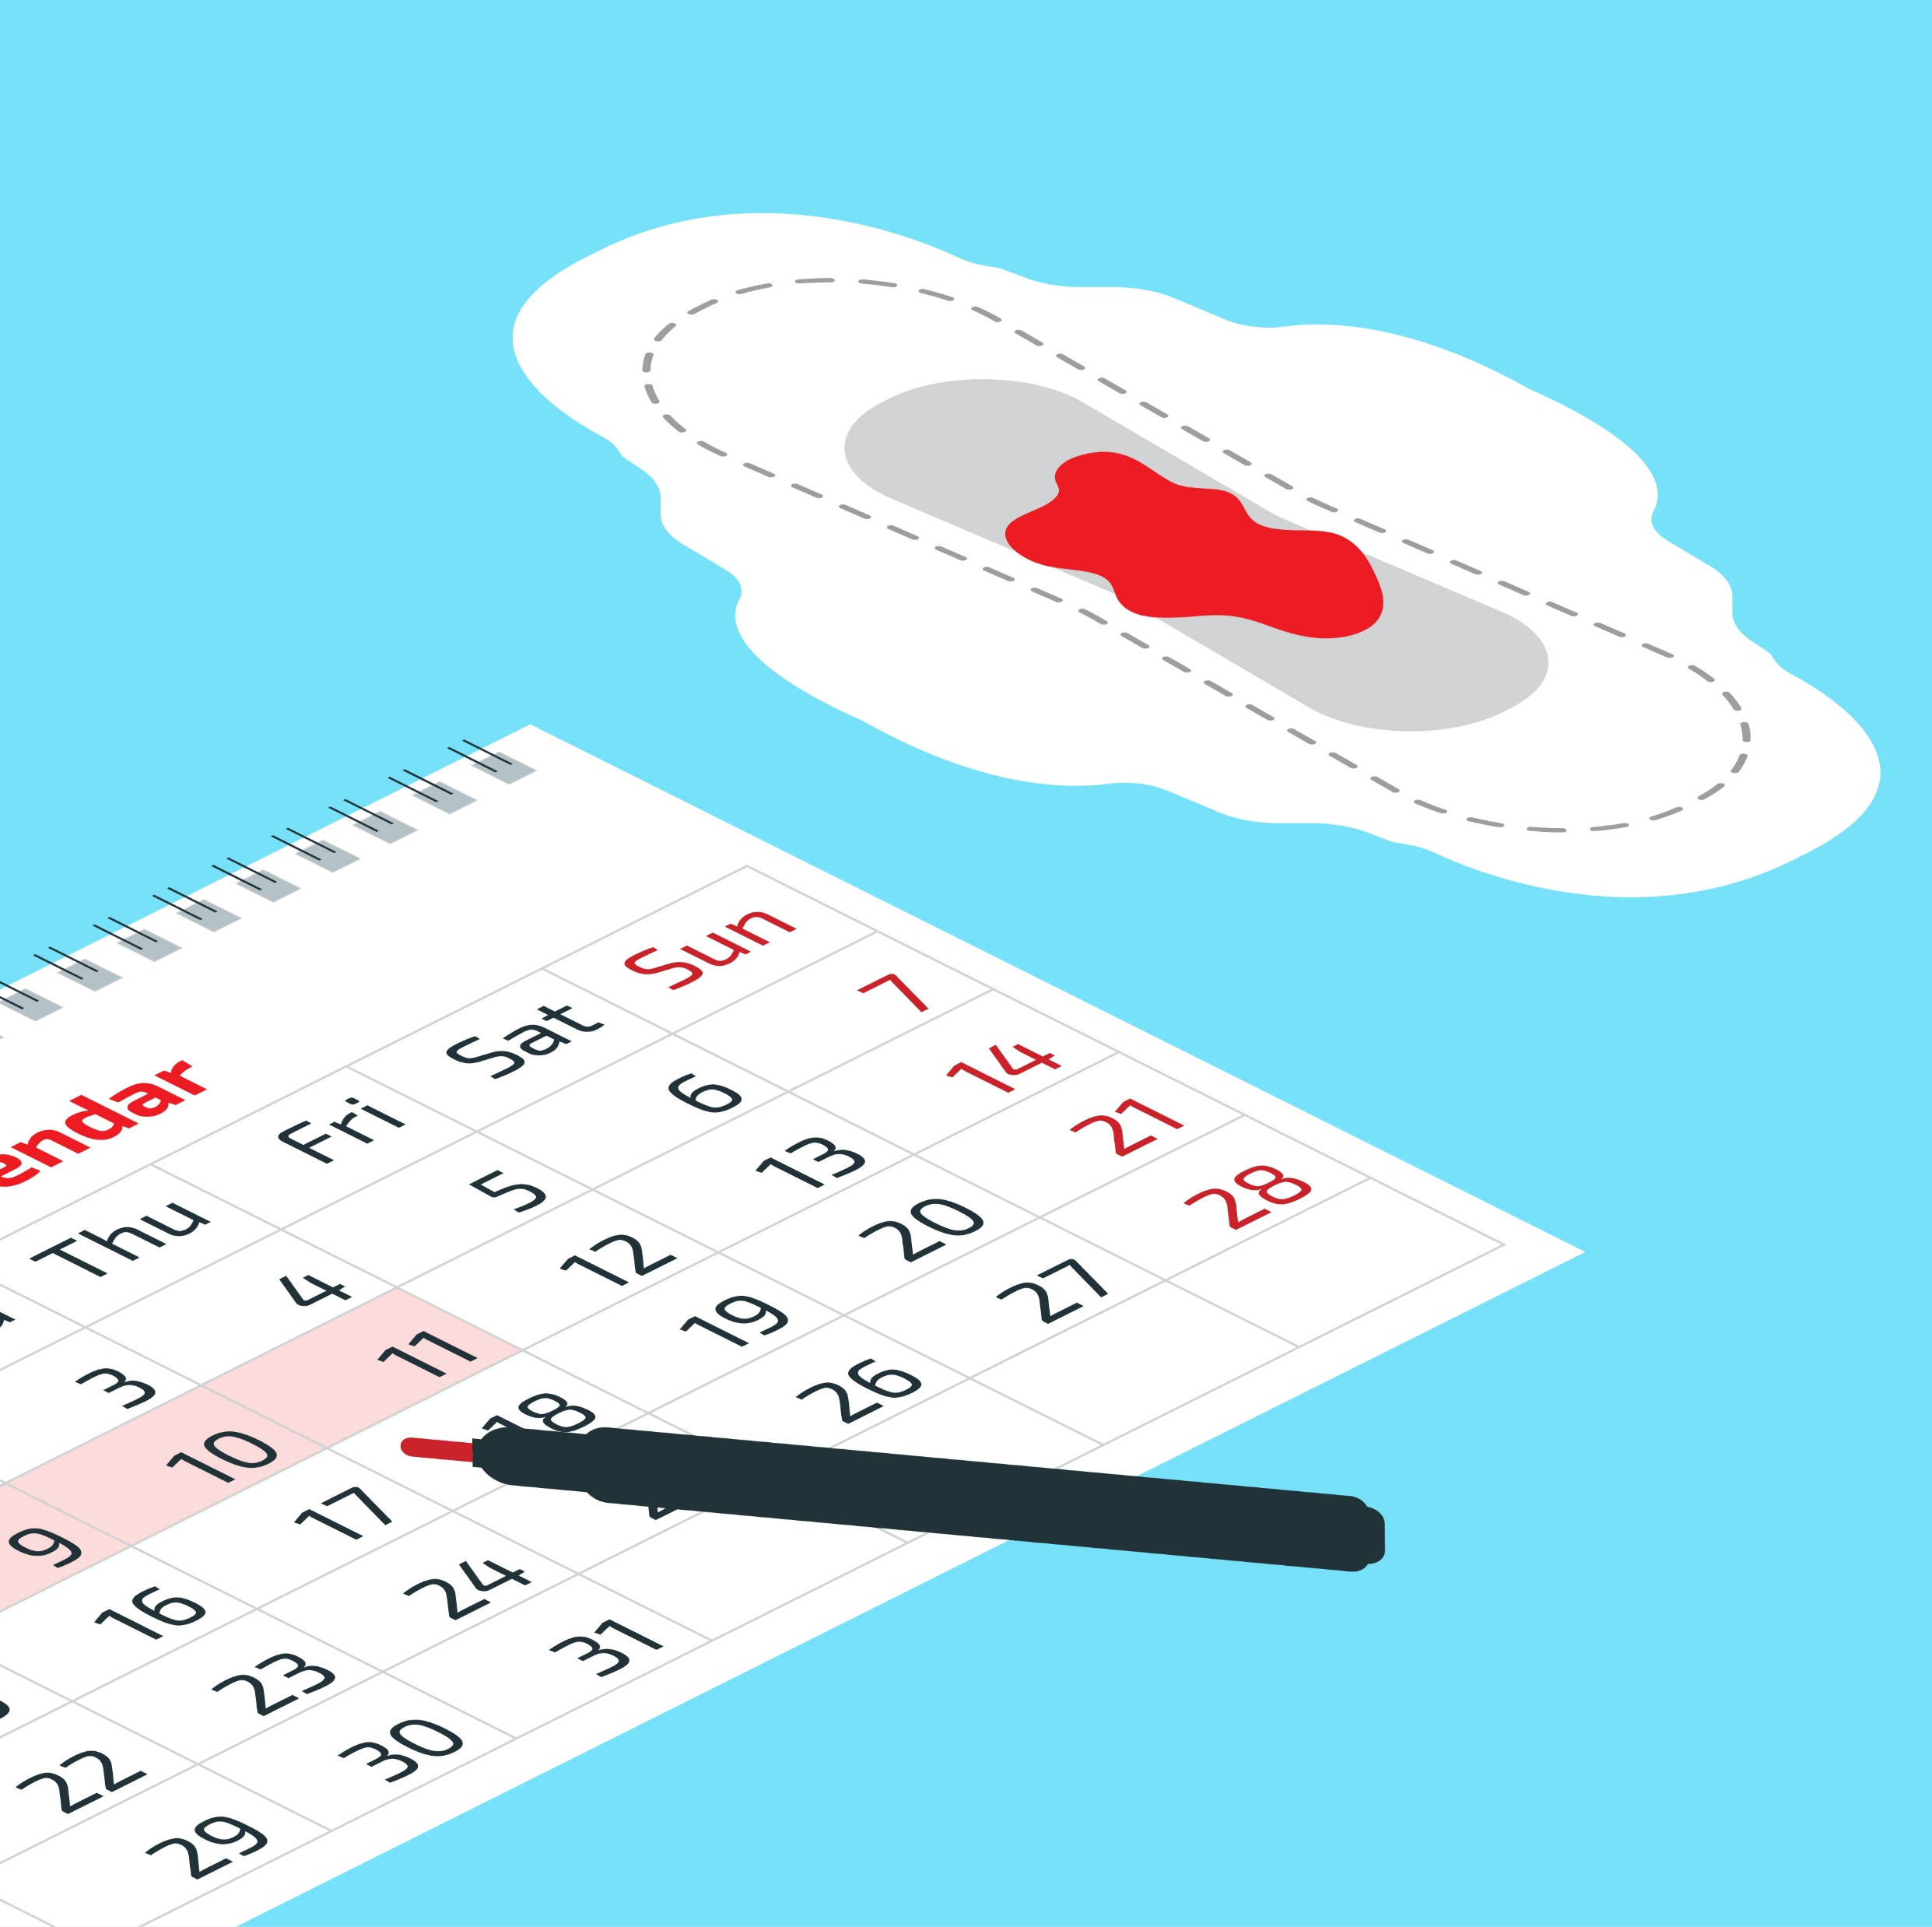
Periods usually last a few days each month.
Some girls mark the start of their period on a calendar.
It helps her to remember to take sanitary wear to school.

Slide 6
A girl will need to change her sanitary towel or tampon a few times a day. Used sanitary wear should go in the bin.

Slide 7
Some girls might experience pain or discomfort during their period. If you have any questions or worries about periods, you should talk to a trusted adult.

Slide 8
Menstruation:
True or False?
This activity ©Hey Girls CIC 2019. Reproduced with kind permission of the owner.

Slide 9
True or False?
A period is when someone pees blood.

Slide 10
A period is when someone pees blood.
FALSE: Period blood does not come from the urethra (pee tube). It is part of a separate bodily system and comes from the womb, leaving the body through vagina.

Slide 11
True or False?
A period is when someone loses a lot of blood each month.

Slide 12
A period is when someone loses a lot of blood each month.
FALSE: The average blood loss is around 1-2 egg cups full, but it can look like more. If someone is losing a lot of blood they should see their doctor.

Slide 13
True or False?
A period is the name for shedding the lining of the womb.

Slide 14
A period is the name for shedding the lining of the womb.
TRUE

Slide 15
True or False?
A period always comes every 28 days.

Slide 16
A period always comes every 28 days.
COULD BE TRUE OR FALSE: the average cycle is around 25-35 days. It will be different for everyone.

Slide 17
True or False?
The start of a period is Day 1 of the menstrual cycle.

Slide 18
The start of a period is Day 1 of the menstrual cycle.
TRUE

Slide 19
True or False?
A period is made up of blood alone.

Slide 20
A period is made up of blood alone.
FALSE: Period blood is a mixture of tissue, blood & mucus.

Slide 21
True or False?
A period always lasts for 5 days.

Slide 22
A period always lasts for 5 days.
FALSE: period length varies from person to person, it normally lasts between 3-7 days

Slide 23
True or False?
You can hold in a period like you can hold in a wee.

Slide 24
You can hold in a period like you can hold in a wee.
FALSE: The muscles in the vagina are not like the muscles in the urethra, you cannot stop or start period flow at will, it just drips out. This is why period products are used.

Slide 25
True or False?
Period flow is always bright red.

Slide 26
Period flow is always bright red
COULD BE TRUE OR FALSE: Period flow can vary in colour from brown to bright or very dark red. It may depend on the day of your cycle.

Slide 27
True or False?
Most people with a female body have periods between the ages of around 12 to 55.

Slide 28
Most people with a female body have periods between the ages of around 12-55.
TRUE: There is variation in ages but most biological females will have regular periods between these ages.

Slide 29
True or False?
Periods are natural and a normal part of growing up for anyone with a female body.

Slide 30
Periods are natural and a normal part of growing up for anyone with a female body.
TRUE

Slide 31
True or False?
All period products are thrown away after use.

Slide 32
All period products are thrown away after use
FALSE: Some period products are disposable (used once and thrown away) and some are reusable (used, washed and used again many times).

Slide 33
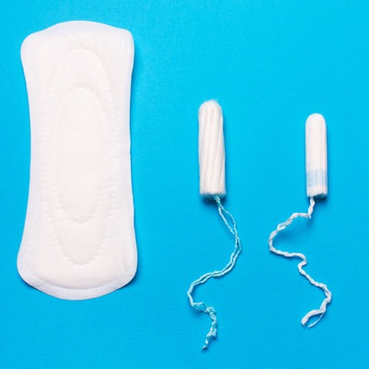
Toxic Shock Syndrome is a rare but serious illness that you can get if you leave a tampon in for a long time. Always use the lightest absorbency for your flow and change tampons every 4-6 hours (maximum 8 hours). If you have a fever and think you might have toxic shock, go to the doctor
Never flush period products down the toilet. Always put them in a bin

