Slide 1
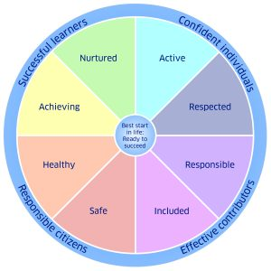
Sgoil Shiaboist - The Rationale for our Curriculum
Vision
Ag obair, ag èisdeachd ‘sa ionnsachadh còmhla
Working, listening and learning together
Our aims at Sgoil Shiaboist
Provide a well balanced curriculum for all pupils
Deliver high quality learning and teaching
Encourage all pupils to achieve their full potential
Ensure that all pupils who require help with their learning are supported in ways which meet their individual needs
Support pupils to meet their individual needs
Encourage a caring, happy, safe ethos
Provide pupils with opportunities to plan, discuss and reflect on their learning
Develop each pupils confidence, self-awareness and self esteem
Continue to improve transition planning at key stages
Develop pupils’ skills in digital literacy including online safety.
Support pupils to know and understand their Rights (UNCRC).
At Sgoil Shiaboist when we work, listen & learn together:
We are actively, involved in and lead our own learning
We work independently and collaboratively
Our learning provides challenge and is differentiated
Values
Honesty, fairness, caring/compassion,
trust, respect , kindness
Our learning is based on four contexts:
Inter Disciplinary Learning (IDL)
Curriculum Areas
Opportunities for Personal Achievement
Ethos and Life of the School
After School Clubs: all learners will have opportunities to participate in a wide range of after school activities.
There will be a strong focus on: local culture and Gaelic language to deepen pupils’ knowledge & understanding of their own environment
Promoting Children’s Rights across the school community.
Curricular areas:
Literacy/Language: Gaelic and English
Numeracy/Mathematics
Health and Wellbeing including Physical Education
Sciences
Social Subjects
Religious and Moral Education
Technologies
Expressive Arts (Music, Drama and Art)
Principles for Curriculum Design:
• challenge and enjoyment
• breadth
• progression
• depth
• personalisation and choice
• coherence
• relevance

