Slide 1
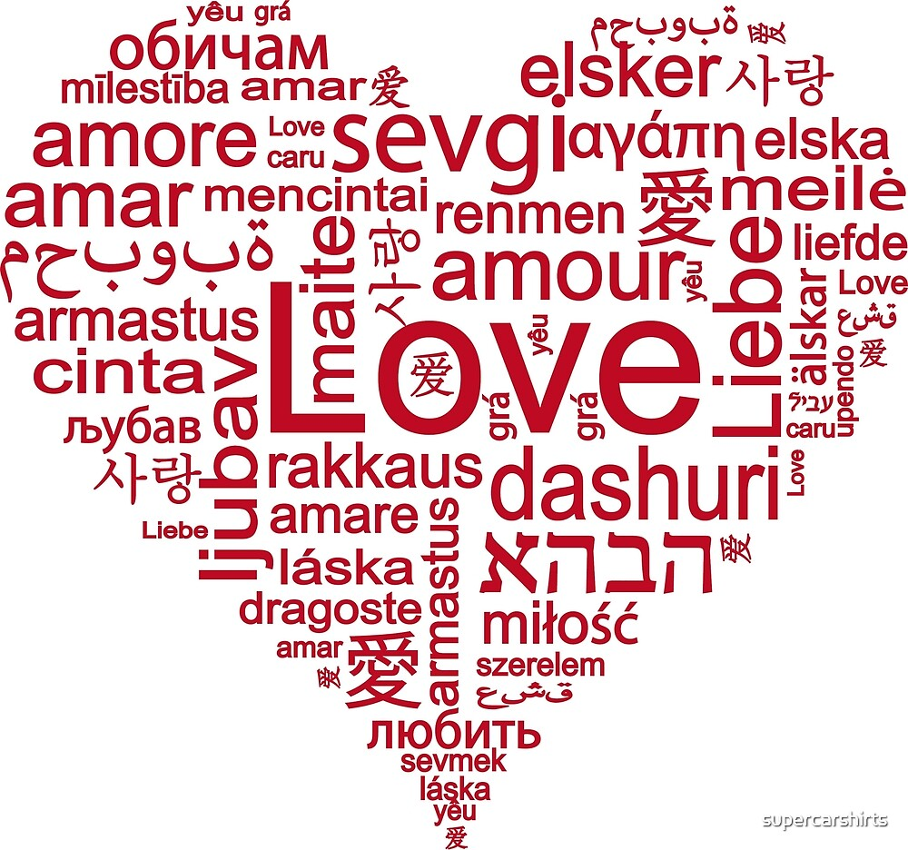
Primary 7 - Part 2
1

Slide 2
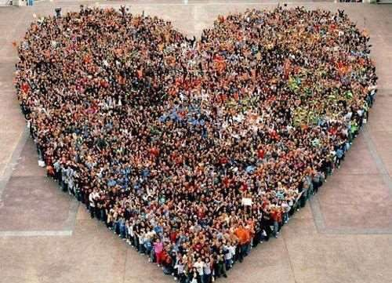
Primary 7 - Part 2
2

Slide 3
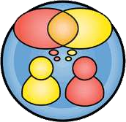
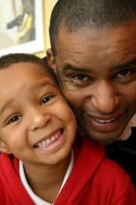
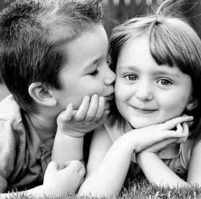
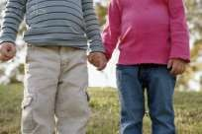
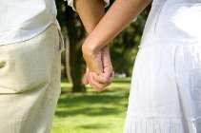
Learning Activity PAIR and SHARE:
Who do you love? Why?
How do you show your love to …?
So, what is love?

Slide 4
A ‘new life’ project
Learning Activity
Do you have a special goal?
What will you need to do to achieve it?
How will you feel when you are successful? What difference will it make to you?

Slide 5
Marriage and Relationships
Learning Activity
Marriage and relationships depends on the couples bringing their own personal gifts and attributes to the partnership.
DISCUSSS in pairs:
What personal qualities help to build a strong marriage or relationship?
How might a couple show their love and respect for each other?

Slide 6
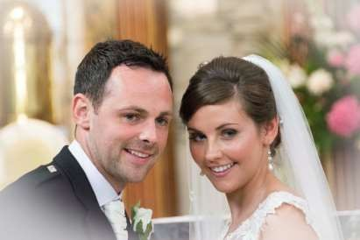
Loving Relationships
Loving relationships are enriched by these qualities:
Trust Loyalty Tenderness Respect
Dignity Intimacy Faithfulness
Openness to new life.

