Slide 1
The Gift of Self
When a loving couple become most intimate with each other, they give of themselves to one another.
This act of “sexual intercourse” should be a mutually agreed expression of two people's love which may lead to the conception of a new life.
1

Slide 2
“And the two
become one flesh. . .”
2

Slide 4
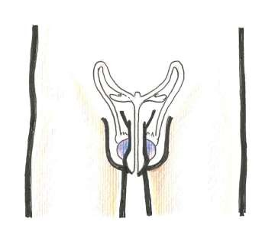
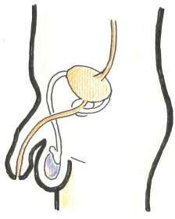
Male sexual organs
Front view
Side view
penis
penis
testicles
testicles
scrotum
scrotum
4

Slide 5
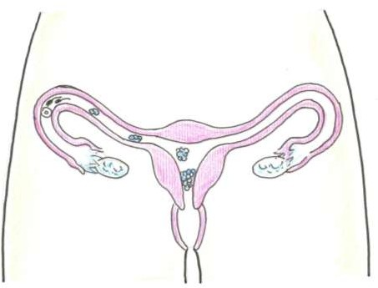
Female sexual organs
Front view of female trunk
The part outside the female body that can be seen is called the vulva. The other parts are inside the body.
The vagina leads from the vulva to the cervix, which is the opening to the womb or uterus.
fallopian tubes
womb or uterus
ovary
ovary
cervix
vagina
vulva
5

Slide 6
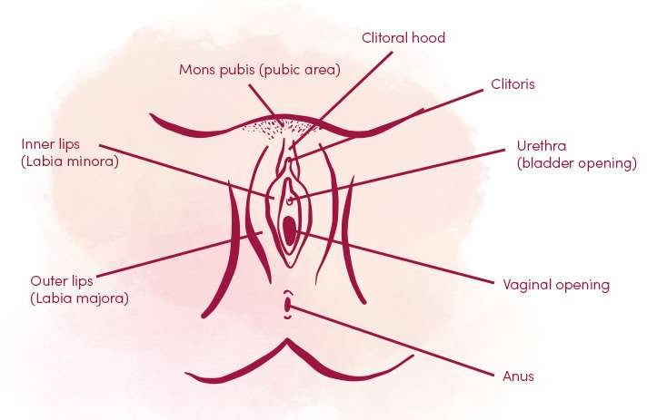
Female reproductive organs 1 (labelled)

Slide 8
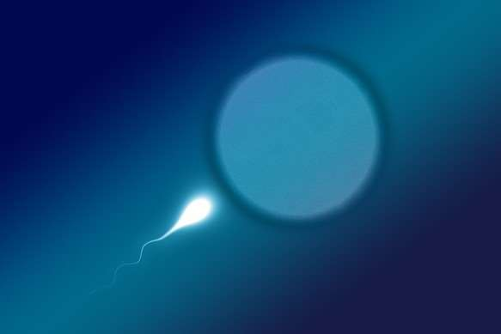
If a man has an orgasm (ejaculates) when his penis is inside the woman’s vagina, then the sperm may meet the egg and this is the way a woman can get pregnant and have a baby.
rshp.scot

Slide 9
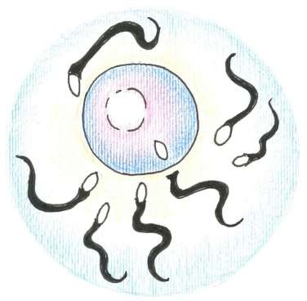
Conception
Although a hundred sperm cells may reach the egg cell only one sperm can enter the egg to fertilise it.
If this happens, it is called conception, and a new life has been created through the loving actions of a couple.
This is called ‘conception’

Slide 10
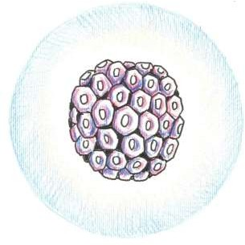
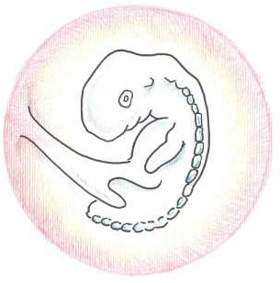
Baby in the womb
After a few days, the fertilised cell divides repeatedly to form a ball of cells.
After 8 weeks, the baby has eyes
but no eyelids.
It starts making tiny movements but its mother cannot feel it yet.

Slide 11
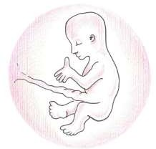
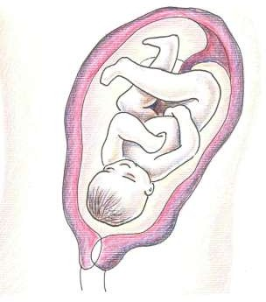
Baby in the womb
After 16 weeks, the baby begins to swallow and to pass urine. It has fingers and toenails.
At this stage its skin is bright red and transparent.
After 24 weeks, the baby can hear voices and other sounds from outside the womb.
It has some hair and eyebrows and eyelashes. Its skin is very wrinkled.

Slide 12
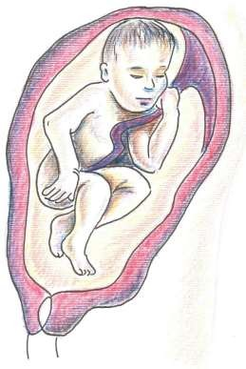
Baby in the womb
After 28 weeks, the baby’s kicks are quite strong and can be felt by putting a hand on the
mother’s stomach.

Slide 13
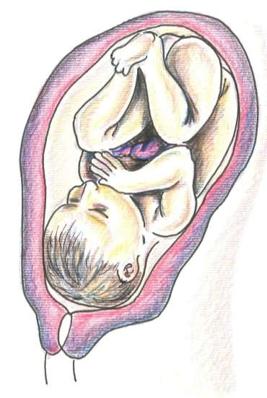
Baby in the womb
After 36 weeks, the baby has taken up its final position in the uterus.
Its lungs are getting ready to take
their first breath.
Some time after 36 weeks, the baby’s head is positioned ready for birth.
The baby could arrive any time between the 38th and 42nd week of pregnancy.

Slide 14
The Gift Of Life
Some parents need help to start the pregnancy
It is the decision of parents to have as many children as they wish to have (contraception)
A child is not an entitlement, or a possession
The creating of new life is a privilege

Slide 15
Some parents need help to start the pregnancy.
Some babies start when the egg and sperm come together in a laboratory. The doctor then puts the fertilised egg back into the woman’s womb. This is called IVF.

