Slide 1
Love and Relationships: Being attracted to someone
I can talk about friendships and relationships.
I can talk about the importance of being cared for, caring for others, caring for myself and what love means.
I know I can have friendships with children of the opposite sex.
I can name an adult/adults I go to if I have a worry.

Slide 2
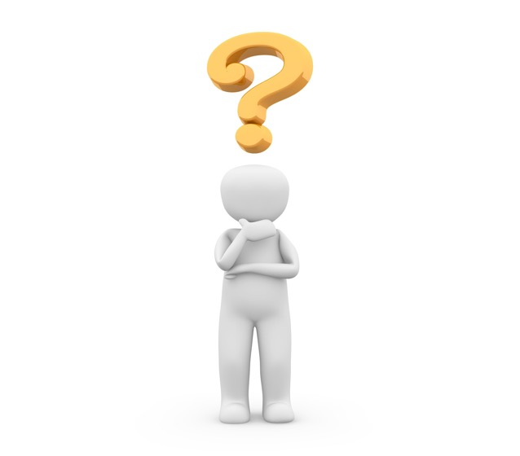
Why do you think there are so many songs, poems, movies and stories about love?

Slide 3
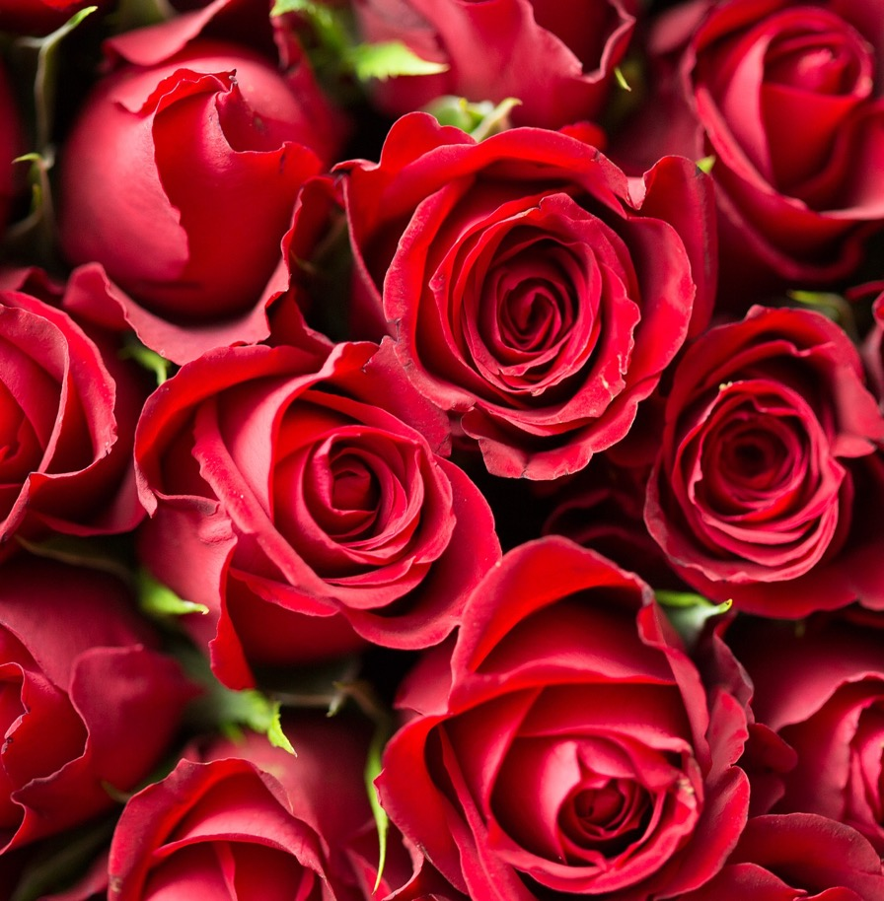
A Red Red Rose
Rachel Sermanni with the Royal Scottish National Orchestra
(4 minutes 30)
https://youtu.be/-1-PF2kt2jg

Slide 4
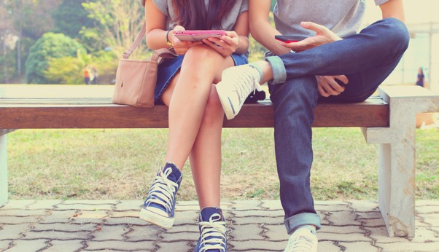
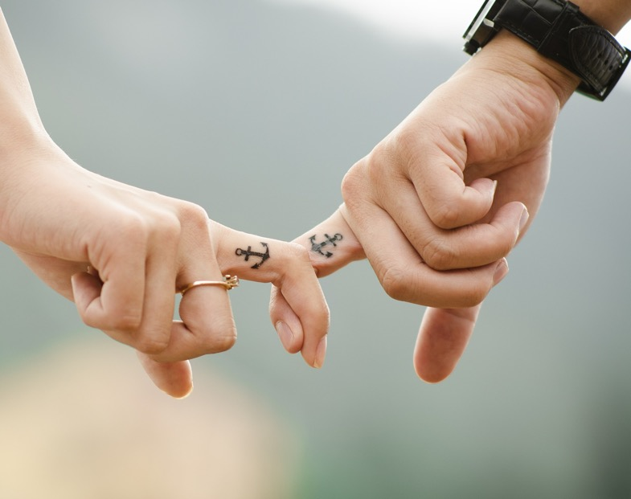
When you like someone
During puberty, you can start to have feelings of attraction to someone.
You might ‘fancy’ other boys and girls.
You may even feel like you’re in love!

Slide 5
When you like someone. That’s okay.
They might like you back.
But they might not feel the same way, and that’s okay too.
You should never try to make someone feel something that they don’t want to feel!

Slide 6
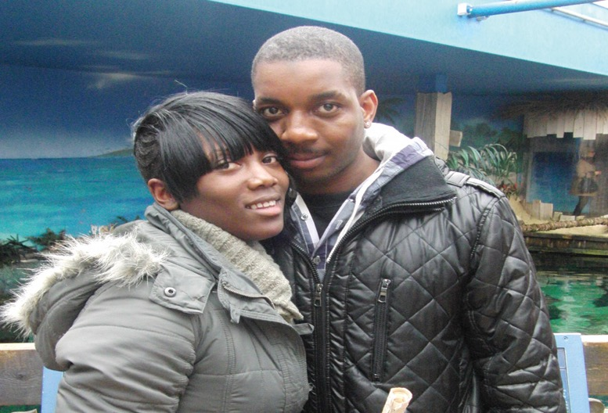
What might these people be thinking about each other?
Notes:
New page. Photos from Workbook

Slide 7
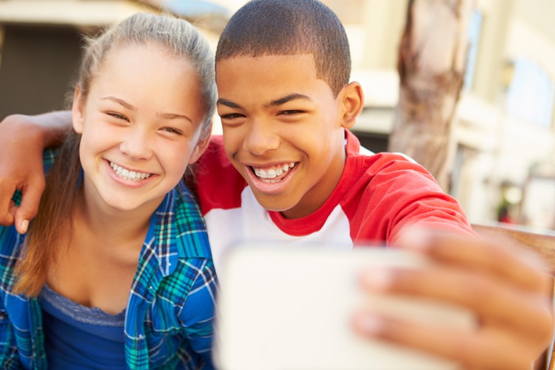
What might these people be thinking about each other?
Notes:
New page. Photo’s from Workbook

Slide 8
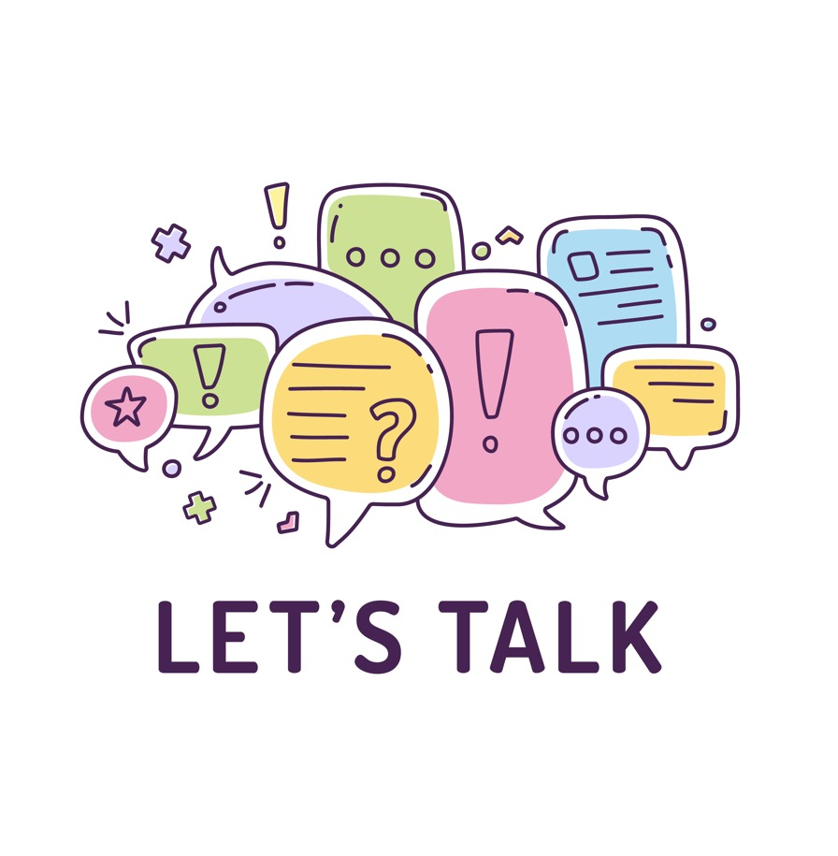
But, what happens if you just don’t want to have a girlfriend or boyfriend?
Do you think children ever feel under pressure to have a boyfriend or girlfriend?
Some scenarios for discussion….

Slide 9
So, if we are feeling that there is pressure to be in a boyfriend/girlfriend situation, what can we say is the best advice about what to say or do?

Slide 10
So, if we like someone, but they just want to be a friend and not a boyfriend or girlfriend how should we react?

Slide 11
If I have a question or a worry about friendships or relationships with others, who can I speak to?

