Slide 1
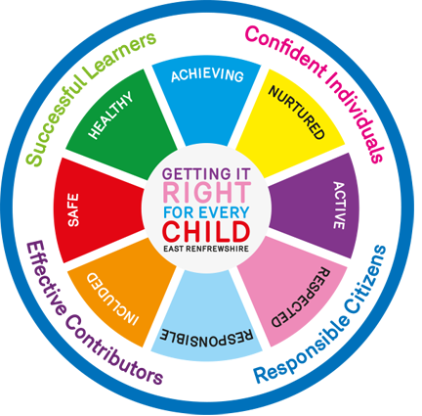
Sgoil Bhreascleit - The Rationale for our Curriculum
Vision
“Leasaich clann cruthachail, cùramach, misneachail agus soirbheachail.”
“Create caring, confident, creative and successful citizens.”
Our pupils at Sgoil Bhreascleit
Caring
Are encouraged to show respect for others
Care for the local community and the wider world
Confident
Participate in cultural activities
Take the lead when working with others
Creative
Think creatively and applying new skills in different contexts
Involved in the planning of their learning
Successful
Celebrate the successes and achievements of children
Planning and undertaking events in the community
Encouraged to consider future careers through opportunities to Develop the Young Workforce.
At Sgoil Bhreascleit we aim to:
Provide a well-balanced, broad based, differentiated and inclusive bilingual curriculum in accordance with local and national guidelines.
Raise the standards of attainment of all pupils by having high but realistic expectations and by encouraging and promoting positive self-esteem in pupils.
Provide stimulating and challenging learning experiences which will motivate and cater for all pupils with differing abilities, aptitudes and interests and provide them and their parents with regular, relevant and helpful reports about their progress.
Promote the health and well-being of pupils and support them in their learning, ensuring that those who are having difficulty are provided with appropriate targets, tasks and activities which take into account their individual needs.
Provide a happy, caring, stimulating and welcoming environment creating mutual respect among pupils, staff, parents and the local community.
Utilise the resources and available accommodation to support pupil and staff activities and ensure the maintenance of these to match educational needs.
Ensure that the school is effectively managed and led, recognising the need for all staff to work together towards clear goals and quality improvement
Values
Kindness/thoughtfulness, compassion, fairness, honesty, respect
tolerance, understanding, empathy
Principles for Curriculum Design:
•challenge and enjoyment
• breadth
• progression
• depth
• personalisation and choice
• coherence
• relevance
Curricular areas:
Literacy/Language
Numeracy/Mathematics
Health and Wellbeing including Physical Education
Sciences
Social Subjects
Religious and Moral Education
Technologies
Expressive Arts

