Slide 1
S1 Information Evening
Marvellous Modern Languages

Slide 2
Modern Languages at Williamwood
S1 & S2
French
3 periods a week
Mandarin
4 lessons
S3 & S4
Nat 5 French
3 periods a week
Spanish
Accelerated Beginner’s National 5 course
S5
Higher French
Spanish
1 week taster
Mandarin Accelerated Beginner’s National 5 course
Higher Spanish
Higher Mandarin
S6
National 4 French
Advanced Higher French
Advanced Higher Spanish
Advanced Higher Mandarin
Crash Higher Spanish

Slide 3
4 skills in all languages

Slide 4
Vocabulary Booklet

Slide 5
Homework
All pupils are expected to revise new vocabulary for around 15 minutes
3 times a week. Pupils should:
1. Copy the words in to their vocabulary jotters
2. Learn the English meanings of the words
3. Learn the spelling of the words

Slide 6
Dyslexic pupils
If your child is dyslexic, he /she does NOT
have to copy the vocabulary into their jotters.
They should experiment with different ways of learning the meanings of the words.
Parents should sign the appropriate section of the vocabulary booklet to show that words have been learnt

Slide 7
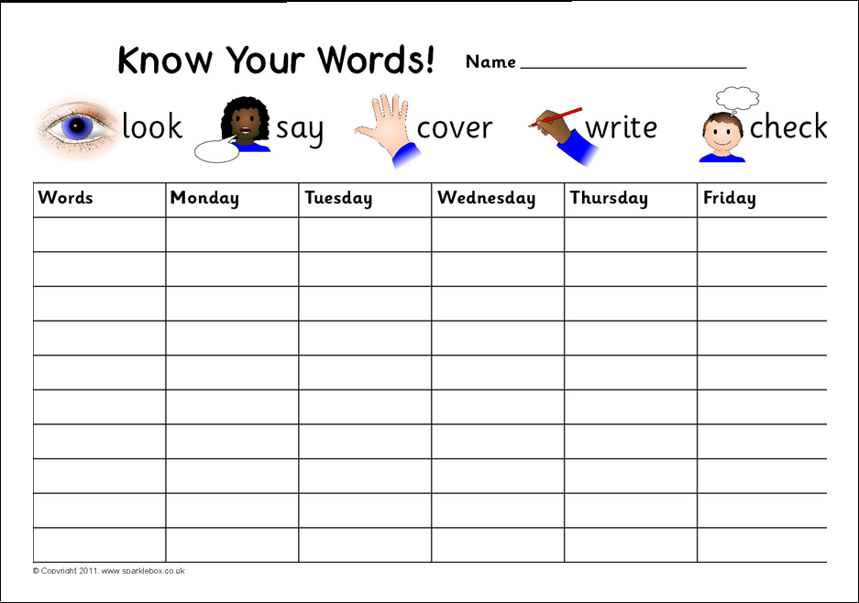
Top tips for learning vocabulary

Slide 8
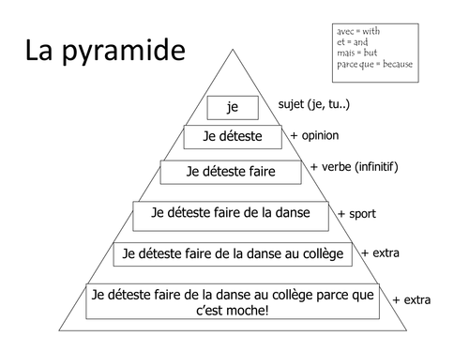
Top tips for learning vocabulary

Slide 9
Top tips for learning vocabulary
Use study cards.
Write the French on one side and the English on the other.
Write the French and English on separate cards and match them up
Play games with the cards

Slide 10
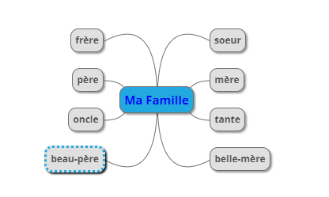
Top tips for learning vocabulary
Draw a mind map

Slide 11
Top tips for learning vocabulary
le chien
Be creative. Draw a picture

Slide 12
Top tips for learning vocabulary
Get someone in the house to test you!

Slide 13
Linguascope
Click here for Linguascope
Ask your teacher for the password

Slide 14
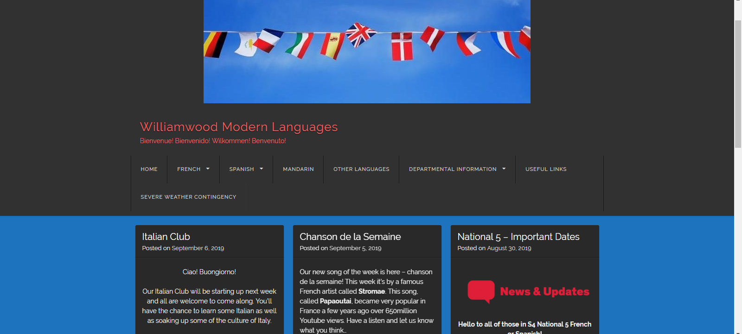
Modern Languages Website
Link to website

Slide 15
Invest in a dictionary
Don’t use Google translate!!
www.wordreference.com

