Slide 1
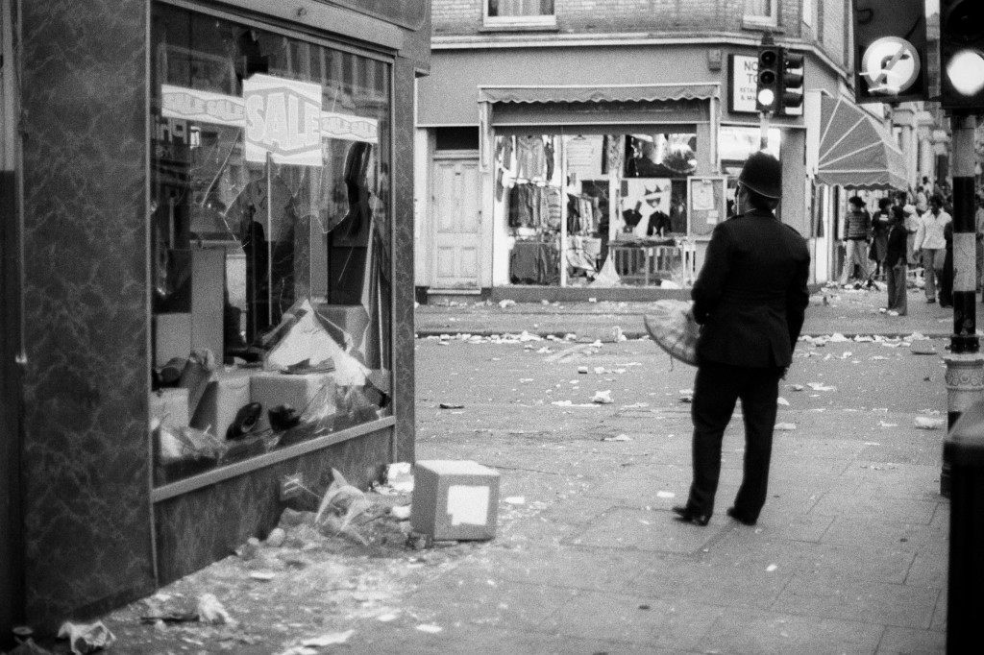
Glasgow 5 March 1971
Edwin Morgan

Slide 2
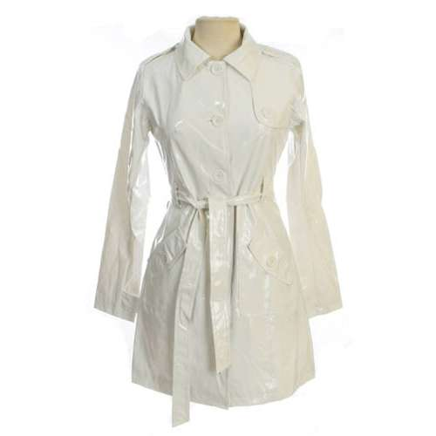
Glasgow 5 March 1971
Edwin Morgan

Slide 3
From: ‘Instamatic Poems’ – published 1972
“I began a while ago by writing short poems which were directly about events which I had either read about or seen in newspapers or on television.”

Slide 4
“the poem must be presented in such a way as to give a visual picture of this event… as if somebody had been there with an Instamatic camera and had just very quickly snapped it…”

Slide 5
About the collection ‘Instamatic Poems’:
The poems' titles comprise a place-name and date, for example 'London November 1971'. The dates range from June 1970 to June 1972. The first six poems all share the same date, 5 March 1971; the remainder are dated only by month and year.

Slide 6
Subject matter:
Describes an incident in a Glasgow street when a young couple are pushed backwards through a shop window by two youths who are intent on robbing the shop.
The poem goes on to describe the attitude of the youths and of the other people nearby.

Slide 7
Themes:
Violence
Social responsibility

Slide 8
Form:
Free verse
No fixed line length
No rhyme scheme

Slide 9
Lines 1-4
With a ragged diamond of shattered plate-glass a young man and his girl are falling backwards into a shop-window.
Readers are thrown into the middle of the action
“Diamond” is the literal shape of the broken window but also has connotations of jewellery/engagement / LOVE. (carat, cut, colour and clarity)
Broken glass, “shattered” broken people, broken society. Onomatopoeic sound word. Readers, like witnesses, hear the noise and should turn round/pay attention.
Present tense. This is happening right now. Crimes like this happen all the time. What would you do if you were a witness?

Slide 10
Lines 5-10
Glass sticking out like a beard? Connotations of anger?
Caught = trapped & vulnerable. Creates sympathy for girl.
Onomatopoeic - gushing sound. Speed of blood like a fountain.
Serious injury. She needs first aid or will bleed to death.
1970s fashion – now literally wet. Alliterative.
The young man's face
is bristling with fragments of glass
and the girl's leg has caught
on the broken window
and spurts arterial blood
over her wet-look white coat.
“white” is symbolic of innocence – now stained with danger/red blood.

Slide 11
Lines 11-14
Metaphor - describes victims’ shape – idea of vulnerability, dehumanisation (comparison to starfish). Strongly visual.
Short line – mirrors violence of situation
Alliteration - highlights the victims’ surprised faces.
There is more pain to come, physical and mental - in this exact moment, we do not know what it will be
Their arms are starfished out
braced for impact,
their faces show surprise, shock,
and the beginning of pain.

Slide 12
Lines 15-19
suggests the criminals are about the same age as the victims who they have used as human ammunition.
two possible meanings:
planned military manoeuvre
surgery
The heartlessness of the act suggests the criminals are lacking in all compassion. Why?
Quick and efficient
CONTRAST with their victims - the criminals blank faces lack conscience, feeling or emotion.
The two youths who have pushed them
are about to complete the operation
reaching into the window
to loot what they can smartly.
Their faces show no expression.

Slide 13
Lines 20-23
links to bitterly cold evening/ cutting wind. Word also associated with cutting/destroying.
Everyone can see the crime.
Very public place. Alliteration echoes sound of shattering glass
Ironic – not because they are attentive motorists, but because they want to ignore the crime they have witnessed
It is a sharp clear night
in Sauchiehall Street.
In the background two drivers
keep their eyes on the road.

