Slide 1
New S1 Reading Recommendations
Here you'll find books last year's S1s thought you might enjoy...

Slide 2
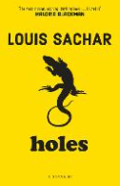
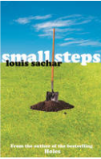
Holes and the sequel, Small Steps by Louis Sachar
Holes
Stanley Yelnats' family has a history of bad luck, so when a miscarriage of justice sends him to Camp Green Lake Juvenile Detention Centre (which isn't green and doesn't have a lake) he is not surprised.
Every day he and the other inmates are told to dig a hole, five foot wide by five foot deep, reporting anything they find. The evil warden claims that it is character building, but this is a lie and Stanley must dig up the truth.
Small Steps
Armpit and X-Ray are living in Austin, Texas. It is three years since they left the confines of Camp Green Lake Detention Centre and Armpit is taking small steps to turn his life around. He is working for a landscape gardener because he is good at digging holes, he is going to school and he is enjoying his first proper romance, but is he going to be able to stay out of trouble when there is so much building up against him? In this exciting novel, Armpit is joined by many vibrant new characters, and is learning what it takes to stay on course, and that doing the right thing is never the wrong choice.

Slide 3
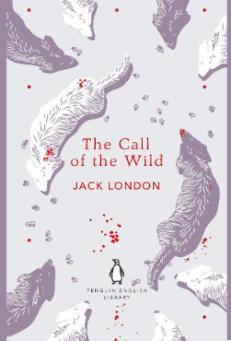
The Call of the Wild by Jack London
To Buck it was boundless delight, this hunting, fishing, and indefinite wandering through strange places. Pampered dog Buck lives a comfortable life in Santa Clara Valley, where he spends his days eating and sleeping in the golden sunshine. But one day a terrible act of betrayal leads to his kidnap, and he is forced into a life of work and danger. Dragged away to be a sledge dog in the harsh and freezing cold Yukon, Buck must fight for his place in the wilderness - and a place to call home. The Call of the Wild is a beautiful and thought-provoking tale following a dog's journey of hope, resilience and finding your family

Slide 4
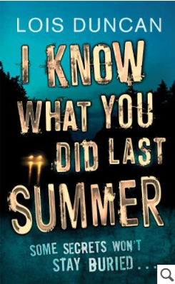
I Know What You Did Last Summer by Lois Duncan
It was only an accident but it would change their lives forever. Last summer, four terrified friends made a desperate pact to conceal a shocking secret. But now, someone has learned the truth, and the horror is starting again. There is an unknown avenger out there who is stalking them in a deadly game. Will he stop at terror--or is he out for revenge? This summer, four friends are going to learn that some secrets just won't stay buried.

Slide 5
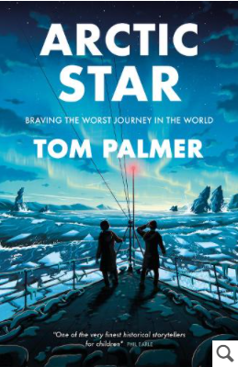
Arctic Star by Tom Palmer
Winter 1943. Teenagers Frank, Joseph and Stephen are Royal Navy recruits on their first mission at sea during the Second World War. Their ship is part of an Arctic Convoy sailing to Russia to deliver supplies to the Soviets. The convoys have to navigate treacherous waters, sailing through a narrow channel between the Arctic ice pack and German bases on the Norwegian coast. Faced with terrifying enemy attacks from both air and sea, as well as life-threatening cold and storms, will all three boys make it home again?

Slide 6
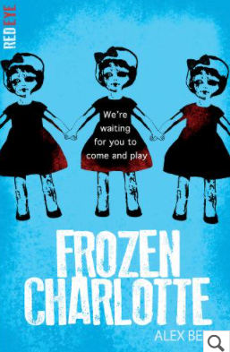
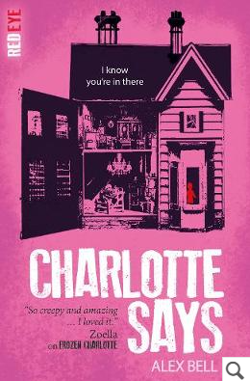
Frozen Charlotte and the sequel, Charlotte Says by Alex Bell
Dunvegan School for Girls has been closed for many years. Converted into a family home, the teachers and students are long gone. But they left something behind... Sophie arrives at the old schoolhouse to spend the summer with her cousins. Brooding Cameron with his scarred hand, strange Lillias with a fear of bones and Piper, who seems just a bit too good to be true. And then there's her other cousin. The girl with a room full of antique dolls. The girl that shouldn't be there. The girl that died. Alex Bell's chilling novel is part of the Red Eye series, perfect for fans of Juno Dawson's Say Her Name and Kendare Blake's Anna Dressed in Blood.
Following the death of her mother in a terrible fire, Jemima flees to the remote Isle of Skye, to take up a job at a school for girls. There she finds herself tormented by the mystery of what really happened that night. Then Jemima receives a box of Frozen Charlotte dolls from a mystery sender and she begins to remember - a seance with the dolls, a violent argument with her step-father and the inferno that destroyed their home. And when it seems that the dolls are triggering a series of accidents at the school, Jemima realizes she must stop the demonic spirits possessing the dolls - whatever it takes.

Slide 7
The Secret Garden by Frances Hodgson Burnett
A pastoral classic of the Edwardian Golden Age, The Secret Garden continues to enchant and entertain over a century after its original publication. Spoilt children, an oppressive country pile and the most wondrous playground of flora and fauna combine perfectly to create a truly iconic novel.
"People never like me and I never like people," Mary thought.
When Mary Lennox is sent to Misselthwaite Manor to live with her uncle, everybody says she is the most disagreeable-looking child ever seen. It is true, too. Mary is pale, spoilt and quite contrary. But she is also horribly lonely. Then one day she hears about a garden in the grounds of the Manor that has been kept locked and hidden for years. And when a friendly robin helps Mary find the key, she discovers the most magical place anyone could imagine...

Slide 8
The Girls I've Been by Tess Sharpe
Soon to be a Netflix film starring Stranger Things' Millie Bobby Brown - this must-read psychological thriller, perfect for fans of One of Us Is Lying, will leave you guessing until the final page.
As an ex con artist, Nora has always got herself out of tricky situations. But the ultimate test lies in wait when she's taken hostage in a bank heist. And this time, Nora doesn't have an escape plan ...
Meet Nora. Also known as Rebecca, Samantha, Haley, Katie and Ashley - the girls she's been.
Nora didn't choose a life of deception - she was born into it. As the daughter of a con artist who targeted criminal men, Nora always had to play a part. But when her mother fell for one of the men instead of conning him, Nora pulled the ultimate con herself: escape.
For five years Nora's been playing at normal - but things are far from it when she finds herself held at gunpoint in the middle of a bank heist, along with Wes (her ex-boyfriend) and Iris (her secret new girlfriend and mutual friend of Wes ... awkward). Now it will take all of Nora's con artistry skills to get them out alive.
Because the gunmen have no idea who she really is - that girl has been in hiding for far too long ...

Slide 9
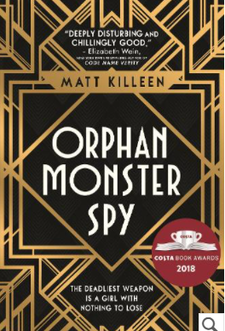
Orphan Monster Spy by Matt Killeen
A teenage spy. A Nazi boarding school. The performance of a lifetime.
Sarah has played many roles - but now she faces her most challenging of all. Because there's only one way for a Jewish orphan spy to survive at a school for the Nazi elite. And that's to become a monster like them.
They think she is just a little girl. But she is the weapon they never saw coming... with a mission to destroy them all.
Survive. Deceive. Resist.

Slide 10
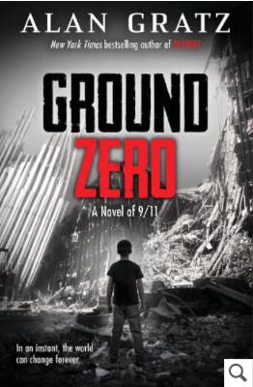
Ground Zero by Alan Gratz
September 11, 2001, New York City: Brandon is visiting his dad at work, on the 107th floor of the World Trade Center. Out of nowhere, an airplane slams into the tower, creating a fiery nightmare of terror and confusion. And Brandon is in the middle of it all. Can he survive - and escape?
September 11, 2020, Afghanistan: Reshmina has grown up in the shadow of war, but she dreams of peace and progress. When a battle erupts in her village, Reshmina stumbles upon a wounded American soldier named Taz. Should she help Taz - and put herself and her family in mortal danger?
Two kids. One devastating day. Nothing will ever be the same. With two action-packed perspectives, Gratz powerfully explores the ways in which the past shapes the present

Slide 11
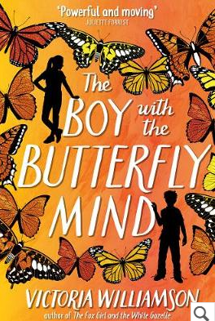
The Boy with the Butterfly Mind by Victoria Williamson
Jamie Lee wants to be normal. But his ADHD makes him feel like his brain is full of butterflies. Elin Watts wants to be perfect. If she can be, surely her dad will come home. When Jamie and Elin's families blend, the polar opposites of chaotic Jamie and ordered Elin collide. As their lives spiral out of control, Jamie and Elin discover that they're actually more alike than they'd admit. Maybe there's no such thing as normal, or perfect. And perhaps, just like families, happy-ever-afters come in all shapes and sizes. Uplifting and moving, The Boy with the Butterfly Mind is an inspiring story of acceptance, blended families, and discovering that in the end, being yourself is more than enough.

Slide 12
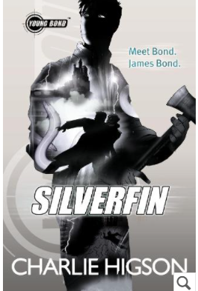
Young Bond: SilverFin by Charlie Higson
Young Bond: SilverFin is the first explosive book in Charlie Higson's bestselling Young Bond series. Before the name became a legend. Before the boy became a man. Meet Bond. James Bond. There's something in the water at Loch Silverfin. Something deadly. Something that must be kept secret... It's James Bond's first day at Eton, and he's already met his first enemy. This is the start of an adventure that will take him from the school playing fields to the remote shores of Loch Silverfin and a terrifying discovery that threatens to unleash a new breed of warfare.

Slide 13
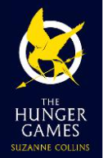
The Hunger Games by Suzanne Collins
The first book in the ground-breaking Hunger Games trilogy. Set in a dark vision of the near future, a terrifying reality TV show is taking place. Twelve boys and twelve girls are forced to appear in a live event called The Hunger Games. There is only one rule: kill or be killed.
When sixteen-year-old Katniss Everdeen steps forward to take her younger sister's place in the games, she sees it as a death sentence. But Katniss has been close to death before. For her, survival is second nature.

Slide 14
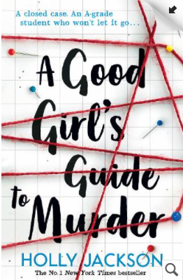
A Good Girl's Guide to Murder
The case is closed. Five years ago, schoolgirl Andie Bell was murdered by Sal Singh. The police know he did it. Everyone in town knows he did it. But having grown up in the same small town that was consumed by the crime, Pippa Fitz-Amobi isn't so sure. When she chooses the case as the topic for her final project, she starts to uncover secrets that someone in town desperately wants to stay hidden. And if the real killer is still out there, how far will they go to keep Pip from the truth . . .
Perfect for fans of One of Us Is Lying, We Were Liars and Riverdale.

