Slide 1
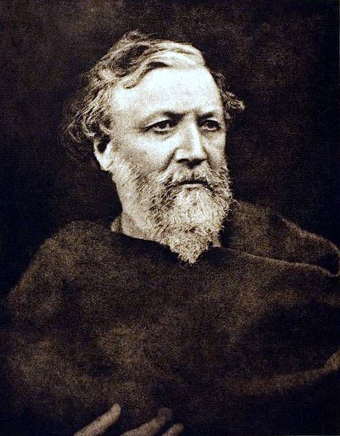
'Porphyria's Lover'

Slide 2
'Porphyria's Lover' by Robert Browning
Critical Essay Exam Preparation
This presentation will look closely at the poem and consider how you should aim to tackle a variety of questions.
Remember! You should be aiming to plan these essays independently. Look at the questions and ask yourself…
‘Could I answer this?’

Slide 3
'Porphyria's Lover' by Robert Browning
The following slides will take you through the poem and identify some of the key elements that you may wish to discuss in a critical essay.

Slide 4
'Porphyria's Lover' by Robert Browning
The rain set early in tonight,
The sullen wind was soon awake,
It tore the elm-tops down for spite,
And did its worst to vex the lake:

Slide 5
The rain set early in tonight,
The sullen wind was soon awake,
It tore the elm-tops down for spite,
And did its worst to vex the lake:
The poem opens with a fairly traditional interpretation of the Romantic tradition. Browning uses a descriptive opening of the natural landscape to provide a context to the poem.

Slide 6
Browning’s word choice is effective here as it employs aspects of ‘Pathetic Fallacy’. This allows Browning to instil the actions of his speaker with the descriptions of the wind.
The rain set early in tonight,
The sullen wind was soon awake,
It tore the elm-tops down for spite,
And did its worst to vex the lake:
The use of Pathetic fallacy mirrors the brooding contemplative nature of the speaker. Sullen and spite indicate his anger and suggest his menacing nature. This adds a particularly dark, brooding tone to the opening lines.

Slide 7
Our first introduction to the speaker is that he is a broken hearted man. This contrasts with the previous descriptions of ‘sullen’ and ‘spite’. Is his heartbreak genuine?
I listened with heart fit to break.
When glided in Porphyria; straight
She shut the cold out and the storm,
Our first vision of Porphyria is one of strength and beauty. She holds an almost ethereal quality as she ‘glides’ in like a goddess. Her mere presence appears to eliminate the cold and the danger of the storm. Does this suggest that she holds power over the speaker as well?

Slide 8
Porphyria appears to have the ability to provide warmth to the cottage. The action of kneeling before the grate would suggest her subservience, however, her actions act against this.
And kneeled and made the cheerless grate
Blaze up, and all the cottage warm;
Consider the action of the female figure being the one with the ability to create fire. This is the first example of the way in which Porphyria emasculates the speaker.
The description of the ‘cheerless grate’ again could be seen to reflect the speaker. However she does not make him warm…for him ‘blaze’ suggests anger.

Slide 9
Porphyria removes her wet clothing. Note that she has still not interacted with the speaker at this point. He watches her from the darkness.
Which done, she rose, and from her form
Withdrew the dripping cloak and shawl,
And laid her soiled gloves by, untied
Her hat and let the damp hair fall,
Consider the significance of the action. The sensual nature of the hair tumbling down, reveals a freedom and an intimacy of the moment.

Slide 10
Despite her alluring behaviour, the speaker chooses to ignore Porphyria. This further illustrates the tense atmosphere between them.
Porphyria removes her wet clothing. Note that she has still not interacted with the speaker at this point. He watches her from the darkness.
And, last, she sat down by my side
And called me. When no voice replied,
She put my arm about her waist,
And made her smooth white shoulder bare,
Notice how Porphyria holds the control. She places his hands on her, drawing him closer. Porphyria continues to use her sexuality to draw the speaker close, by baring her smooth white shoulder. The porcelain white skin symbolises innocence and purity.

Slide 11
The description of her hair as ‘yellow’ is significant as it is a colour that implies treachery. This suggests that Porphyria has been unfaithful in the past.
Once again, Porphyria dominates the interaction by placing the speakers head on her hair. He is being enveloped by the yellow of her treachery.
And all her yellow hair displaced,
And, stooping, made my cheek lie there,
And spread, o'er all, her yellow hair,
Murmuring how she loved me-she
Porphyria whispers of her love in an almost comforting/parental fashion. He appears submissive as he lies in her warmth and listens to her tenderness.

Slide 12
The description of her hair as ‘yellow’ is significant as it is a colour that implies treachery. This suggests that Porphyria has been unfaithful in the past.
Once again, there is a suggestion of danger as this word means to cut. This could be seen as a threat of her brutal murder to come…
Too weak, for all her heart's endeavour,
To set its struggling passion free
From pride, and vainer ties dissever,
And give herself to me for ever.
The words ‘give herself to me for ever’ foreshadow his later actions where he gains control of Porphyria through death.

Slide 13
Here the speaker reflects on the fact that Porphyria has made a great sacrifice and effort to be with him this night.
So, she was come through wind and rain.
Be sure I looked up at her eyes
Happy and proud; at last I knew
Porphyria worshipped me; surprise
The use of the word ‘worshipped’ indicates the way in which the speaker feels Porphyria idolises him. Their relationship is about control rather than love.

Slide 14
The obsession is clear here through the use of the word ‘swell’ which highlights the way in which his feelings are taking over him.
This is significant as it suggests that his actions were planned out and considered. He did not simply murder her without consideration.
Made my heart swell, and still it grew
While I debated what to do.
That moment she was mine, mine, fair,
Perfectly pure and good: I found
The repetition of ‘mine’ highlights his commanding and possessive nature. Linked to the way she is said to worship him, it is clear that this is a relationship of control and power.

Slide 15
The word little suggests her delicacy and the fact that she was very vulnerable in this position. She becomes almost child like in his hands.
Here, the danger of that yellow hair can be seen once more. She is literally murdered by her own sexuality. The thing she used to be alluring has been her undoing…
A thing to do, and all her hair
In one long yellow string I wound
Three times her little throat around,
And strangled her. No pain felt she;
The speaker takes control, takes her hair in his hands and winds it tight around her neck. In doing this, he takes control of her.

Slide 16
The word little suggests her delicacy and the fact that she was very vulnerable in this position. She becomes almost child like in his hands.
Here, the danger of that yellow hair can be seen once more. She is literally murdered by her own sexuality. The thing she used to be alluring has been her undoing…
A thing to do, and all her hair
In one long yellow string I wound
Three times her little throat around,
And strangled her. No pain felt she;
The speaker takes control, takes her hair in his hands and winds it tight around her neck. In doing this, he takes control of her. Enjambment reveals the way that the hair was wrapped.

Slide 17
The suggestion that she felt no pain seems to be important to the speaker. The pause after her death reveals to the reader that Porphyria will be silent for all eternity.
This image suggests the way in which he is somwhat afraid of what he will see when he opens her lids. He fears that they will reveal the horror of his actions.
I am quite sure she felt no pain.
As a shut bud that holds a bee,
I warily opened her lids: again
Laughed the blue eyes without a stain.
The eyes appear as he imagined and he is overjoyed that they still show such warmth and life. They have not been stained as a result of his actions.

Slide 18
He has reversed the previous position. Porphyria’s head now rests on his shoulder indicating that through his murder of her, he has gained power over the relationship at last.
The speaker sees that the reversal of position puts him in a more powerful position. The seemingly natural order has been restored.
I propped her head up as before,
Only, this time my shoulder bore
Her head, which droops upon it still:
The smiling rosy little head,
The word still is significant here as it could have two meanings. It could mean that her head lay without moving or even (more troubling) that it is still there.

Slide 19
Delusion of the speaker who seems to believe that this is what both he and Porphyria always wanted. He sees their life as perfect now.
So glad it has its utmost will,
That all it scorned at once is fled,
And I, its love, am gained instead!
The speaker genuinely believes that he has helped Porphyria to gain what it is that she always wanted. He believes that she is fortunate to have him.

Slide 20
He feels that he has triumphed in the power struggle between him and Porphyria. They are finally together as he always wanted to have.
The speaker sees that the reversal of position puts him in a more powerful position. The seemingly natural order has been restored.
Porphyria's love: she guessed not how
Her darling one wish would be heard.
And thus we sit together now,
Continuation of the image that he could only control Porphyria through her murder. The way that they continue to sit together highlights the fact that his quest for power has destroyed all that they had.

Slide 21
There is a frightening undercurrent to this statement. He sits all night in domination of her corpse. Only through death can he control his love and her actions.
There is a frightening undercurrent to this statement. He sits all night in domination of her corpse. Only through death can he control his love and her actions.
This is also the first time in which the speaker refers to them as ‘we’ suggesting that only now can he see them as a couple. Partnership for him only comes with control.
And all night long we have not stirred,
And yet God has not said a word!
Here he alludes to the fact that he knows he has done wrong…he is aware that God could punish him for his actions. The exclamation mark at the end of the poem could be seen as a reflection of his triumph at escaping justice.

Slide 22
'Porphyria's Lover' by Robert Browning
Critical Essay Exam Preparation
Today we are going to prepare our plan for our first Critical Essay at Higher.
Essentially, the process remains the same, although the depth of analysis and relevance to the question must be significantly tighter than they were at Intermediate 2.

Slide 23
'Porphyria's Lover' by Robert Browning
Critical Essay Exam Preparation
Here is your question. It has been taken from the 2007 Higher paper.
Choose a poem in which the speaker’s personality is gradually revealed.
Show how, through the content and language of the poem, aspects of the character
gradually emerge.

Slide 24
'Porphyria's Lover' by Robert Browning
Critical Essay Exam Preparation
Here is your question. It has been taken from the 2007 Higher paper.
Choose a poem in which the speaker’s personality is gradually revealed.
Show how, through the content and language of the poem, aspects of the character
gradually emerge.

Slide 25
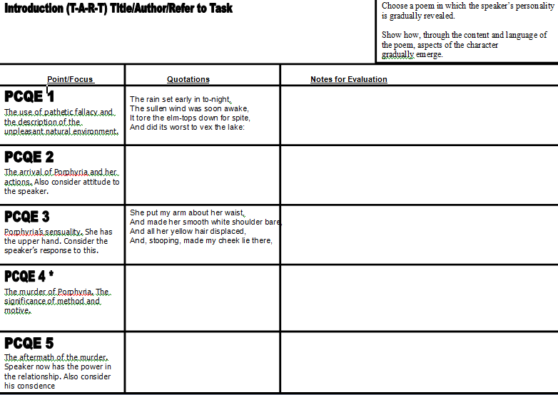

Slide 26
'Porphyria's Lover' by Robert Browning
Choose a poem in which the speaker’s personality is gradually revealed.
Show how, through the content and language of the poem, aspects of the character gradually emerge.
Now you need to consider how you will structure your response. Obviously you will be looking at the actions of the speaker and the murder of Porphyria, but there are other aspects of the poem that you should also consider.
The use of Pathetic Fallacy and how this introduces the character of the speaker.
The arrival of Porphyria and what this reveals about their relationship and the character of the speaker.
The sensuality of Porphyria and what this reveals about their relationship. (The power struggle)
The murder of Porphyria and the speaker’s quest for power/his need for her adoration.
The aftermath of the murder and the conscience of the speaker.

Slide 27
'Porphyria's Lover' by Robert Browning
Choose a poem in which the speaker’s personality is gradually revealed.
Show how, through the content and language of the poem, aspects of the character gradually emerge.
You must consider how you will structure your introduction and summary paragraphs. Remember to use TART and ReBOOT to help you.
Introduction
Title
Author
Refer to
Task

Slide 28
'Porphyria's Lover' by Robert Browning
Choose a poem in which the speaker’s personality is gradually revealed.
Show how, through the content and language of the poem, aspects of the character gradually emerge.
You must consider how you will structure your introduction and summary paragraphs. Remember to use TART and ReBOOT to help you.
Introduction
Robert Browning’s chilling ‘Porphyria’s Lover’ is a poem in which the poets mastery of the dramatic monologue form is used to gradually reveal the personality of his speaker. As the poem develops, the reader is slowly presented with the inner turmoil and delusion of the speaker as he feels driven to murder his beguiling lover in order to regain the power in their relationship.

Slide 29
'Porphyria's Lover' by Robert Browning
Choose a poem in which the speaker’s personality is gradually revealed.
Show how, through the content and language of the poem, aspects of the character gradually emerge.
Paragraph 1: The use of Pathetic Fallacy and what this reveals about the speaker.
In this paragraph you must introduce that Browning’s contextualising of the setting and his use of Pathetic Fallacy help to instantly introduce aspects of the speaker’s character.
The threatening and foreboding mood of the opening lines of the poem is in defiance to the previous Romantic tradition and reflects the brooding of the speaker.
This brooding and contemplative nature is fully indicated through the poet’s use of Pathetic Fallacy. Consider the word choice of ‘sullen’ and ‘spite’. What does this reveal about the speaker?

Slide 30
'Porphyria's Lover' by Robert Browning
The rain set early in tonight,
The sullen wind was soon awake,
It tore the elm-tops down for spite,
And did its worst to vex the lake:

Slide 31
The rain set early in tonight,
The sullen wind was soon awake,
It tore the elm-tops down for spite,
And did its worst to vex the lake:
The poem opens with a fairly traditional interpretation of the Romantic tradition. Browning uses a descriptive opening of the natural landscape to provide a context to the poem.

