Slide 1
S1/2 Science Competition!!
“My eco-friendly school”

Slide 2
About the project
STEM Science Fair October 11th 2017
Work in groups of 2 or 3 or individually to design and build a model of your own eco-friendly school
The winner will be chosen on the night
The winner will be the project with the most creative design, original ideas and the best model
The winner will receive iTunes voucher

Slide 3
What is Eco-Friendly?
Eco-friendly means…
“something that is not harmful to the environment”
Examples of things that are eco-friendly;
Recycling
Solar panels
Wind turbines

Slide 4
What should I include?
A model of your eco-friendly school (use recycled materials where possible for bonus points!)
A “model guide” that gives information about your school, explaining how it is eco-friendly

Slide 5
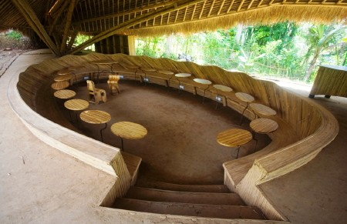
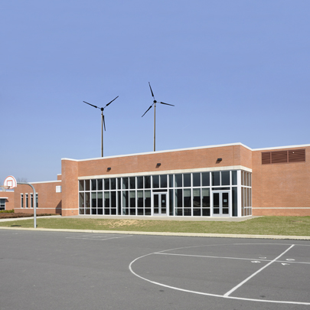
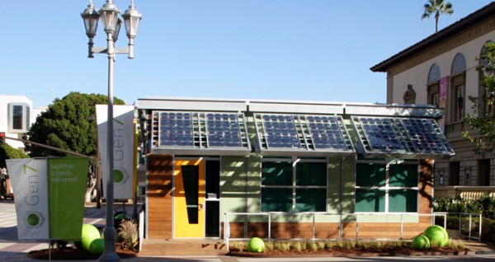
Some inspiration…

Slide 6
Any questions?
See Miss Regan (Science 13) or Miss McBride (Science 12)

