Slide 1
Muddy Movers
Developing Children’s Physical Literacy
Promoting Emotional Resilience

Slide 2
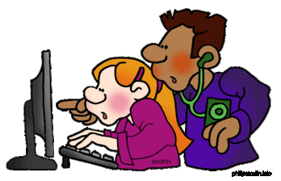
Research shows:
Early childhood exercise :
Builds Strong Bones
Builds Muscle Strength
Increases Lung Capacity
May improve Academic achievement
Threats to Outdoor Exercise & Play:
Lifestyle
Safety Fears

Slide 3
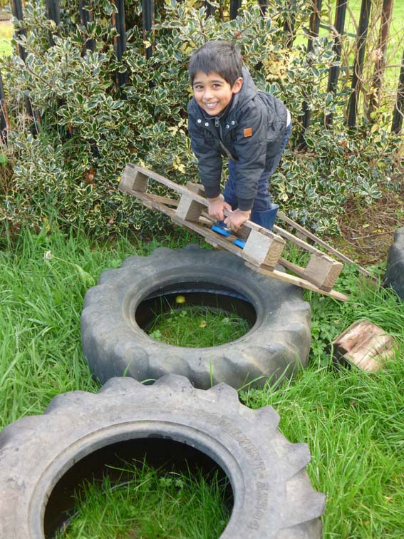
Physical Literacy Skills
Core Strength
Jumping (from various heights)
Balancing
Co-ordination
Spatial Awareness
Negotiating Obstacles
Hand-eye/Foot-eye co-ordination
Throwing & Catching

Slide 4
Emotional Resilience
Increased Confidence
Assessing & Managing Risk
Perseverance
Mental Wellbeing
Sense of Achievement
Team Work, Social Skills
Freedom to Experiment at own pace
Problem-solving

Slide 5
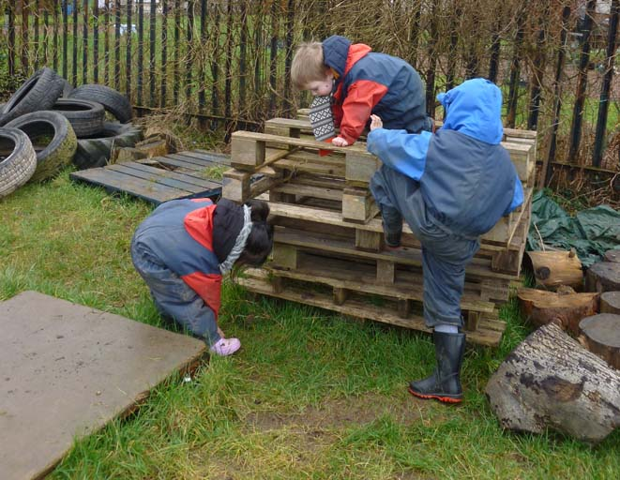

Slide 6
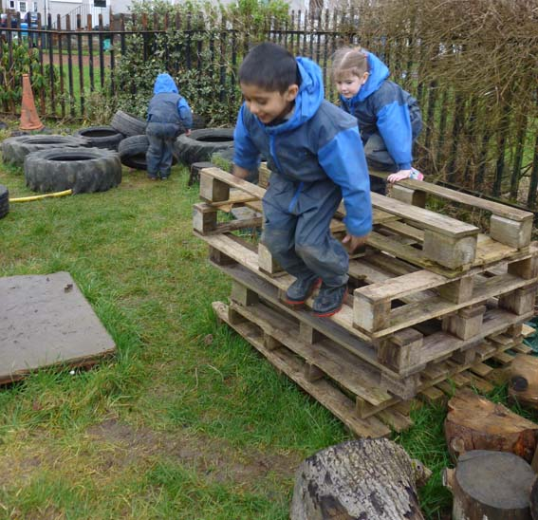

Slide 7
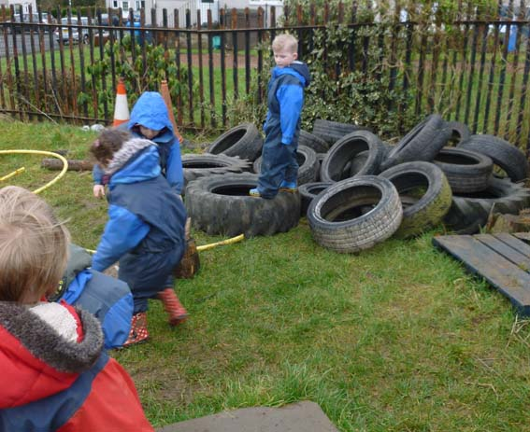

Slide 8
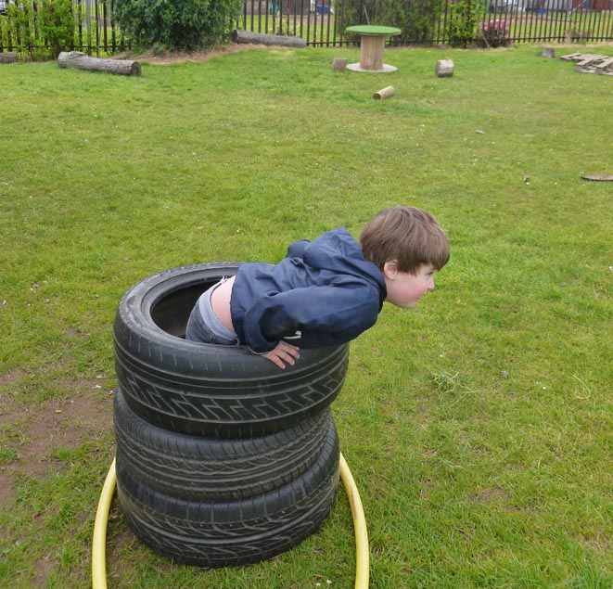

Slide 9
Nicholson’s Theory of Loose Parts
(Materials that can be moved, carried, combined, redesigned, lined up, taken apart and put back together in multiple ways - High Affordance)
Empowers creativity & imagination
More stimulating and engaging
Allows children to develop their own ideas & explore their world
Allows children to play in many different ways
on many different levels.

Slide 10
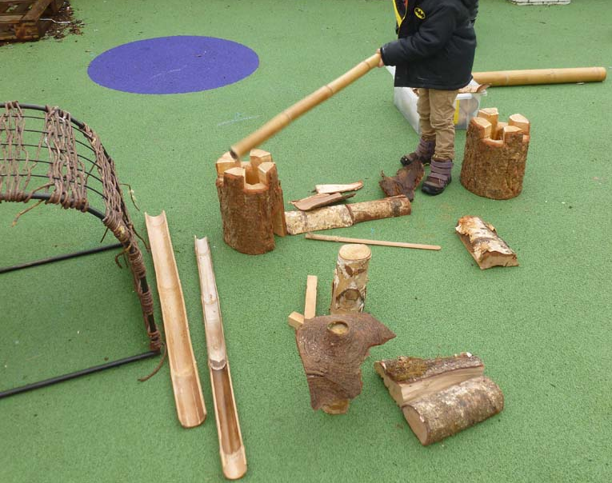

Slide 11
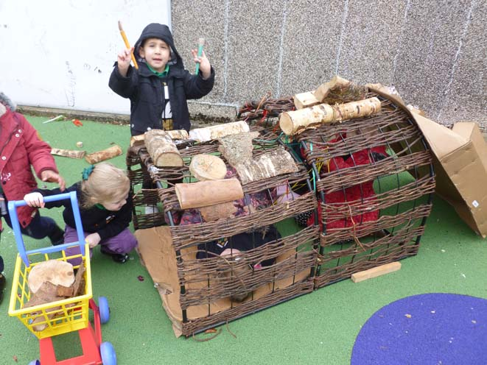
Core Strength
Teamwork
Creativity
“We’re building an extension!”

Slide 12
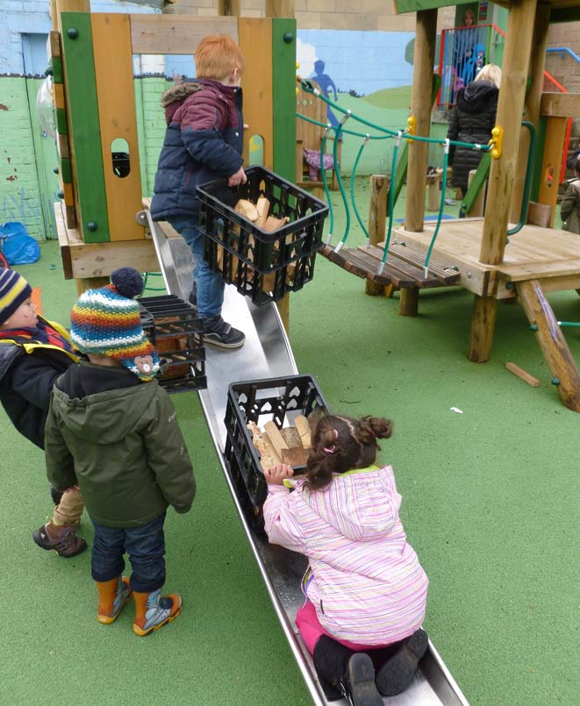
Core
Strength
Teamwork
“Here’s a delivery of logs. We’re taking these logs to the factory”
Creativity

Slide 13
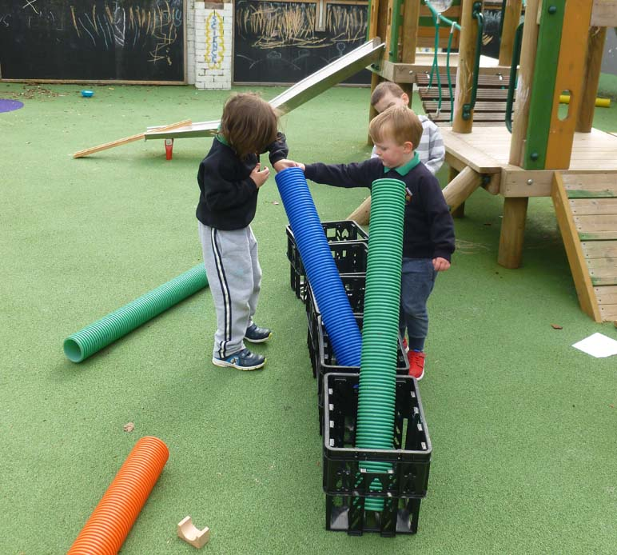
Teamwork
Problem-solving
Discovery

Slide 14
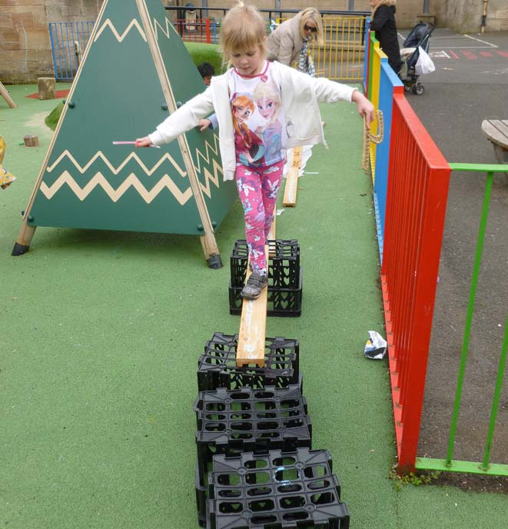
Balance

Slide 15
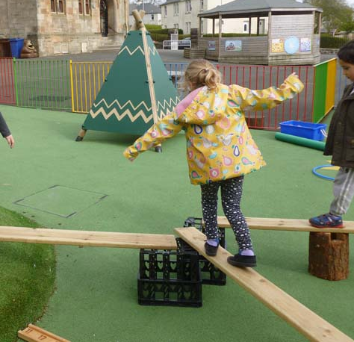

Slide 16
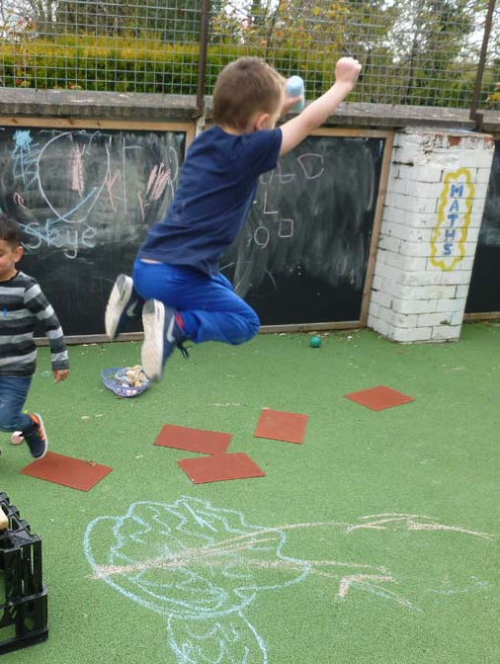
Jumping

Slide 17
Learning to Manage Risk
Risk Averse v Risk Aware
Challenge
Assessing Risk
Do I feel Safe?
What Help do I need?
Scaffolding

Slide 18
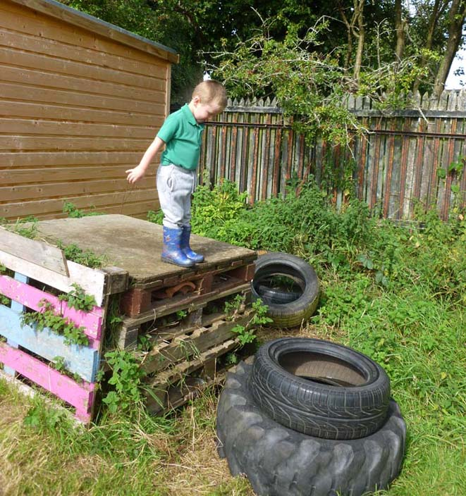
Challenge
Risk Assessment
“Can I do it?”

Slide 19
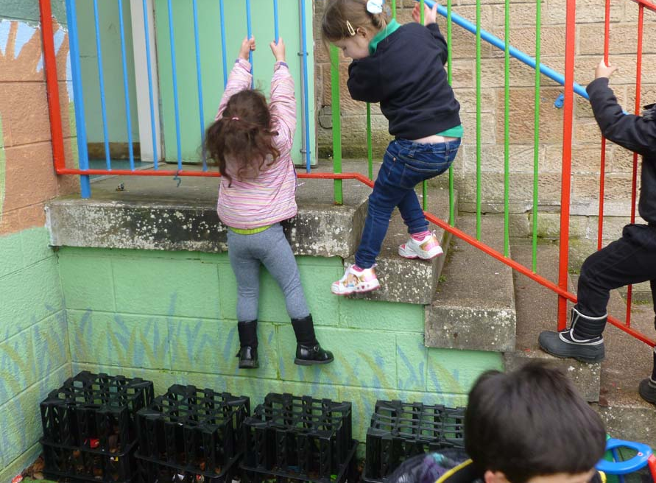
Children set up their own scaffolding

Slide 20
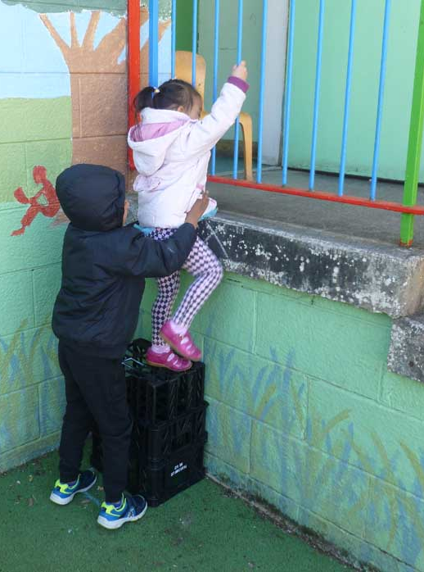
Peer support
Scaffolding

Slide 21
“I was scared in case I fall down, so we put the boxes there”
“I’m scared of my first time doing it.
It doesn’t look safe.”
“Can I get a bit of help to jump?”
Scaffolding
Assessing risk
“We put the boxes there for her ‘cos she couldn’t do it.”
Challenge
“Look I just did this all by myself – that’s the first time I did it all by myself... I’m gonna keep trying it lots of times.”
Peer support
“I don’t need help any more for this!”
Confidence
Perseverance

Slide 22
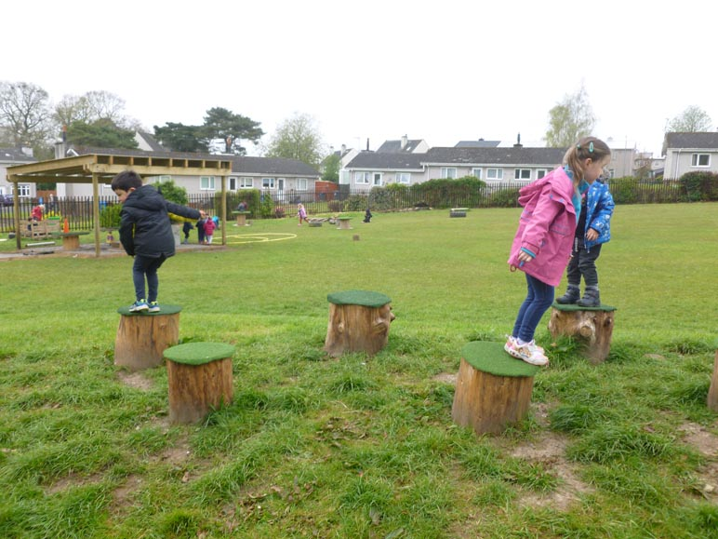

Slide 23
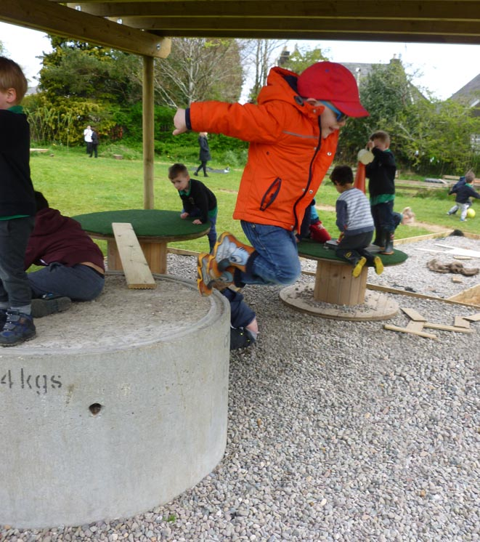

Slide 24
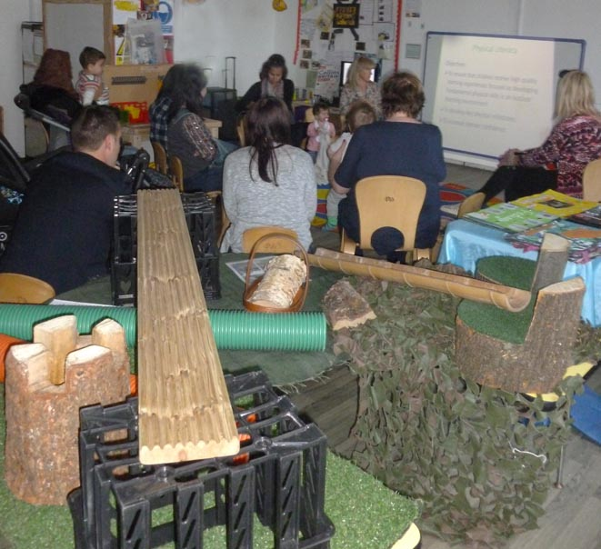
Parents’ Information Session

