Slide 1
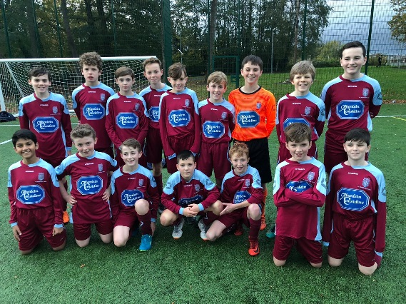
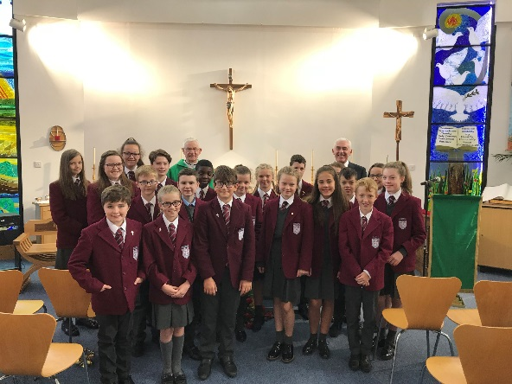
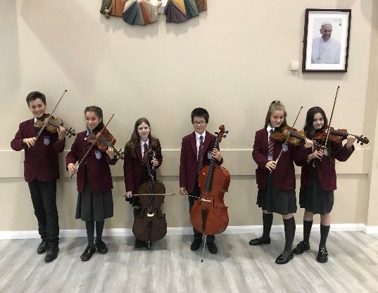
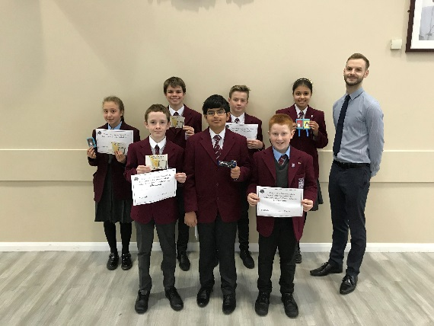
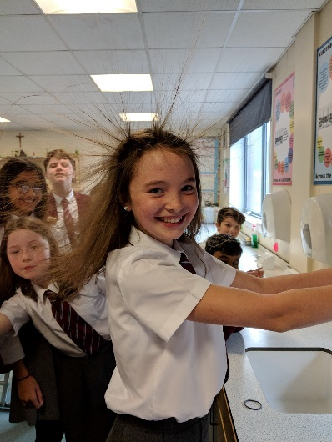
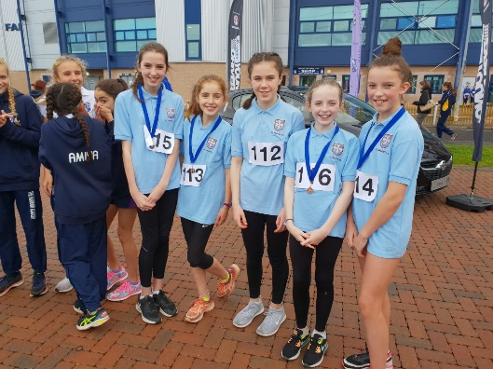
S2 ASSEMBLY
23 August 2019

Slide 2
School Prayer
Jesus, as a child you grew in learning and wisdom.
Bless Saint Ninian’s High School,
a community of faith and love
where young people learn,
work and grow together.
Help us to make our school a place
where teachers are valued for their dedication;
where pupils are encouraged
to develop their talents
and where all
staff, young people and parents -
work together
in trust and friendship.
Live among us now and forever.
Amen

Slide 3
Our Faith

Slide 4
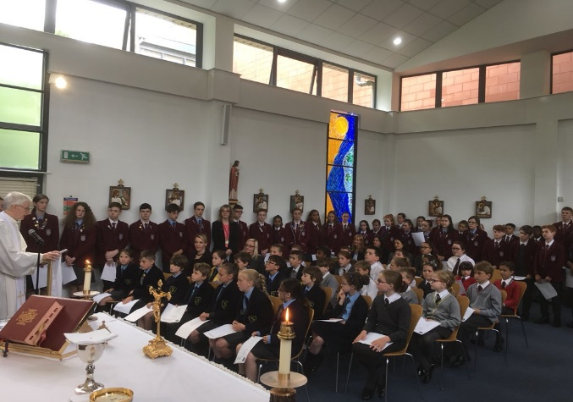
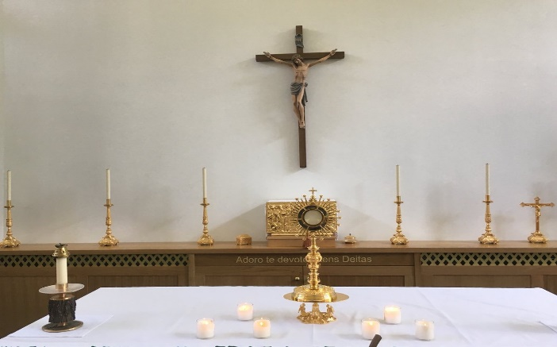
Morning Mass
Eucharistic Adoration and Rosary
Venerable Margaret Sinclair Novena
Tuesday, Thursday and Friday 8.25am
Friday 12.20-1.00
Monday 12.40
Family members are always welcome!
"The best, the surest and the most effective way of establishing everlasting peace on the face of the earth is through the great power of Perpetual Adoration of the Blessed Sacrament."
Blessed John Paul II

Slide 5
Inaugural Family Mass
Our Inaugural Family Mass to celebrate the start of the new academic year will take place on Thursday 29 August at 7pm in the Atrium.
A warm invitation is extended to all staff, pupils and parents for what is always a very happy occasion.

Slide 6
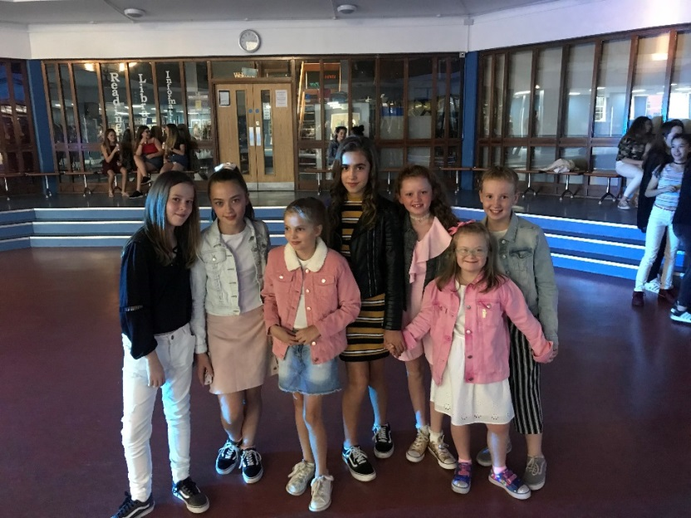
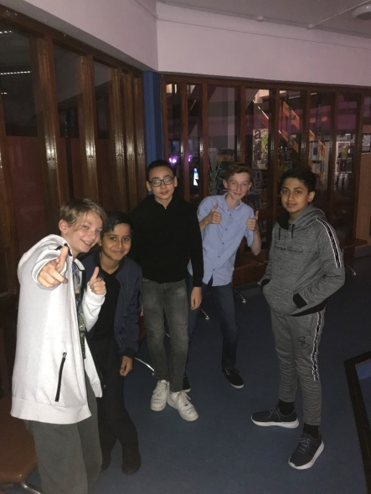
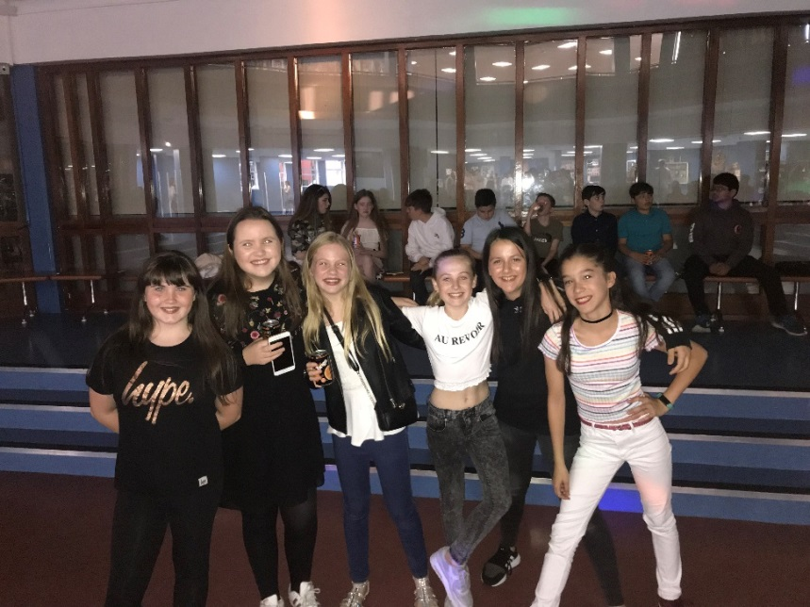
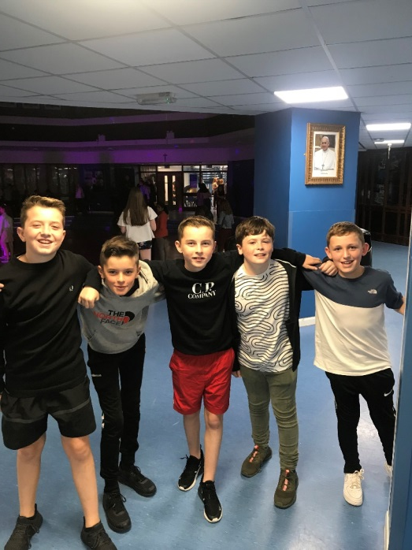
S1 – S2 Disco
Thursday 5 September
7pm – 9pm
Tickets from Religious Education Base and Teachers

Slide 7
Our School and Community

Slide 8
Lockers
All S2-S6 locker holders should ensure their locker is securely closed and padlocked.
If it has a tie or a School padlock on it a new 40mm padlock should be purchased ASAP and you must see Mrs Callan/Mrs Zochowska in School office. A padlock can be purchased from Office for £5 or pupils can provide their own.
All lockers must be secure by Friday 30 August. After this date, any insecure lockers will be reallocated and you will lose your locker.

Slide 9
St Ninian’s High School Media Team
Be responsible for news and information for pupils, parents and staff
Celebrate school successes and achievements
Looking for presenters, writers and producers from S1-S6
Create regular Podcasts and Videos to be shared on iTunes, Spotify, YouTube and more!
To join, please attend meeting at 12:40pm on Wednesday 28 August in Lecture Theatre
See Mr Fuchs for further details

Slide 10
Our Learning and Teaching

Slide 11
Expectations & Standards
Pupils are asked to abide by the rules of our school
Respectful and Courteous and Well Mannered
Always highest standard of uniform
Always attend school & be punctual for all classes
Work hard in class and at home
Show respect for each other, for teachers , other members of staff, and for visitors – ALL VISITORS SHOULD BE DIRECTED TO FRONT DOOR.
Behave reasonably at all times both in school & travelling to and from school

Slide 12
Interval and Lunch
Pupils are reminded that Break and Lunch intervals should be used for toilet breaks and to refill water bottles
Pupils should avoid requesting to go to the toilet where possible, especially at the beginning of period 3 and 5
Pupils should access lockers during break or lunch

Slide 13
Litter
Street
Community
Football pitch
Corridors
It is your responsibility to help keep the school and community in good and clean condition. Make sure both you and your friends are doing their bit to keep your school clean and an enjoyable place to be.

Slide 14
Lunchtime Procedures
NO shops at all during lunchtime
Eastwood Theatre/Sports Centre café at lunchtime ONLY for S3-S6
S1/S2 remain in school at all times
Ensure excellent time-keeping between periods and at lunchtime (especially for pupils on the pitches, as this is a privilege)

Slide 15
Using the Cafeteria
Pupils must ensure they have sufficient funds – DO NOT SHARE PARENT PAY number with others
Pupils must ensure they clear away table mess and push chairs in
Pupils must queue in a respectful manner

Slide 16
Dress Code
Maroon blazer with school badge
Grey trousers / Grey school skirt of an appropriate / modest length and comfort (not tight fitting)
Pale blue or white shirt
Black shoes
Tie (fixed appropriately)

Slide 17
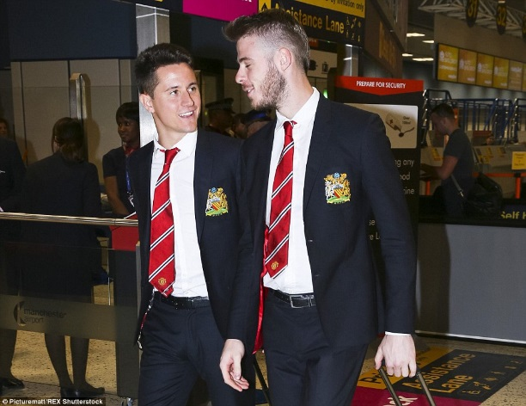
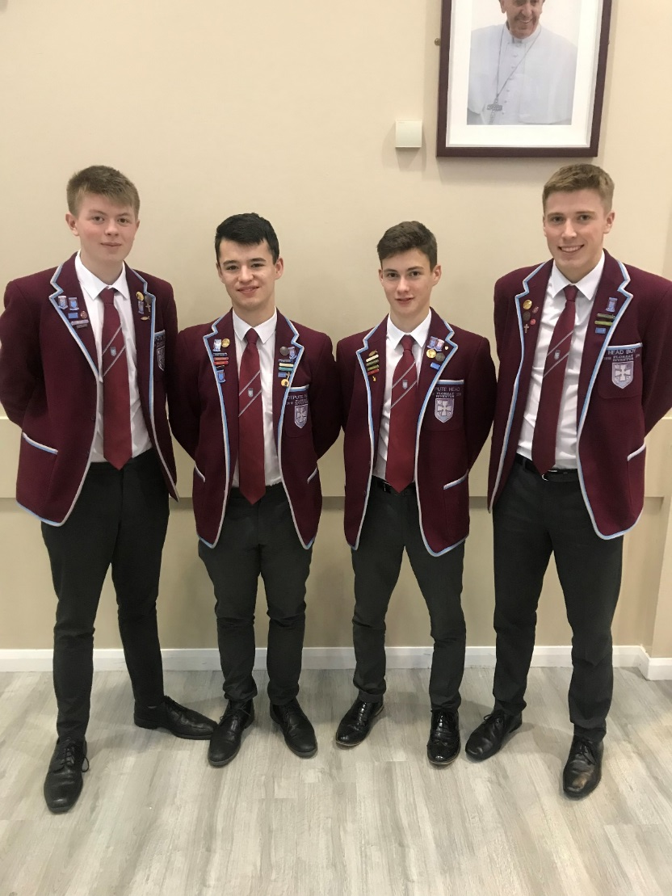
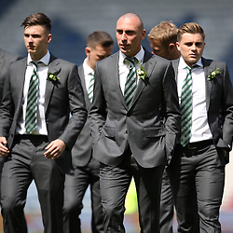
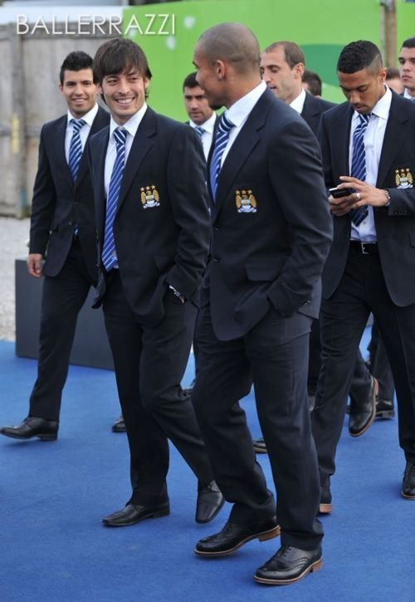
Shirts
People judge books by their covers
Look professional
Ready to do your best
Pride in your appearance
Tuck shirts in!

Slide 18
Footwear
No trainers/boots to be worn in school
School shoes only in school

Slide 19
Dress Code
Sky blue polo shirt
Black shorts/tracksuit trousers/sports leggings
Training shoes which have built in support (not fashion shoes)
Absolutely no football or designer tops, shorts or tracksuit trousers.
Jewellery should NOT be worn in Physical Education.

Slide 20
Mobiles
No use of mobile phones for calls in the school building
Mobile phones should be switched off between P1-P2, P3-P4, P5-P6/7
No mobile phones between classes
Phones will be confiscated if these rules are not obeyed

Slide 21
Belongings
You must ensure your personal belongings are safe
Lost property including P.E. Kit is your responsibility to locate
Your name must be on your personal property
Clothing (including Blazers, ties, P.E. kit etc)
Bags
Equipment for class (including jotters, pencil cases etc

Slide 22
Corridor Movement
Keep to the left
Keep walking
Don’t stop and prevent flow of movement
Don’t ‘bunch’ together
Don’t block corridors or doorways
Serious accidents could happen
No mobile phones used or they will be confiscated

Slide 23
Settling Down To Work
Always be on time to class
Be well behaved, respectful and courteous
Settle down into work of class
Do as the teacher tells you
The teacher decides when you can answer out and engage in discussions
Don’t waste a single minute!

Slide 24
Presentation of Work
Always have a heading
Always have a date
Underline
Use a ruler
Make sure your writing is legible for others
You can’t get marks if the teacher can’t read it

Slide 25
Be Organised
Keep pencil case full
Make sure you have correct jotters
Have your work organised in folder
Polypockets / dividers
Check your homework diary every night
Always complete your homework

Slide 26
Homework and Studying
Studying is additional to homework tasks
Important in advance of tests
Every minute counts!

Slide 27
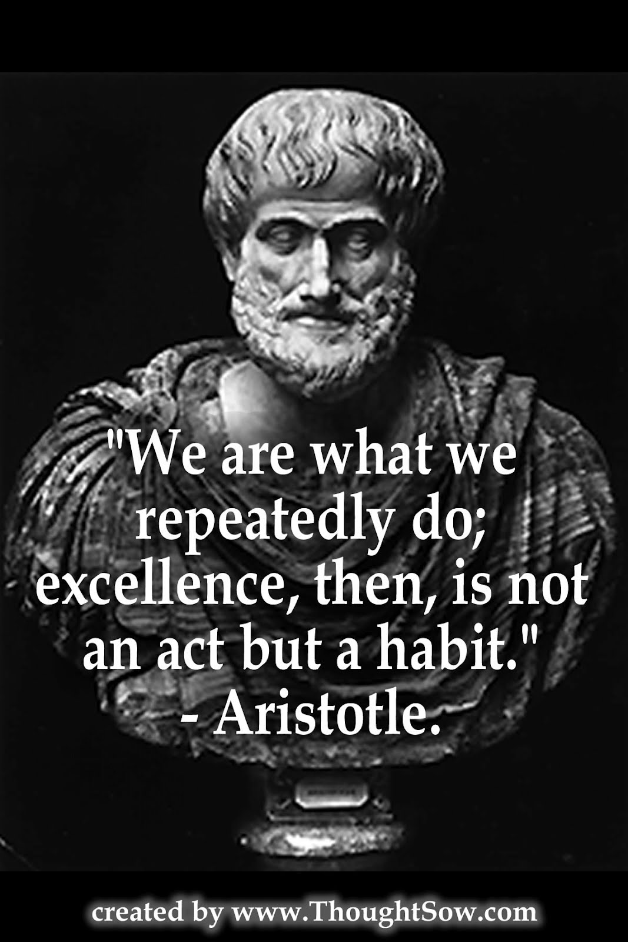
Focus of the Week

Slide 28
Our Health and Wellbeing

Slide 29
iDEA is a programme that helps you develop digital, enterprise and employability skills for free.
Through a series of online challenges and events, you can gain industry recognised awards that help you stand out from the crowd.
What’s the Big iDEA?
Innovation
Digital Technology
Enterprise
Employability
Thursday Lunchtime
ICT 8
S1-S3 welcome

Slide 33
Monday @ 3:30 – 4:45
Badminton Club
Sports Hall with Miss Miller

Slide 34
Monday S1-S3 @ 3:30- 4:30
Basketball Club
Games Hall with Mr Ford

Slide 35
Tuesday S4-S6 @ 3:30- 4:30
Basketball Club
Sports Hall with Mr Ford

Slide 36
Thursday @ 3:30- 4:30
Cheerleading Club
Small Gym with Miss Lanigan

Slide 37
Senior
Tuesday @ 3:30 – 4:30
Dance Club
Gym with Mrs Burns

Slide 38
S1-3
Wednesday @ 2:45 – 3:45
Dance Club
Gym with Mrs Burns

Slide 39
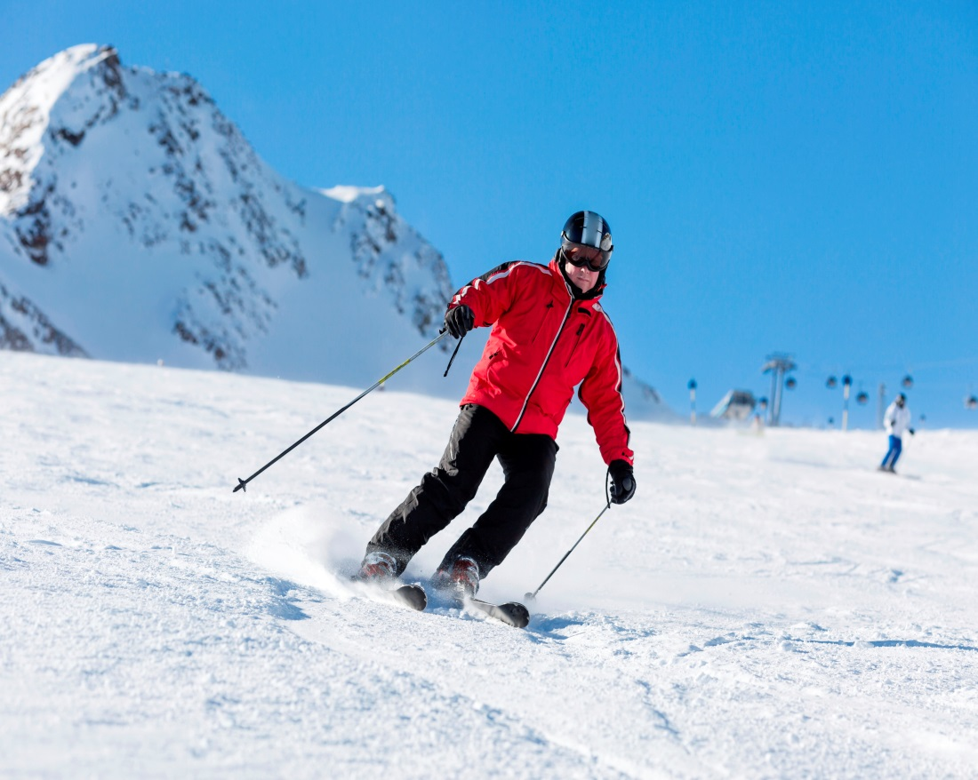
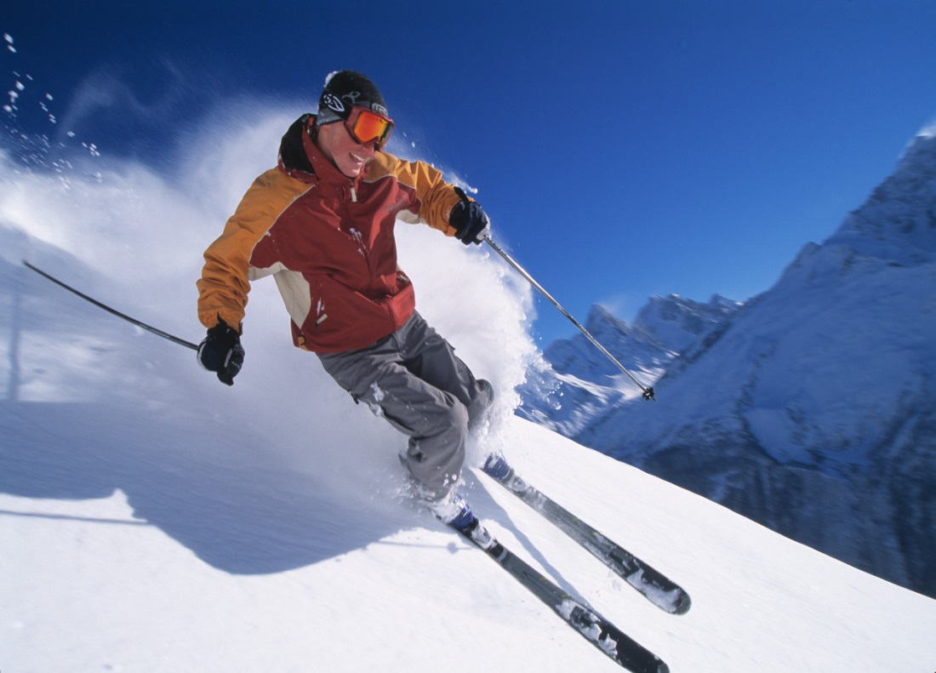
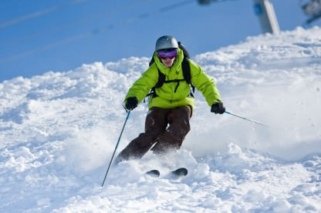
Wednesday after school
Skiing
Xscape with Mr Eaglesham

Slide 40
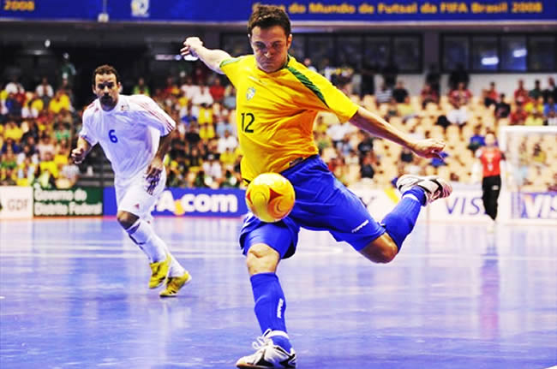
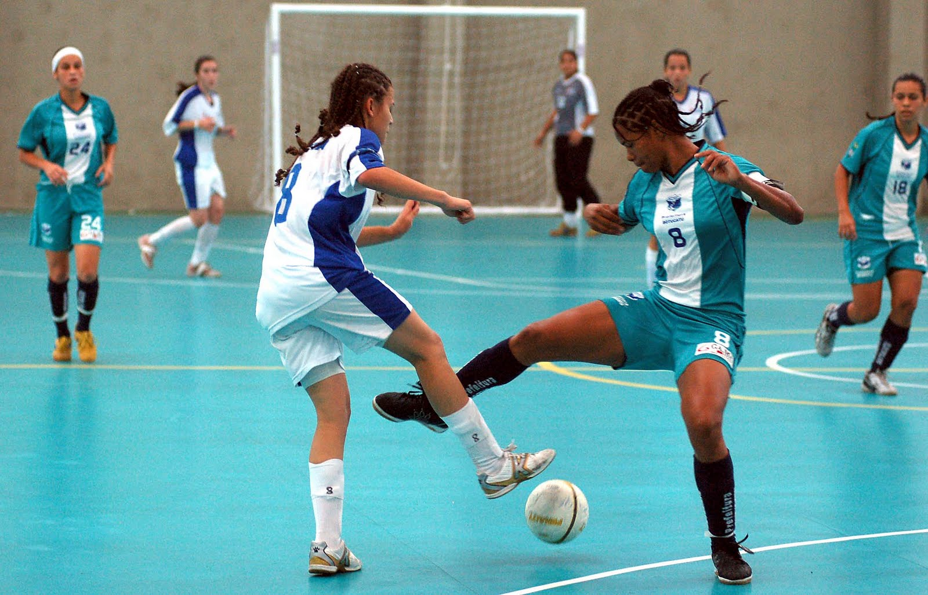
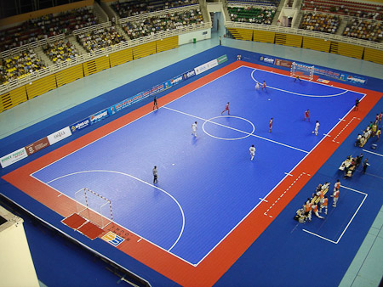
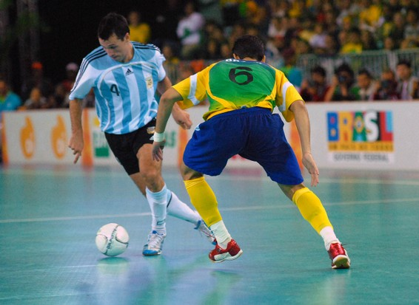
S3
Thursdays @ 12:20 – 12:50
Futsal
Games hall with Mr Lough
Lunch Club

Slide 41
S1-2
Monday @ 12:20 – 12:50
Futsal
Games hall with Mr Ford
Lunch Club

Slide 42
Monday @ 3:30- 4:30
Gymnastics Club
Small Gym with Mrs Burns

Slide 43
Tuesday @ 3:30- 4:30
Hockey Club
Outside with Mr Lough

Slide 44
S1-2
Wednesday @ 2:40 – 4:00
Netball Team
Games Hall with Miss Briggs

Slide 45
S3
Thursday @ 3:30 – 4:45
Netball Team
Games Hall with Miss Miller

Slide 46
Senior
Thursday @ 3:30 – 4:45
Netball Team
Sports Hall with Miss Briggs + Miss Lanigan

Slide 47
Lunch time
@ 12:20 – 12:50
Netball Club
Sports Hall with Miss Briggs

Slide 48
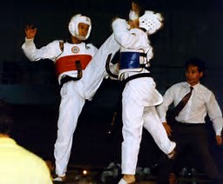
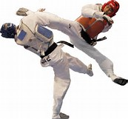
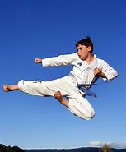
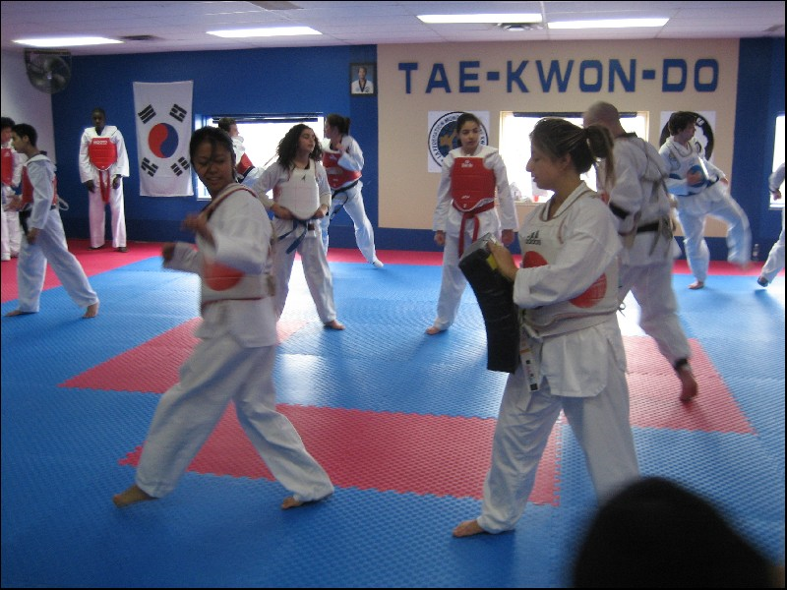
Wednesday @ 3:30- 4:30
Taekwondo
Gym with Mr Paterson

Slide 49
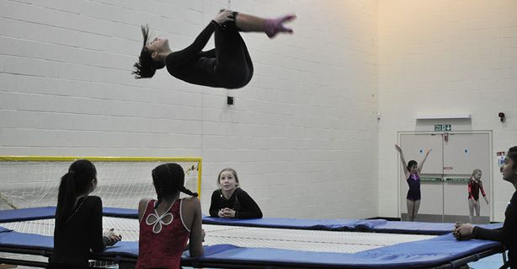
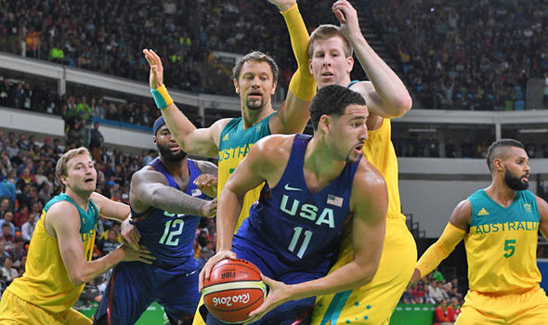
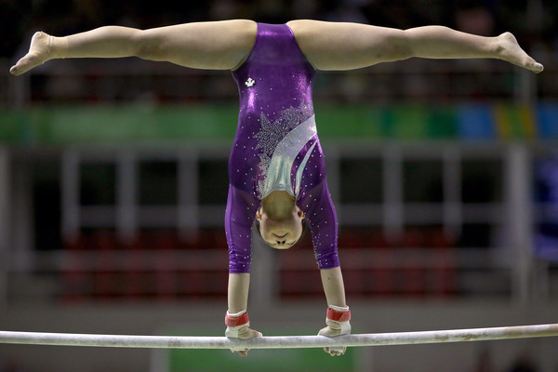
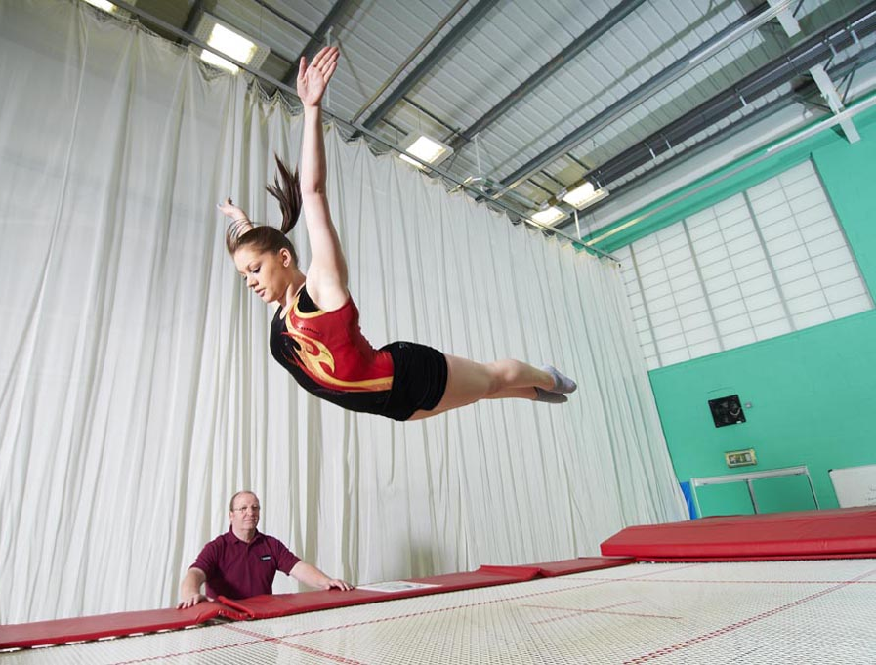
Friday Club
Multi-Sports
2:45 – 4:00

Slide 50
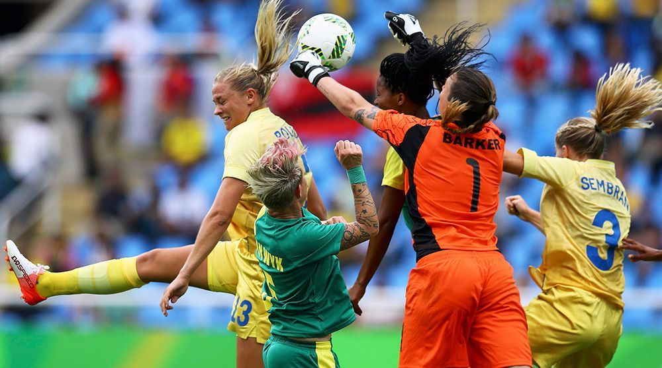
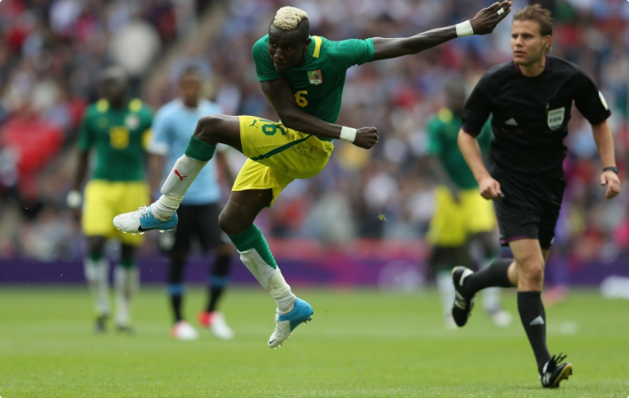
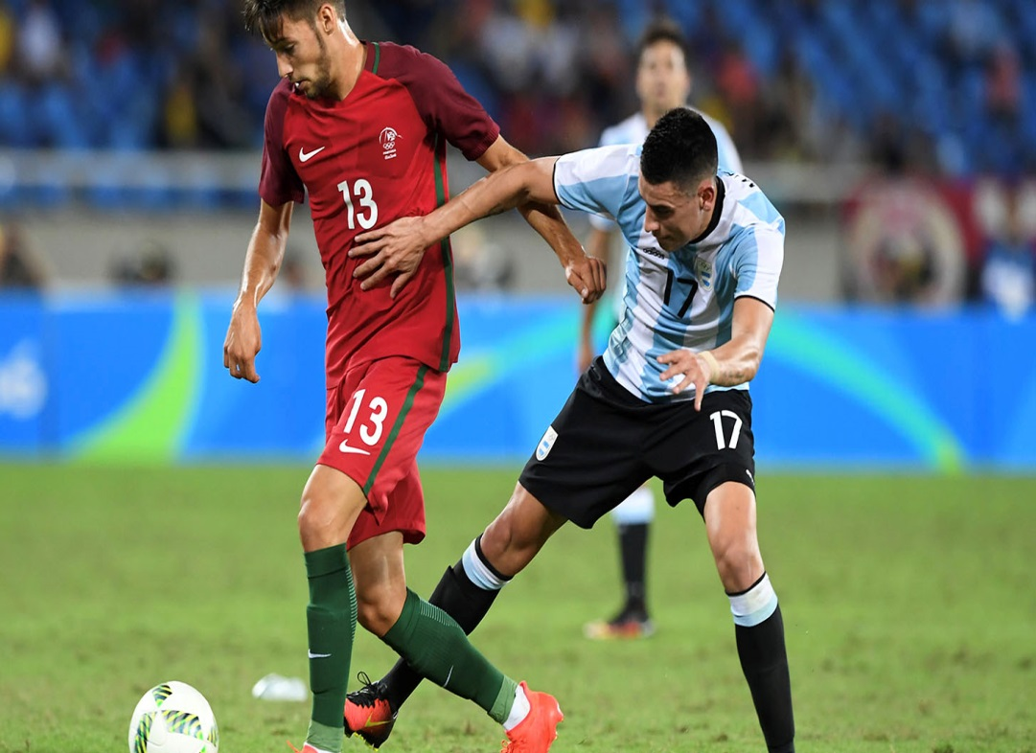
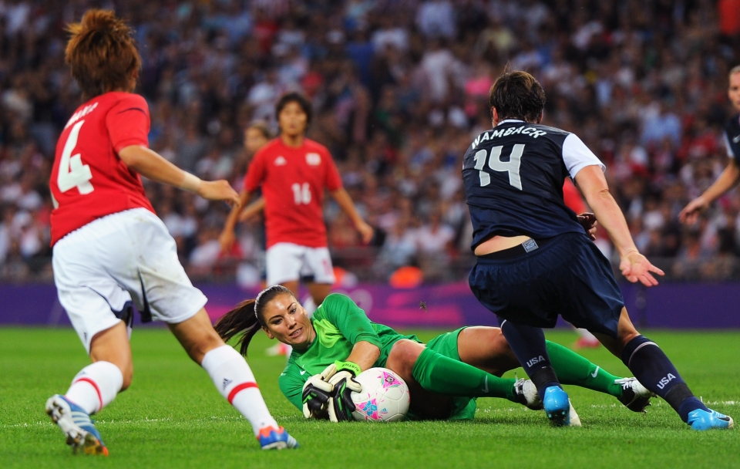
12:20 – 12:50
Football Pitch
Everyday @ Lunch

Slide 51
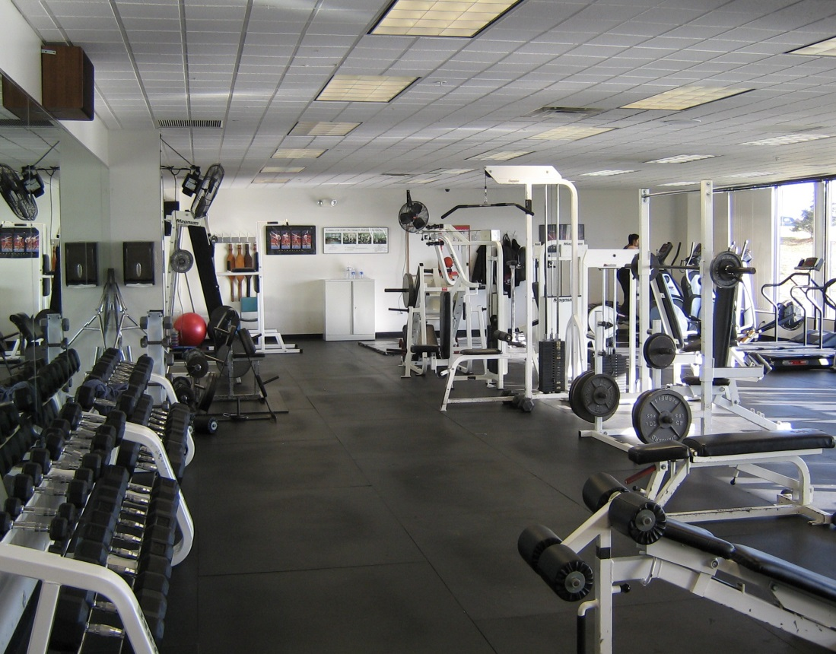
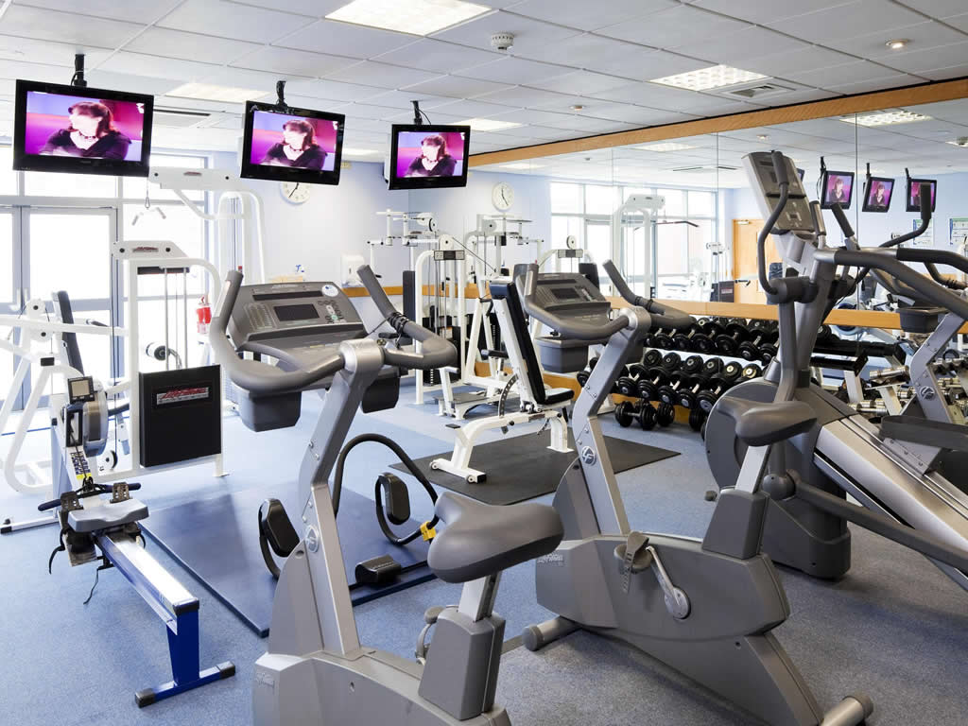
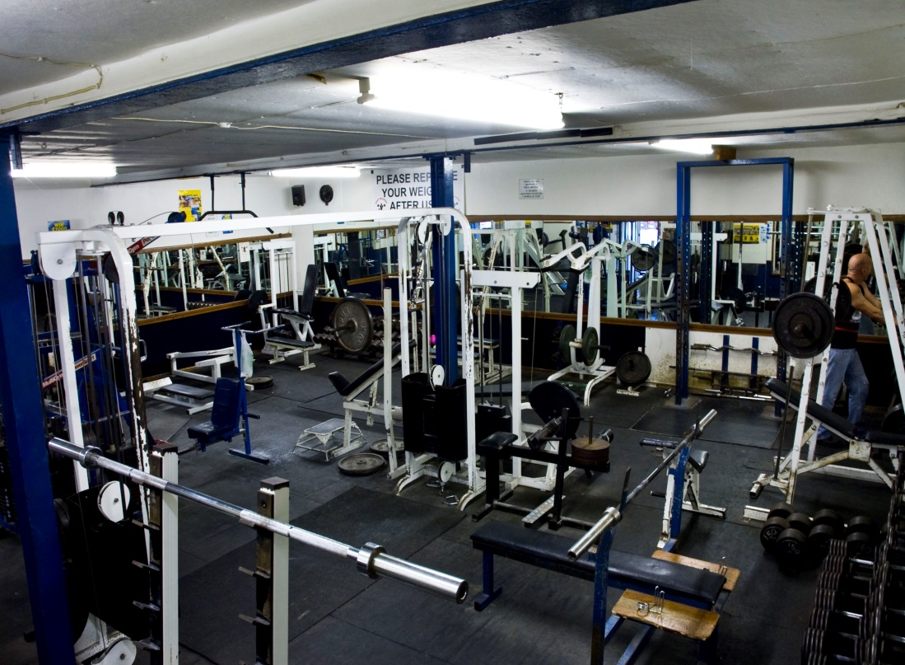
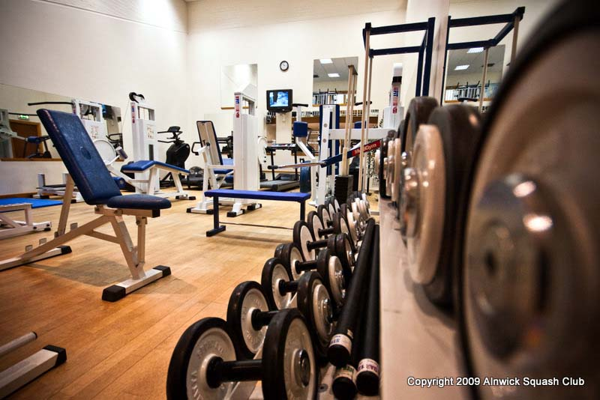
12:20 – 12:50
Fitness Suite
Everyday @ Lunch

Slide 52
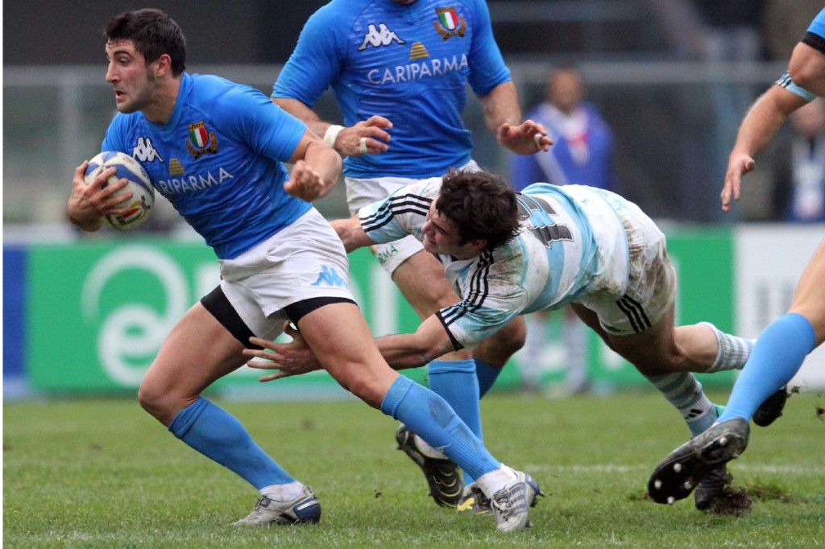
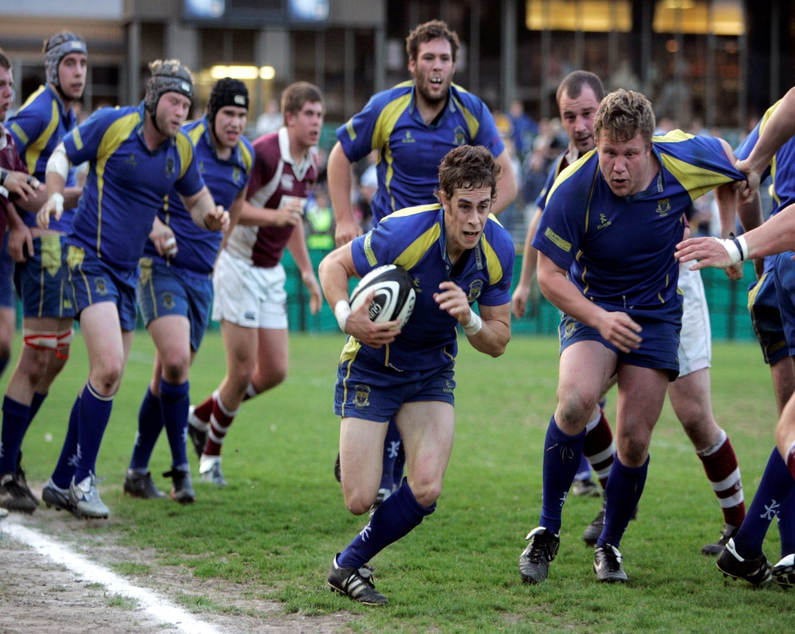
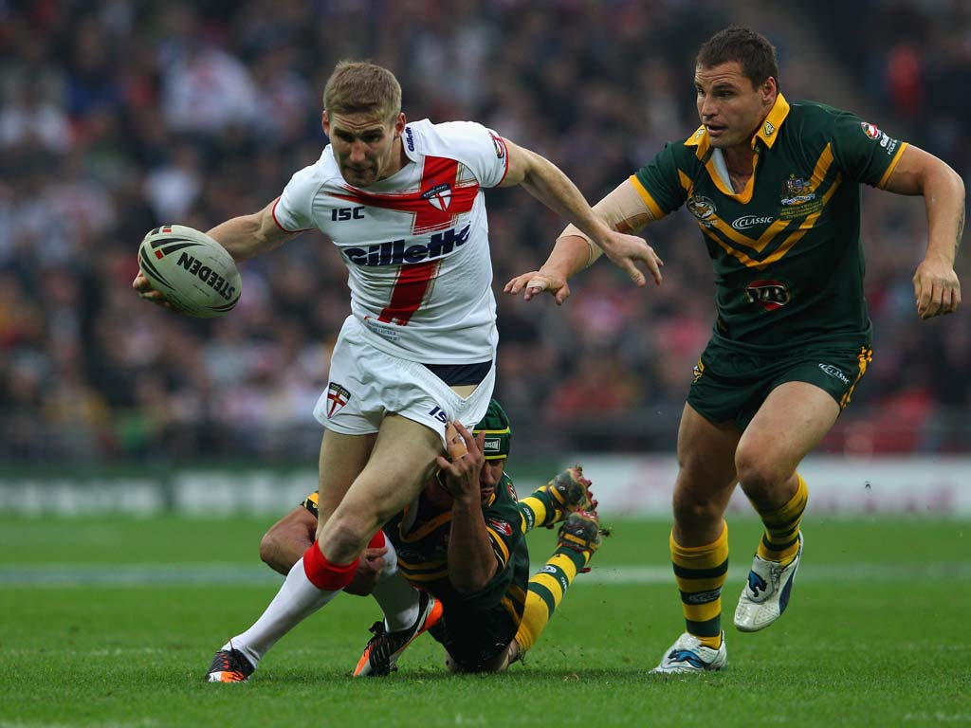
@ 2:45 – 3:45
Rugby Club
Outside with Mr Low

Slide 53
Tuesday @ 3:30- 4:30
Volleyball Club
Games Hall with Mr Cheshire

Slide 54
Tuesday @ 4pm-5pm
Tennis Club
Giffnock Tennis Club
with Kerry Comerford

Slide 55
Wednesday Lunch Time
Squash Club
Giffnock Tennis Club
with Kerry Comerford

Slide 56
Our Successes and Achievements

Slide 57
Key Dates 2019
Inaugural Family Mass – 7pm on Thursday 29 August 2019
S1/S2 Disco – 7pm on Thursday 5 September 2019
Vocations Mass – Tuesday 10 September 2019
S2 Sponsorship Event – Thursday 19 September 2019
Interim Reports Issued – Friday 20 September 2019
Ski Trip Information Evening – 6pm on Thursday 7 November 2019
S2 Information Evening – 6pm on Thursday 14 November 2019
Music from the Movies – 7pm on Thursday 14 November 2019
Christmas Market – 6pm on Friday 29 November 2019
S2 Ceilidh – Thursday 12 December 2019
Christmas Carol Service and Concert – Thursday 19 December 2019

Slide 58
Key Dates 2020
S2 Ski Trip – Saturday 11 January to Saturday 18 January 2020
Valencia Information Evening – 7pm on Tuesday 4 January 2020
Careers Evening – Thursday 27 February 2020
Life Group Afternoon Tea for Life – Saturday 21 March 2020
Dance and Gymnastics Show – Wednesday 25 March 2020
Fashion Show – 6pm on Thursday 26 March 2020
Life Lenten Service – 7pm on Thursday 26 March 2020
Spring Concert – 7pm on Thursday 2 April 2020
Ardeche Information Evening – 7pm on Thursday 14 May 2020
Full Reports Issued – Friday 15 May 2020
S2 Parents’ Evening – Thursday 11 June 2020
Ardeche Trip – Thursday 18 June to Friday 26 June 2020

Slide 59
Who can I ask for help?
ME
Pastoral
Support
Teacher
Youth
Counsellor
Rainbows
Campus
Cop
Careers
Officer
Attendance
Officer
School
Chaplain
School
Nurse
Class
Teacher
Year
Group Head

Slide 60
Hail Mary
Hail Mary full of Grace, the Lord is with thee. Blessed are thou among women and blessed is the fruit of thy womb Jesus.
Holy Mary Mother of God, pray for us sinners now and at the hour of our death
Amen.

