Slide 1
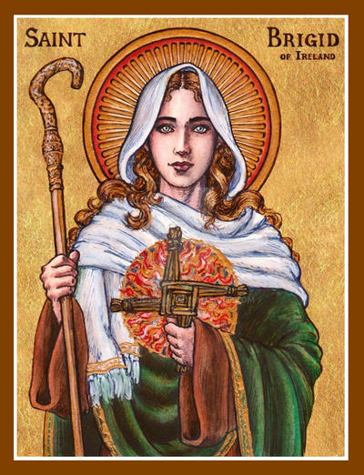
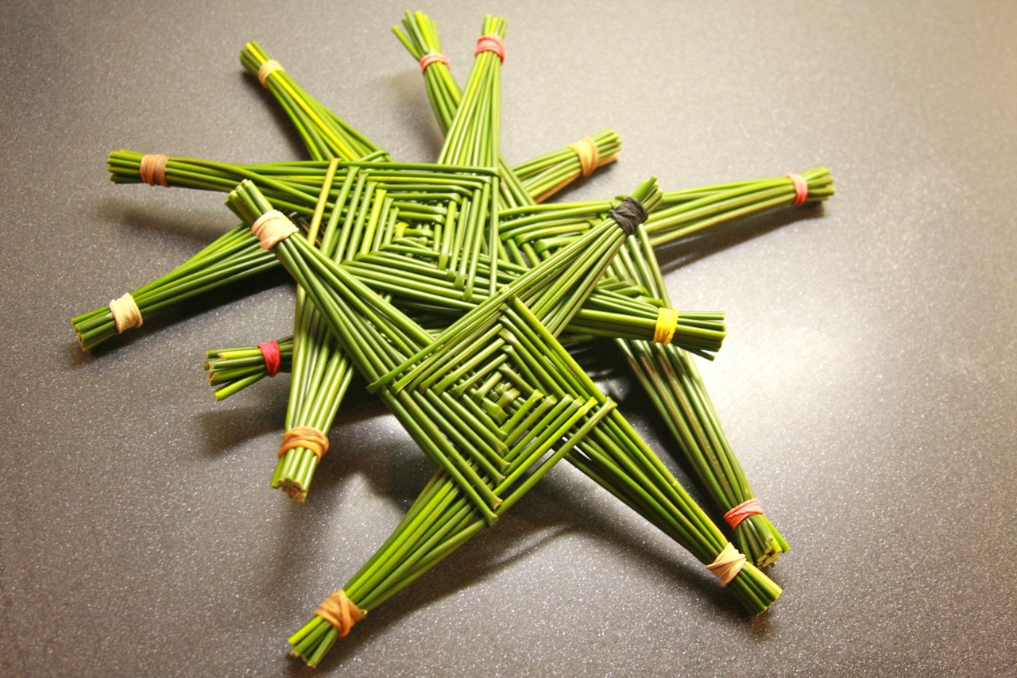
St Brigid of Ireland
Celebrate St. Brigid’s feast day- Lá Fhéile Bríde
Bring your lunch and learn how to make a St Brigid’s cross
Tuesday 1st February in RE 4.

