Slide 1
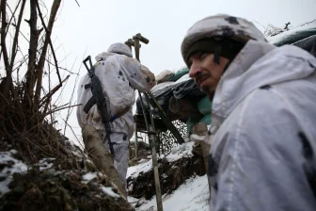
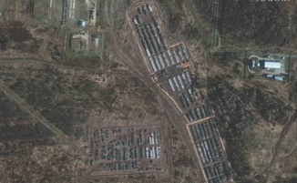
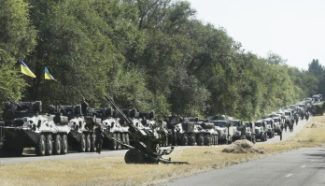
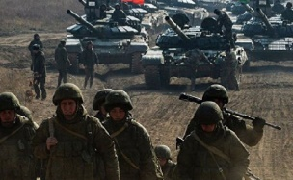
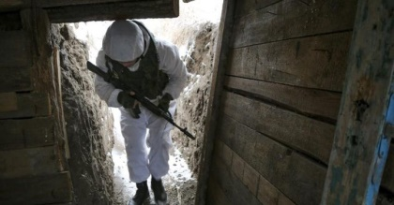
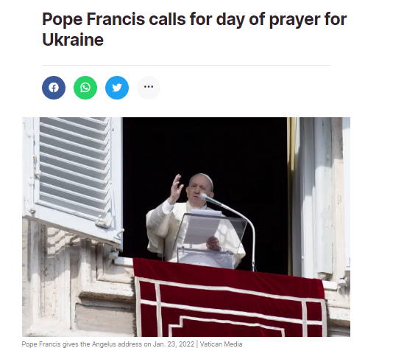
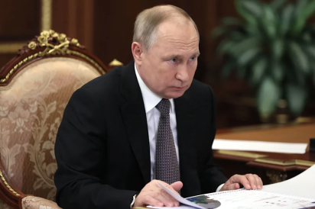
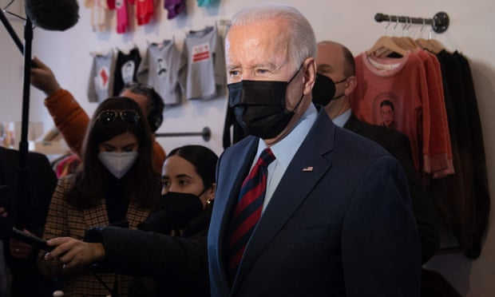
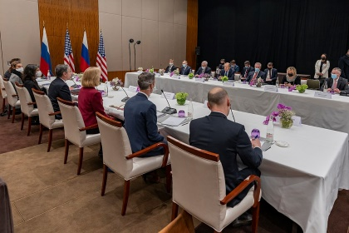
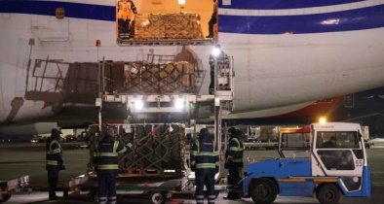
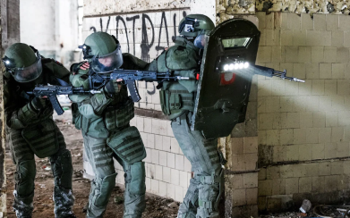
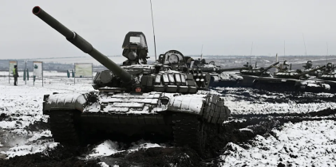
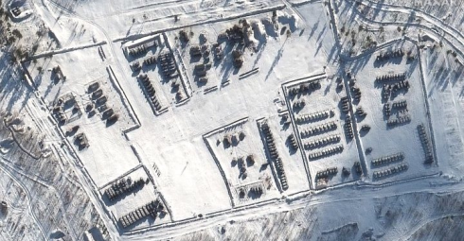
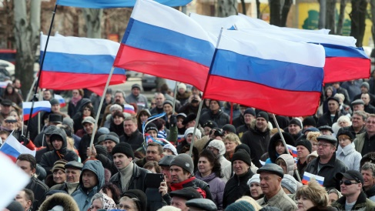
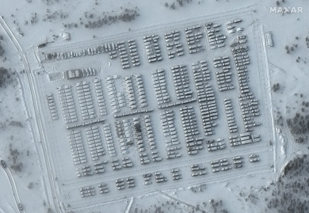
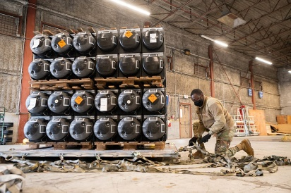
Wednesday 26th January 2022: A World Day of Prayer For Ukraine

Slide 2
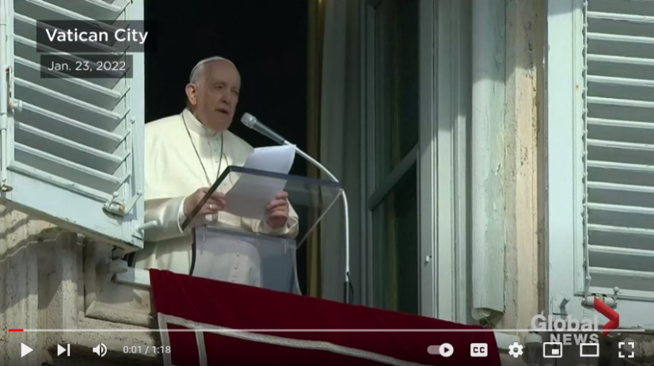
https://www.youtube.com/watch?v=h2ptmqhucDk
Pope Francis on Sunday called for 26thJanuary to be a day of prayer for peace in Ukraine, as the threat rises of a Russian invasion into the Eastern European country.
“I am following with concern the increase of tensions that threaten to inflict a new blow to the peace in Ukraine, and call into question the security of the European continent, with wider repercussions,” the Pope said after his weekly Angelus address..
“I make a heartfelt appeal to all people of good will, that they may raise prayers to God Almighty, that every political action and initiative may serve human brotherhood, rather than partisan interests,” he stated.
“Those who pursue their own interests, to the detriment of others, disregard their human vocation, as we were all created as brothers and sisters,” Pope Francis said. “For this reason, and with concern, given the current tensions, I propose that next Wednesday, 26th January, be a day of prayer for peace.”
– Pope Francis on Sunday 23/01/2022

Slide 3
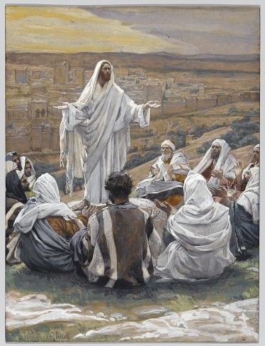
During this troubling time, we can gather strength from the wisdom of the Holy Bible:
“It is an honour for a man to separate himself from quarrels: but all fools are meddling with reproaches.”
– Proverbs 20:3
“Blessed are they that hunger and thirst after justice: for they shall have their fill.”
– Matthew 5:6
“Blessed are the peacemakers: for they shall be called the children of God.”
– Matthew 5:9
Let us now say an Our Father, to the end that His Holiness has directed:
Our Father who art in heaven, hallowed be thy name. Thy kingdom come. Thy will be done on Earth as it is in heaven. Give us this day our daily bread; And forgive us our trespasses, as we forgive those who trespass against us; And lead us not into temptation but deliver us from evil; for thine is the kingdom, the power and the glory, forever and ever. Amen.

