Slide 1
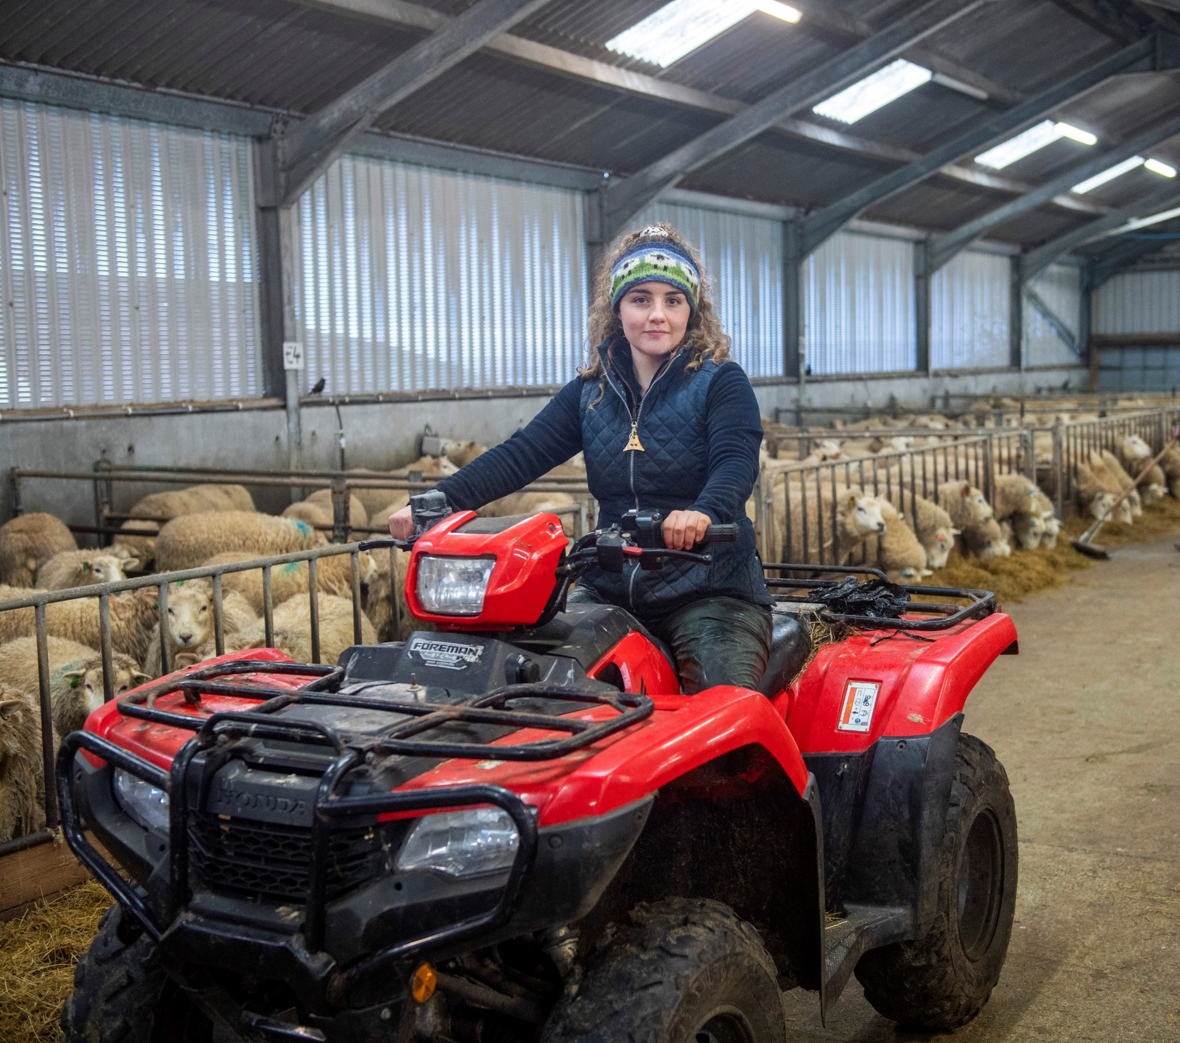

Slide 2
Notes:
Today, you can find apprenticeships in more industry sectors than ever before. They are based on the skills employers want so they're always relevant.
There are currently over 40,000 people doing an apprenticeship in Scotland.

Slide 3
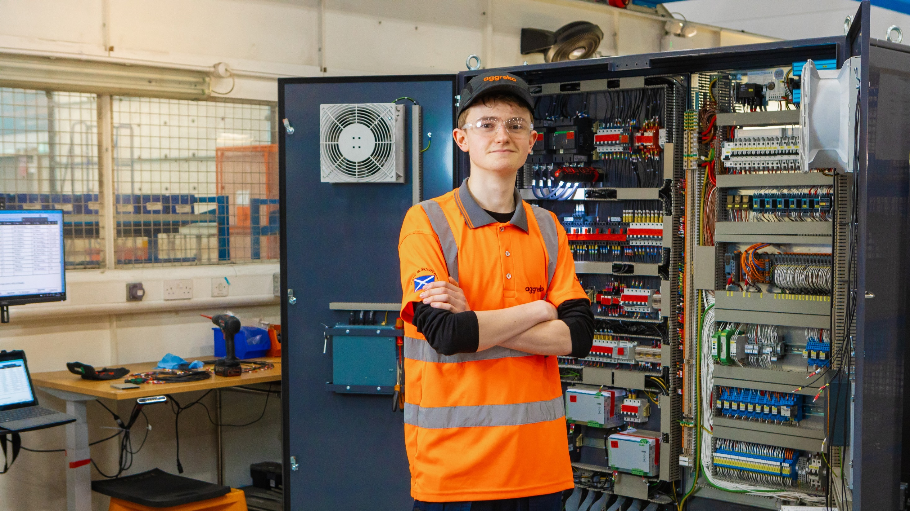
Notes:
If you're keen to get stuck into real industry experience a Foundation Apprenticeship could be the right move for you. You’ll be able to gain work experience alongside your studies. It can really boost your confidence and get you excited about your future career.

Slide 4
You will:
develop industry knowledge and experience
do industry projects and placements
take part virtually or in person
You will get:
a qualification at SCQF Level 6 (same level as a Higher)
Notes:
Pupils can take a Foundation Apprenticeship in S5 or S6 and Foundation Apprenticeships are now offered in all 32 Scottish local authorities.
There is also a pilot programme of Foundation Apprenticeships at SCQF Level 4 and 5 offering opportunities for pupils from S3 to S6 in selected schools the opportunity to gain a work-based learning qualification at an earlier level of learning.

Slide 5
A Foundation Apprenticeship:
takes up to two years
usually starts in S5
is a subject choice
lets you spend time with a learning provider and an employer
Notes:
Delivered in partnership by learning providers and employers, knowledge gained is supported through a series of practical activities including industry project-based activity and work placements undertaken virtually and in person.

Slide 6
Accountancy
Business Skills
Civil Engineering
Creative and Digital Media
Engineering
Financial Services
Food and Drink Technologies
Hardware and System Support
Scientific Technologies
Social Services Children and Young People
Social Services and Healthcare
Software Development
Notes:
There are 12 types of Foundation Apprenticeship to choose from in a wide range of subjects and sectors.
There are also pilot SCQF level 4 and 5 Foundation Apprenticeships for pupils in S3 to S6. They focus on the Construction, Automotive and Hospitality sectors.
Some of Scotland’s biggest and best employers are involved in the work part of Foundation Apprenticeships. Many excellent local employers also offer great opportunities.

Slide 7
When you do a Foundation Apprenticeship, you can:
get knowledge, skills and experience
gain an industry-recognised qualification
move on to a Modern or Graduate Apprenticeship
enhance your CV and job applications
get a qualification recognised by colleges and universities
build confidence and develop key skills: creativity, problem-solving and communication
Notes:
The Foundation Apprenticeship will help you in many ways. Here are the main benefits that apprentices receive.

Slide 8
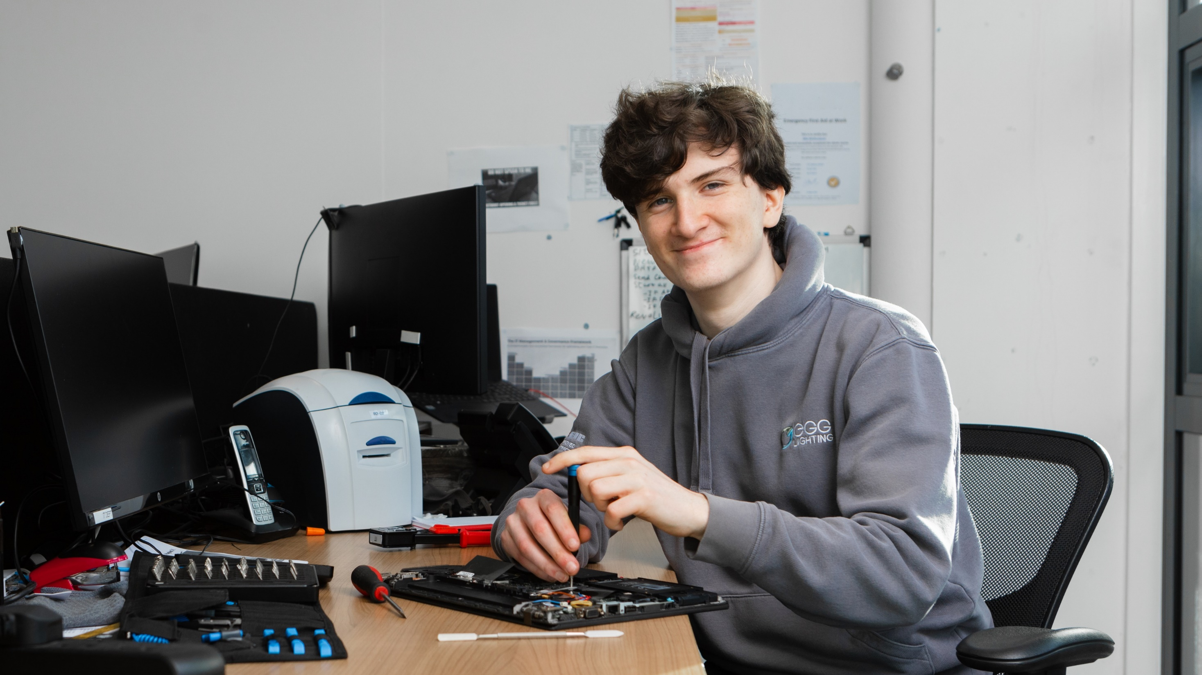
Notes:
Modern Apprentices learn on the job – gaining skills, experience and qualifications to kick-start your career.
You’ll learn real-life industry skills while you work towards a qualification that’s accredited by the SQA.
As long as you’re aged 16 or over, a Modern Apprenticeship could be the right fit for you.

Slide 9
Get a real job with a real employer – many of Scotland’s biggest and best businesses are involved
Notes:
Around 12,000 companies offer Modern Apprenticeships, including many of Scotland’s top employers.
All sizes from large national companies, small to medium-sized companies and family firms across Scotland offer apprenticeships.
Modern Apprenticeships can be for new or existing employees.

Slide 10
Earn while you learn
Notes:
Modern Apprenticeships are jobs with structured training – so you’ll be earning while you learn.
There is a national minimum wage for apprentices – but many employers pay above this. Salaries range from about £8,000 to £20,000 per year depending on the job.

Slide 11
A Modern Apprenticeship:
gives hands-on experience with a real employer
is open to you if you’re 16 or over
offers an SQA qualification
Notes:
Modern Apprenticeships are designed with industry – so the skills apprentices learn are the ones that employers want.
Anyone aged 16 or over can become a Modern Apprentice. From day one you’ll:
have a real job, with a real employer, that earns you real pay
gain skills and hands-on experience that employers value
work towards an industry-recognised qualification.
Modern Apprenticeships are mapped to the Scottish Credit and Qualifications Framework, from levels 5 – 12 which includes technical and professional level MA qualifications.
The different qualification levels mean you can train at the standard that’s the best fit for you and your job.

Slide 12
Notes:
There is a massive range of apprenticeships available, such as Construction, Design, Engineering, Sport, Healthcare, Marketing and much more.
As long as you’re aged 16 or over, a Modern Apprenticeship could be the right fit for you.
Different apprenticeships take different lengths of time to complete – some can take up to four years.

Slide 13
When you do a Modern Apprenticeship, you will:
get training that is designed for industry and employers
choose from over 100 Modern Apprenticeships
learn in a real-world environment
earn a wage
gain experience that helps with your CV and job applications
get your career moving
Notes:
We survey apprentices and these are the main reasons they say why they started their apprenticeships:
91% of apprentices are still in employment six months after completing their Modern Apprenticeship
96% of employers say former apprentices are better equipped to do their jobs

Slide 14
A Modern Apprenticeship opens up opportunities to:
progress your career
start a Graduate Apprenticeship
complete further learning
Notes:
Completing a Modern Apprenticeship opens up a world of opportunities – you can:
progress your career with your current employer or within the sector
get a head start on a Graduate Apprenticeship, reducing the time it takes to complete it
do further learning at university or college

Slide 15
Notes:
A new way for individuals to gain qualifications through work.
Graduate Apprenticeships are jobs open to anyone over 16 who wants to work, learn and earn up to Master’s degree level.

Slide 16
Graduate Apprenticeships are a way to:
gain qualifications up to Master’s degree level
work and earn a wage
spend time during your working week with a leading university or college
Notes:
Graduate Apprenticeships have not only been designed to benefit industry, they have been designed with apprentices’ development in mind.
Graduate Apprenticeships allow people to fulfil their career aspirations, to learn from real-life work experience and obtain a sense of achievement.
Through their Graduate Apprenticeship, apprentices will:
achieve a nationally recognised, accredited and certificated higher education degree
gain transferable skills that are required by employers and industry
combine their knowledge and skills into competent practice
Graduate Apprenticeship courses are developed through ongoing consultation with employers, universities, professional bodies and qualification authorities in the form of technical expert groups.

Slide 17
Achieve a nationally recognised degree, gain transferable skills that employers need and earn a wage
Notes:
Graduate Apprentices are paid employees, spending most of their time learning on the job while being supported by a structured university programme working towards a degree qualification.

Slide 18
You will be in paid employment while gaining qualifications
Apprentices are employees – you spend most of your time with the employer
Open to new and existing employees
Notes:
As a Graduate Apprentice, you will be in paid employment while gaining qualifications.
Apprentices are actual employees - you spend around 80% of your time with the employer. The rest of the time is spent with a university or college, as agreed in a personalised learning plan.
The integration of work and learning counts towards the qualification, meaning that attendance at university can be
flexible, based on the employer’s requirements.
Completion time of the qualification can take up to 5 years depending on the level of qualification.

Slide 19
Accounting
Business Management
Civil Engineering
Construction and the Built Environment
Cyber Security
Data Science
Early Learning and Childcare
Engineering: Design and Manufacture
Engineering: Instrumentation, Measurement and Control
IT: Management for Business
IT: Software Development
Notes:
Some of Scotland’s most innovative and exciting employers offer Graduate Apprenticeship jobs. Right now, there are 13 different types on offer – all in growing sectors with great career prospects [subjects shown on screen – full breakdown of SCQF levels available below]:
Accounting - SCQF level 10/11
Business Management (Including Financial Services) - SCQF level 10
Civil Engineering - SCQF level 10
Construction & the Built Environment - SCQF level 10
Cyber Security - SCQF level 10
Cyber Security - SCQF level 11
Data Science - SCQF level 10
Early Learning & Childcare - SCQF level 9
Engineering: Design & Manufacture - SCQF level 10
Engineering: Instrumentation, Measurement & Control - SCQF level 10
IT: Management for Business - SCQF level 10
IT: Software Development - SCQF level 10

Slide 20
When you do a Graduate Apprenticeship, you will:
get qualified – up to Master’s degree level
gain skills
earn a wage
learn skills that matter to employers
focus on growth industries
Notes:
There are many benefits to taking on a Graduate Apprentice :
Get qualified - work towards DipHE, Honours and Masters professional qualifications
Gain skills - develop transferable, recognised skills that are considered relevant by industry, employers and universities
Get earning - be in paid employment while gaining a degree and, as learning is funded, there is no cost to the apprentice and you avoid student debt
Industry designed – so you can be confident that what you learn is relevant, and right for your role
Focused on growth industries - available in a wide range of growth industries that offer strong career prospects for the future

Slide 21
When you complete your Graduate Apprenticeship you could:
progress to other levels of the GA
continue further university or college learning
do further on-the-job training
Notes:
Pathways from taking a Graduate Apprentice are dependent on the level of completion and include:
Progress on to other levels of the Graduate Apprenticeship
Further university or college learning
Further ‘on-the-job’ training
Opening up more career opportunities with the existing employer or in their chosen sector

Slide 22
Find out more: Visit the Apprenticeships.scot website Follow Apprenticeships.scot on Facebook, Instagram and Twitter
Speak to your SDS Careers Adviser
Notes:
(Signpost to CIAG and Scottish Apprenticeship stands, if relevant)

