Slide 1
Grant Thornton School Leaver Apprenticeship
Notes:
Emma

Slide 2
.
Who we are – School Leaver Liaison Team
Commercial Audit – RGU Route:
Emma Harkness, Audit Associate, 4th year school leaver
Email: Emma.Harkness@uk.gt.com
Christina Guo, Audit Associate, 3rd year school leaver
Email: Christina.Guo@uk.gt.com
Alana Moody, Audit Associate, 2nd year school leaver
Email: Alana.Moody@uk.gt.com
Commercial Audit – AAT Route:
Kieran Hand, Audit Associate, 2nd year school leaver
Email: Kieran.J.Hand@uk.gt.com
Zsombor Kormos, Audit Associate, 1st year school leaver
Email: Zsombor.Kormos@uk.gt.com
Public Sector Audit – AAT Route:
Lewis Gunn, Audit Associate, 1st year school leaver
Email: Lewis.f.gunn@uk.gt.com
Vanessa Unmosa, Audit Associate, 1st year school leaver
Email: vanessa.omoregie.unmosa@uk.gt.com

Slide 3
GT Introduction
Grant Thornton is one of the world's largest professional services networks of independent accounting and consulting member firms which provide assurance, tax and advisory services to privately held businesses, public interest entities, and public sector entities.
CEO – Dave Dunkley
We have 26 offices in the UK just now with over 4,600 employees. In Scotland, our offices are in: Glasgow, Edinburgh and Aberdeen. We also operate in over 130 countries employing over 62,000 people globally.

Slide 4
What do we do?
Tax
Ensuring companies are compliant with tax law
Advisory
Provide advice to clients on how to improve operations, reorganising the way they work, considering their potential with mergers and acquisitions
Audit
Examine company annual accounts and issue assurance reports to ensure that they have accounted for everything correctly and all transactions are appropriate business transactions.
Audits provide shareholders, the public and regulators with confidence in the accuracy of a corporation’s financial reporting.
Providing tax structuring advice to help businesses grow
Corporate & international tax
Indirect Tax
Capital allowances
Real Estate tax
Tax dispute solution
Tax risk management
Grant Thornton is made up of more than 40 separate service lines which are split between large and complex areas and the Dealing and Business Consulting.
Business Risk Services
Forensic Investigation Services
Public Service advisory
People Advisory
Restructuring

Slide 5
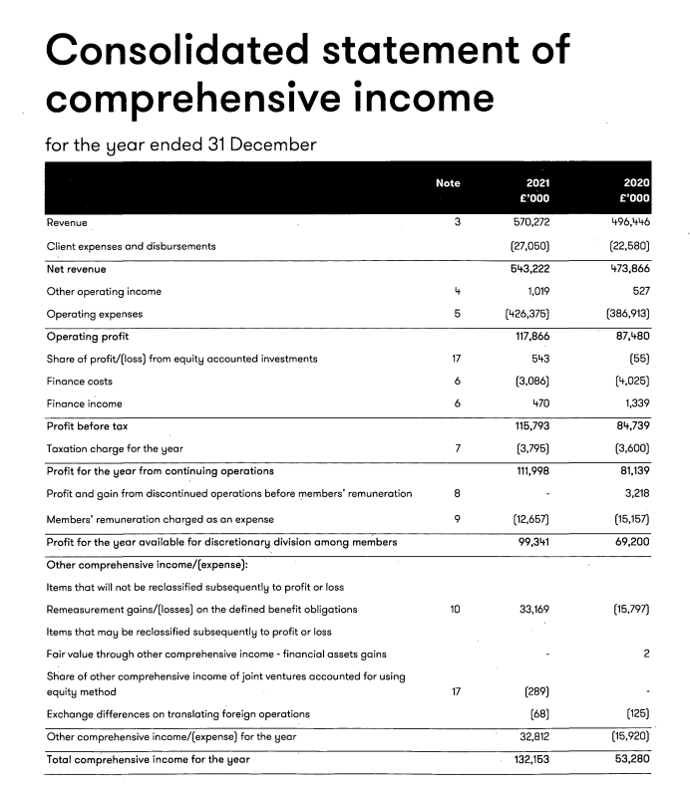
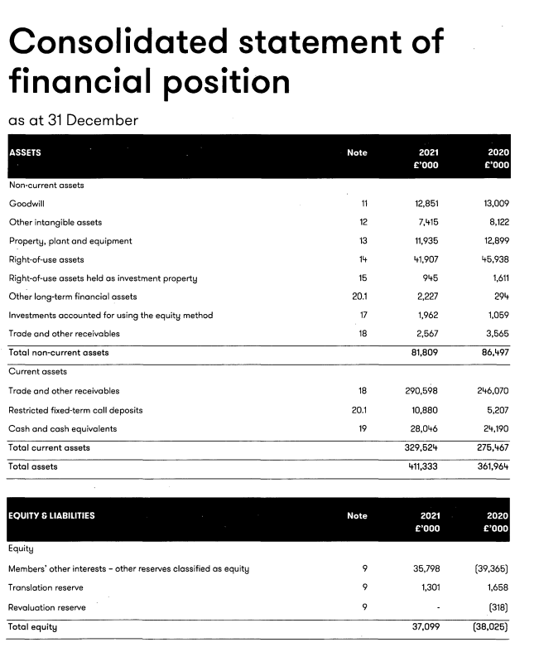

Slide 6
Accountancy – what does this involve with Grant Thornton? A typical day is hard to describe, as there isn't one! But let's look at audit for example, Tasks could include:
interaction with senior clients
performing testing procedures
discussing significant issues with the client
Stock Takes
explanation of key business trends to others
Travelling

Slide 7
School leaver – Graduate Apprenticeships
If university’s not for you, why not begin working towards a professional qualification right away? Through a graduate apprenticeship
What you’ll do
Five years of studying and working at the same time. You will be learning and gaining real-work experience.
Gain cutting-edge skills and knowledge working on a variety of exciting projects and clients.
Interact with senior business figures early in your career and meet/work with people you wouldn't usually meet.
Work at our client sites, helping to provide the insight, advice and expertise they need to grow.
University
College
Apprenticeships

Slide 8
School Leaver Recruitment
Our growth in school leaver recruitment
2011 – 19 school leavers
2017 – 70 school leavers
2019 – 80 school leavers
2021 - over 90 school leavers
2022 - 188 school leavers
Grant Thornton UK LLP has been named in the top 10 of the Department for Education’s Top 100 Apprenticeship Employers 2022.
Grant Thornton ranks 10th in the list and is one of only two accounting firms to be included in the top 10. As a firm we are currently training almost 1,000 apprentices through a combination of its early careers programme, recruiting a mix of both graduates and those joining straight from school, and those studying further on in their careers.

Slide 9
Grant Thornton
What we have to offer
A competitive salary based on market rates and the cost of living.
Time off for classes and exams (exam costs covered by GT).
A flexible benefits package, which could include pension, buying holidays, private medical cover, subsidised gym membership, and season ticket travel discount.
A focus on wellbeing e.g. flexible bank holidays, birthday off etc.
An employee recognition scheme where we celebrate the great things our colleagues do. This means people award shout-outs, vouchers and special treats for those who go the extra mile.

Slide 10
Isn’t all just audit work…
Can join teams:
Sustainability: Fundraise and raise awareness for our selected charity partner
Social committee: Organise social events
People team: Being a representative for your year group and attending meetings to speak about issues/share news
School Liaison: Promote and help recruit more school leavers
Social events:
End of month drinks
GT Boat Cruise
Christmas event
CSR Day

Slide 11
Two available school leaver routes
Typical School leaver route:
Precursor Qualification to ICAS CA Qualification
Unique New route:
University Degree+ ICAS CA Qualification
(Not guaranteed but please do express your interest to Grant Thornton, if this is the route you would like to take)

Slide 12
School leaver programme: broken down
Year 1: AAT Level 3 Advanced Diploma in Accounting
Year 2: AAT Level 4 Professional Diploma in Accounting
Year 3: First year of ICAS – TC exams
Year 4: TPS ICAS exams
Year 5: TPE ICAS exams
Two years of AAT and 3 years of ICAS learning. You will become CA Qualified at the end

Slide 13
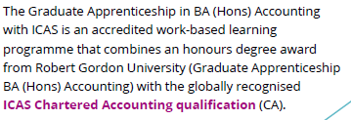
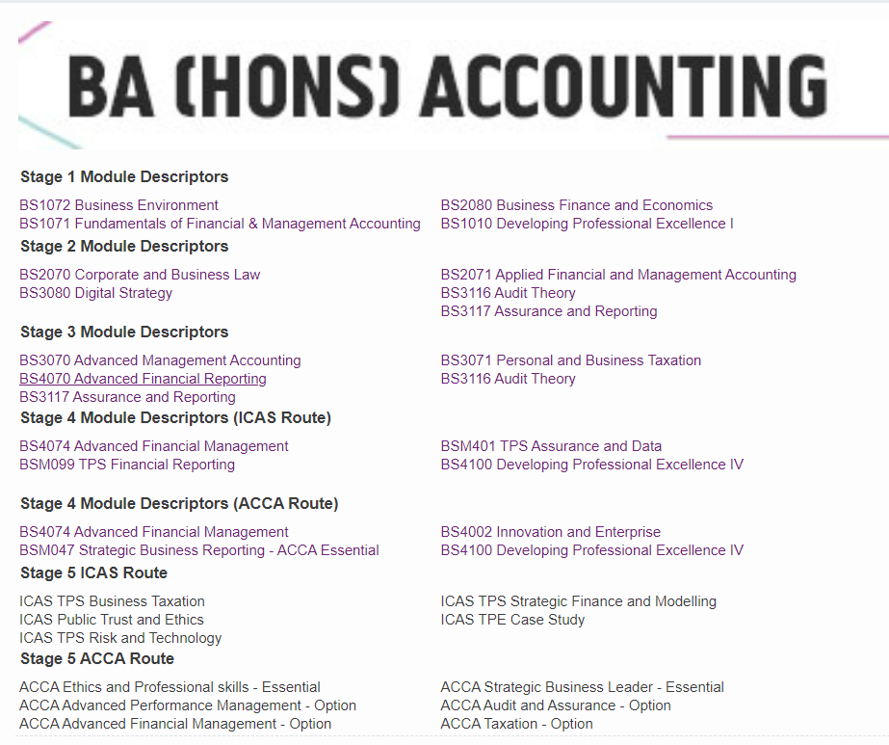
Graduate Apprenticeship in BA (Hons) Accounting
4 years of University + ICAS learning begins in 4th year
1 year of ICAS (No more university) and become CA Qualified at the end

Slide 14
At the end of both routes you will become CA Qualified
The title ‘chartered accountant’ (CA, ACA or FCA)
Minimum of three years in-depth training
Passed a series of rigorous exams in financial management, auditing, business strategy and taxation
Committed to continuing professional development to keep their skills up to date.
Chartered Accountants command higher salaries throughout their careers:
Starting salaries for accountants vary depending on the location, sector, size and type of firm.
From £35,000 to £80,000.
The average annual salary of an ICAEW Chartered Accountant in business is £134,000
The average global member salary across all sectors is £108,000

Slide 15
Career Progression after qualifying
Professionally qualified (CA), opportunities
Continue to progress in your team or a different area of our business (such as tax, advisory and more) with a secondment or permanent move.
Work on a project with one of our global member firms, or even transfer to another branch.
Leave Grant Thornton and work in other fields.
Grant Thornton cares about our employees and their progression in their professional careers. Will offer internal opportunities or allow you to re-join after you have left. [Don’t need to stay in audit forever!]

Slide 16
Work Experience – Access Accountancy
The Access Accountancy programme is in line with Grant Thornton’s purpose and is part of our commitment to achieving social mobility across the UK. The aim of the programme is to give students a taste of what it’s like to work within a global professional services firm, as well as developing them both personally and professionally. Whether they are looking for a fast track onto our school leaver apprenticeship programme or to build their CV ahead of university, this is a great opportunity for them to enhance their experience.
The first day will involve a welcome and skills sessions ran by an external party. The second day will involve a Tax session and a talk from our Tax partners. The third day will be all things Audit, and there will also be a session on the AAT qualification, Thursday will be a presentation that they will have prepared throughout the week, and advisory sessions. There will also be sessions on sustainability Inclusion and diversity and personal branding
Requirements
Attend a state school or college
Are (or have been) eligible for free school meals
OR would be the first member of their immediate family to attend university.
Tuesday 10th October to Wednesday 11th October

Slide 17
Pizza Night
On the 21st September 2023 we are hosting a pizza night.
Come visit our office at Glasgow queen street.
During this we provide:
-Pizza and drinks
-Information about Grant Thornton
-Networking opportunity

Slide 18
Other Options
Even if you don’t decide to join as a school leaver, there are other opportunities available later down the line including:
Internships (3rd year of university)
12 Month Placement (Take a one year break from University and work full time for a year in Grant Thornton)
Graduate Route (3 year training contract after 4 year at university where you work full time while also studying towards getting your CA Title with ICAS)
By doing it this way, it will take minimum 7 years to qualify (4 years at university and 3 year of ICAS)
Whereas, if you join as a school leaver it will take 5 years for either routes and at the time you are making money while learning and gaining experience from working.

Slide 19
School Leaver Route

Slide 21
Our Programmes:
Summer internships
Graduates
Apprenticeships
12 Month Placements

Slide 22
The Grant Thornton Trainee Experience

Slide 23
CV Preparation
Always tailor your CV
Stick to one font and size
Keep concise
No longer that two A4 sheets
Include LinkedIn URL
Ask someone to proofread
Include school work experience

Slide 24
Before your interview…
Most importantly… know your strengths.
When preparing for your interview, have a think about four or five examples that you might want to use that really show you at your best. Here are some standard topics to think about:
Working in a team
Dealing with large amounts of data
Dealing with a complex situation
Problem solving
Relationship building
How you might tackle challenging work
Things to avoid….
Don’t use examples from the experience day itself, have pre-prepared examples that you know well and can use for different questions.
You can draw examples from every aspect of your life, not just work experience. Think about a project you’ve completed in class, a hobby or sport, it could even be day-to-day tasks so how you approach exams or course work.

Slide 25
During your interview…
Pause to think about your answer – take a second before answering a question to show you are putting some thought into your answer
Answer the question being asked – this doesn’t only go for interviews, but also application forms. If you don’t answer the question, the interviewer won’t have enough evidence to be able to evaluate you against the competency or strength
Ask questions - This shows the interviewer that you are someone who was engaged and can think on their feet. Remember, the interview is not just about the interviewers getting to know you, but it’s also an opportunity for you to get to know the company, and make sure it’s the right place for the first steps in your career

Slide 26
CLEARR Values
You should share our CLEARR values. Always striving to grow yourself, you should be driven to succeed with the ability to see tasks through to the end and remain agile, even when things don’t go to plan. Relate these values back to your interview answers!

Slide 27
STARE Technique
Situation
Action
Result
Task
Evaluate

Slide 28
Don’t worry!
We don’t expect you to have much experience

Slide 29
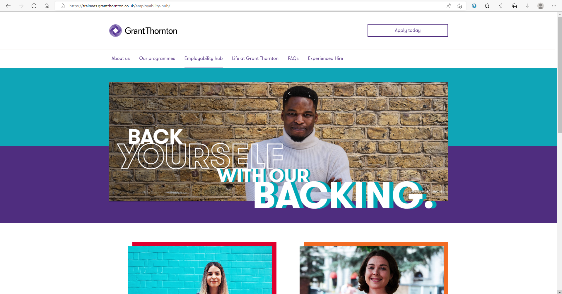
GT Employability Hub

