Slide 1
ANGLO-EASTERN (UK) Ltd Cadets

Slide 2
What we do?
AEUK manage UK Cadets on behalf of four clients, both deep-sea and offshore.
We manage all aspects of the UK Cadet program from initial selection and recruitment of the cadets, vessel placement, travel, documentation etc.
We liaise with the UK Colleges to ensure cadets are actively engaged in training and regularly review their progress.
Utilize government funding incentives and manage them on behalf of the Cadet Client.
We deal with all day-to-day aspects of the Cadet Training Program to ensure the Cadets training runs smoothly.

Slide 3
UK Program
The UK Cadet program is a well-established training program in the UK, that trains hundreds of Cadets a year. Numerous Training Providers and Shipping Companies follow this MNTB/MCA approved training in order to supply their company with well trained and competent Officers.
Cadet’s train in the following disciplines:
Deck – Leading to OOW Unlimited CoC
Engine – Leading to EOOW Unlimited CoC
ETO – Leading to ETO CoC.

Slide 4
Colleges
AEUK use the following colleges in the UK, the cadets complete all academic aspects as well as STCW elements of their training at the selected college:
City of Glasgow College – Glasgow
North Atlantic Fisheries College’s – Lerwick, Shetland
Warsash Maritime School – Southampton
Fleetwood Nautical College – Fleetwood
South Shields Marine School – South Shields

Slide 5
Length of Cadetship
The Length of the Cadetship is dictated by which academic route the Cadet is placed on, at present these are as follows:
Advanced Certificate (HNC) 3 years – Deck/Engine
Advanced Diploma (HND) 3.5years – Deck/Engine/ETO
Foundation Degree 3 years – Deck/Engine/ETO
By completing the above courses this means all academic requirements are met for an OOW CoC.
It is highly beneficial for the Cadet and Company for the Cadet to train at HND or FD level. This allows the cadet to complete all academic elements required for Chief Officer/Master or 2nd/Chief Engineer except for additional MCA exams and STCW courses. By completing at cadet level, it greatly reduces the need for leave when completing the next rank.

Slide 6
Sea / College Time.
The UK Cadet program is split into 5 or 6 phases comprising time at sea and college. A brief outline of how this time is split is detailed below; duration of phases is dependent on the college attended and discipline:
Phase 1 – College – Introduction to relevant academic subjects as well as completing basic STCW courses.
Phase 2 – Sea.
Phase 3 – College - Complete the main academic section of the course and some additional SCTW’s.
Phase 4 – Sea.
Phase 5 – College – Complete MCA written and orals exams and advanced SCTW’s in order to receive CoC.
Phase 6 – College – Additional phase for those sitting the HND.

Slide 7
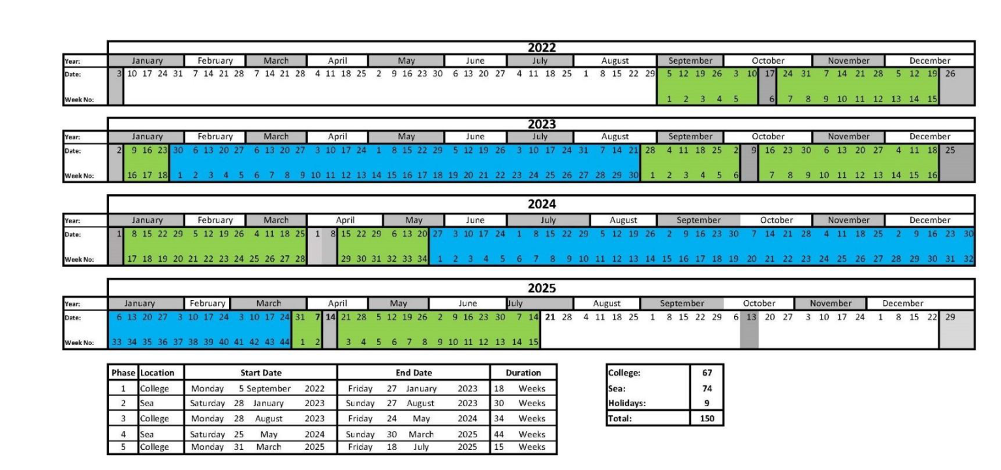
Phase Schematics

Slide 8
Sea Time
During Phases 2 and 4, the Cadets are berthed onboard the Client’s vessels to accrue sea time. They are required to achieve the following amount of sea time across the two phases:
Deck Cadets – 12 months
Engine Cadets – 8 months
ETO Cadets – 8 months.
Whilst onboard the vessel, Cadet’s have a Training Record Book which must be completed. It comprises of many tasks; after the completion of the sea time and completing the training book the Cadet should be ready to take on the role of a Junior Officer. Officer’s and Crew onboard do need to be involved in the cadets training and be prepared to teach and allow them to shadow them as they carry out tasks and eventually allow the cadet to carry out the task whilst they supervise.
Vessels for Cadet Training must be MCA approved, as long as they have a good PSC history then there is normally no issues. Vessels can be of any flag. At least one Deck and Engine officer must hold a UK CeC to sign off the cadets TRB’s. This can be arranged by AEUK on the client's behalf if required.

Slide 9
UK Government Incentives
The UK Government offers incentives to Shipping companies that actively recruit and train British Cadets:
SMarT Funding – For eligible cadets we can claim on behalf of the Shipping Company a monthly amount of money to offset the cost of training. Currently we can claim 150 weeks of funding which over 3 years totals £30,000. In addition to this, on receipt of the cadets CoC a further payment of £5,000 is received and on completion of the HND or FD a further £4,560. The above payments cover around 30% of the cost of training a cadet.
UK Tonnage Tax – A client can put its vessel(s) into the UK Tonnage Tax Scheme regardless of the vessel flag, if the company has a UK based office. The number of vessels entered into the scheme will directly influence how many cadets you must train. If numbers are not met, then the company is liable for PILOT (payment in Lieu of Training).
AEUK can manage and run both these incentives on the client's behalf.

Slide 10
Cadet Costs
Cadet costs vary per client and there several factors that influence the cost for example, what college they study at or where they join/leave vessels. Below are the typical things a Client/Sponsor would cover:
Tuition and course Fee’s.
Cadets are paid a monthly training and accommodation allowance.
Travel costs to/from vessels and College.
Medical’s, vaccinations, visas and documentation costs.
Uniform and PPE.
AEUK’s monthly management fee and one-off recruitment fee.
AEUK Cadet Training Officer travel expenses to visit cadets for pastoral and review meetings (costs split between clients).

Slide 11
COVID-19
COVID-19 has had an impact on Cadet training, but working closely with the Colleges, MNTB and Shipping companies we have put several measures in place to keep training running as smoothly as possible including the below:
Since March 2020 Cadets have been learning online in order to keep the academic phases running and completing on time. With the relaxations on rules across the country Cadets have now been able to go to College for practical aspects of training and STCW courses.
In some cases, we have restructured college phases, cadets have completed phase 1 and 3 back-to-back to relieve the pressure on berth during travel restrictions, this allowed Cadet in later phases to be prioritised for completing sea time.
When we have been unable to place a Cadet onboard their sponsors vessel, we have found alternative sea time to allow Cadets to continue training.
Client COVID procedures are strictly adhered to ensure cadets do not pose a threat to vessel crews.
During this time, we have been unable to visit Cadets in college, we have therefore made use of Teams and Zoom to interact with our Cadets ensuring we communicate with them regularly and checking in to ensure they are coping with the demands of online learning and restrictions caused by COVID.

Slide 12
AEUK Cadet Statistic’s
From January 2015 to present AEUK have recruited 117 Cadets for various clients of which 88.9% of Cadets have completed or are still in active training.
In the previous 5 years 93 CoC’s have been awarded.
In 2019, five AEUK managed Cadets won a total of 6 awards between them from various colleges. Including Marine Engineer of the Year at Warsash Maritime School and the Bells Nautical Trust Prize.
In 2019 one cadet was further supported by AEUK to reach Chief Officer and he hopes to receive his Masters ticket in the coming months. Many others are successfully climbing the ranks in their current companies also.

Slide 13
Thank you.
Any questions, please contact me at fpdcadets@angloeastern.com
Or
0141 353 1020
www.angloeasternoffshore.com
Anglo-Eastern (UK) Ltd.
144 Elliot Street
Glasgow, G3 8EX
United Kingdom

