Slide 1
PRIMARY 2B OPEN AFTERNOON
Miss McHaffie

Slide 2
Our curriculum rationale
What do we want for our children?
How will we work together to achieve this?
Over the last year we have been working on refreshing our curriculum rationale. This has been completed with pupils, parents and staff.
https://sway.office.com/HwqDj1X3c79O4rEU?ref=Link
Notes:
Signpost Curriculum Rationale https://sway.office.com/HwqDj1X3c79O4rEU?ref=Link

Slide 3
Vision, Values and Aims
School Vision
In St Luke’s Cluster we nurture every child’s unique God given talents to enable them to flourish in a climate of high expectations, innovation and creativity.
Values
We value love, faith and understanding.
Aims
To inspire the moral purpose of learning and teaching to; unleash potential, raise attainment, promote equity and transform the life chances of each and every learner, especially those most in need of support.
Notes:
The rationale is underpinned by our cluster vision, values and aims which are (see above).

Slide 5
Relationships, Rigour and Relevance
Our rationale sets out a hopeful, ambitious and equitable vision of improvement for the community of St. Mark’s Primary School. We are moving through a period of recovery from Covid-19 into a period of renewal, with a clear focus on delivering a revised curriculum that is defined by relationships, rigour and relevance.
At St. Marks we believe building strong relationships with our learners helps us to support pupils in developing as individuals. As part of the ongoing focus on Health and Wellbeing, we promote positive relationship strategies in class. (e.g. Recognition Board, Proud Cloud, etc.). Rewarding pupils who demonstrate kindness, thoughtfulness and commitment to their learning through stickers and certificates.
It would be great to hear about your child’s achievements out with school, you can send in evidence of achievements from home through Google classroom so that we can celebrate their successes.

Slide 6
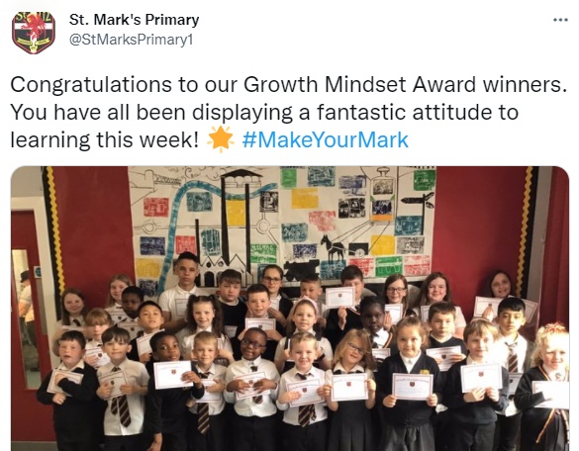
Growth Mindset
Regular lessons about Growth Mindset.
Weekly awards to celebrate growth mindset.
Developing a natural instinct to challenge themselves.
Developing a willingness to have a go.

Slide 7
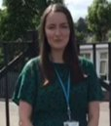
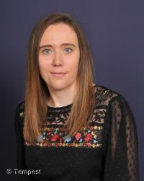
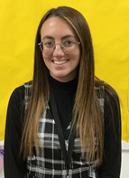
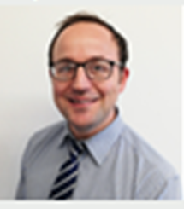
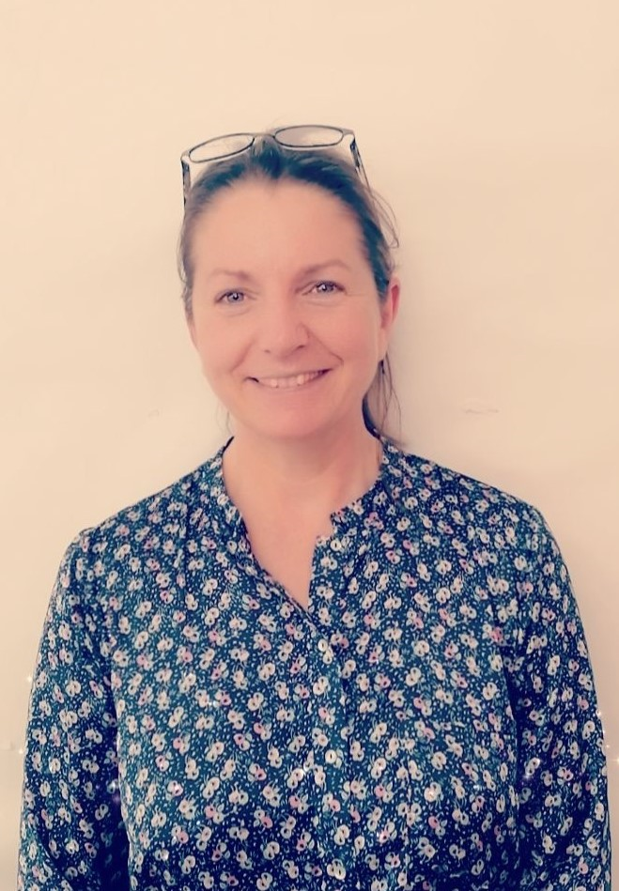
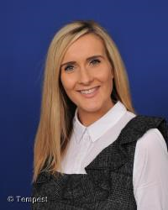
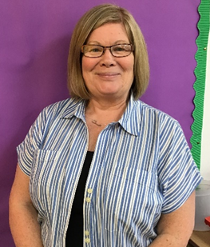
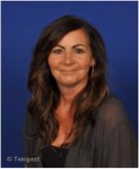
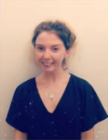
Our Primary 2 Team
Mrs Byrne PT
Miss McKay P2a
Miss McHaffie
Mr Cobain
Mrs McIntyre
Mrs Guy
Mrs Muscat
Mrs Reid
Mrs Deeny

Slide 8
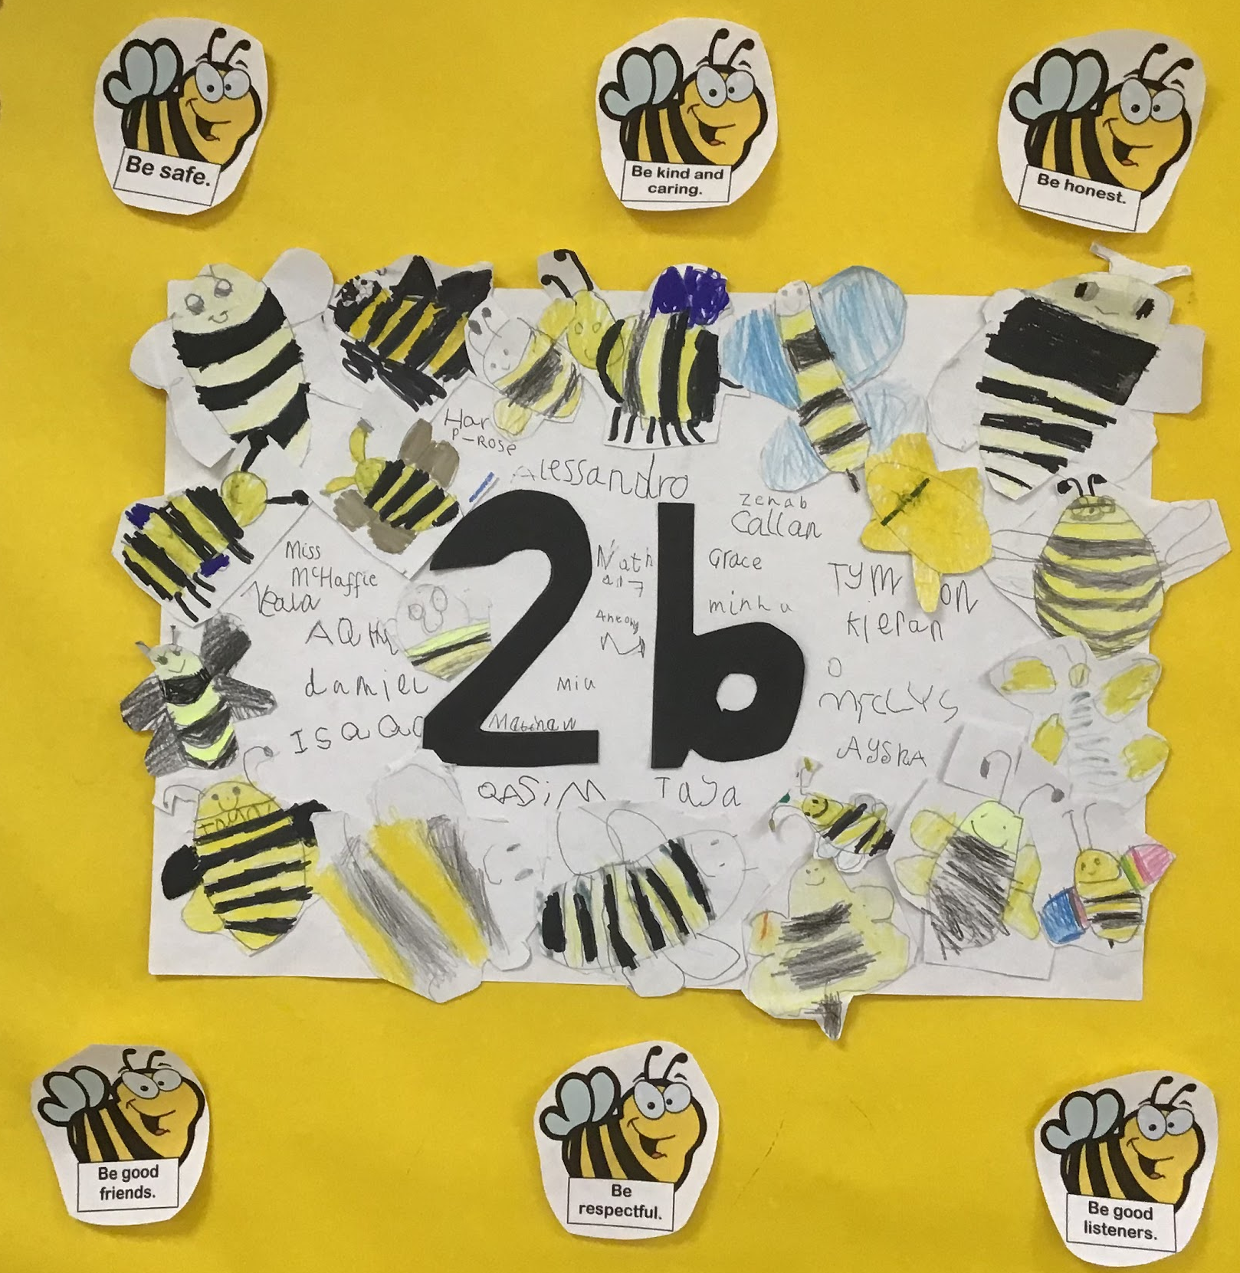
Our Class Charter:
To be helpful.
To be kind.
As a Rights Respecting school, each class sets their own class rules which are displayed as a Class charter.
In the first two weeks of school I have been working with P2b discussing what rules they might like and what rules we might need. These are then displayed in the classroom.

Slide 9
Literacy - practising letter sounds - identifying letters in the everyday In Primary 2, I will be focusing on developing pupils reading skills you can support your child at home by practising these sounds regularly and encouraging your child to complete their homework.

Slide 10
Developmentally primary 2 children are at a stage where pencil grip is important to practise.
Pupils are reminded to hold their pencils with a tripod grip. In school we will continue to practise handwriting and further develop their fine motor skills.
At home, encouraging your child to colour, write, build with small materials and use cutlery will all help to develop their fine motor skills.

Slide 11
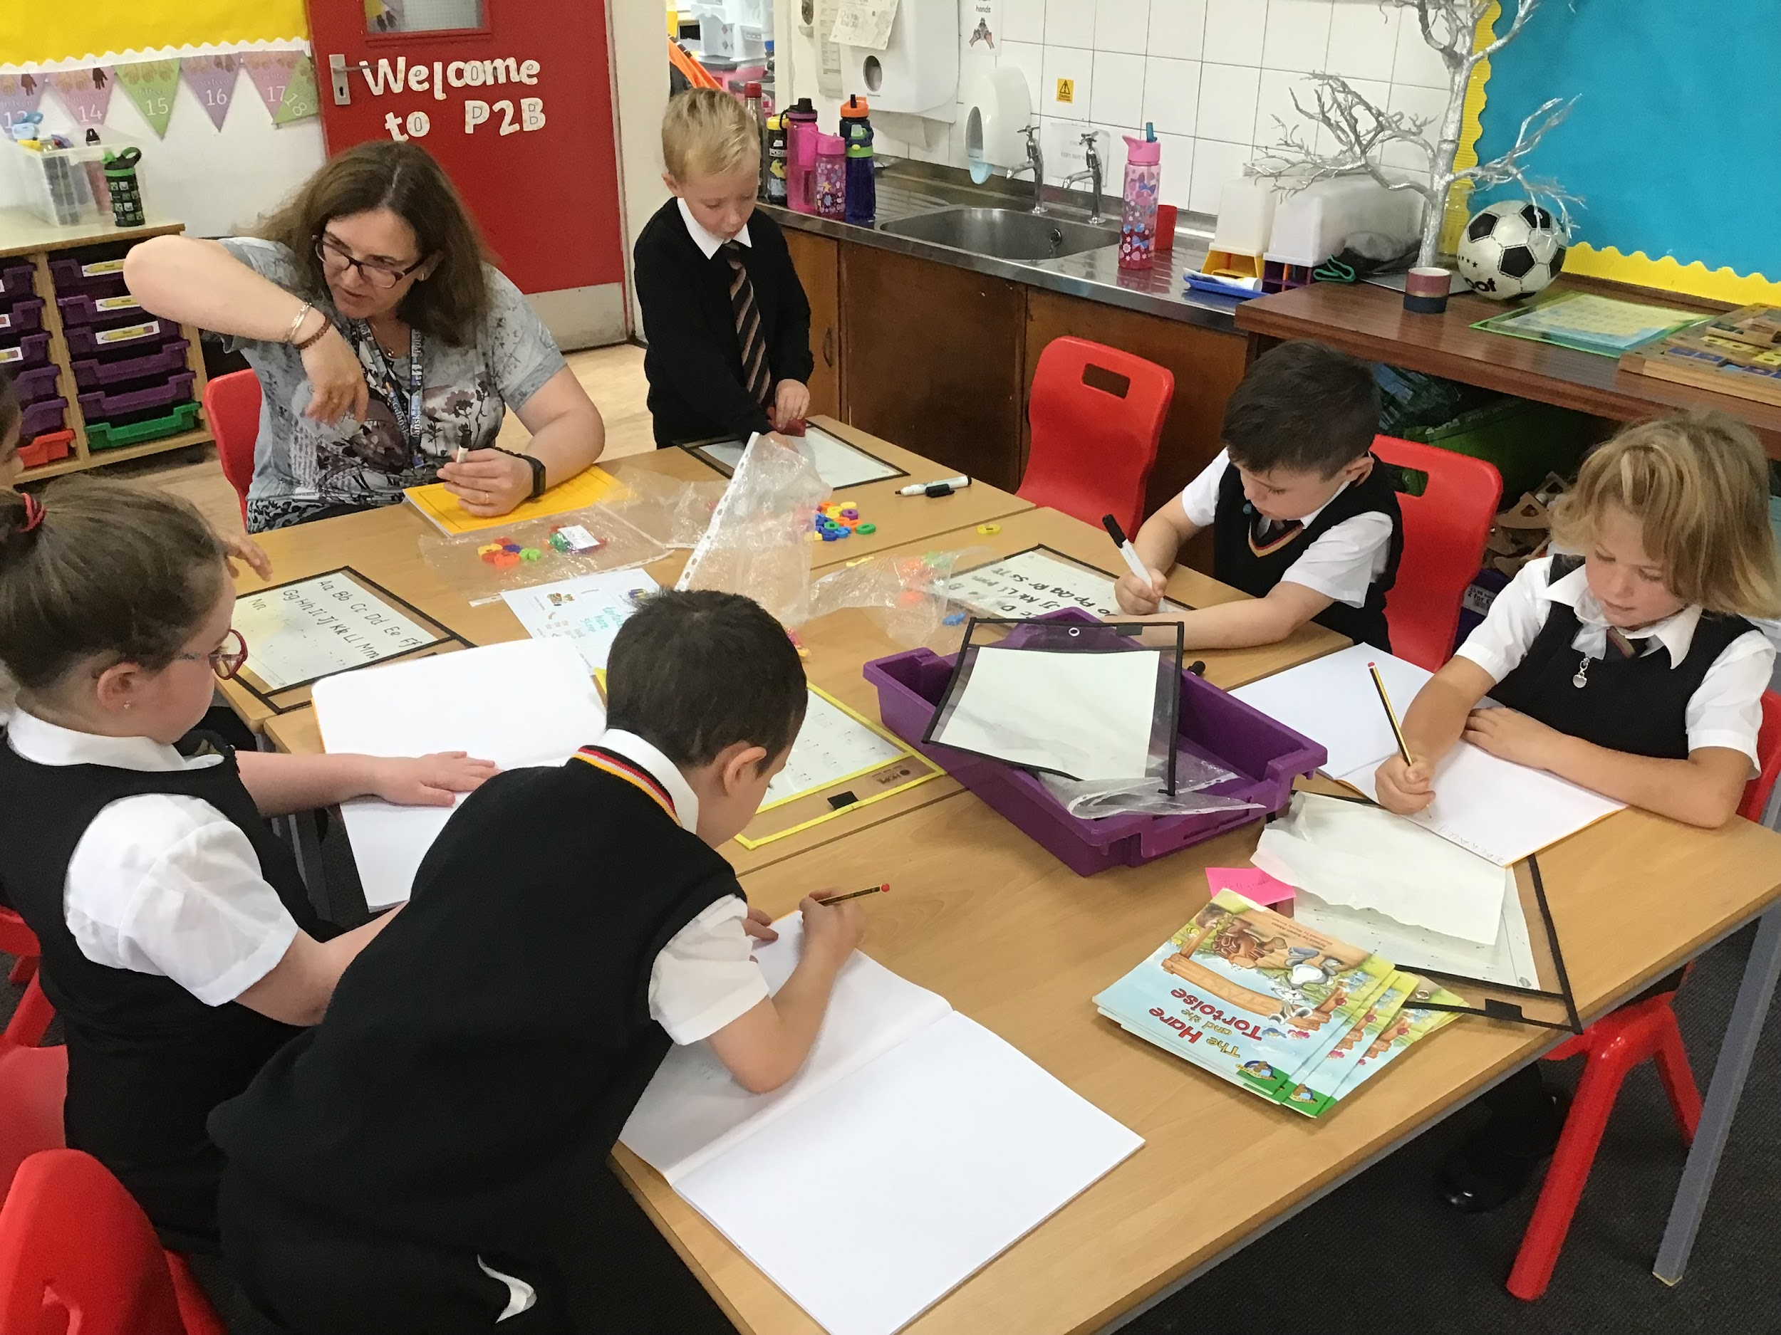
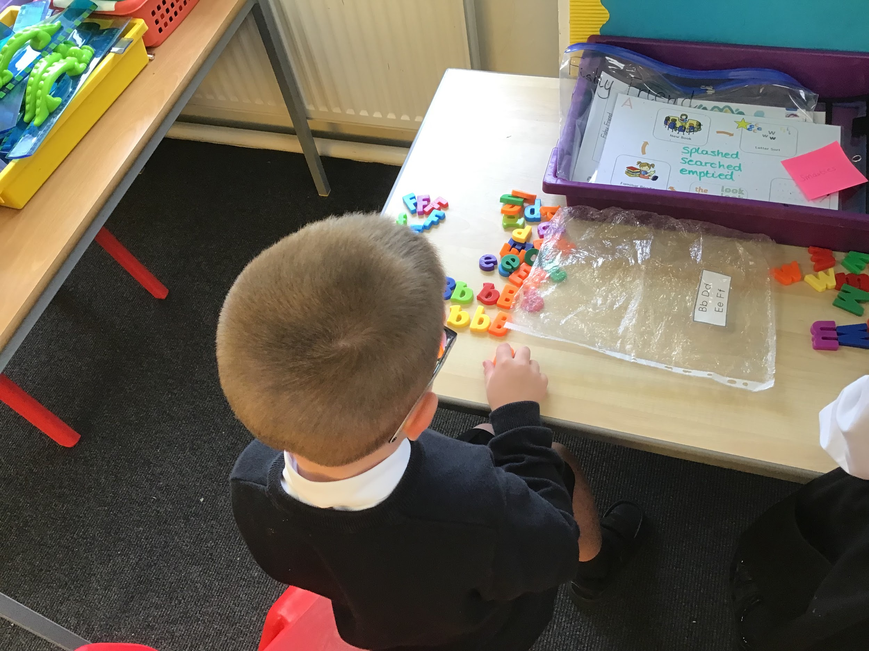
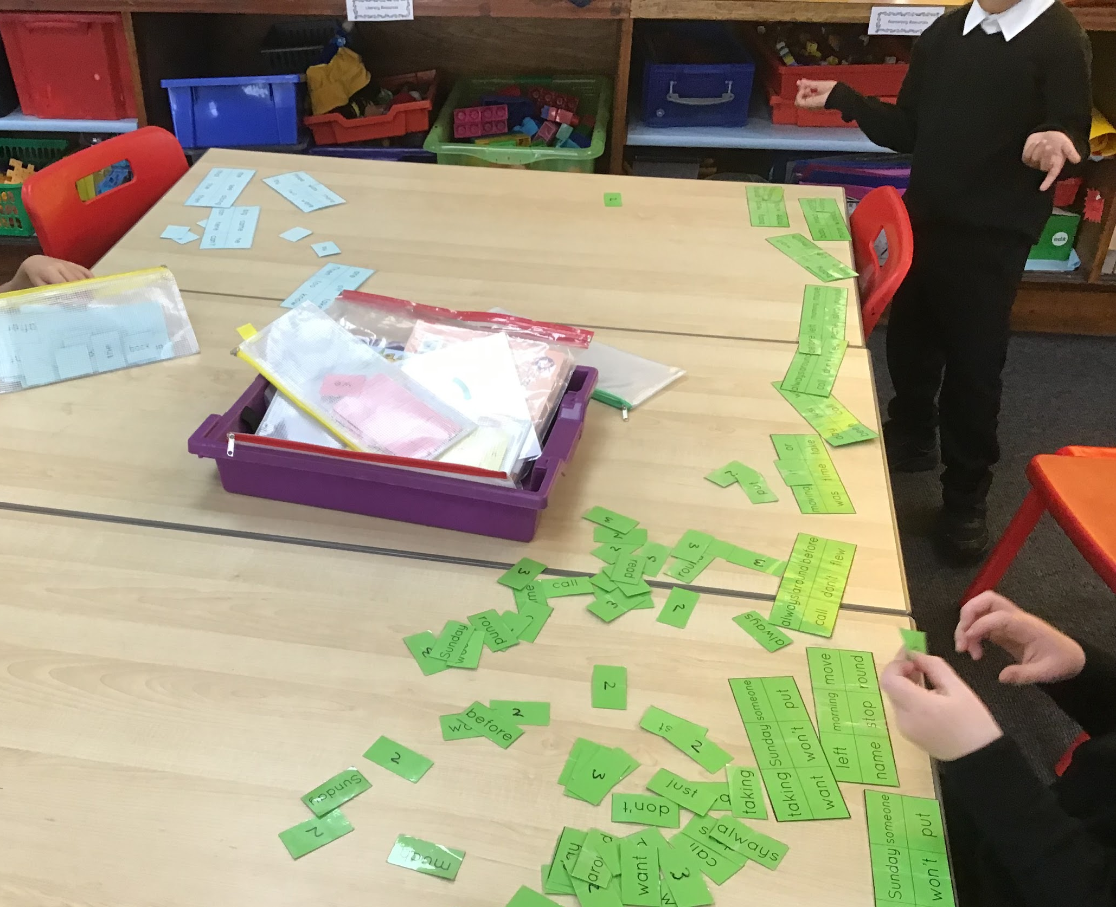
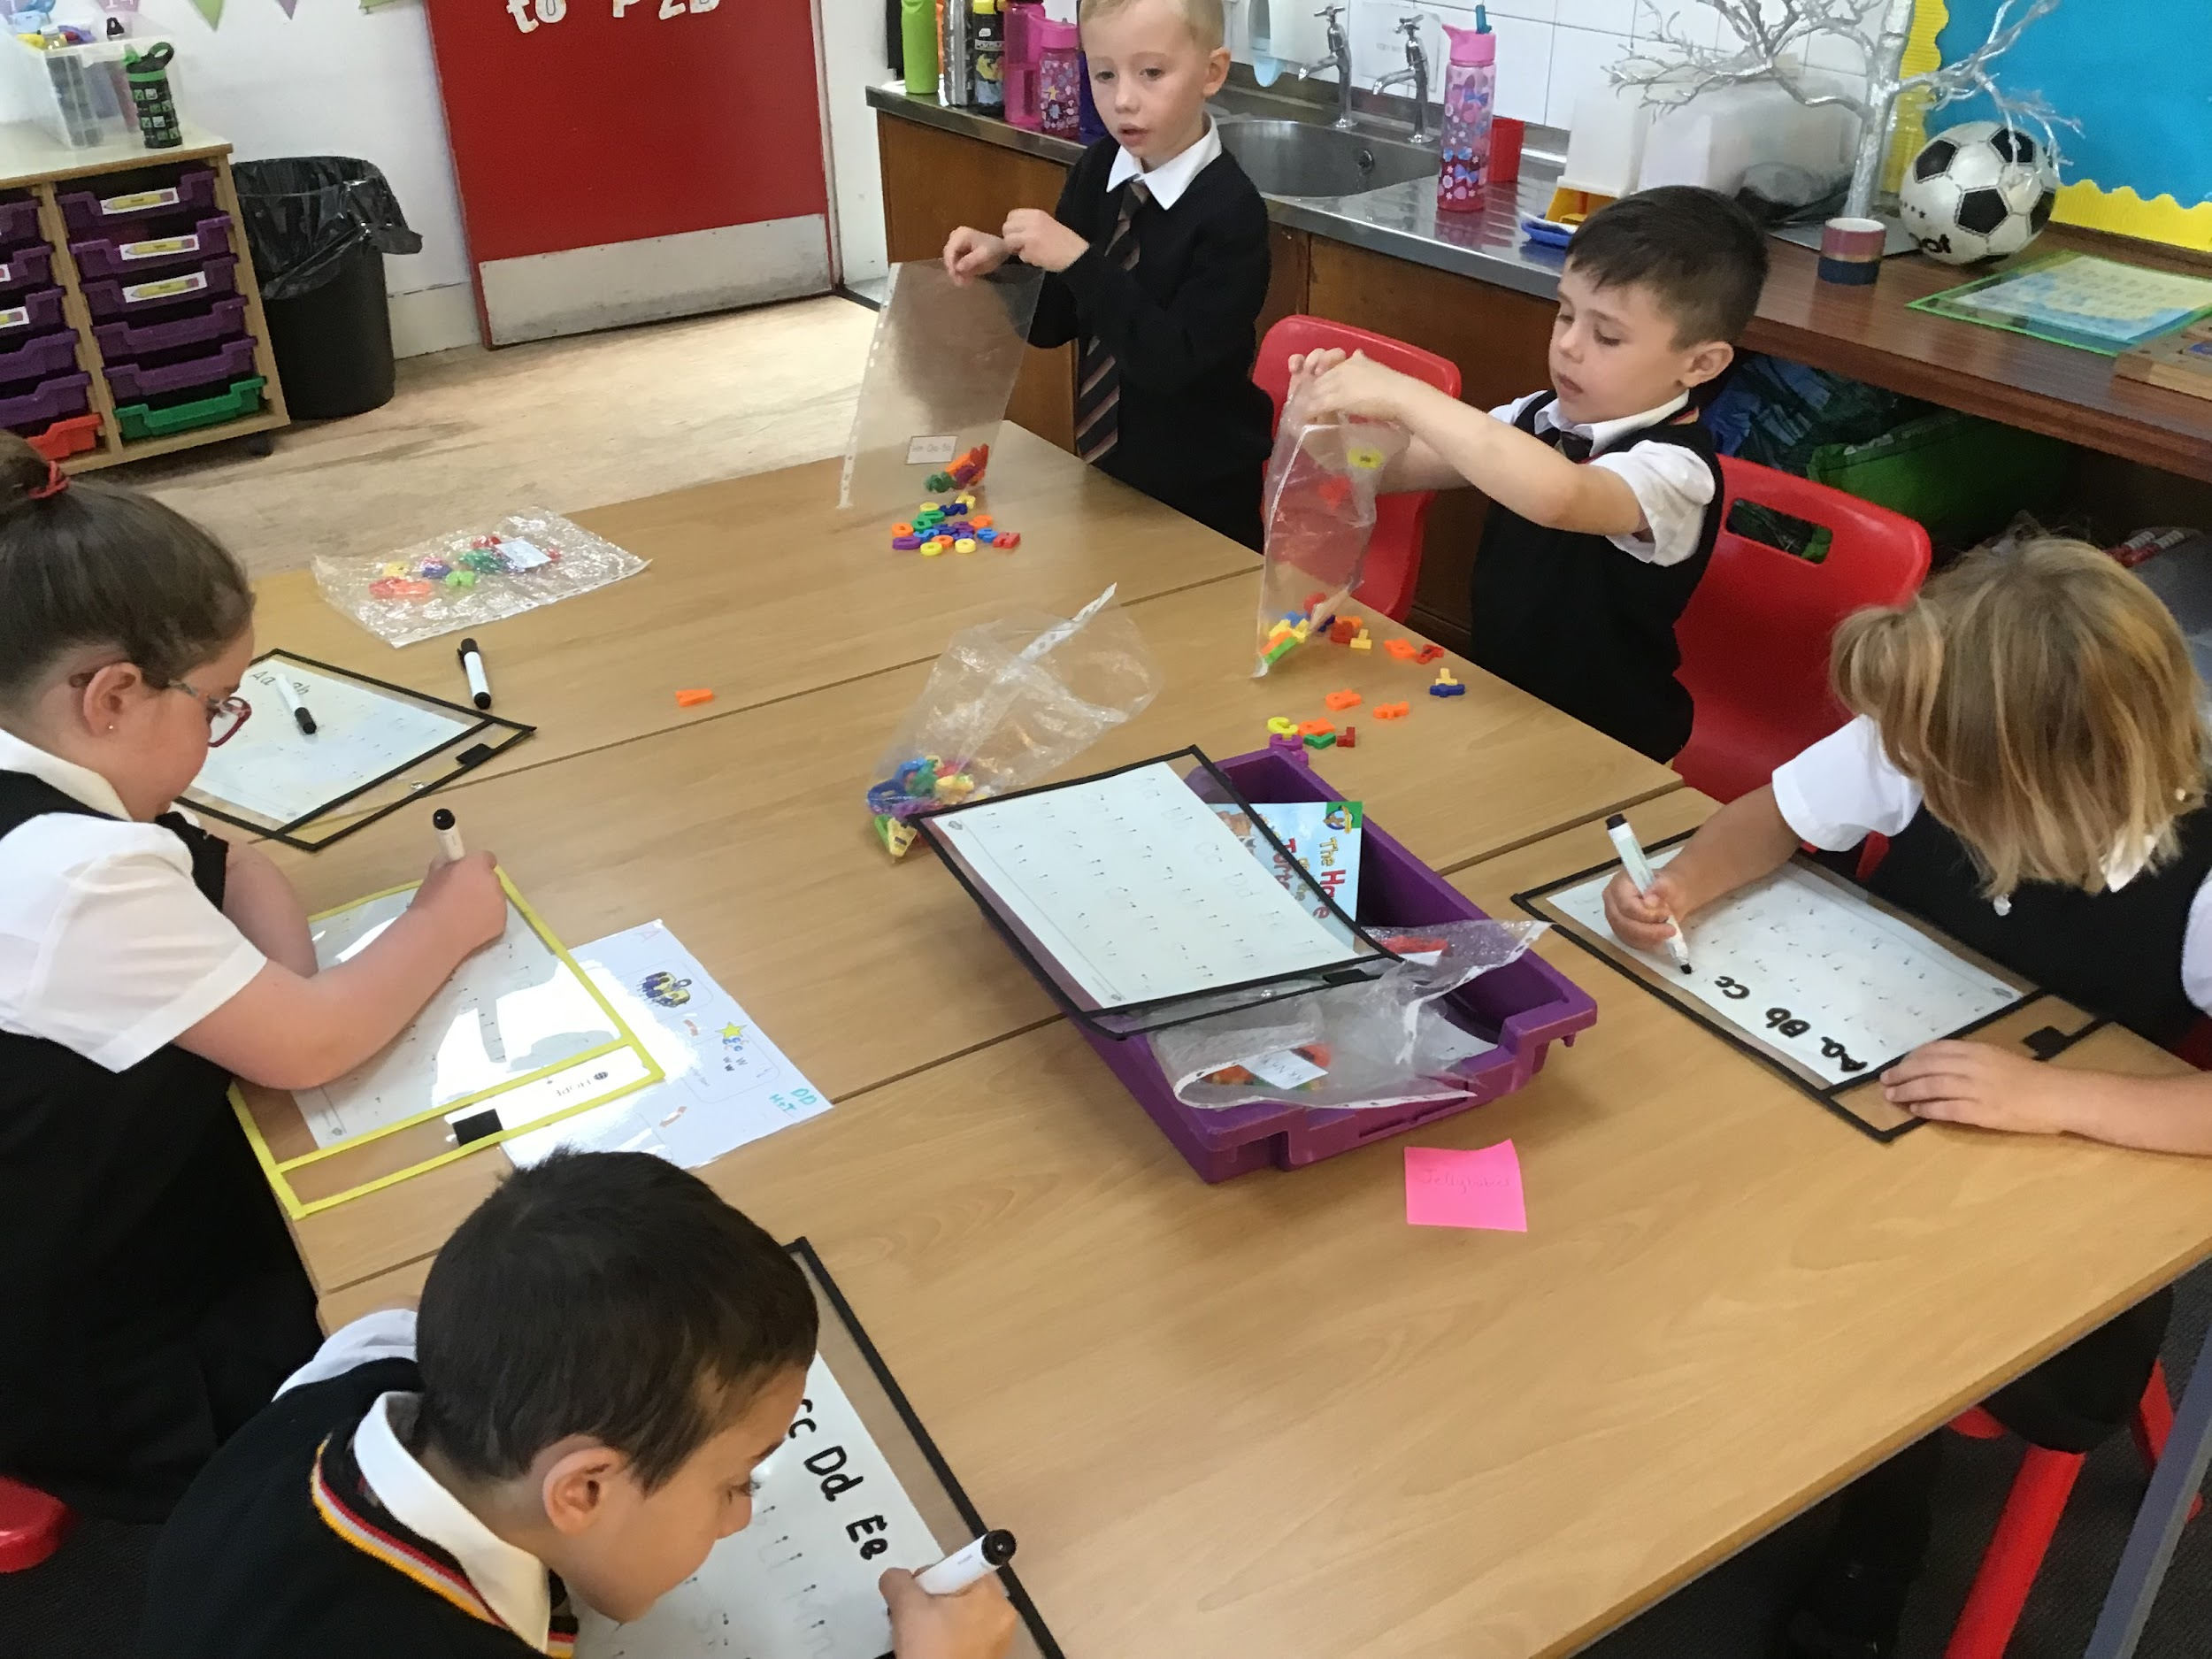
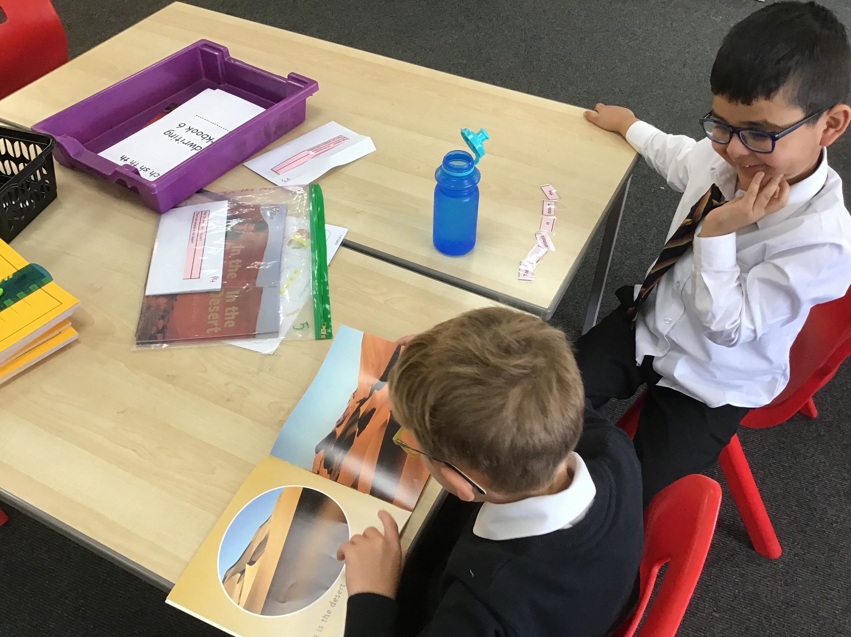
Daily Literacy Learning (DLL) is a whole class approach to teaching reading and writing with a focus of oral language. This programme is specifically for P2 children and was successfully trialled in St. Marks last year and remains a focus on the school. The main aims of DLL are to develop pupils into confident, independent readers and writers with strong oral language skills.

Slide 12
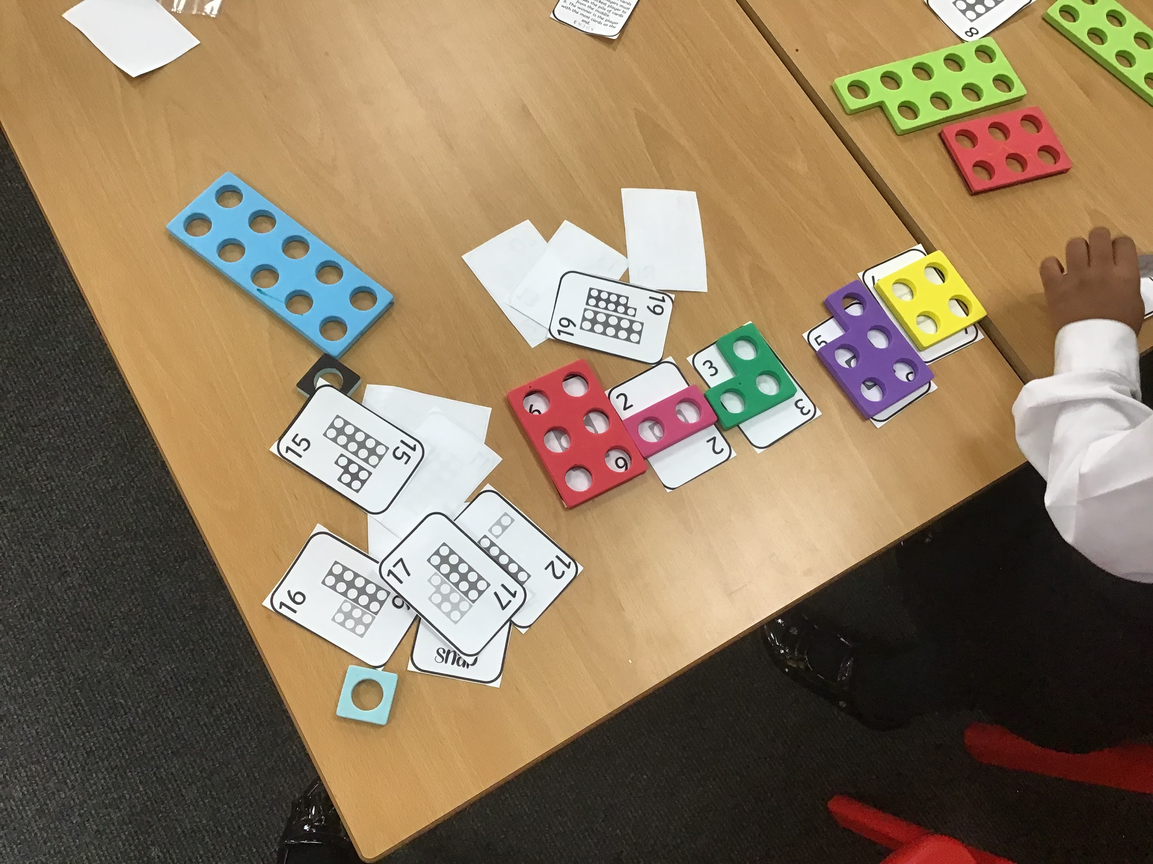
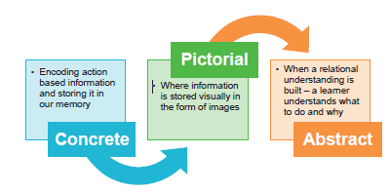
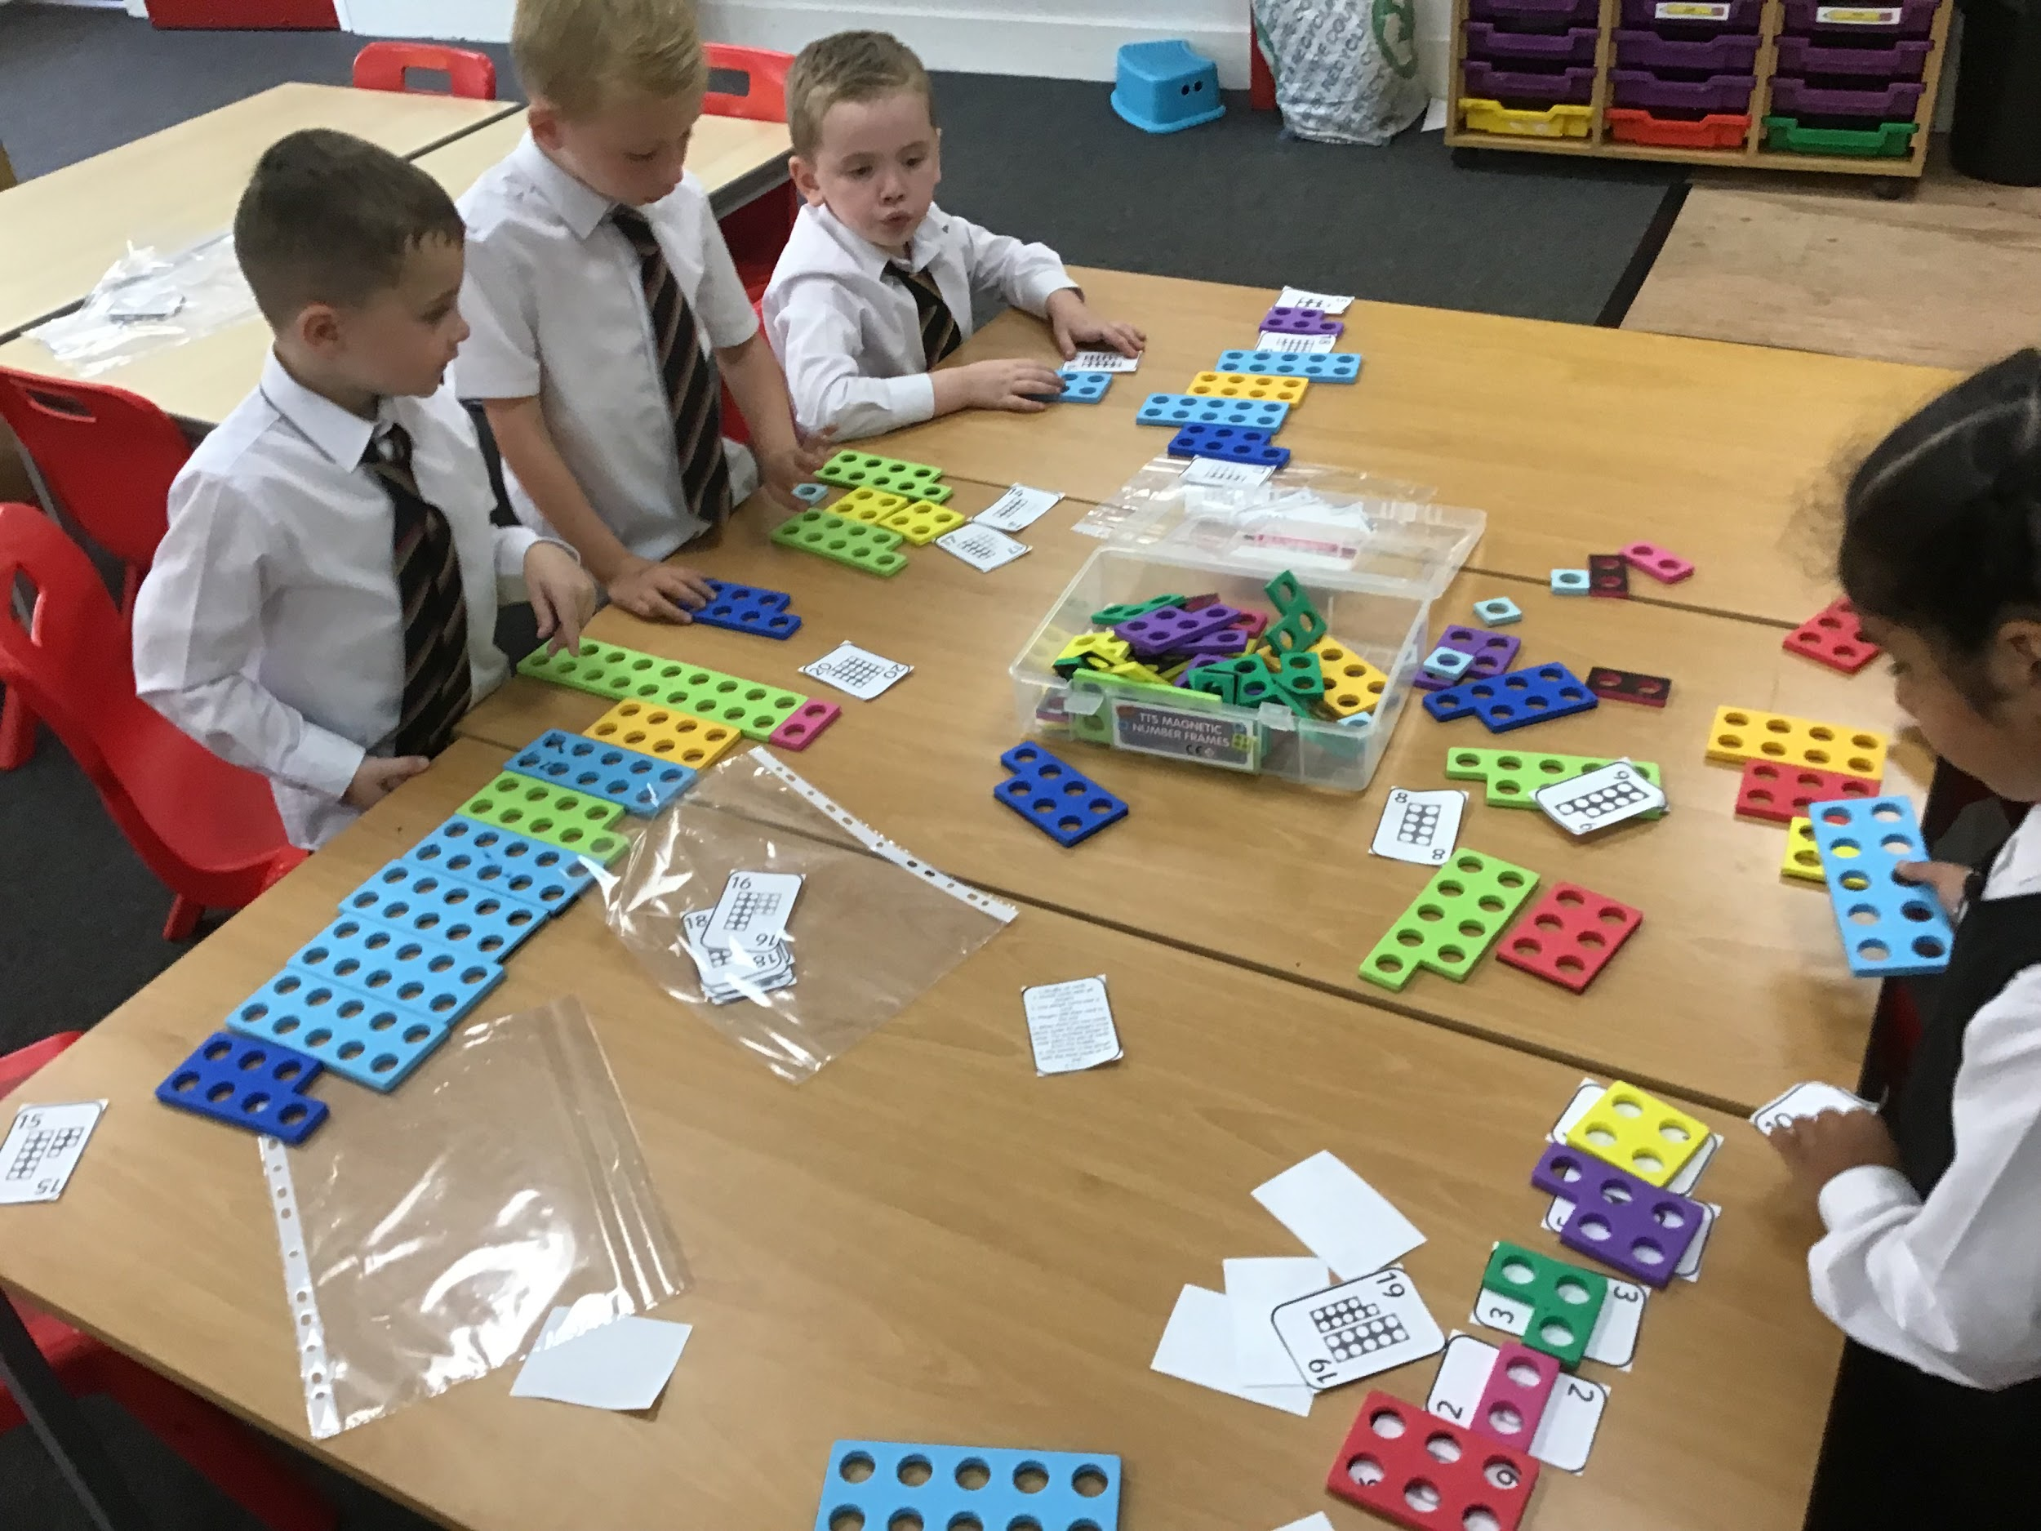
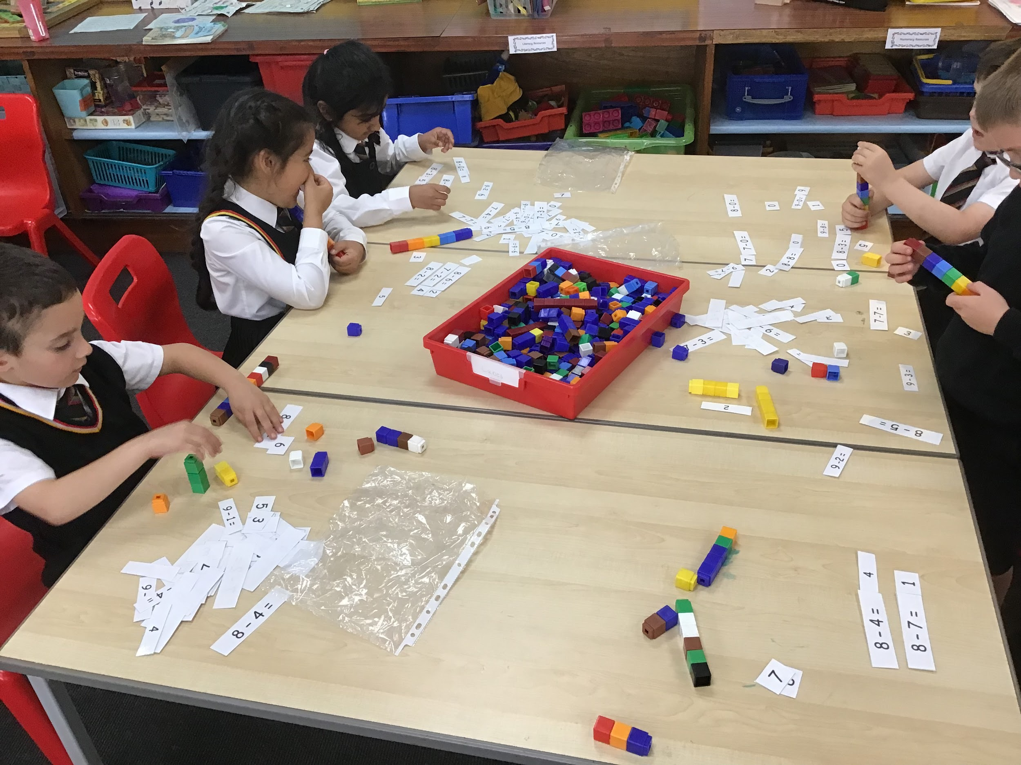
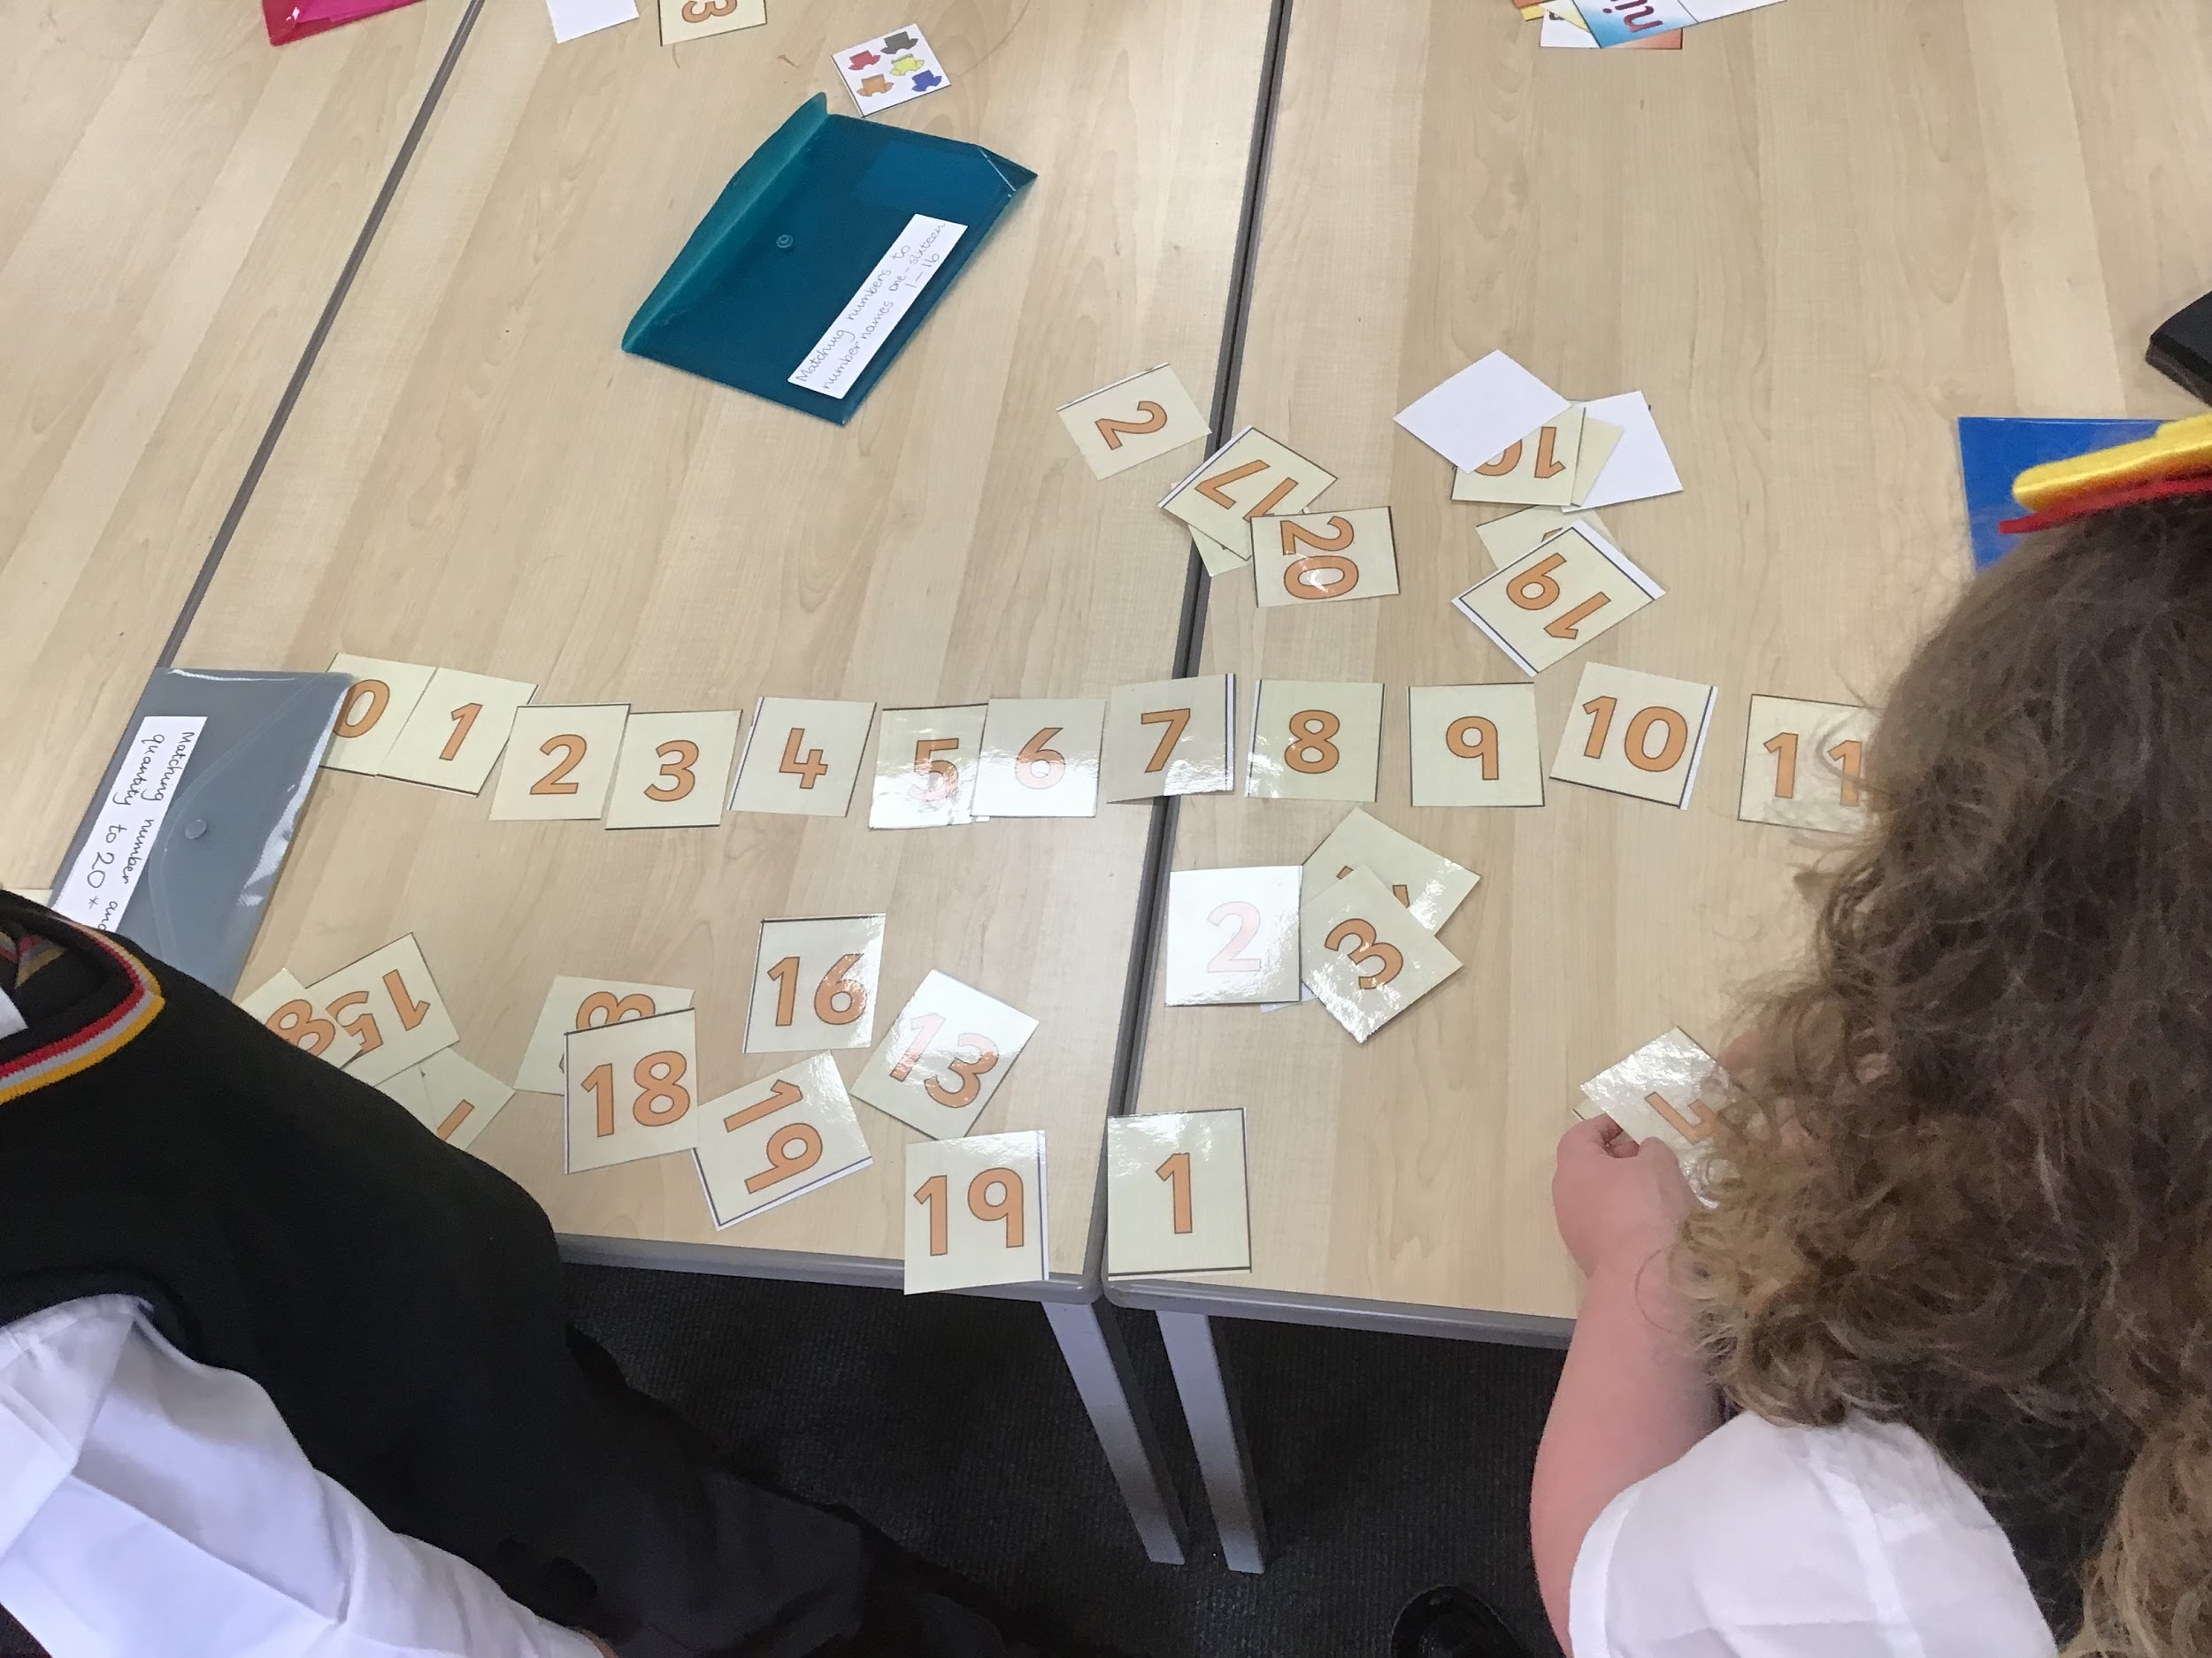
Numeracy
In Primary 2 we will continue the good practice of Primary 1 to provide Concrete, Pictorial and Abstract opportunities. As this is a highly effective approach to teaching mathematics that develops a deep and sustainable understanding of maths in pupils.
At home you can support your child by practise counting, recognising numbers, applying addition and subtraction strategies. Of course there was also be numeracy homework. Should you require any cubes to support your child at home please let me know. As it’s important the children have the tools they need to complete their homework.

Slide 13
OUR MISSION
As a Catholic School, our mission is to develop as a community of faith and learning, providing the highest quality of education, and offering formation through the promotion of Gospel values, through celebration and worship, and through service to the common good.

Slide 14
Religious Education
In our classroom we have an Altar. We teach RE throughout the week based on the This is our Faith, in addition to learning prayers and participating in school masses.

Slide 15
P.E. days are Thursday and Friday! PE kit should be worn to school on PE days. PE kit is black shorts/ joggers/ leggings, yellow polo shirt, black trainers.
PE will often be delivered through outdoor lessons, children should also bring their school jumper, a waterproof jacket/ outdoor trainers on those days. There is support for any families who require help with any aspect of school uniform or PE uniform

Slide 16
Outdoor Education
Outdoor Learning will occur on a Friday. Pupils will engage with the natural world and participate in environmental and adventure activities.
Mrs Carwood our forest school leader is currently working with Primary 1 and Primary 7. Primary 2 should get a forest school block later on in the year.

Slide 17
Homework
Shared each Monday To be returned Friday 3 digital tasks - weekly check in - Numeracy - Reading 1 written task - spelling
Literacy Planet
Education City

Slide 18
Communications Class blog - visit our class blog to see what we are doing in class, available through the school website. Twitter - look out for P2 pictures on twitter @stmarksprimary1 - find out about the parent partnership events (new members welcome) @marksparent First meeting is occurring on the 8th September. -
https://blogs.glowscotland.org.uk/er/StMarks/home-learning/

Slide 20
Will be sent home with jotters before both parents nights in October and March, for you to add any other achievements to this page!

