Slide 1
Primary 1b Open afternoon

Slide 2
Introduction
Click the speaker button on each slide to hear extra information.
Welcome to Primary 1B virtual open afternoon.
This presentation will give you an insight into our year ahead in Primary 1 and hopefully answer any questions you may have.
If there is anything at all not covered within the presentation that you would like to chat about, please get in touch.

Slide 3
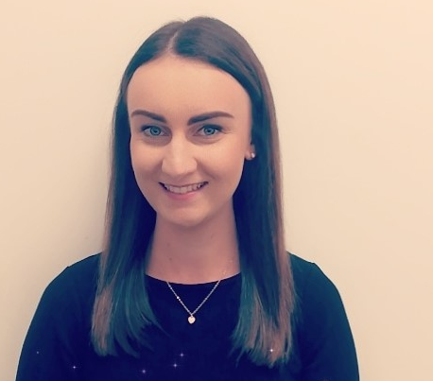
About the Teacher / Year Ahead
My name is Miss McAlpine
I am new to St Mark’s this year however I have been teaching for four years now, with this being my third year in Primary 1.
I am really looking forward to working with your children this year.
Year Ahead
Playful Pedagogy
Outdoor learning

Slide 4
The Classroom
It is our aim in St. Mark’s to provide a quality learning environment which stimulates and motivates pupils.
Play based learning across Primary 1.
We have several different areas within our classroom that facilitates learning through play.

Slide 5
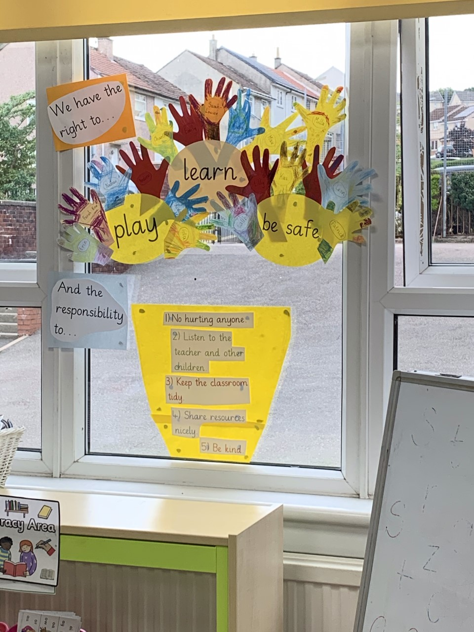
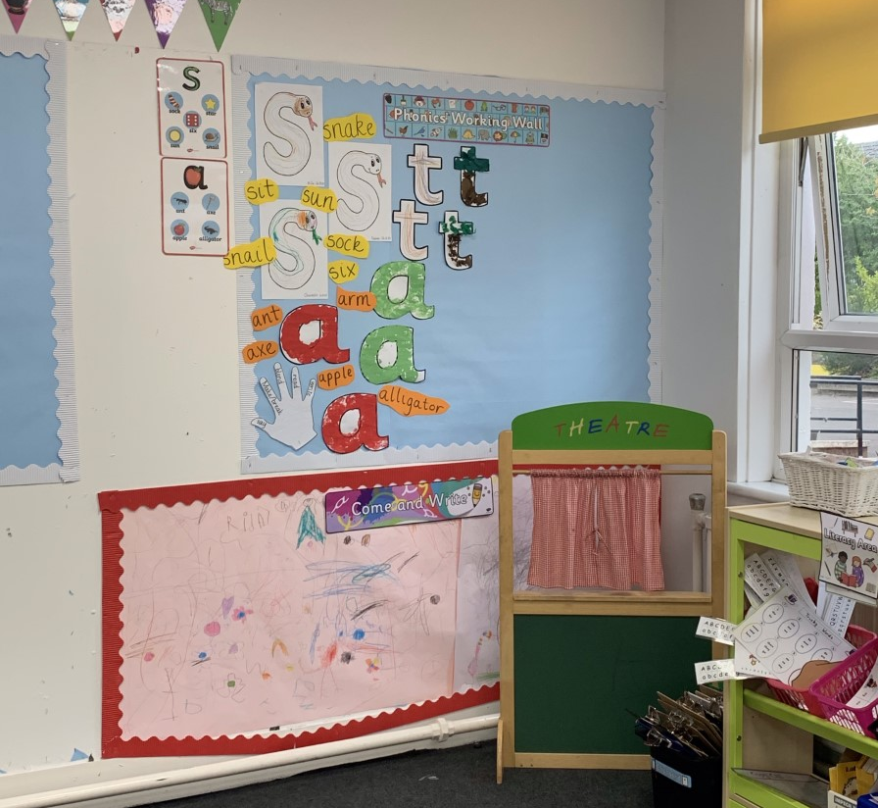

Slide 6
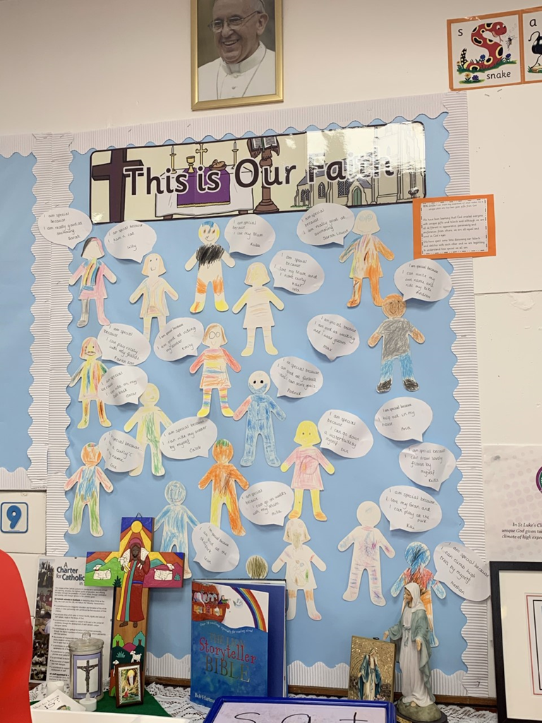

Slide 7
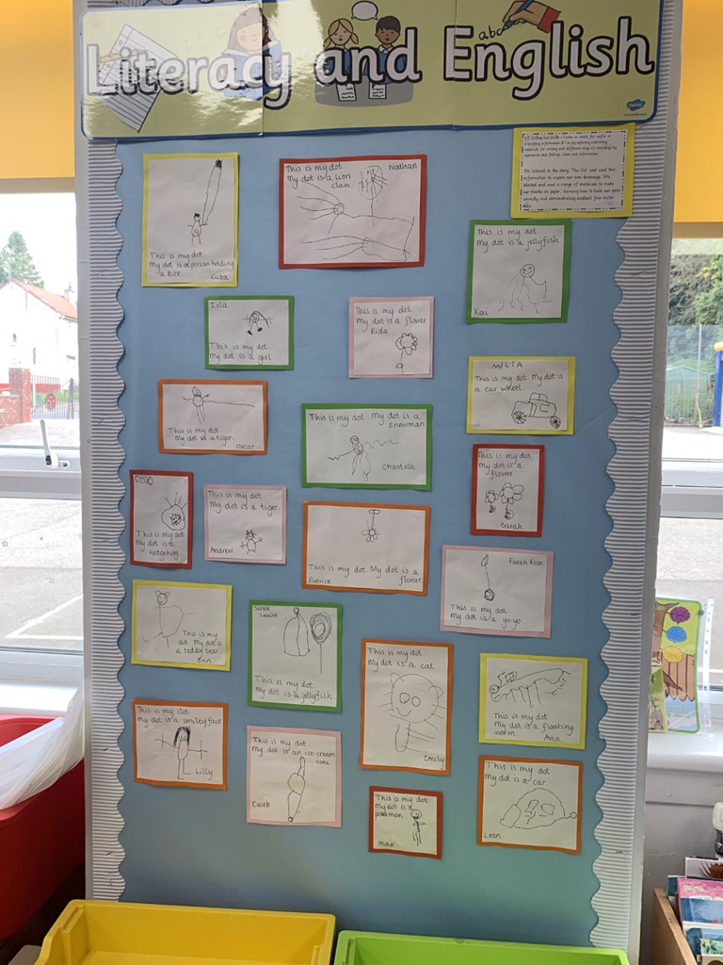

Slide 8
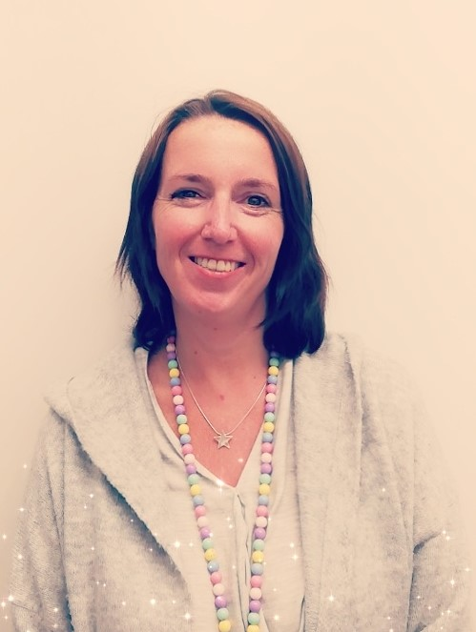
People Who Work With Primary 1B
Problem solving teacher
Mrs Stephen
Classroom Support – Mrs Muscat

Slide 9
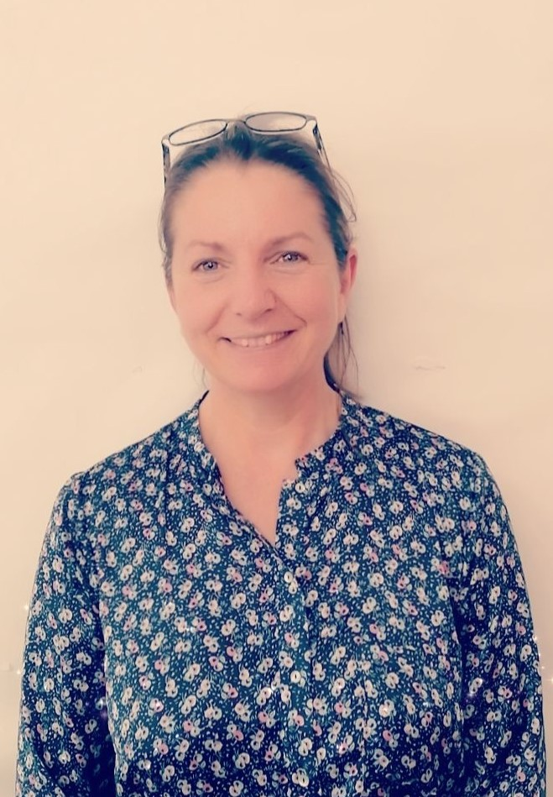
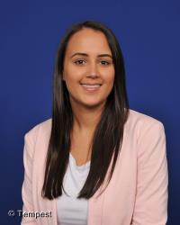
Art Teacher – Mrs McIntyre Primary 1a Teacher – Miss B McFlynn

Slide 10
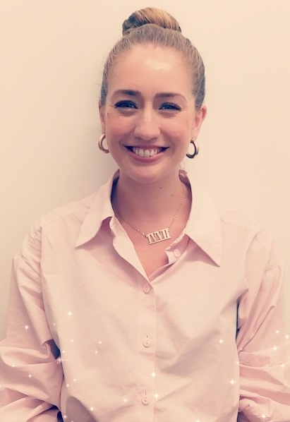
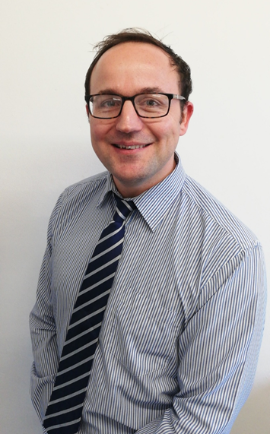
Science Teacher – Mrs Reid Senior Management – Mr Cockbain

Slide 11
The Curriculum
This year in St. Mark’s we are following the recovery curriculum model. All at St Mark’s have a firm commitment to prioritising the physical, mental and emotional wellbeing of our children.
We are therefore focusing on Literacy, Numeracy and Health and Wellbeing.

Slide 12
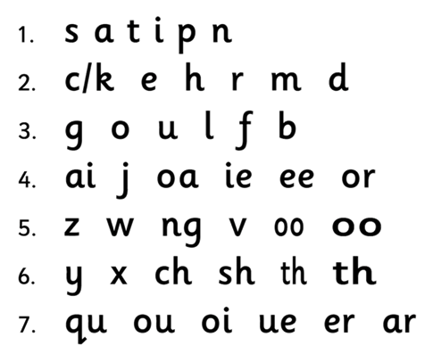
Literacy
This year in Literacy, we will be using a range of resources to support and guide your child’s learning.
To support their learning of phonics, we will be using Jolly Phonics.
The 5 basic skills of Jolly phonics are:
Learning the letter sounds
Learning letter formation
Blending
Identifying sounds in words
Tricky words

Slide 13
Numeracy
Early level experiences and outcomes
Term 1 – exploring numbers, counting on and back, addition, 2D and 3D shape, patterns and relationships.

Slide 14
Health & Wellbeing
Health and Wellbeing plays a significant role in the recovery curriculum.
It is vitally important that all children are supported as they return to school and they are settled into learning in a calm learning environment.
Proud Cloud
Throughout the school, there are a range of other initiatives offered to children such as Talking Heads and Seasons for Growth. If you are interested in further information, please do not hesitate to contact the school office.

Slide 15
Religious Education
In St Mark’s Primary School we nurture every child’s unique God given talents to enable them to flourish in a climate of high expectations, innovation and creativity.
Our school values of love, faith and understanding will guide all learning and teaching within the classroom.

Slide 16
Outdoor Learning
Outdoor clothing can be left in school. It will be sent home regularly to be cleaned.
All items of clothing should be labelled with your child’s name.
Appropriate clothing:
Waterproof clothing, i.e. rain suit, waterproof trousers, jacket with hood
Wellie boots preferably or old trainers

Slide 17
Home Learning
Seesaw

Slide 18
This will allow your child to log into the ‘Seesaw Class App’ and complete home learning tasks.

Slide 20
Your child will bring a letter like this home today. It will explain how to access the ‘Seesaw Family App’

Slide 21
Additional Information
Glasses
Snacks / Healthy snacks
Water
Getting ready for PE
Clothing clearly labelled

Slide 22
St Mark’s Parent Partnership
We are looking for a parent from each class to be a parent representative on the Parent Partnership.
If you would like to find out more about the Parent Partnership, the AGM will take place via an online meeting on Thursday 3rd September at 7pm.
Please check the school website and social media for details of how to join this meeting.

Slide 23
Thank You
Thank you for taking the time to listen to this presentation today.
I appreciate your continued support and look forward to working with you this year.

