Slide 1

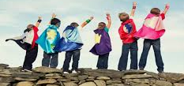


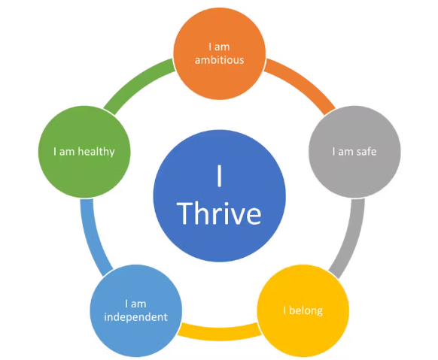

  We used books and signs in different languages so everyone felt included and we loved sharing words from home.
  Our teachers kept checking how we got on in maths to make sure the work was not too easy or too hard and they gave us the right help so we could all keep getting better.
  We learned about friendships, families and growing up in a safe and respectful way and P7 children helped shape the lessons so they felt real and useful for us.
  When we moved to our new class, we got to meet our teacher, see our classroom and even write letters, which helped us feel ready, less worried and more excited about starting a new stage.
  Some children learned life skills like shopping, cooking and keeping safe and teachers understood how we learned best so we felt proud and more independent.
  We learned about the Zones of Regulation so we could learn how to understand our feelings, manage tricky emotions and look after each other.
  Our teachers used the Circle Framework to help make our classrooms fair and welcoming for everyone and they listened to our suggestions so we felt included and ready to learn.
  Our school and nursery worked hard to make sure everyone felt safe and respected. We learned about fairness, kindness and diversity and we know what to do if someone is treated unfairly.
Leadership and Improvement
Quality of Care
Netherlee Primary School and Nursery Class
  We were awarded the Keeping the Promise Award because our school and nursery made sure every child felt cared for, safe and respected. Pupils’ attendance was better and teachers saw increased engagement and participation.
  In nursery, we used Froebel ideas like learning through real activities. We made our own bread, which helped us practise maths, follow instructions, work together and feel proud of what we made.
  We looked after our school and nursery gardens with help from our parents / carers, which made learning outside fun. We grew food, learned where it came from and enjoyed looking after our school and nursery environments.
  We learned meta-skills like problem-solving, teamwork and creativity. We used a lot of digital tools to help with our learning and felt proud when we solved challenges together.
  Teachers, parents / carers and children worked together to write Wellbeing Plans and Universal Passports, offering extra support for those who needed it.
  Special reading and learning support programmes like SNIP and Together Better Readers helped lots of children to become more confident when reading and understanding stories and parents/carers said these supports really helped.
  We got better at learning French because nursery and teachers worked together, used new resources and planned fun lessons. This helped us to get better at speaking and understanding French.
  Our school and nursery won lots of awards. We were awarded the We Make Music Gold Award, the Eco Schools Award, the Sport and Physical Activity Award and the
  Digital Wellbeing Award.
Standards and Quality Report
2024/2025
Best Possible Outcomes
Quality of Education

