Slide 1
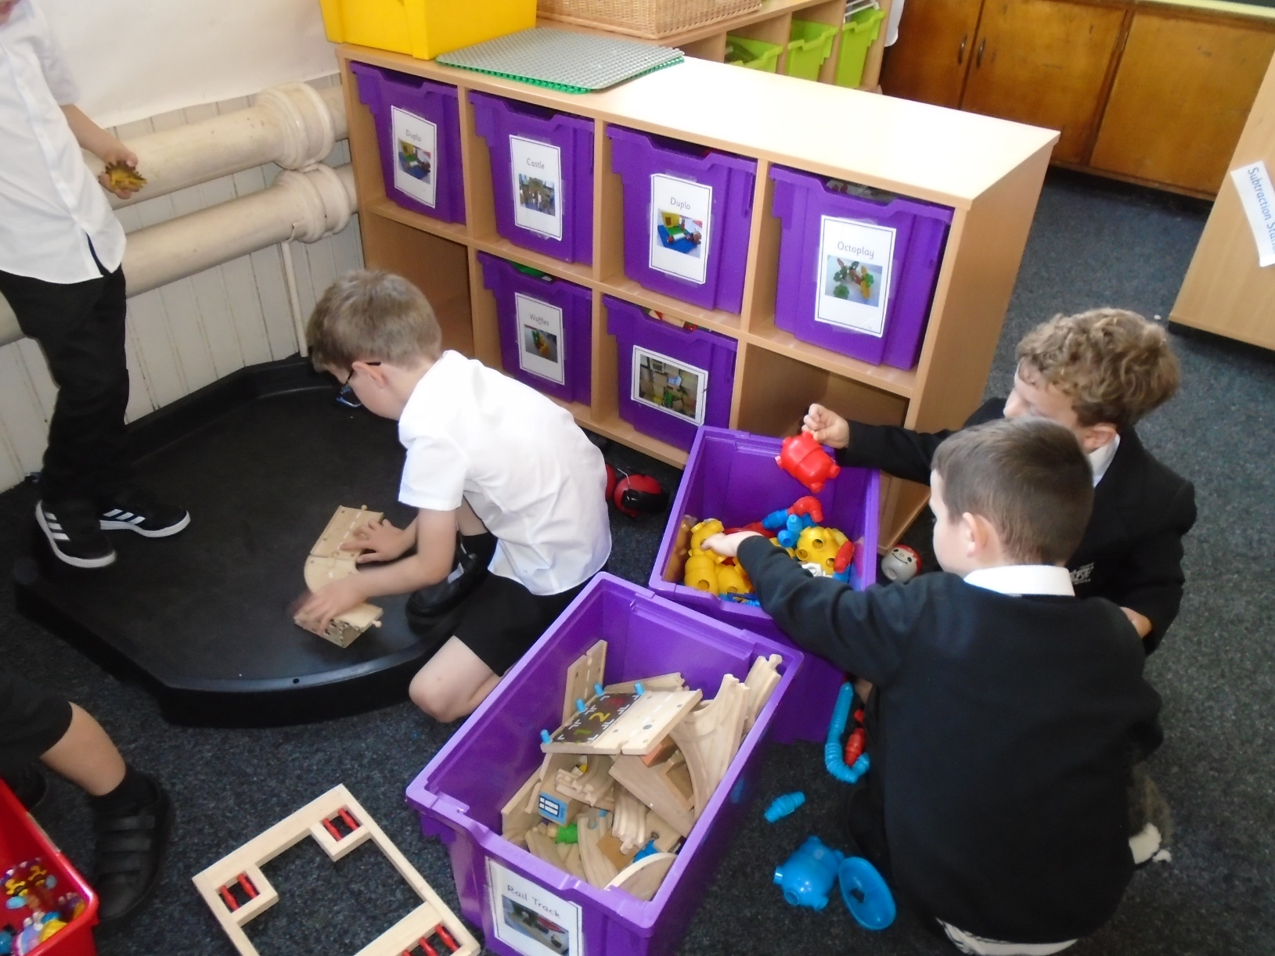
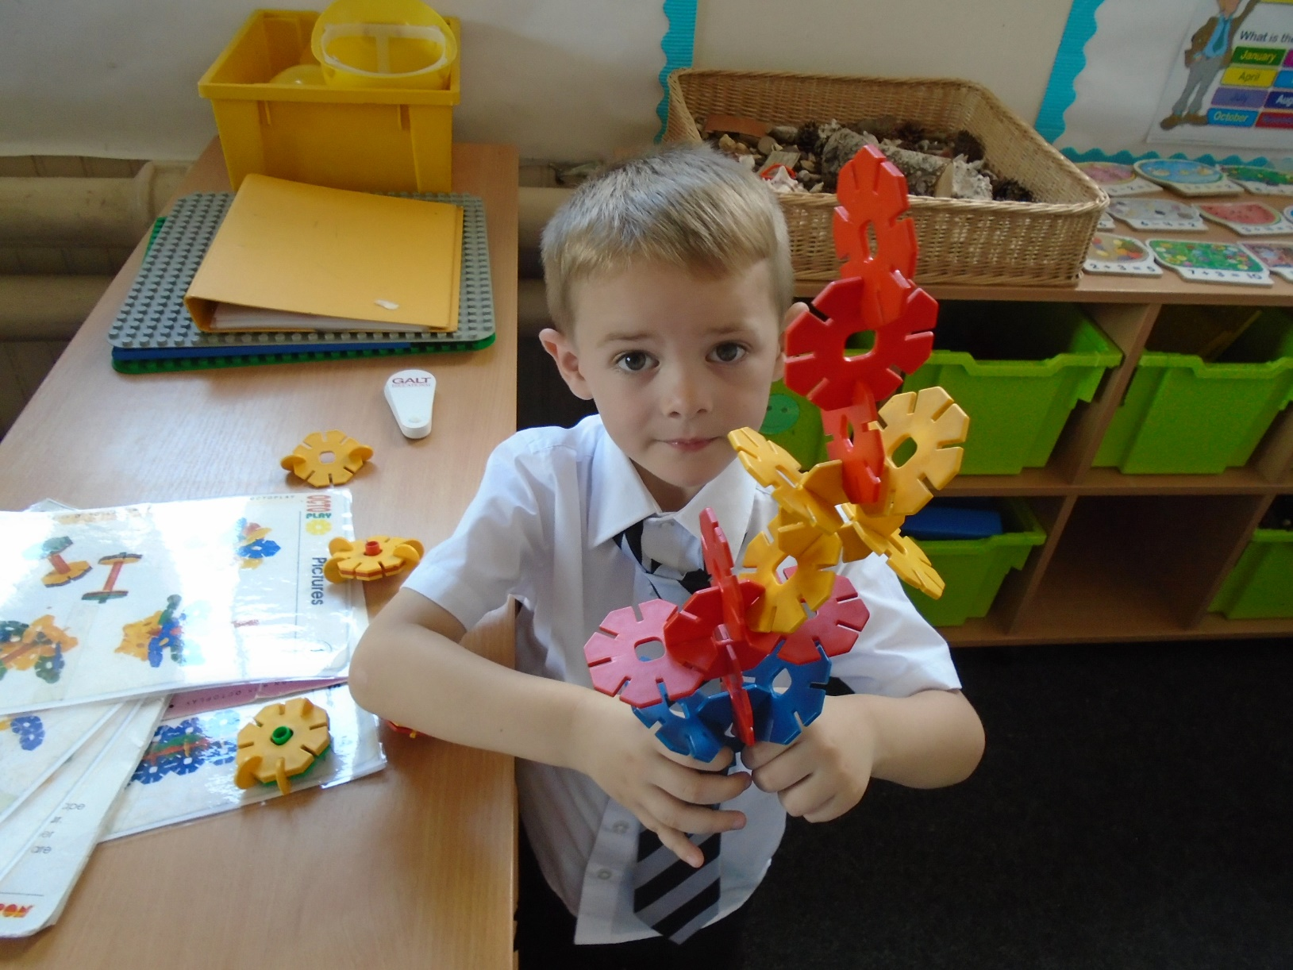
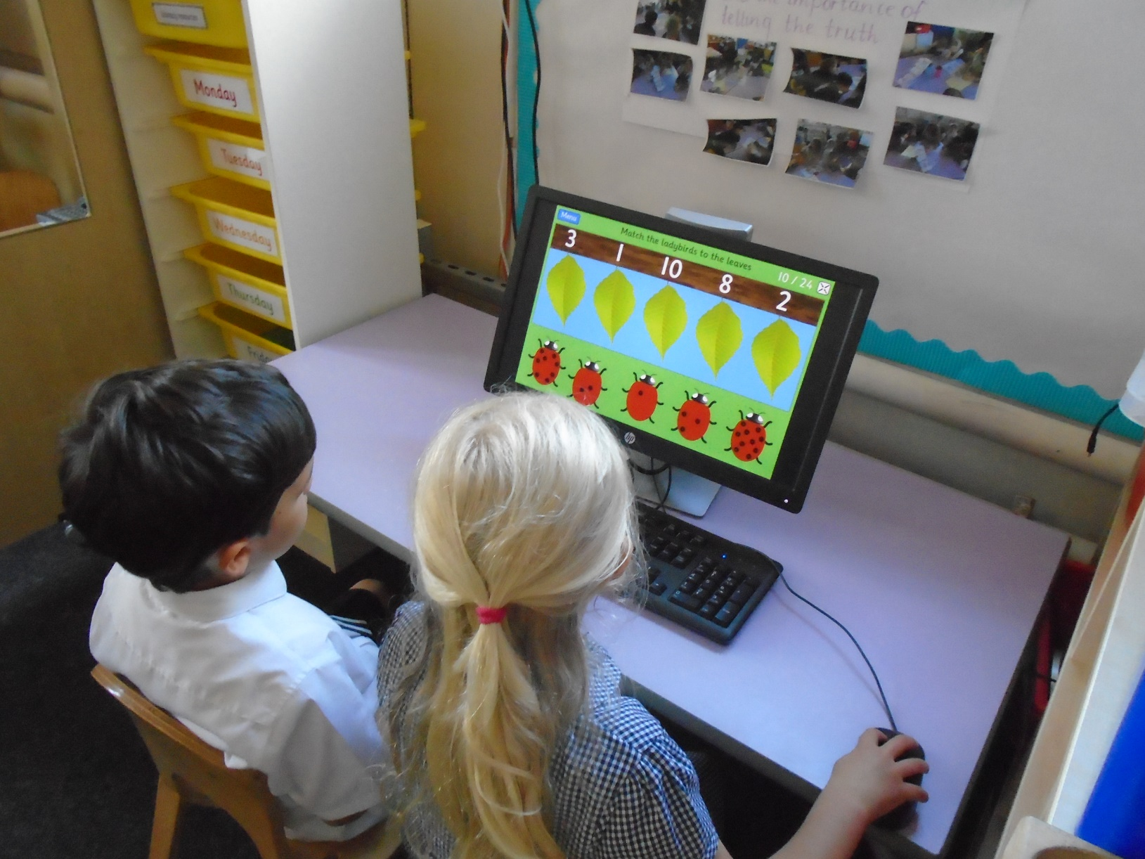
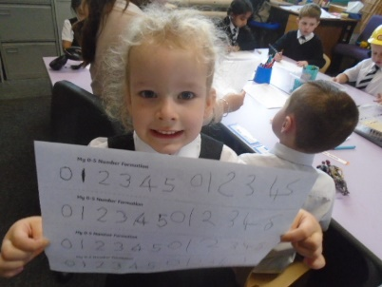
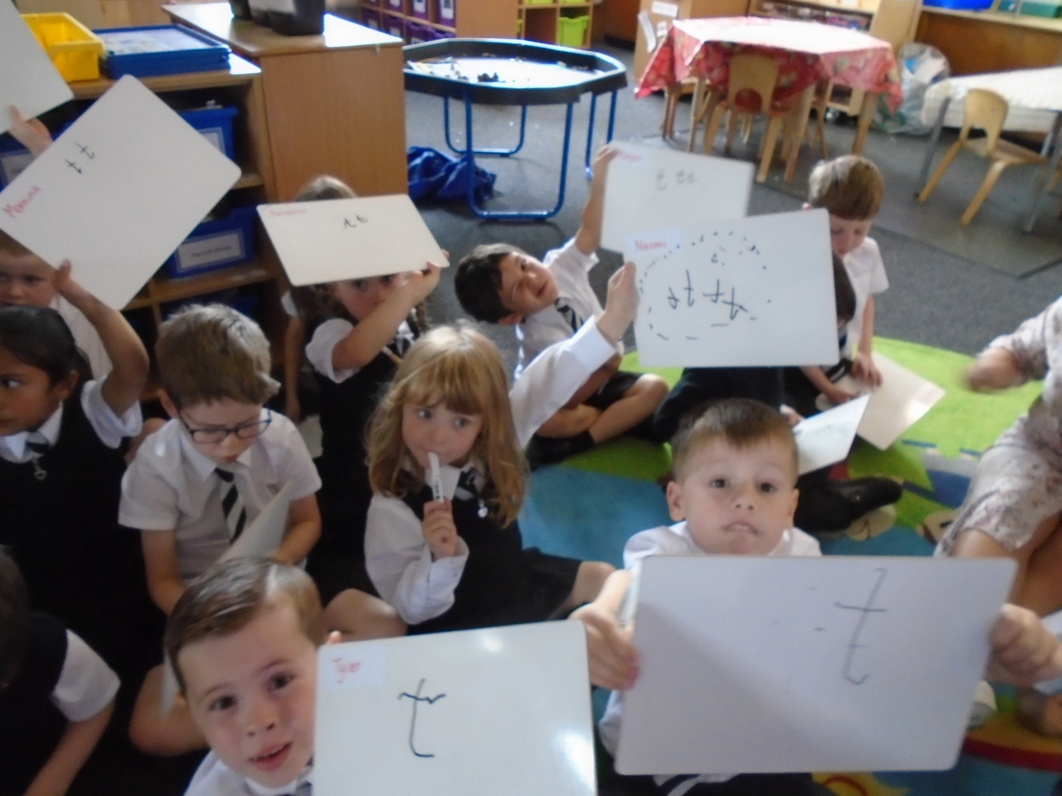
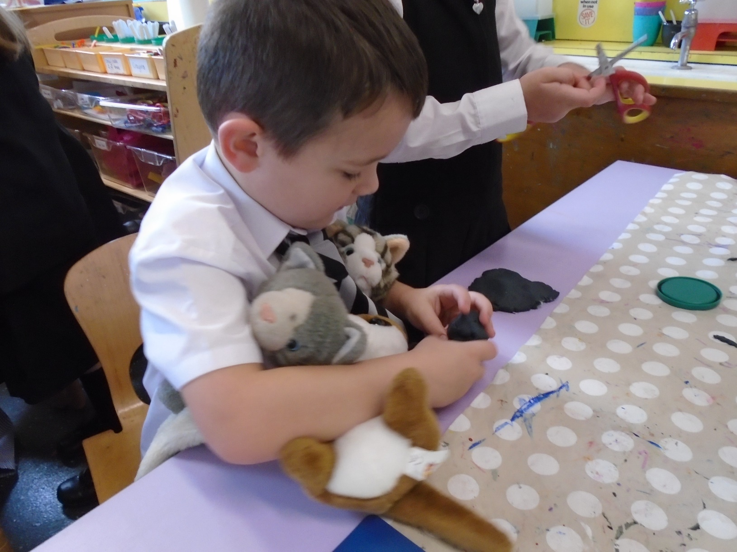
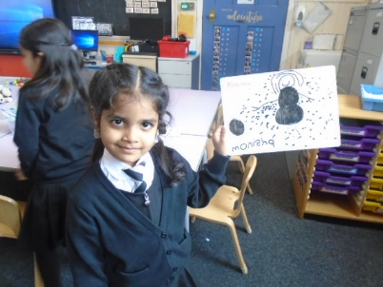
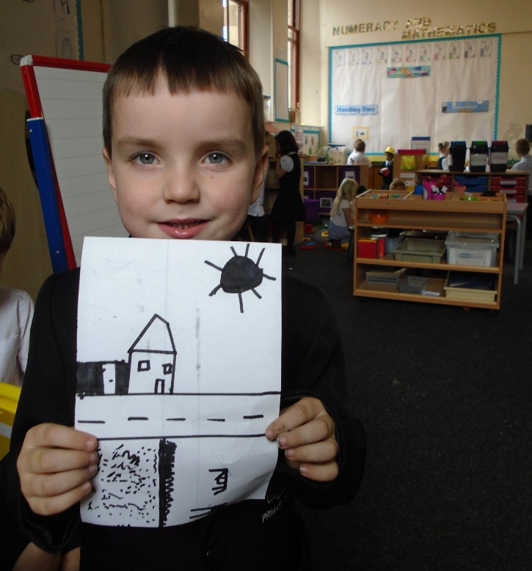
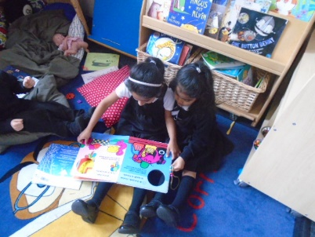
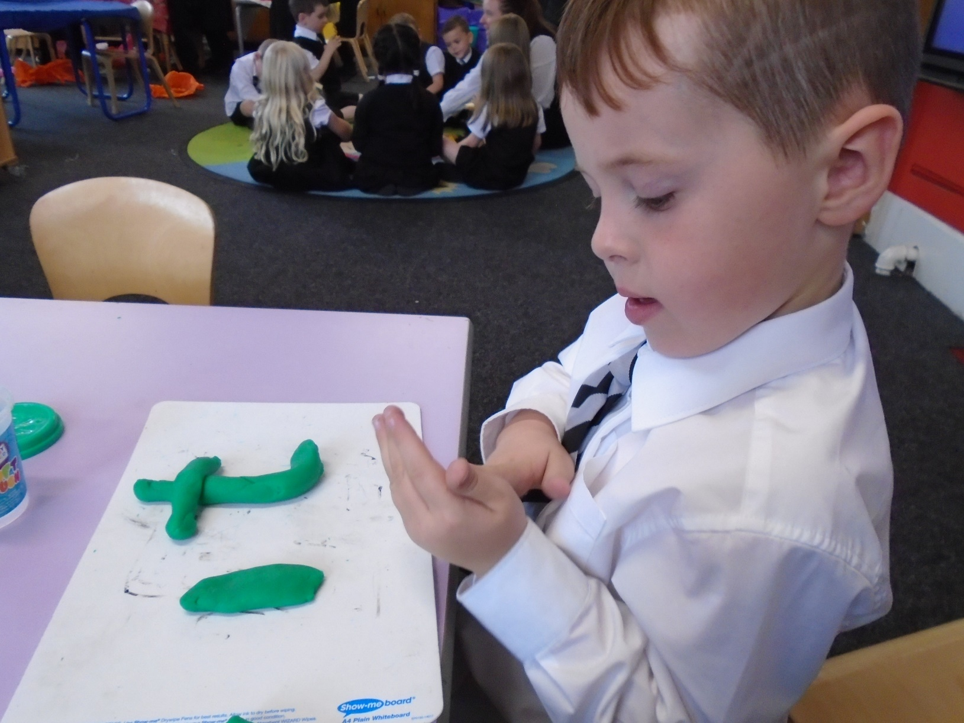
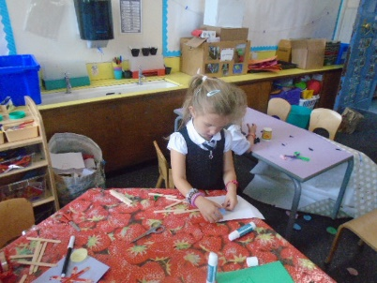
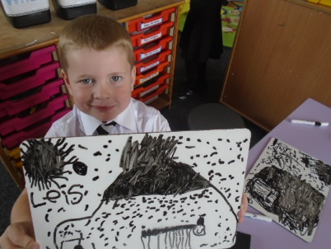
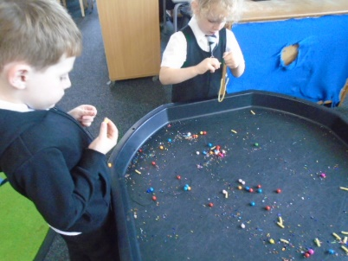
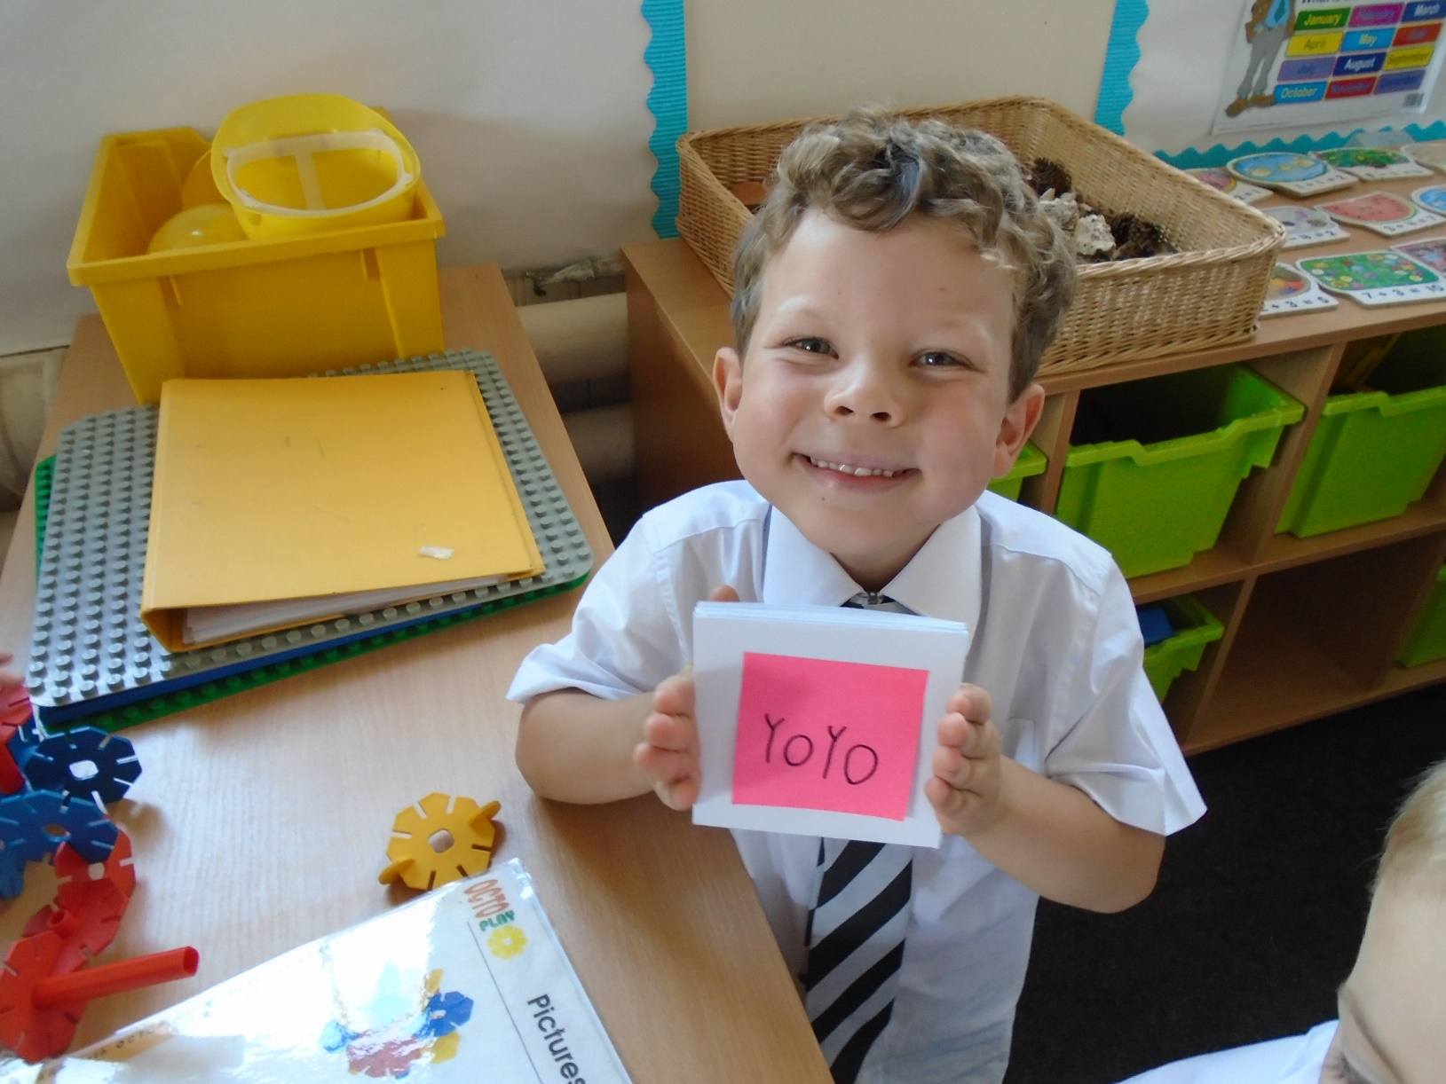
Busby Primary School
Welcome to Primary 1
Miss Paisey & Miss Wight
Lots of fun in P1!

Slide 2
Our Timetable
Include a brief overview of your weekly timetable
PE Days
Thursday: outdoor, MUGA – change of shoes only & bring jacket in case of rain
Friday: indoor, full gym kit (shorts/leggings, white t-shirt, trainers/plimsolls)
Please ensure that your child has a waterproof jacket every day in case of rain.

Slide 3
A Day in Primary 1
What does a typical day in P1 look like?
Routines of the day
Play pedagogy structure
Use of ICT, embedded across CfE
Outdoor learning opportunities
Learning Journals and observations

Slide 4
Our Homework
Homework folders
Phonics homework (snake books)
Reading homework
Termly homework grid
Family homework

Slide 5
Promoting Positive Behaviour
Our whole school code of conduct and revised (2019) policy is now available on the school website.
We are a Rights Respecting Gold award school. This means that we fully embed children's rights throughout the school's policies, aims and ethos. A RRS teaches about children’s rights but also models rights and respect in all its relationships: between teachers, adults and pupils.
Children will be awarded house points and there will be a monthly reward for the winning house.
This session we have introduced a whole school system where positive behaviour is rewarded in line with our code of conduct.
Each classroom has its own charter, designed by the children,and this helps to promote positive behaviour.

Slide 6
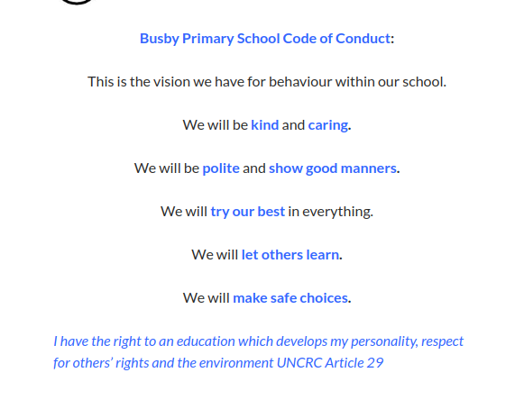
Our Code of Conduct

Slide 7
Literacy
Handwriting – Nelson not cursive
Reading- Storyworlds
Phonics – Jolly Phonics
Writing

Slide 8
Maths and numeracy
East Renfrewshire Cluster methodology (language)
Handy Hints cluster videos online
Numeracy across the Curriculum (e.g. loose parts, skills academy…)
Mental maths/ Number talks
Group and flexible learning
Plenary sessions/ sharing learning experiences

Slide 9
Skills Academy
Please provide an overview of what is on offer for your children and the skills which they will learn.
P1-3 Skills Academy: Thursday afternoon or Primary 4
Life Skills- Mrs McLean
Food Technology- Mrs Forsyth
Design/Technology – Miss McDonald
Community Skills- Miss Wight
Creativity- Miss Paisey
Please come prepared with anything you have been asked to bring!

Slide 10
Our Wider Achievements
We would love to share in the children's achievements out-with school.
Please let us know about these using our online form so we can celebrate each one!
Once you have completed the form, send a photo into school with your child so we can add it to our whole school display.
Remember to look out for our Wider Achievement assemblies throughout the year in November, February and April.

Slide 11
Our Class Blog
Each class has an active blog to keep you involved and updated on the children's learning experiences throughout the year.
Each class blog can be found on the school website.

