Slide 1
Act it Out
Problem Solving

Slide 2
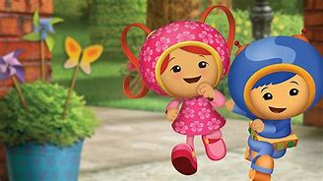
Team Umizoomi – Nick Jr
Milli, Geo and Bot are always trying to solve problems

Slide 3
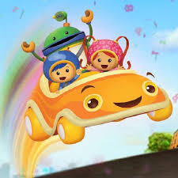
Milli, Geo and Bot come across all sorts of problems that they need to fix
They work together as a team to act it out
and solve problems
They need to know their Shapes and their Numbers!

Slide 4
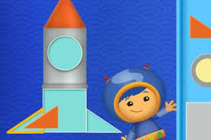
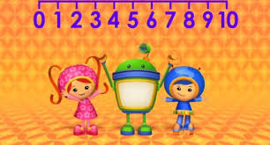
Watch an Episode
You can find Team Umizoomi on the TV or you can find episodes on YouTube on you computers or other devices
See if you can help them solve their problems by identifying shapes and numbers.

