Slide 1
Anxiety in Autism Healthier Minds
Chris Atherton
&
Angela Merrylees-Stalker

Slide 2
DSM V
Autism Spectrum Disorder
“persistent difficulties with social communication and social interaction”
“restricted and repetitive patterns of behaviours, activities or interests” (this includes sensory behaviour)
present since early childhood, to the extent that these “limit and impair everyday functioning”
Source: NAS

Slide 3
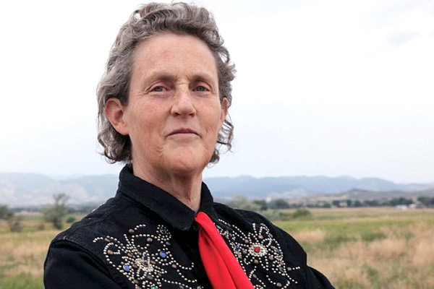
Temple Grandin
“Fear is the main emotion in autism”

Slide 4
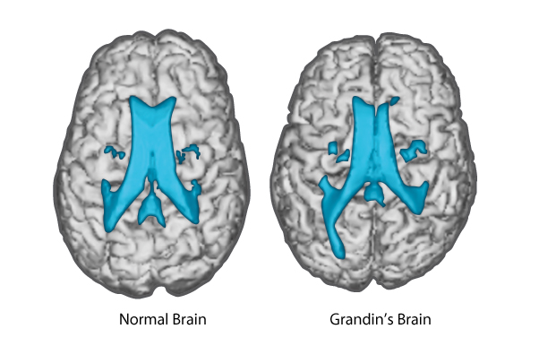
Temple Grandin

Slide 5
Patterns of Cognitive Difference in Autism Spectrum Conditions
Central Coherence Theory
Extreme Male Brain Theory
Executive Function Theory
Theory of Mind
Context Blindness Theory
Monotropism Theory

Slide 6
Result
The social world becomes extremely difficult for the person to navigate
Attempts to communicate are misinterpreted by others
Attempts to understand the communication of others is undermined
A system for navigating the social world is not effective / consistent enough
The social world is a place where I am not safe – fear, anxiety, stress = cognitive rigidity
Less options to choose from – most effective is to sabotage = I AM BACK IN CONTROL

Slide 7
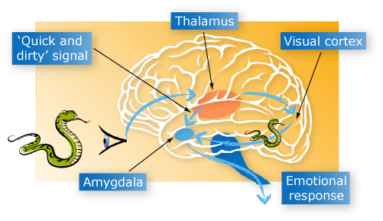
The brain and behaviour: anatomy of a hijack
FIGHT OR FLIGHT, FREEZE, RESPONSE
Heart rate and blood pressure increase. Large muscles prepare for action

Slide 8
The Escalation
Trigger
Phase
Escalation
Phase
Crisis
Phase
Recovery
Phase
Post Crisis
Phase
Learning
Phase
Outburst
Additional
Incident
A
R
O
U
S
A
L
Aggression
Anger
Anxiety
Baseline Behaviour
Exhaustion
Time
Notes:
Hypervigilant and hyper aroused young people often operate just below the crisis phase

Slide 9
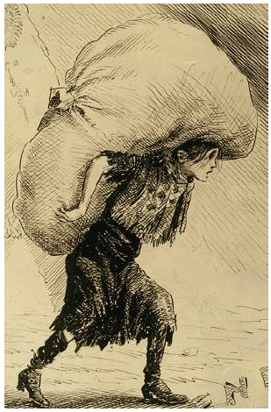
These children and young people are often carrying a very heavy load

Slide 10
What can I do to help?

Slide 11
Autism Specific Considerations (That can help just about anyone)
Keep things visual
Understand their sensory needs
Enhanced the structure
Break tasks down
Time to process
Make it easier
Tell them why
Support change and transition
Gradual exposure
Make it logical
Teach for each context

Slide 12
Autism Specific Considerations (That can help just about anyone)
Clear and consistent language
Special interests
Make them feel useful and capable
Highlight your own mistakes and recovery
Backward learning
Indirect praise
Depersonalise the situation:
Use rules to your advantage, e.g. “I have a dress code for work, because those are the rules of the system.”

Slide 13
Managing anxiety driven controlling behaviour

Slide 14
The Low Arousal Approach
Avoid dominating eye contact
Avoid jaw tension
Divert attention
Keep calm – or at least be aware of your emotions
When they step backwards – do the same
Step backwards in demanding situations – give the person space
Sometimes the hardest, but best thing to do is nothing
Don’t stand opposite – toe to toe (a little on the side)

Slide 15
The Low Arousal Approach
Sit down when the person is agitated
Avoid a marked body language – arms folded or fingers pointing
Pretend to be walking home from the pub
Avoid being infected by the person’s tension
Make sure your calm is contagious
Wait- it is often enough
Make other people leave
Avoid touching with tense muscles
Relax when somebody grabs you

Slide 16
Pathological Demand Avoidance
“Pathological demand avoidance (PDA) is increasingly, but not universally, accepted as a behaviour profile that is seen in some individuals on the autism spectrum.
driven to avoid everyday demands and expectations to an extreme extent. This demand avoidant behaviour is rooted in an anxiety-based need to be in control.”
NAS 2017

Slide 17
PDA as Atypical ASD
People with PDA can appear to have better social understanding and communication skills than others on the autism spectrum, and are often able to use this to their advantage. However, they might not really have as good an understanding of social matters as it seems.

Slide 18
Distinctive Features
resists and avoids the ordinary demands of life
uses social strategies as part of avoidance, eg distracting, giving excuses
appears sociable, but lacks understanding
experiences excessive mood swings and impulsivity
appears comfortable in role play and pretence
displays obsessive behaviour that is often focused on other people.
appear controlling and dominating, especially when they feel anxious.
can be enigmatic and charming when they feel secure and in control.
There are underlying neurological differences...

Slide 19
Controlling Behaviour
Use Less Direct Demands
Avoid…
Try challenges – “Bet I can get my coat on before you!” or “Can you show me……..”
“I wonder if we can...”
“Let’s see if we can make something...”
“I can’t see how to make this work...what do you think?”
“Shall we see if we can beat the clock...”
“Maybe we could investigate…”
“Who do you think could help us today…”
“It’s time for you to...”
“You’ve got to...”
“You need to...”
“You must...”
“You are not…”
“I need you to…”

Slide 20
Controlling Behaviour
Try to make them feel useful
“It would be really helpful if you could…”
Pretend you don’t know / get it wrong
For example, mis-read words in books, or ask them to show you how to do a certain task that you want them to do.
Offer limited choices – to give them SOME control
“Do you want to start the phased return during period three or period four?”
Choose your battles
Have flexibility - is this worth a massive meltdown?
Not the same as letting a person do what they like! Boundaries are clearly important, but where possible avoid them becoming power battles. E.g. ‘Because I’m telling you…”

Slide 21
Controlling Behaviour
Balance tolerance and demands
Accept that some days their anxiety is so high they will struggle to accept most demands, even ones others might not view as a ‘demand’, so reduce pressure.
On days where tolerance is higher try increasing demands.
Don’t take it personally
The demand avoidance is caused by high anxiety levels due to a perceived loss of control, and strategies to avoid may be quite elaborate, and seem calculated and hurtful.
Treat every day as a fresh start
Don’t let what happened yesterday drag over into today, it has no benefit to the child or yourself.
Voice control
Use a calm, even tone of voice, especially when they are demand avoiding.

Slide 22
Coping With Mistakes / Getting things wrong
Model how you and others have coped with frustration / making a mistake / ask for help yourself
If they are stuck, refusing or struggling, try backward learning – you do 90%, they finish the last 10% (and build from there)
Make “Asking for help” part of the daily timetable
Indirect praise
For example talk to a pupil or member of staff about something good the child has done while they are in earshot – may be more easily accepted than directly praising them.

Slide 23
Emotional Regulation
Teach strategies to deal with emotions (e.g. CBT / Resilience / Mindfulness)
Develop awareness that their reaction to the emotions of others are real and allow them to withdraw
Encourage them to express their feelings through pictures, books / scenes or music – I feel like…
Use something that they can relate to:
“How would Taylor Swift deal with that?

Slide 24
Phobic Reactions
Remember that:
no = never = the world is caving in on me
Teach coping strategies – psychoeducation, CBT, resilience
A de-sensitisation programme might help (e.g. building on short amounts of time in no-preferred situations / classes – rewarding and recognising very small steps and appropriate use of safety plans)
Use probability / maths / likelihood and logic, if the young person can relate to this. (Numbers are consistent, language / people are not).

Slide 25
Egocentrism
Self perception as an adult
Fixed mindset
Mistakes are not ok
Teaching and displaying appropriate social behaviours including language / topics appropriate to the context
Use rules to your advantage – depersonalise the situation (e.g. I have a dress code for work, because those are the rules of the system)

Slide 26
Closure
Remember that people with ASD have difficulty with transitions, but also with the idea of ‘finished’ and moving on between preferred and non preferred activities.
When will this (activity / work) end?
How will I know?
I am being interrupted
I need to complete this
Having an end leads to a feeling of closure = reduced anxiety

Slide 27
Moral Pop-Out Effect
Moral information processed faster than any other (Gantmans and Van Bavel, 2014)
Behaviour is viewed through a moral filter
When triggered – we can fail to see behaviours as their strategy for keeping self-control
Judging it as immoral instead of understanding
Maybe the change of perspective is starting to suppress the moral pop out effect

Slide 28
Affect Contagion
We feel other people’s affects…
Joy
Anger
Anxiety
Fear
Shame
Stress lowers our ability to withstand affect contagion
Important to reflect on your own experiences so that you can own your own feelings and remain responsive to the children’s needs

Slide 29
It’s a challenge for our internal and external narrative…
“Manipulating”
“Picking and choosing”
“Not buying in”
“Out to disrupt”
“Not interested”
Internally – “He’s not in today, result!”
You can choose a more helpful narrative:
“Fairness isn’t sameness…”
“This person is doing the best that they can right now…”
What is wrong with this person?
What has happened to this person?

Slide 30
What can we do together?
Create an relationship driven ethos as teachers, for teachers, with parents, with children and young people
Recognise that small changes from adults can affect huge changes for children
Find the perfect baseline in true consistency
Not through control and authority, but through:
Relationships
Routine
Emotional Availability
Opportunity

Slide 31
Helpful questions…
What problem is this person trying to solve?
Why now?
Why is this directed toward me?
How does this behaviour make me feel?
What is going on that is maintaining this behaviour?
Who can I share my concerns with?
How can I act rather than react?
Notes:
Your feelings – this will give you a clue as to what the function of the behaviour is

