Slide 1
Supporting Learners in the Early Years
June Walls
Kirstie Rees
Gillian Thorburn

Slide 2
Plan of the day
June – universal approaches and support
Kirstie - understanding and responding to distress behaviour
Gillian - understanding and supporting children with autism
Notes:
First part will be in your establishment groups specifically thinking about your centre ; strengths, areas for development etc
Then, opportunities to work together with colleagues from other establishments where we will focus on a case study.
You all bring a unique set of skills and experience and its important you have opportunities to learn from each other.
Supporting Learner’s Needs 21.1.20
9.30-10.00 Introduction and Activity June
10.00-10.45 June –universal supports and discussion
10.45-11.00 COFFEE
11.00-11.15 Discussion
11.15-12.30 Kirstie Addressing Behaviours
12.30-1.15 LUNCH
1.15-2.30 Gillian and ASD
2.30 COFFEE
2.45-3.00-discussion and questions

Slide 3
Activity: Introducing David!
Take a moment to read about David, a new child starting in your room
Note down David’s strengths and needs and things that can be used to motivate David. Note down possible sensory issues/triggers.
Notes:
Have out: case study, a range of assessment tools, template for recording answers
Assessment tools – I can, developmental milestones, observation profiles

Slide 4
Part 1: Universal Supports
Aim: To provide an opportunity to reflect on how effectively your learning environment, interactions and relationships meet children’s additional support needs
Notes:
Time to reflect… There will be things within this presentation that you will identify as a strength within your establishment or your own personal practice and there may be things you identify as areas for development. Its so important that we are continually taking a step back and reflecting on the language we use, our daily interactions with children and our learning environment.

Slide 5
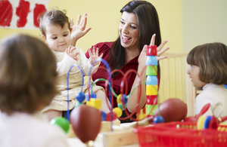
Universal Supports
Adult communication and interaction
Learning environment
Notes:
To do this first part we are going to use the PANECAL audit tool which was developed by educational psychology and SLT.

Slide 6
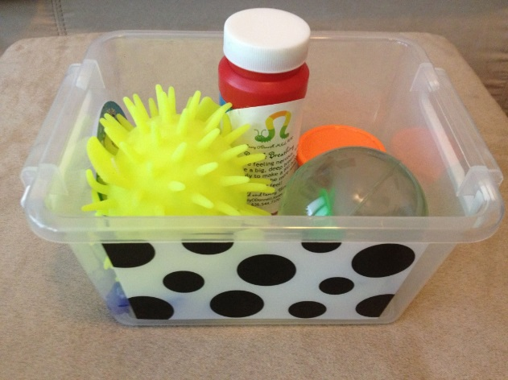
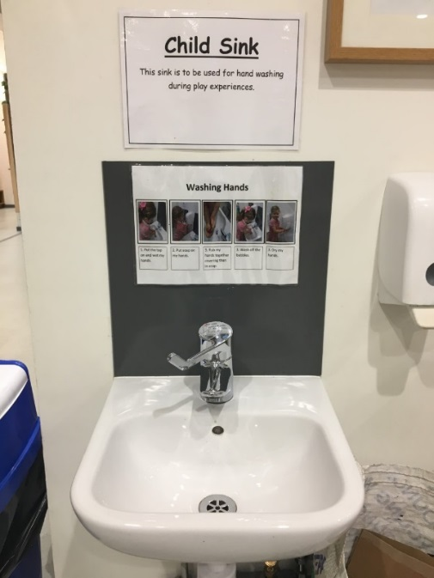
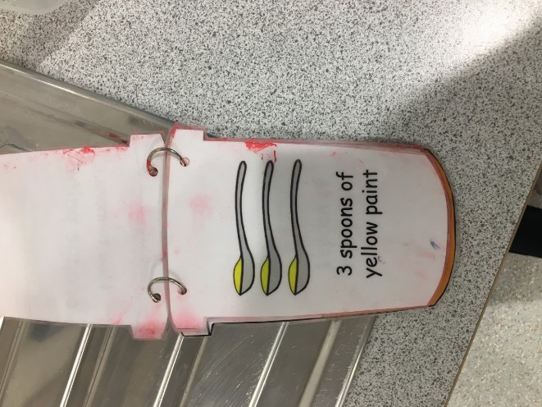
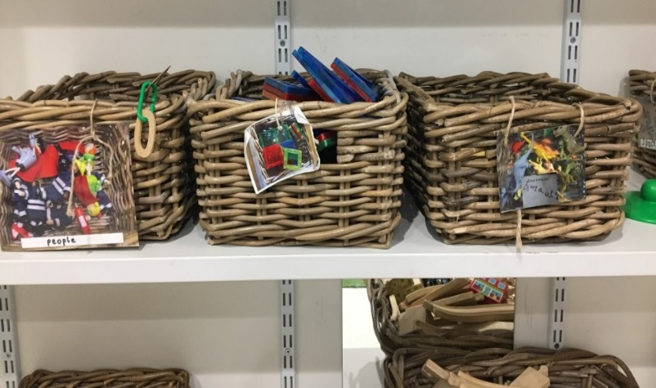
A physical environment that enhances and promotes opportunities for communication for all children
Notes:
Looking at indicator 1. Pulled out just some of the relevant points to think about.

Slide 7
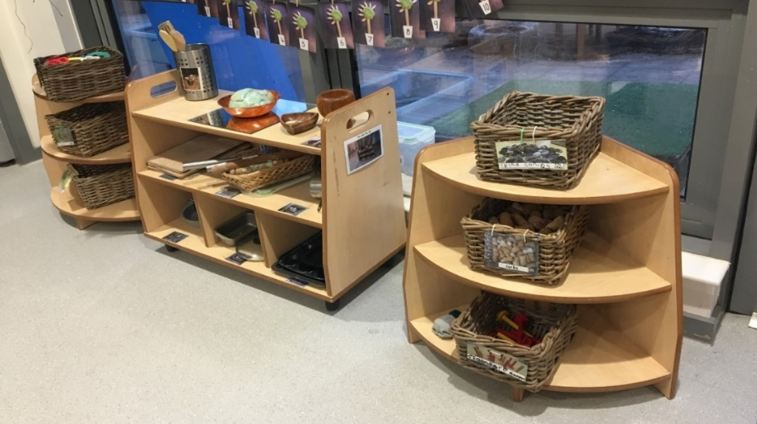
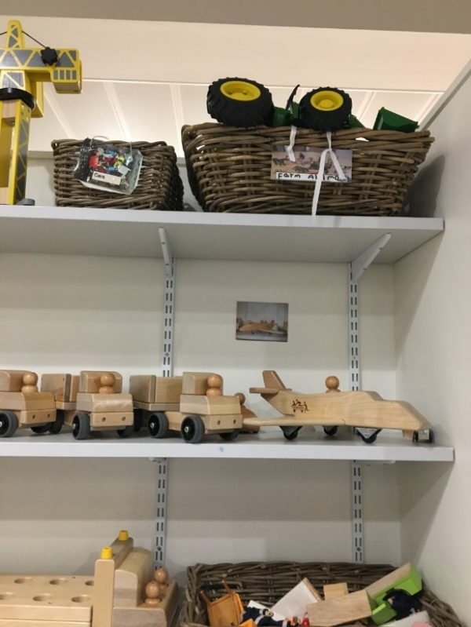
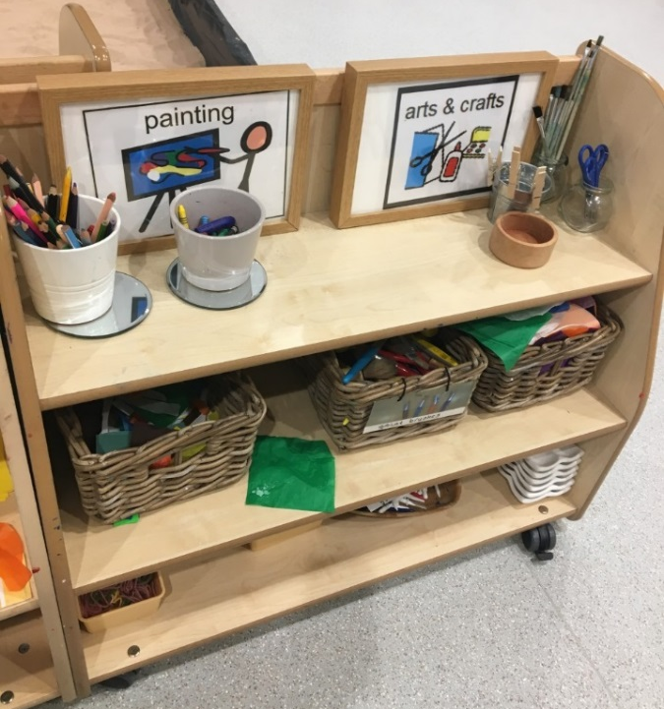
Do you provide recourses that are accessible and encourage child led learning?
Are you providing equipment that is accessible and clearly labelled with a picture of symbol?

Slide 8
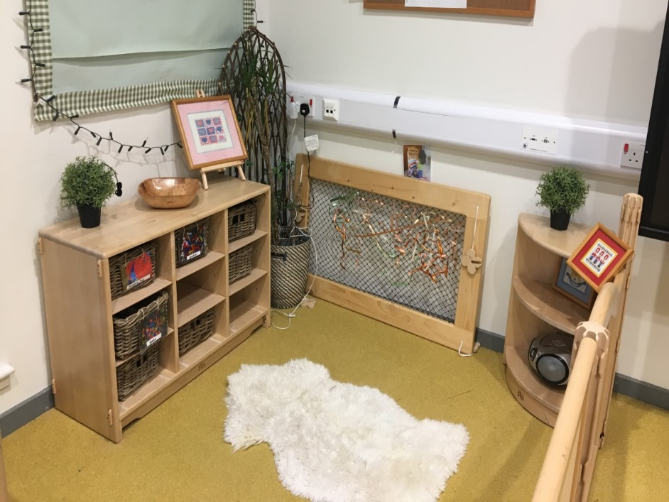
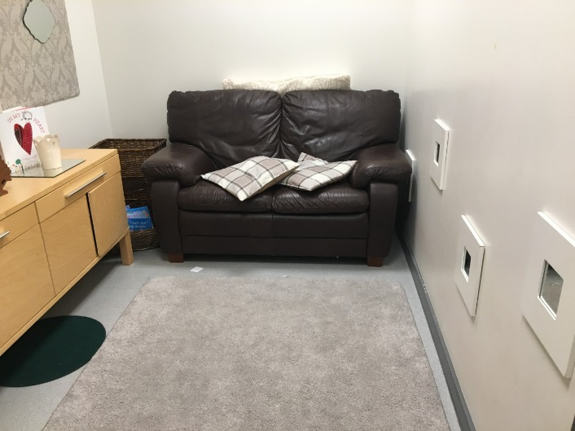

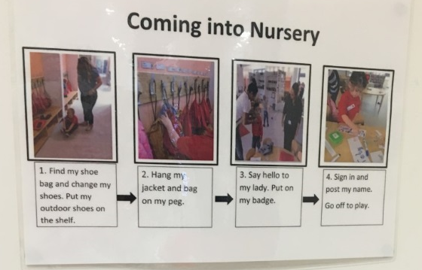
Does your environment have well defined learning areas?
Do you have quiet areas that are less visually distracting/stimulating?
Are symbols and pictures used to aid children’s understanding?

Slide 9

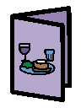
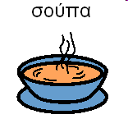
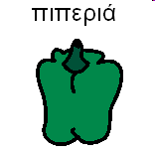

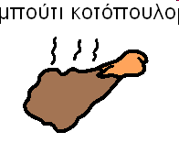
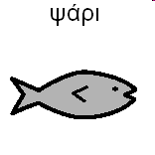
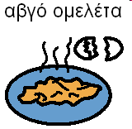
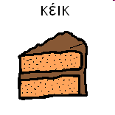


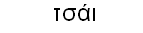

❖  
❖  
❖  

Slide 10

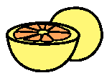




❖  
❖  
❖  

Slide 11
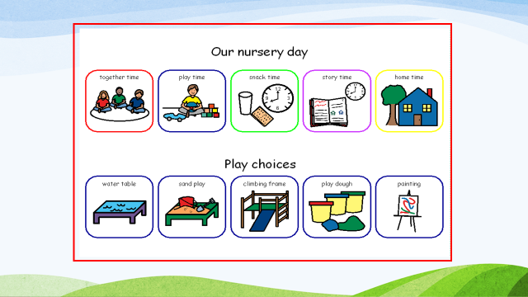
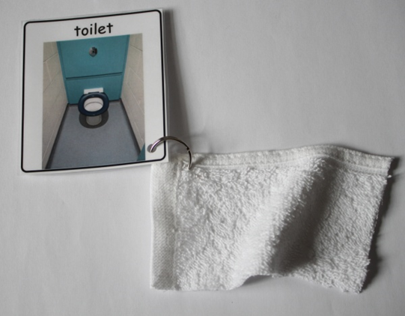
Stages of Establishing Universal Visuals
Symbolise the environment e.g. labels
Visualise routines e.g. snack time, handwashing
Visualise choice boards e.g. song or story choice
Objects of reference
Notes:
Symbols shouldn’t be set up just when an individual comes in and requires it. It should be integrated in to your environment and as a means of communicating with children at that stage. Visuals should complement verbal communication. It might take a bit of time to set up but once its in place when you have a child that comes in who really needs it, its much easier to access and put the support in place.
Visuals implemented in this way :
Encourage the child to move about more activities- the environment is more accessible to them
Develop language
Teach particular skills
Enhance development in specific areas

Slide 12
Reflect on strengths and areas for development… (think about what evidence you have)
Do you provide recourses that are accessible and encourage child led learning?
Are you providing equipment that is accessible and clearly labelled with a picture of symbol?
Does your environment have well defined learning areas?
Do you have quiet areas that are less visually distracting/stimulating?
Are symbols and pictures used to aid children’s understanding?

Slide 13
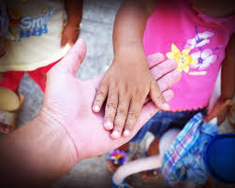
Communication that encourages and promotes participation from all and interaction styles that are responsive to individual children’s needs

Slide 14
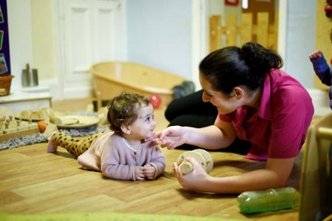
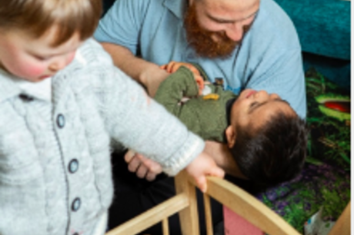
Do you use simple repetitive language?
Do you gain children’s attention before delivering instructions?
Do you talk at an appropriate rate using short sentences?
Do you adapt language to the level of the child to offer support and challenge?
Notes:
Gain childs attention- get down to their level, use their name etc

Slide 15
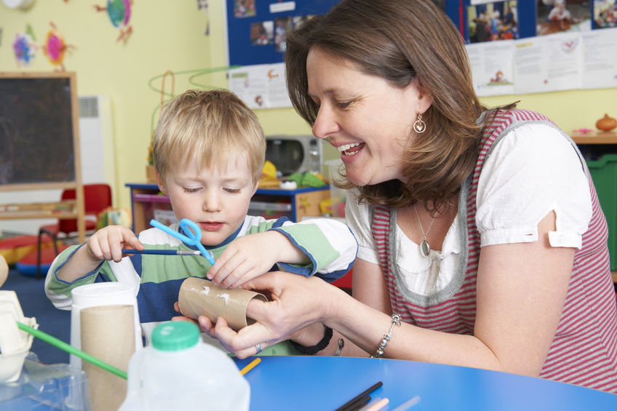

Do you model correct language when you hear a child’s incorrect vocalisation?
Do you extend the child’s vocalisations?
Do you use vocabulary that children can understand?
Do you give children time to respond?
Do you support verbal language with gestures and visual cues?
Do you give choices?
Notes:
Use positive correction -reflect back the correct word or phrase?
Running commentary rather than asking questions all the time
Encouraging children to speak within groups as well as in free play? – Even the least verbal children
Forced choice, closed questions open questions
I can see you’re feeling angry is that right, is it – Be honest! I see you smiling are you happy, You said you are angry at xx are you sad that he doesn’t want to play just now?
‘Safe hands’ instead of ‘no hitting’
Ensure all staff are aware of the chosen phrases
VERP- Interesting just to reflect on the language and interaction we use with young children. One example was when child led play was introduced people were anxious about asking questions, lost a bit of confidence and just asked the same question. Its interesting to just reflect on our verbal communication and how effectice this is. There is a project called PANECAL which is used like an audit tool but can be a helpful checklist just to reflect on. Just looking down that like there will be strengths for you and for your centre as a whole and perhaps areas to develop. But just thinking about reflecting on how effective your verbal communication is.. Is it pitched correctly for each individual in the room?

Slide 16
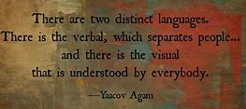

Slide 17
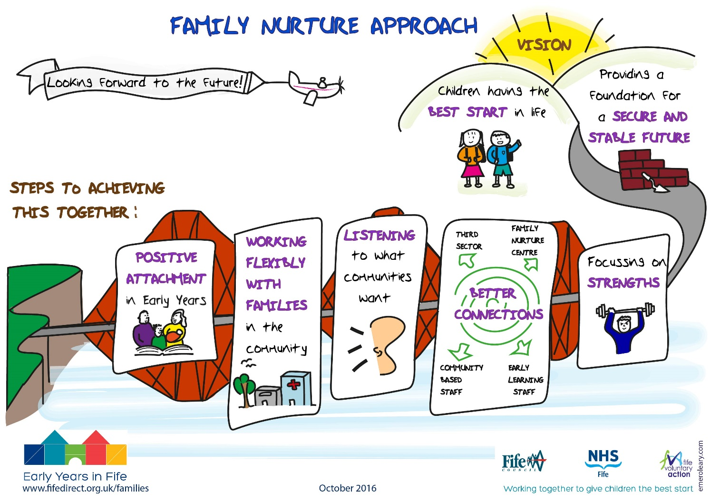
Do you speak sensitively to children?
Do you settle children when they arrive?
Do children have a consistent trusting relationship?
Notes:
Key worker- and regular contact with them
Modelling and scaffoloding

Slide 18

Do you regularly join in play with children?
Do you model a range of positive behaviours and language?
Modelling acceptance of making a mistake
Modelling problem solving
Modelling asking for help
A focus on relationship repair
Modelling play, social skills etc
Do you develop children’s emotional vocabulary by naming and describing emotions and feelings?
Notes:
Children learn through modelling so thinking about the language you use and the example you are showing that its ok to make mistakes and model how you would go about problem solving that. Its ok to ask for help-
Children are learning about relationships and problem solving so these are opportune times in nursery for them to learn about feeling, develop empathy- how the other person felt and problem solve how they could make it better.

Slide 19
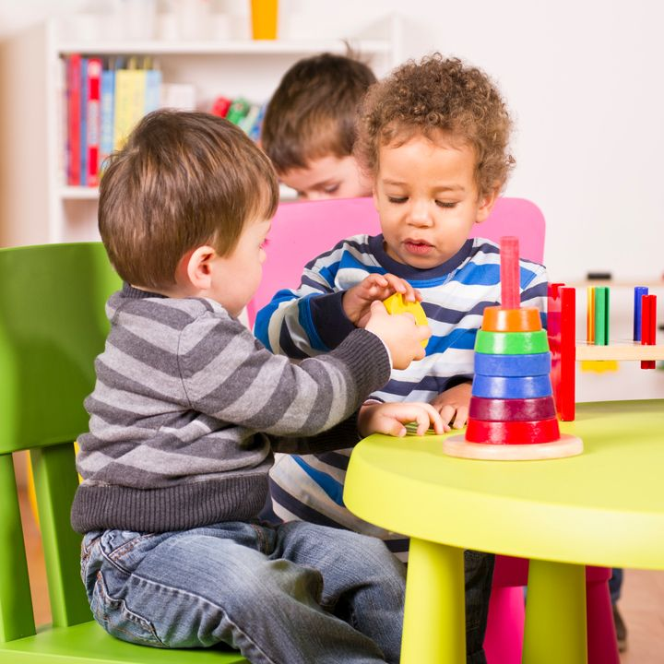
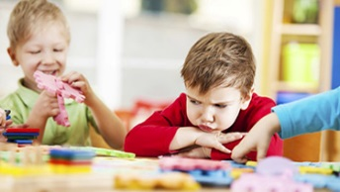
Do children have clear explanations of expectations and boundaries?
“Be a good boy…”
“Are we showing good listening?”
“Behave!”
“The children in this room are great at helping tidy our toys away”
“Don’t hit”
“safe hands”
…and is this consistent?
Notes:
Are the expectations clear. Even thinking about some of the phrases we use…
We all feel more at ease when we know what to expect in a given situation and helps them to trust that the adult is in control. Using the same phrases around the nursery
Having the consistent expectations as a staff team; The response is predictable; Consequences are logical
Make sure expectations are consistent (not all the same), how you react, the phrases you use around key rules so safe hands in nursery can be the prompt that is used by all staff, good waiting
Are we consistent helping them to predict?

Slide 20
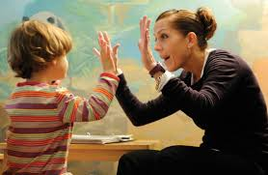
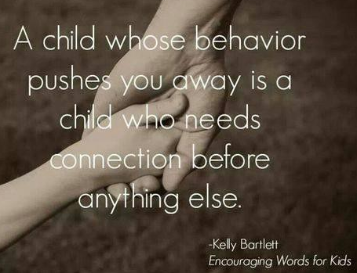
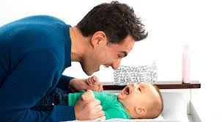
Are you attuned to non verbal communication?
Notes:
From indicator 4 but still relevant to indicator 3: responding sensitively to unsettled children, responding to efforts to communicate no matter what that means is
Gillian going to talk more about intensive interaction as an approach to develop communication and interaction with children with communication needs but actually think about how all children could benefit from adults really tuning in to them and taking the lead from them.

Slide 21
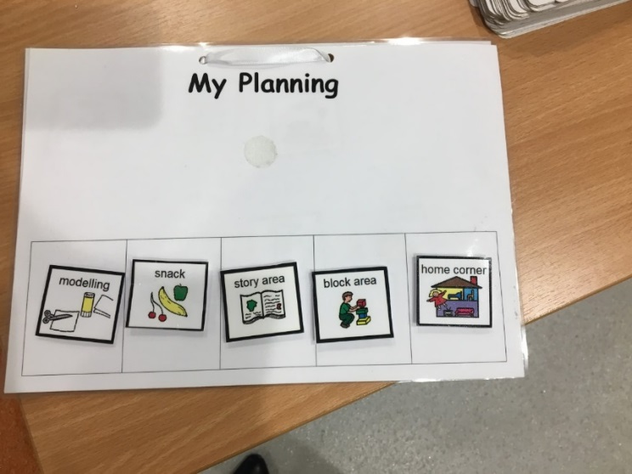

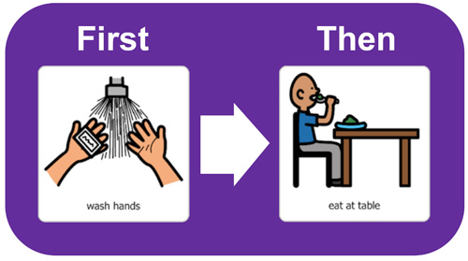
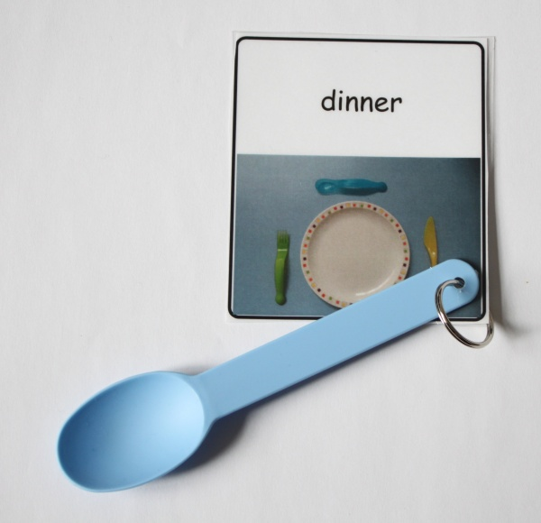
Do you prepare children for expected changed and support transitions?
Notes:
What transitions do children make in the early years?
Visuals and markers in the environment help children (and adults) make sense of things.

Slide 22
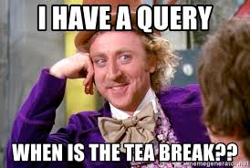

Slide 23
Reflect on strengths and areas for development… (think about what evidence you have)
Do you:
use simple repetitive language?
gain children’s attention before delivering instructions?
talk at an appropriate rate?
adapt language to the level of the child to offer support and challenge?
model correct language when you hear a child’s incorrect vocalisation?
extend the child’s vocalisations?
use vocabulary that children can understand?
give children time to respond?
support verbal language with gestures and visual cues?
give choices?
speak sensitively to children?
settle children when they arrive?
regularly join in play with children?
model a range of positive behaviours and language?
develop children’s emotional vocabulary by naming and describing emotions and feelings?
prepare children for expected changed and support transitions?
Are you attuned to non verbal communication?
Do children have clear explanations of expectations and boundaries?
Do children have a consistent trusting relationship?

Slide 24
If you have the universal support in place you have to put in as much targeted support for individual children
These supports will support all learners but are a crutch for learners with ASN.

Slide 25
Supporting Learners with ASN:
Understanding and Addressing Behaviours
Behaviour as Communication
Notes:
The

Slide 26
Aim of Session
1. To discuss behaviour as communication
To help staff to make sense of and address behaviours that are challenging
3. To talk about ways of supporting one another
Notes:
All behaviours as communication – how we are with our partner; at work. Our behaviour communicates a lot. It can be more difficult to understand and interpret the behaviour of young people wit learning difficulties who reply on a far more limited repertoire of communication to make their needs known. Can have responses to environment – rather than deliberate attempts to initiate. These behaviours can be challenging , deskilling and stressful/. Important to look of ways of supporting one another

Slide 27



Behaviour as Communication
How do babies get our attention?
Notes:
Signalling ( smiling, vocalising, cooing) as they get older, begin to point, grab us, craw. l away, throw things, look at us
Aversive ( crying – distress signals)
Active behaviours (crawling) Eventually learn more complex means of communication. E.g. cry deliberately – just top get us up the stairs. As new parents, spend a lot of time trying to work out what the behaviours mean.

Slide 28
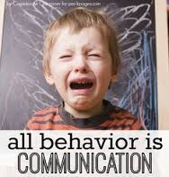
Notes:
Continues as we are adults; how we communicate with others is often non verbal but is still am means of getting our needs met; ignoring people, shitting a dorr,; arguing;

Slide 29
Behaviour as Communication
‘Having learning needs affects the way a person understands information and how they communicate. Children with more learning difficulties may have no or extremely limited verbal communication. Many may experience complex physical, sensory, or mobility difficulties.’
Notes:
For children with learning difficulties, like I said, their communication may be a response to the environment; may be because child lacks cognitive and communicative abilities or lacks social awareness so is unsure of the social appropriateness of a behaviour. This can include aggression, destruction, self-injury, and other behaviours (e.g. running away) I have mentioned the challenging behaviour foundation here. Challenging behaviour is often associated with learning difficulties. Need, BUILD too has a journal and conference. Challenging Behaviour foundation is esp. useful for professionals and for parents. E.g. telephone line, advice sheets on restraint

Slide 30
Poor Self-Regulation
Limited Understanding
Rigidity of Thought
Sensory Sensitivities
Spikey Profile
The Development of Children with Learning Difficulties
Notes:
Inability to stop and think and think of consequences .
Limited understanding – processing time – nay lead to high anxiety level if they don’t know what is happening next
Sensory issues can be huge. Means there can be a lot of triggers that are difficult for us to identify; e.g. sitting on a carpet; light coming through blinds; someone being too close to them

Slide 31
There is always a reason for the behaviour.
They may be ill or in pain
It may be filling a communicative function
(to avoid, express feelings, get stimulation, obtain tangibles, get attention)
It may be a reaction to fear or anxiety or discomfort
It may be to get sensory feedback
Notes:
It is not deliberate or provocative or meant to annoy. You can often get it down to 4 or 5 main reasons; this helps me when trying to do assessments
In many cases, it’s a way for a person to control what is going on around them and to get their needs met.
Dundee university:- 80% of the difficult behaviours have a message value
Approx. 5% are ‘habit’ behaviours: these are hardest to shift as they are deeply ingrained.

Slide 32

Children may display a limited repertoire of behaviours.
E.g. one behaviour may serve many communicative functions
Notes:
People with severe and complex learning needs are not likely to have learned the complex social responses that most people use to make sure that their own interests are respected. The challenging behaviours that people engage in may serve a function which it is not ethical to suppress. In other words, the functions of that behaviour should be respected. Interventions must result in people being given or taught viable alternatives to achieve desired ends.’
Limited re[pertoire the smile behaviour may sever a number of different functions, both positive and negative. I am working with 4 years old with very severe autism in a mainstream setting. She is biting; assessment suggests it is when someone is too close; when she is stressed and she cannot make sense of the environment but also when she is excited,

Slide 33
Iceberg Analogy
Specific Behaviour
kicking other children
Underlying
Impairments
Literal interpretations
Sensory overload
Poor communication
Poor understanding of social rules
Child’s Motivation
Wish to escape
To ask for something
To express feelings
To get stimulation

Slide 34
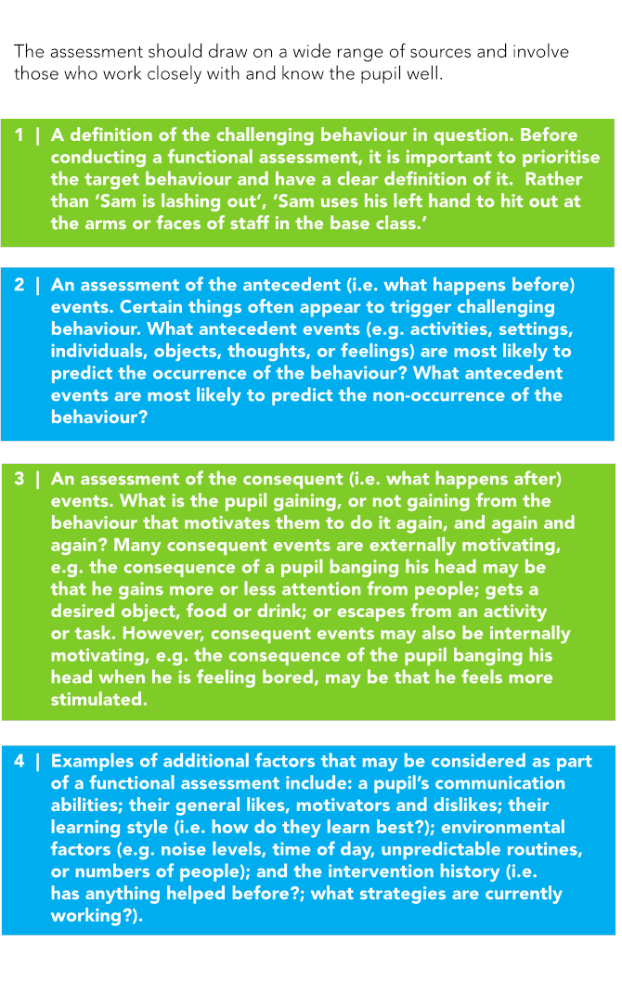
Assessing Behaviours
Notes:
Refer to the Framework for severe and profound needs. Not just relevant for those with profound needs, Health and wellbeing – highlights impact puff transitions on change sin behaviour – e.g. change in staff
Again , highlights need to have in depth knowledge of pupil in order to detect changes
Importance of working out what behaviour means – this needs to be based on accurate assessment – in order to out in place strategies which increase choice making and communication whist replacing challenging behaviour with more appropriate one in that context with the use of other approaches – e.g. solution focused meeting in order to elicit times when child is coping better and when behaviour is not present
Assessment of meaning – antecedents. Consequences
Functional analysis approach

Slide 35
Define the behaviour
Think about what behaviour you are seeing from David

Slide 36
2. Assess the behaviour:
What are the Reasons for the Behaviour?
E.g. ‘kicking other pupils’ may be…
An attempt to escape from a group situation
An attempt to reduce sensory and environmental input
An attempt to obtain attention of some form
An attempt to obtain a desired object or activity. .
it is important to try to make an accurate assessment before formulating hypotheses..

Slide 37

Assessing Setting, Triggers and Consequences
Observations
Tally
ABC Sheet
Motivational Assessment
Frequent Contact with Home
Notes:
Define the problem behaviour

Slide 38
Consider the Following...
WHO ..is present when the problem occurs?
.
WHAT ...is happening just before the problem occurs,
and what happens immediately after the behaviour?
WHEN …does the problem behaviour occur?
WHERE …does the problem behaviour take place?

Slide 39
Think about the ‘exceptions?’
(Be Solution-Focused!)
WHO ..is present when the problem is NOT there?
WHAT ...is the child doing when the behaviour is not present?
WHEN …is the child engaging in an activity?
WHERE … in the nursery does the child cope well?

Slide 40
Influencing Factors
Physiological
Environmental
Activities and Demands
Events or incidents that occur some time before problem behaviour

Slide 41
Activity
Complete the ‘Motivational Assessment’ for a young person with whom you work .
NB Think carefully about the target behaviour

Slide 42
Case Study – Can you now do the following?
Identified Behaviours
Reasons for Behaviours (from your assessment)
‘Exceptions?’

Slide 43
Addressing the Behaviour
Putting together a Behaviour Plan
Environmental changes
curriculum changes to meet pupil’s need
Interventions to reduce/replace behaviours
teaching new skills
e.g. to increase communication skills

Slide 44
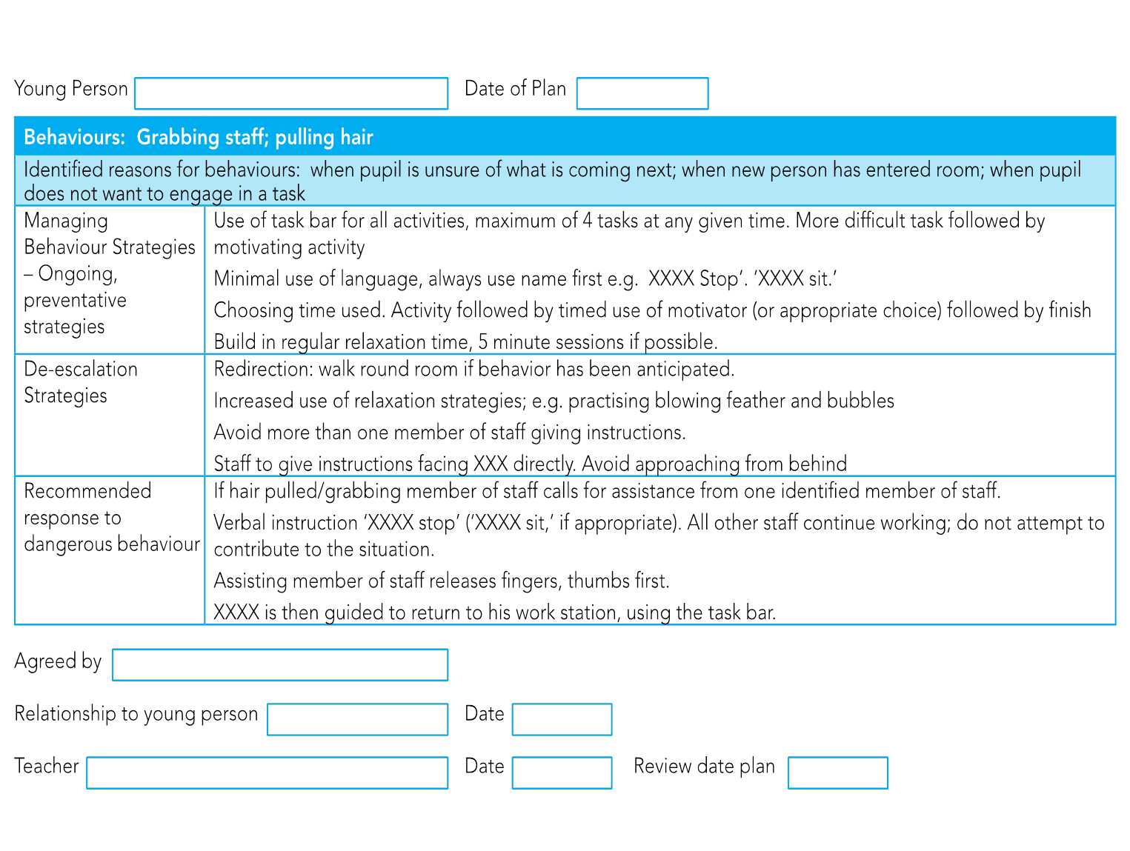
Notes:
Example of preventative strategies and development of skills

Slide 45
Writing a Plan for David
Remember to focus on times when the behaviour is not present/

Slide 46

Supporting One Another
On-going, open discussions with colleagues and at staff meetings; liaison with parents, staff and other agencies
Solution-Focused discussion
Input into positive behaviour support plans (including proactive and reactive strategies; environmental changes; clarification of strategies everyone should use)
Sharing of Resources

Slide 47
Lunch

Slide 48
Supporting children with autism in the Early Years.

Slide 49
Discussion
What is autism spectrum disorder?
What are the common traits and challenges?

Slide 50
What is autism spectrum disorder?
DSM V definition
“persistent difficulties with social communication and social interaction”
“restricted and repetitive patterns of behaviours, activities or interests” (this includes sensory behaviour)
present since early childhood, to the extent that these “limit and impair everyday functioning”
Source: NAS

Slide 51
Identifying Autism
Common Traits and Challenges

Slide 52
Common Traits and Challenges
Difficulty understanding and using non-verbal communication skills:
-Eye contact (Do they look at you when you talk to them and play with them?)
-Gaze (Will they look at something that you are looking at?)
-Facial expressions (e.g. Do they show emotion in their facial expressions? Understand your facial expressions? Reciprocate a smile? Do they know when you are sad?)
-Gesture (Do they point at things they are interested in? Do they follow your point?)

Slide 53
Common Traits and Challenges
Difficulty with play and social interaction:
Do they show interest in other children and adults? (e.g. watching others, showing or telling you things, inviting you to join their play)
Reciprocity – will they copy/respond to your actions (e.g. clapping, waving, noises, language?))
Are their play skills at an appropriate level for their age?

Slide 54
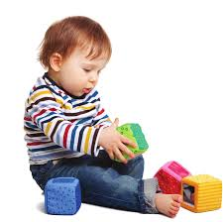

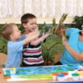
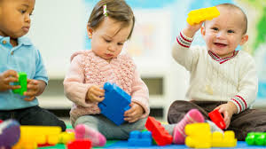

Development of Social Play
Solitary play (0-2 years)
Spectator play (18-30 months)
Parallel play (2-3 years)
Associative play (3 – 4 years)
Co-operative play (4 years )
Notes:
Solitary play: playing alone. Thinking, exploring, discovering
Onlooker play: (18 months-2½years) This stage of play involves random exploration. A child learns through personal interaction with people and objects within the environment. They don’t participate in the play around them. They spend much of their time watching other children in their play. They may even talk to them but they don’t interact or join in with them. Although the child may ask questions of the players, there is no effort to join the play. This type of play usually starts during toddler years but can take place at any age. As a child grows they will start to notice others around them during their play. This is considered Onlooker play and is around the 2 -2½ years.
In this stage the child spends most of their time observing, watching other children play
Parallel play (2 -3 years): Children play side by side with similar toys, but there is a lack of group involvement. They play independently but will play next to other children and they may use their toys.
Associative play (3-4 years): Involves a group of children who have similar goals. They will play with other children using the same equipment and will even talk and interact with them but not actually playing with them. Children in associate play do not set rules, and although they all want to be playing with the same types of toys and may even trade toys, there is no formal organization. Associative play begins during toddlerhood and extends throughout the preschool age.

Slide 55
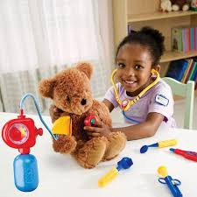
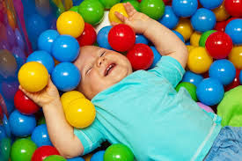
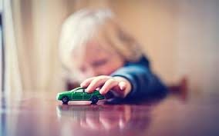
Play Developmental milestones
Exploratory 1 – 12 months
Functional 12 – 18 months
Pretend 2 years
Notes:
Pretend – starts with symbolic play (around 20 months) – pretending that an object is something else e.g. shoe as a phone

Slide 56
As their language develops you may start to notice….
Language not used meaningfully – e.g. copying words heard (echolalia)
Pronoun confusion (saying ‘you’ for ‘I’)
Literal understanding of language (e.g. find it difficult to understand jokes)
Difficulty sustaining a two-way conversation
Differences in speech – e.g. tone and volume

Slide 57
Common Traits and Challenges
Repetitive behaviours (e.g. lining up toys, spinning wheels, repetitive phrases)
Repetitive movements (e.g. flapping hands, waving fingers on front of eyes)
Like a set routine. Distressed by changes to usual routine.
Unsettled at points of transition, particularly moving from preferred to non-preferred task.
Fixated interests

Slide 58
Senses are Hypersensitive (over-sensitive) or Hyposensitive (under-sensitive)
Often sensitive to loud noises, busy environments
Can be sensitive to certain textures (reluctant to eat certain foods, wear certain clothes)
Can be sensitive to smell
Can be sensitive to light , or fascinated with lights
Can be indifferent to pain

Slide 59
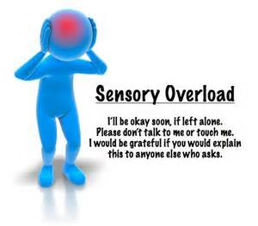
Experience it
https://www.youtube.com/watch?v=Lr4_dOorquQ
Notes:
1m 24s
https://www.youtube.com/watch?v=Lr4_dOorquQ

Slide 60
As they become older you may notice..
‘Inappropriate’ comments and actions
Difficulty understanding norms of social proximity
Require support to help them to understand other people’s feelings
Difficulty understanding other people’s thoughts (can give too much or too little information when talking, can misinterpret people’s actions and intentions)
Need / desire to do things my way - predictability

Slide 61

Associated Difficulties
Delayed Speech and Language
Delayed motor development
Anxiety
Distressed behaviour
“Fear is the main
emotion in autism”
Temple Grandin
Notes:
toe walking

Slide 62
Meeting the Needs of Children with Autism

Slide 63
Activity: David
What assessment tool(s) would you use to identify targets for David and to plan additional supports?
Notes:
Explore different assessment tools

Slide 64
Social Communication Assessment and Planning: THE SELF
Social Interaction
  Social conversations
  Social conventions
  Social play
  Friendships
  learning
Emotional Literacy
  Self awareness
  Awareness of others
  Self management
Language and Communication
  Listening
  Talking
  Understanding
Flexibility
  Accepting another’s point of view
  Coping with change
  Obsessions vs interests

Slide 65
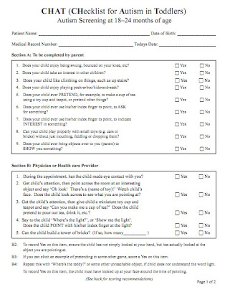
Toddlers
The CHAT
(Checklist for Autism in Toddlers,
Baron-Cohen 2000)
QCHAT
(Quantitative Checklist for Autism in
Toddlers, Allison et al 2008)
For children around 18-24 months
Available online
Notes:
http://www2.gsu.edu/~psydlr/M-CHAT/Official_M-CHAT_Website_files/M-CHAT-R_F.pdf

Slide 66
Social Play Record
Coventry Grid (ASD vs Attachment)
Speech and Language Scales
Observation template

Slide 67
Creating an Early Years Environment which Reduces Anxiety
make it predictable
make it visual
make it consistent
make it easy to process
make it explicit

Slide 68
Considering Sensory Needs – Examples
Remember to use visuals to cue/plan/transition
I need to shut out noise or other senses – ear defenders; black out tent; planned time away from the group; sensory room
I need to make a mess with water/sand/slime – define an area for messy play
I need to touch – make a sensory box with different materials
I need to taste/bite – provide alternative food items to taste or chewable items
I need deep touch – provide tight cuddles (set time limits); fill a rucksack with items for the child to carry; keep a supply of heavy blankets

Slide 69
Make it Visual
Knowing what to expect reduces anxiety
Language processing difficulties affects the ability to understand verbal instructions
Words ‘disappear’ – symbols / pictures can be held on to
Nature of the visual can be flexible to fit the need:
  Real objects
  Tactile symbols / object of reference, for example swimming trunks, packaging, food labels
  Photographs
  Miniatures of real objects
  Coloured pictures
Notes:
All children will benefit from a visual timetable
= knowing what to do and what is next reduces anxiety

Slide 70

Stages and Purposes of Visuals
Symbolise the environment
Visualise routines e.g. snacktime, handwashing
Song or story choice
Objects of Reference
Personalised ‘Now’ boards
Personalised ‘Now and Next’ boards
Visual timetables
Develop language
Emotional Regulation
Social Stories
Restoring Relationships
Notes:
Not just jumping straight to now and next but thinking about the purpose of the visual
It is to:
Encourage the child to move about more activities
Develop language
Teach particular skills
Enhance development in specific areas

Slide 71
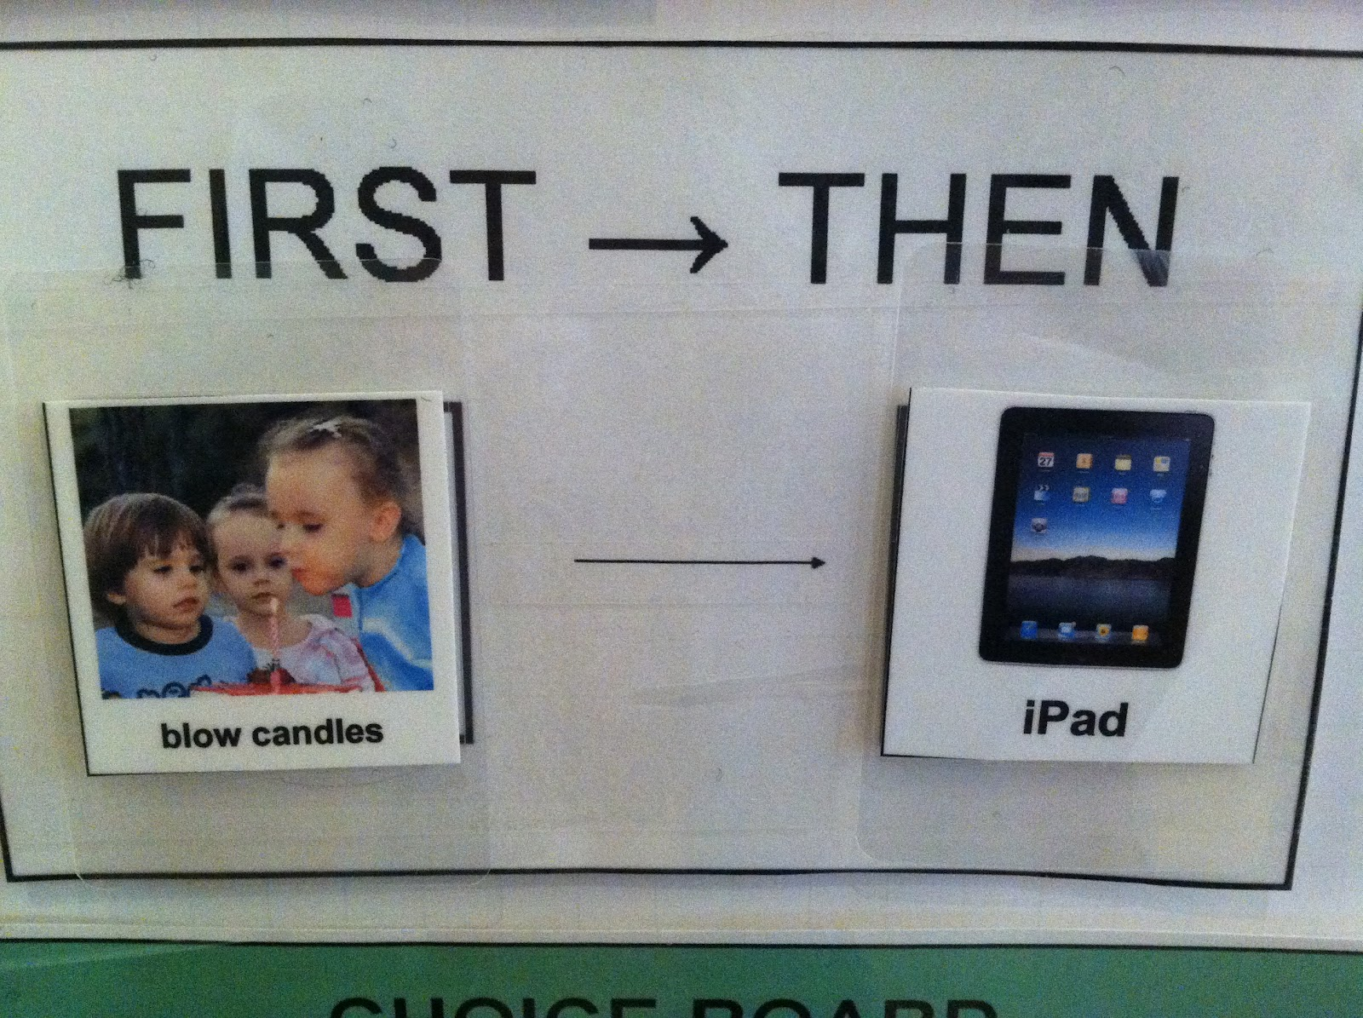


Start with Now and build up to now/next
Helps understanding of a 2 step sequence
Reduces uncertainty of what is coming next and what is expected
Use as a motivator for less preferred activities
Encourages the child to move between activities
Personalised photographs or google images?
Notes:
Provide a concrete source of information regardless of noise levels etc.
Help to break down instructions into manageable chunks of information
Provide a clear message about the daily routine – what there is to look forward to and how many tasks there are left

Slide 72
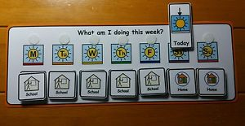

Visual Timetables
  Using a visual timetable to provide a structure- a clear beginning middle and end point
  The child knows what to expect
  Helps with transitions – remove each activity as its completed (finished box?)
  Can use at nursery and home
Notes:
Knowing what to do now and what to do next reduces anxiety. Words ‘disappear’ – symbols / pictures can be held on to
The person should always know:-
Where do I have to be?
What am I doing?
How much do I have to do?
When will I know when I have finished?
What will I do next?
Things must have a beginning, middle and a clear ending.
Children respond best in a structured environment where things are organised and clearly labelled.

Slide 74
Modelling and Scaffolding through child led play
Join child in their play
Model language and appropriate social behaviour
Praise and encourage positive behaviours
Model play skills e.g. functional play or pretend play

Slide 75
Planned play sessions
A little more adult led e.g. social play group with planned target outcomes
Can start 1:1 then increase size of group to include more children (gradually)
Targets such as:
-Developing emotional vocabulary
-Understanding emotions and facial expressions
-Managing strong emotions
-Sharing and turn taking
-Developing functional or pretend play skills
-Language development
Notes:
Play skills
2 sets of the same toys (choose appropriate toys for their stage. E.g. a child who is engaging in sensory play – mouthing objects, pushing and pulling toys is not ready to be introduced to a doll with all her accessories. Better to start with a small car to push or a piece of plasticine to roll out)
Play script may be used . Ensure language appropriate to child’s level of understanding. E.g. toy man and with wheelbarrow and toys. ‘in’ ‘push push push’. Plastecine and a roller ‘roll roll roll’
(cars, animal set, animal train , children’s playground, farmyard, garages, the sea, dolls, dog with pet carrier, building blocks, space shuttle, firemen, cup of tea, making a sandwich, camper van and park, car track, teletubbies, teddy bear’s picnic)
Play dough, sand and water, puppets)

Slide 76






Supporting Emotional Regulation
Notes:
Some children will make progress with this just by consistently using visuals and reducing the anxiety in the nursery environment. Others will require specific teaching of skills.

Slide 77






Supporting Emotional Regulation

Slide 78
Make it Explicit – Social Stories
Visually teaches the rules of a situation
Can be modified to suit the child’s interests, developmental stage and communication needs
Read regularly and during times when the child is relaxed
Can be linked to a reward system

Slide 79

Make it Explicit – Social Stories

Slide 80
Activity
Discuss the approaches and additional supports which are commonly used in your establishment already to support children with ASD?
Discuss ways in which your approaches could be further developed.

Slide 81


Intensive Interaction:
Learning through Social Connection

Slide 82


Training, books and DVDs Dave Hewett or Pheobe Caldwell

Slide 83
Intensive Interaction - Who is it for?
Children and adults with severe and complex needs including those with ASD
Pupils who may be pre-verbal, with few or limited communicative behaviours
Pupils who are extremely socially withdrawn, and who show little interest in other people
Pupils who display various stereotyped self-stimulatory behaviours
Notes:
Mirror neurons fire in person who makes noise/does an action and person who hears/sees it.
Children with ASD overloaded with sensory information
Based on studies of parent-Infant Interactions

Slide 84
Behaviour as a language they can respond to
Notes:
Why do children with ASD/communication difficulties stim or use repetitive behaviours? – seeking feedback, trying to control their world, focusing on one activity to reduce the confusion of the outside world, feels safe – BY LEARNING THEIR LANGUAGE WE CAN ENGAGE WITH THEM
Intensive interaction is an approach to
teaching and spending time with people with learning difficulties which facilitates the development of social and communication skills (Nind, 1999)
To support people with severe and complex needs including those with ASD
Pupils who may be pre-verbal, with few or limited communicative behaviours
Pupils who display various stereotyped self-stimulatory behaviours

Slide 85
How is it done?
1) Observation (whole body)
2) Gain attention – Use behaviours/sounds which are in their repertoire
e.g. ‘That’s my sound etc but where is it coming from?’
3) Surprise and pause to encourage engagement
That’s my sound but it sounds a bit different e.g. echoed on a kazoo, different pitch, different timing, different rhythm
That’s my rhythm but it’s in a different context – e.g. tap along to the rhythm of their vocalisations
Notes:
Observation – Look at their whole body – Not just face
Try to work out what is wrong, what they are trying to communicate?
What are they getting out of a particular action? What sensory feedback are they getting (Do they like the look, feel or sound of a particular action)?
Let them know that you are coming over (e.g. point to yourself and to the room/seat next to them) and ask permission to sit down next to them using gesture if this can be understood by the child (point to yourself and the chair)
2) Attention
(That’s my sound etc but where is it coming from?’)
Brain is fascinated when it sees something which is part of its repertoir – they start to flirt with you!
3) Surprise to encourage engagement
(That’s my sound but it sounds a bit different e.g. echoed on a kazoo, different pitch, different timing)
(That’s my rhythm but it’s in a different context – e.g. tap back with the rhythm of grunts)
Change rhythm

Slide 86
Examples
Mirror their actions
Use their sounds (even if they are not using them at the time)
Use name within ‘safe noises’ e.g. ‘Ah ah John ah ah’
Clap rhythm of rocking
Tap wall
Touch child
Tap feet
Pause to allow time for a response
Positive response to any behaviour which is interactive
Notes:
Work out what they respond to
*Always try to use sounds – easier to work with sound than anything else.
Although visual stimuli and touch can also work well
Video yourself
Neutralise the overloading speech by sandwiching with familiar/safe noises ‘Ah ah – John – Ah Ah’
What do you do if they are not really doing anything – e.g people with physical disabilities, cerebral palsy?
What sounds can they make? What have you seen them do?
Do this and it may or may not work
Pheobe: Example of a girl with cerebral palsy. Very rarely lifted her head up. All concerned and had tried lots of things to enc her to keep her head up. Had not been successful with any approach. She made a tutting noise. All staff took time to stand around her and make a tutting noise each day. Within 3 weeks her head was up all the time
Can mimic something as simple as their breathing
Can use a gazoo – so you are copying the noise but changing it slightly as you are using the gazoo
** If find a successful strategy – Do not suspend it because it seems the person is better – must keep it up.
Work at their pace – give them rest if they need it.
If telling you to go away – encourage but respect their wishes – this is good as it is communication! They need to know that you respond when they try to communicate something to you

Slide 87
Be attuned
Follow the child’s lead
Pause and allow time for response
Read the child’s behaviour and stop when they need a break.

Slide 88
Promotes the fundamentals of early communication
Learning to give attention to another person.
To share attention with another person.
Learning to imitate
Taking turns in exchanges of behaviour.
To have fun, to play. Develop concentration on a play activity.
Using and understanding non-verbal communication such as eye contact gesture, facial expressions, body language.
Learning to use and understand vocalisations
**An opportunity to model language e.g. ah ah.. John.. ah ah
**Reduction in distressed behaviours
Notes:
Research has shown II leads to improvements in children’s communication skills and confidence, reduction in distressed behaviour, improved adult child relationship, for some increased use of language
having your vocalisations become more varied and extensive, then gradually more precise and meaningful.
Study undertaken at Oxford Brookes University aimed to identify examples of good practice of II. Questionnaires sent to 118 special schools in England. Staff were asked to comment on benefits for pupils and staff. Their responses were summarised as follows…
Improved communication – increased use of vocalisations – greater use of language. Example in which man with complex learning difficulties and ASD began singing a nursery rhyme after a short period of time in which P Caldwell was using II. Prior to this point it was said that he very rarely used language – he had certainly never been heard to sing a nursery rhyme
Greater tolerance and enjoyment of interaction – CB. Reluctant to interact with me on previous visits – used his sounds and I gained his attention straight away. He seemed very interested. I mirrored what he was doing with a ball and he reached out to take the ball from me. He then passed it back.
Also improvements in ability to attend. Criticism – just spending time with children rather than educating them. Clear that II is education. Not possible to educate a pupil who is unable to attend. II helps to draw children out from their inner world. This has to happen before any education can take place. Improving communication and social interaction is a key target for these children anyway.

Slide 89
Sasha and Riana
https://www.youtube.com/watch?v=qkJKktBaTRY
https://www.youtube.com/watch?v=UvIEwUbzF4c
Notes:
Part 1
Part 3 stop at 2 min 30 sec

Slide 90

Pheobe Caldwell - Reaching Ricki
https://www.youtube.com/watch?v=kyU92EUjgf4
Notes:
https://www.youtube.com/watch?v=7k-1FwTBtlc
3.25 – 6.30? Later tickles toes peek a boo pop noise

Slide 91

Reducing ‘problem’ behaviours
Remove stressors, attend to the function of the behaviour
Validate the young person’s feelings by responding to vocalisations/behaviour - empathise
Mirror behaviour to get attention
then calm it down/change the
behaviour
Notes:
Behaviours which you are aiming to limit:
Aim to identify the stressor – remove this stress
e.g. distressed by noise of bus outside – take child to different room during this time
Or the cause of the behaviour – address this
e.g. rocking/swinging – may have vestibular problems (problem with balance) or difficulties with pro-prioception (messages you get back from the muscles and the nerves). Children with ASD can be undersensitive to this info so they rock and swing in order to increase the information that their brain receives in relation to body movement.
Solution – build in time for physical activity – trampoline or swing
2) Validate their feelings – Help them to recognise that you know how they feel
Respond to their vocalisations and the behaviour should decrease
Even if not making noises at time – you start making his noise
AND
3) Use the behaviour to get attention then change it
Try firm hand on shoulder
e,.g shouting – copy noise but a bit quieter
e.g. biting – mirror the biting and they usually stop
e.g. head banging - bang desk at same rhythm. Then do ‘bang bang’ with a raised eye brow as if to say ‘Did I get that right?’ Alter the rhythm in order to keep the child interested
e.g. echolalia – Mardi
Self stimulation:
Listen to vocalisations. If excited use vocalisations and tapping to calm them down
Tap hand then stroke arm – change the action
Concern – Should we not be discouraging their repetitive behaviours – Use them as a way to get their attention. Need their attention before you can teach them anything. After you have attention communication and interactions will improve
Lowers stress and as a result improves ability to concentrate

Slide 92
Examples
Shouting – copy noise but a bit quieter
Biting – hand to mouth to gain their attention
e.g. head banging - bang table with same rhythm. Alter the rhythm to keep child interested. Then calm it down, divert attention.

Slide 93
Evaluation and Next Steps
Reflect on the information discussed today.
What is your centre already doing well?
What idea(s) could you take from the workshop today to develop practice within your centre?

