Slide 1
Meeting Learner’s Needs in the Early Years
East Renfrewshire Educational Psychology Service
Christine McGovern and Siobhan Drummond

Slide 2
Aims:
To provide an opportunity to :
reflect on how effectively your learning environment, relationships and interactions meet children’s additional support needs
consider when a targeted approach to meeting a child’s needs is necessary and how targets might be identified
understand and gain confidence in writing SMART targets
practice generating strategies that will support achievement of identified targets
Notes:
If these are high quality that is your children feel safe, they trust the adults, and they are engaged that will reduce the amount of additional targeted support that children will eg wheelchair, anxious party
Targets need to be meaningful support you to measure progress, opportunity to open dialogue with parents in a positive way

Slide 3
Universal Support
Notes:
What do we mean bv this, what might it look like:
Relationships, Environment, Interaction

Slide 4
Providing a Stimulating Learning Environment
Are you providing:
A physical environment that enhances and promotes learning and engagement?
Resources that are accessible and encourage child led learning experiences?
Equipment that is accessible and clearly labelled with a picture of symbol?
Well defined learning areas?
Quiet areas that are less visually distracting/stimulating?
Symbols and pictures are used to aid children’s understanding?
Supporting independent and experiential learning?

Slide 5
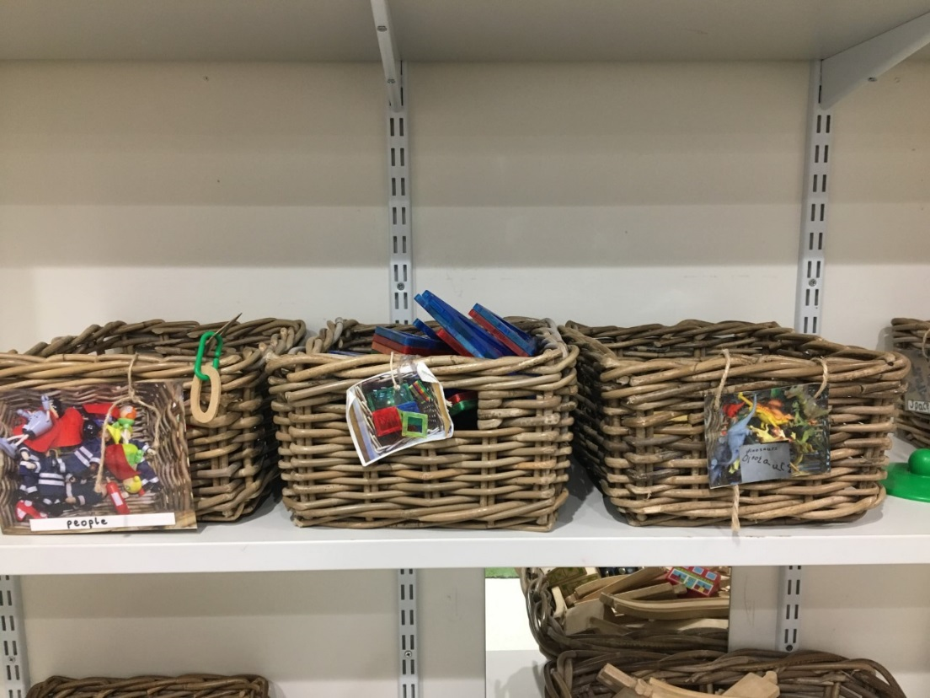

Slide 6
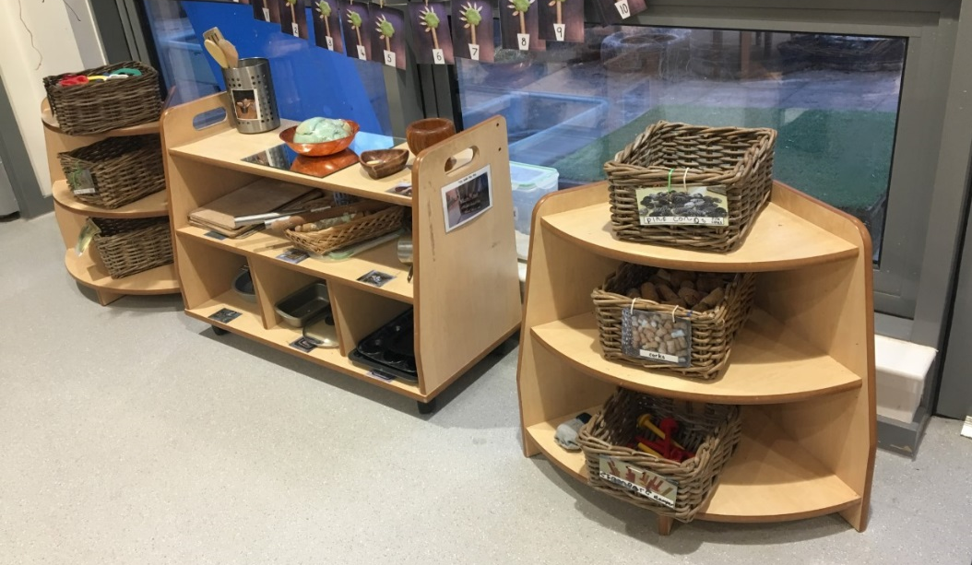

Slide 7
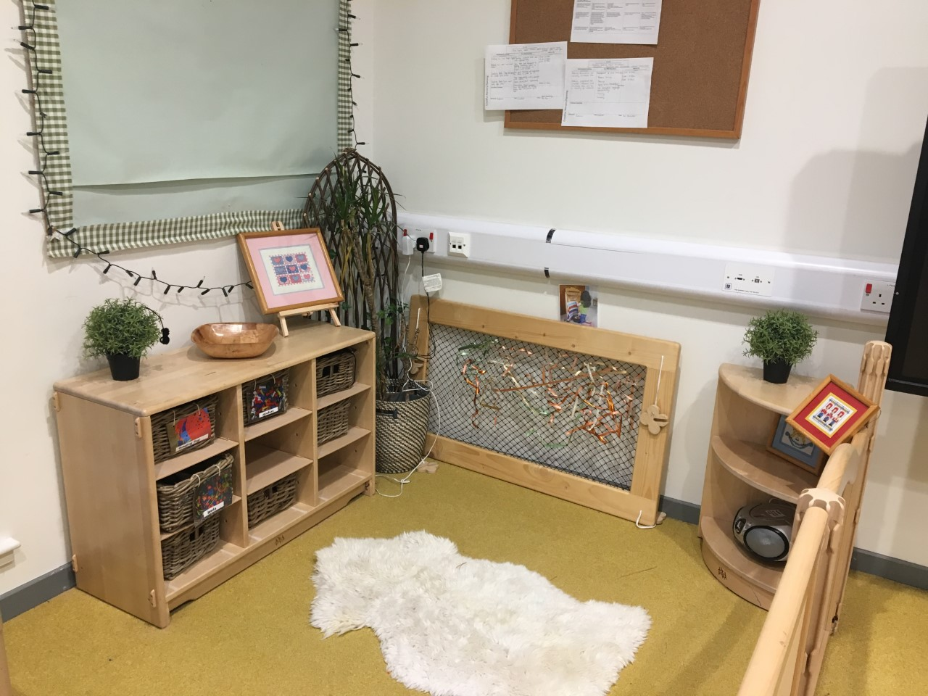

Slide 8
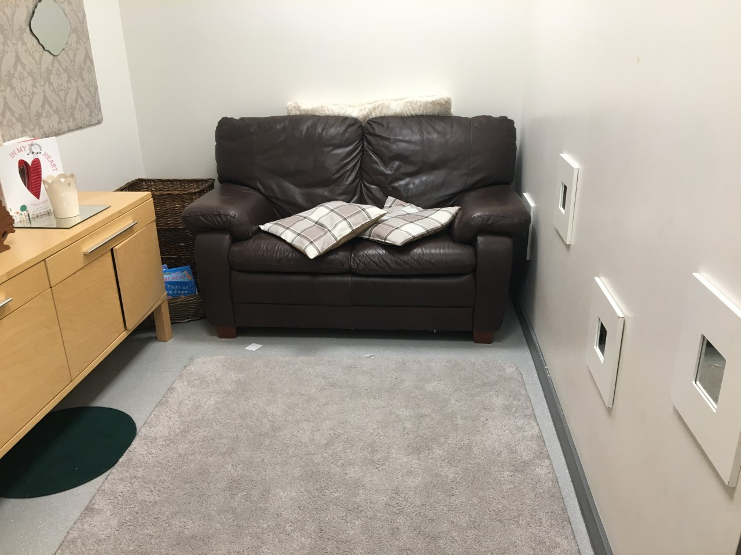
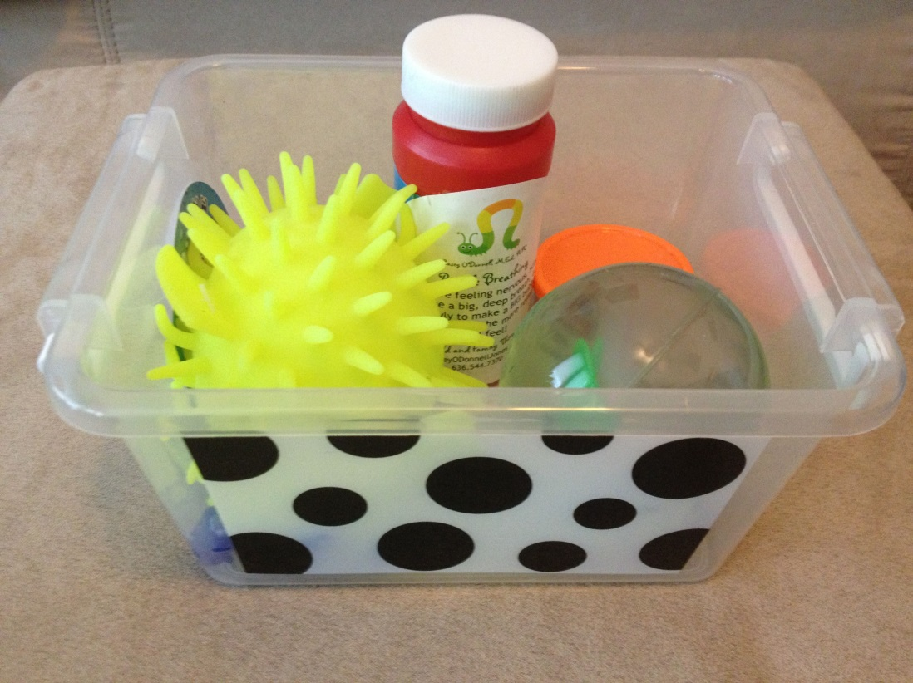

Slide 9
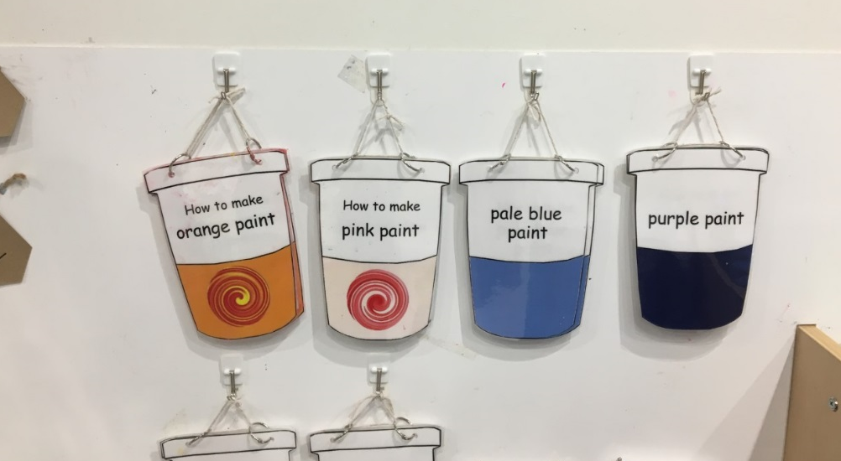
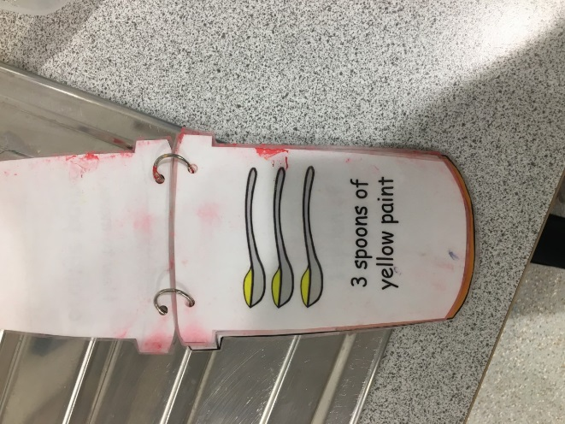
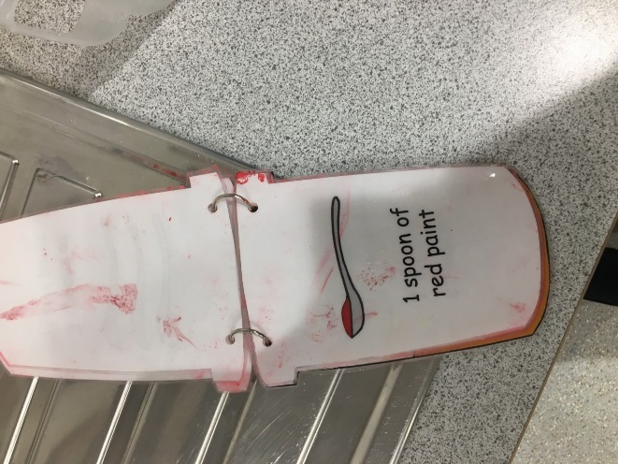
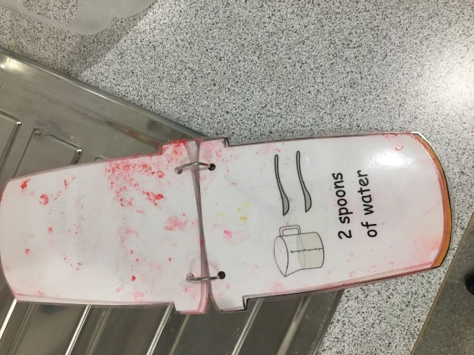
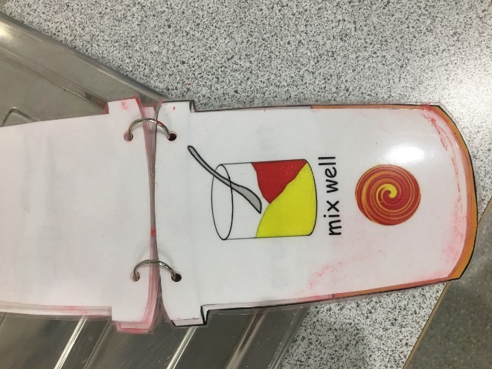

Slide 10
Building Positive Relationships
Are you:
Giving clear explanations of expectations and boundaries?
Consistent – helping them to predict?
Modelling a range of positive behaviours (acceptance of making a mistake, problem solving)?
Focussed on relationship repair?
Using logical consequences?
Attuned to non verbal communication?
Preparing children for transitions?
Notes:
Do children know and understand what is expected of them, are you explicit so avoiding sit nicely, behave, be a good boy! do they tell them what to do, not what not to do so positively framed… Pre empting risks, temptations making boundaries clear
We all feel more at ease when we know what to expect in a given situation, consistency helps children feel safe, helps them to trust that the adult is in control. Make sure expectations are consistent (not all the same), how you react, the phrases you use around key rules so safe hands in nursery can be the prompt that is used by all staff, good waiting

Slide 11
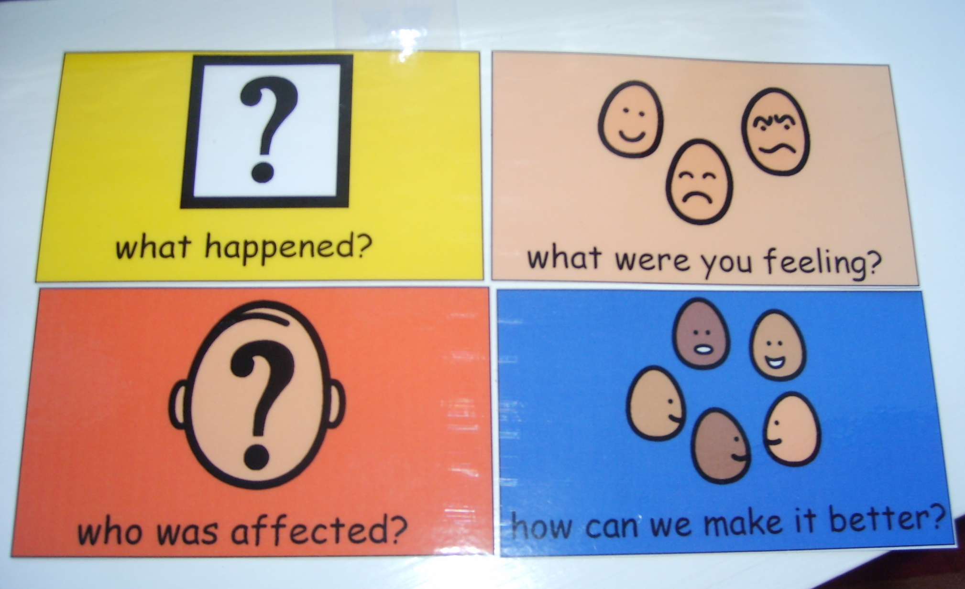
Restoring Relationships

Slide 12
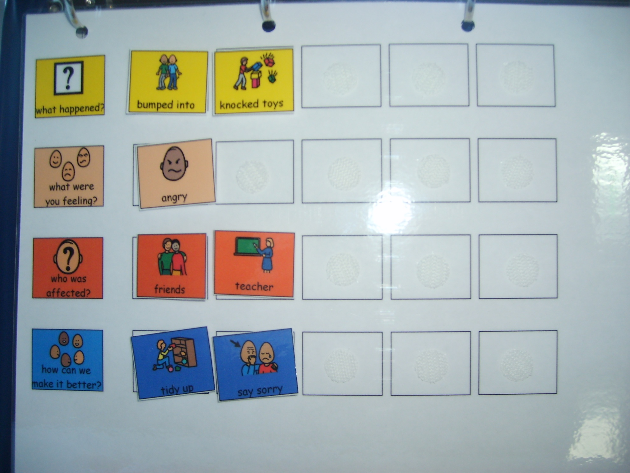

Slide 13
Language and Interaction
Do you:
Use simple repetitive language during everyday activities?
Gain children’s attention before delivering instructions?
Talk at an appropriate rate using short sentences?
Model correct language when you hear a child incorrect vocalisation?
Extend the child’s vocalisation?
Encourage children to ask questions?
Encouraging children to speak within groups as well as in free play?
Notes:
Running commentary rather than asking questions all the time
Encouraging children to speak within groups as well as in free play? – Even the least verbal children

Slide 14
Language and Interaction
Do you:
Give children time to respond
Give a running commentary
Support verbal language with gestures and visual cues
Utilise a range of types of questions
Encourage peer interaction and facilitate shared turn taking and play
Develop children’s emotional vocabulary by naming and describing emotions and feelings
Notes:
Forced choice, closed questions open questions
I can see you’re feeling angry is that right, is it – Be honest! I see you smiling are you happy, You said you are angry at xx are you sad that he doesn’t want to play just now?

Slide 16
Visuals

Slide 17
Targeted Support
Notes:
Thinking about targeted support.
Identifying the areas you wish to provide targeted support
Consider appropriate targets – might want to focus on 3 at one given time
Consider what strategies would support the child to meet this target- really important to ensure target is right

Slide 18
Social Skills Assessment
Language and Communication
Listening
Talking
Understanding
Flexibility
Accepting another’s point of view
Coping with change
Obsessions vs interests
Emotional Literacy
Self awareness
Awareness of others
Self management
Social Interaction
Social conversations
Social conventions
Social play
Friendships
learning
Notes:
When thinking about needs- might be helpful to use this as a guide
Important to note that there's not a specific score you are trying to reach- scaling so you are considering small manageable steps to move forward. So a target around they will develop their emotional literacy – not focused enough and difficult to see tangible progress. However if you break that down you will see tangible steps forward.
The SELF is broadly categorised in to 4 areas…

Slide 22
Outcome focused and SMART targets
Outcome focused planning – the benefit or difference made to an individual as a result of an intervention
SMART Targets
Specific
Measurable
Achievable
Realistic/ relevant
Time bound
Notes:
Outcome is not a description of the service being provided (working 1:1 with keyworker once a week) Its what you will hope to achieve during this time.
Specific- clear simple language describing exactly what a child will be able to do. Working on small next steps.
ex, they will know numbers 1-10 -> they will be able to say numbers 1-10 or point to the number when named
Measurable – How are you going to measure… if a child spontaneously points to the right number on one occasion would we say they know numbers 1-10?
Achievable
Realistic
Relevant – don’t just work on what you know they can do. What are the key needs? If a child has good visual recall so can sequence numbers but isn’t using language to communicate their needs the plan should be focused on language targets.

Slide 23
Example:
I can give my attention to a task for a set period of time
I can sustain attention at a non-preferred activity for 5 minutes on some occasions with full adult support (January- March 2019)
Notes:
So once you identify an appropriate area to focus on from the SELF then make it a SMART target
Social interaction – Learning -
TIME
FREQUENCY
ADULT SUPPORT

Slide 24
Task: Develop SMART targets
Consider a child you work with or previously worked with in your establishment and develop two appropriate SMART targets using the SELF as a guide

Slide 25
What does the child need to help them get there?
Consider:
Adult intervention
Resources
Opportunities
A change in the environment or routine
Notes:
Next- think about supports – what does the child need to get there?
How much do you think you will need to intervene? Sit with the child/ provide prompting/ set up activity
What resources will help the child get there- a book, an egg timer etc
If your working on flexibility you might want to consider making frequent planned changes to the routine in order to work on that target.

Slide 26
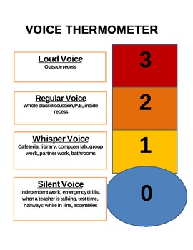
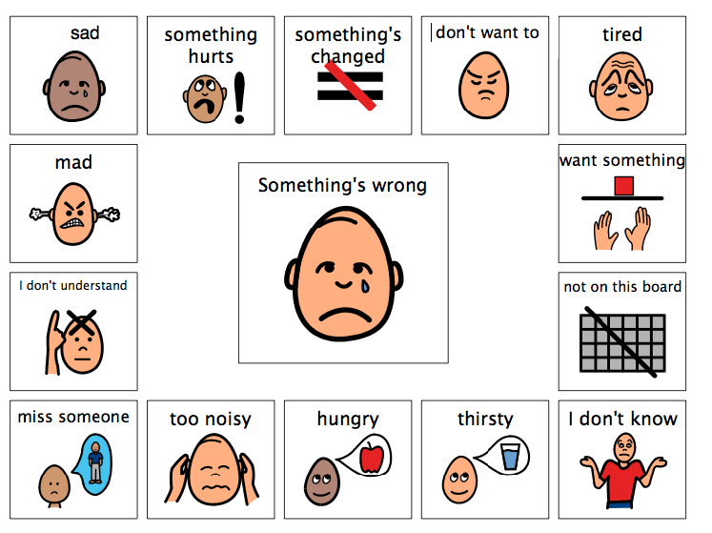
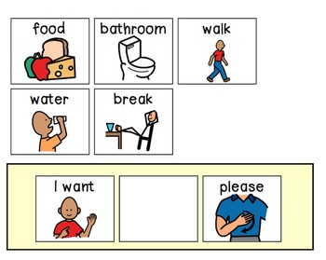
Language and Communication: Listening, talking and understanding
Visual to communicate, show simple sentence structure and learn appropriate tone.

Slide 27
Language and Communication: Listening, talking and understanding
Use simple consistent language
Use the child's name at the beginning of the instruction
Allow processing time
Check for understanding
Positive correction
Notes:
‘Safe hands’ instead of ‘no hitting’
Ensure all staff are aware of the chosen phrases

Slide 28
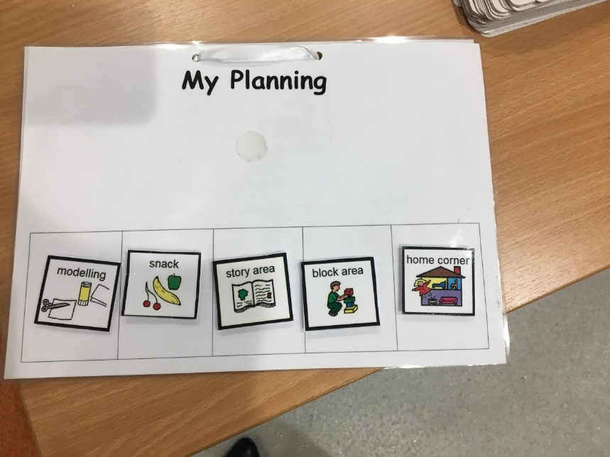
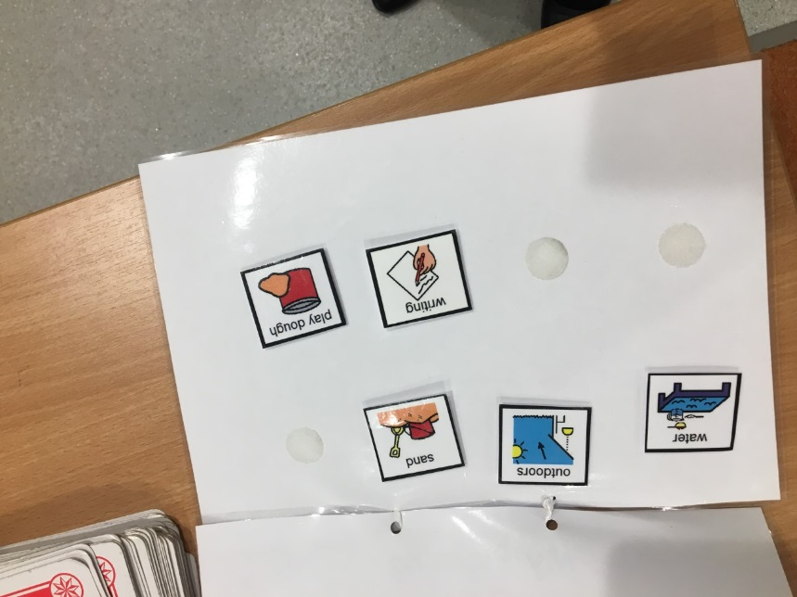
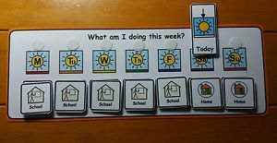
Flexibility: Accepting another’s point of view, coping with change and obsessions vs interests
Using a visual timetable to provide a structure- a clear beginning middle and end point
Notes:
Knowing what to do now and what to do next reduces anxiety. Words ‘disappear’ – symbols / pictures can be held on to
The person should always know:-
Where do I have to be?
What am I doing?
How much do I have to do?
When will I know when I have finished?
What will I do next?
Things must have a beginning, middle and a clear ending.
Children respond best in a structured environment where things are organised and clearly labelled.

Slide 29
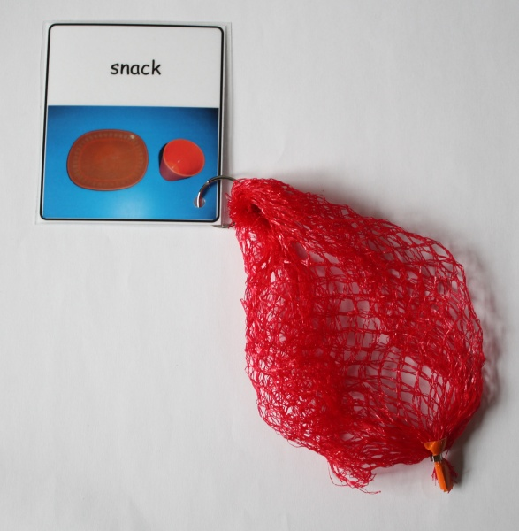
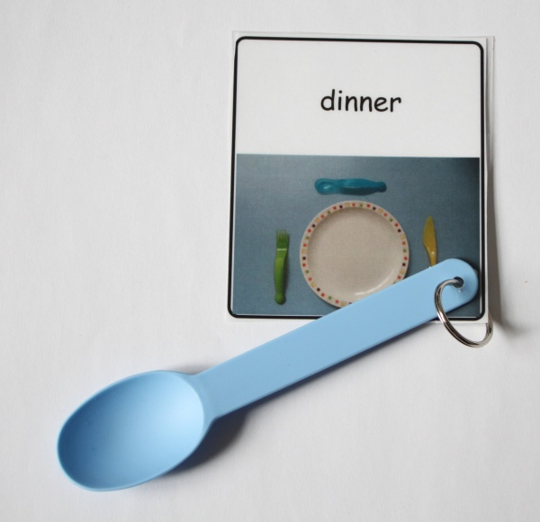
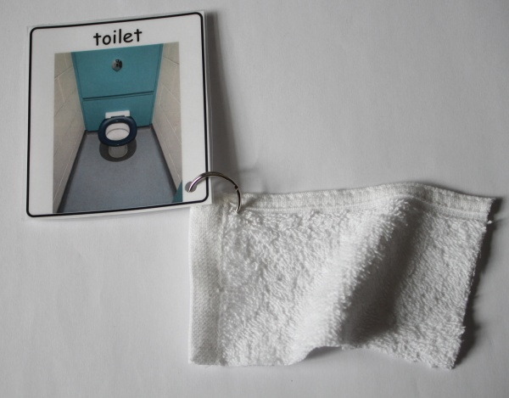
Flexibility: Accepting another’s point of view, coping with change and obsessions vs interests
Supporting transitions using real objects, tactile symbols (object of reference) and/or photographs
Notes:
Outdoors- a picture or wellies
**Give time for transitions i,e. in 5 mins, in 2 mins, in 1 min, 10, 9, 8, 7, 6, 5, 4, 3, 2, 1

Slide 30
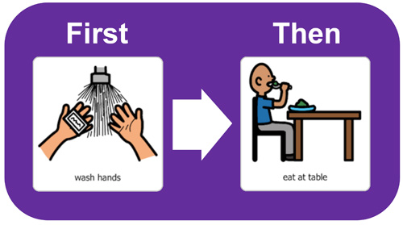
Flexibility: Accepting another’s point of view, coping with change and obsessions vs interests
‘First and then’ or ‘now and next’ to encourage a child to engage in an adult led or non preferred activity
Notes:
Particularly helpful if a child has quite specific interests, doesn't really explore all areas of the nursery or you are trying to carry out a focused activity to work on a target i.e. encouraging more interaction with peers.

Slide 31
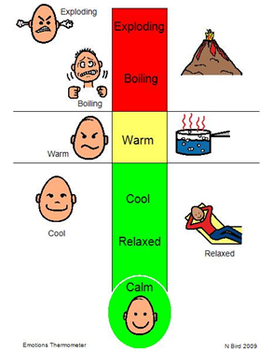
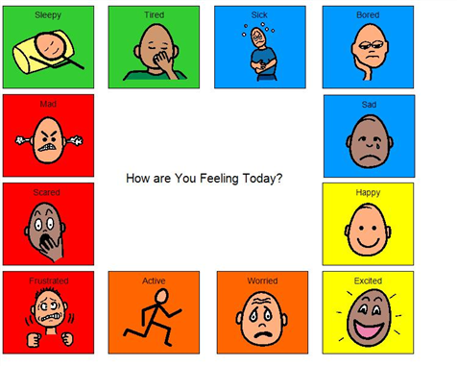
Emotional Literacy: Self awareness, awareness of others and self management
Notes:
Time out. Thinking time
Time to talk
Empathy-
Social stories

Slide 32
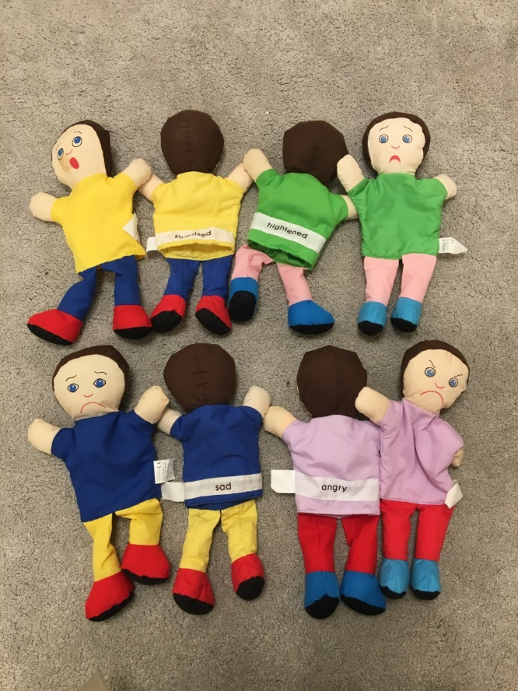
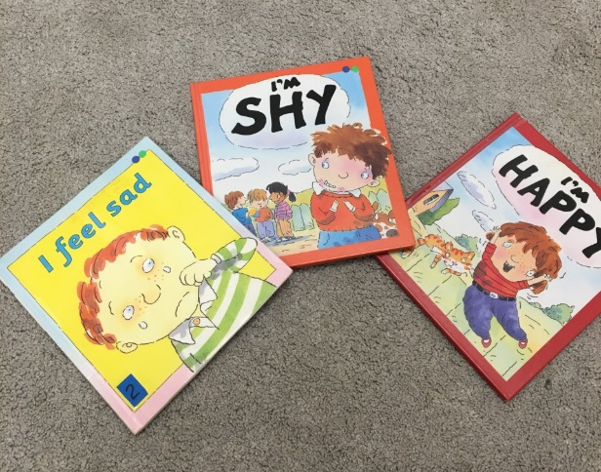
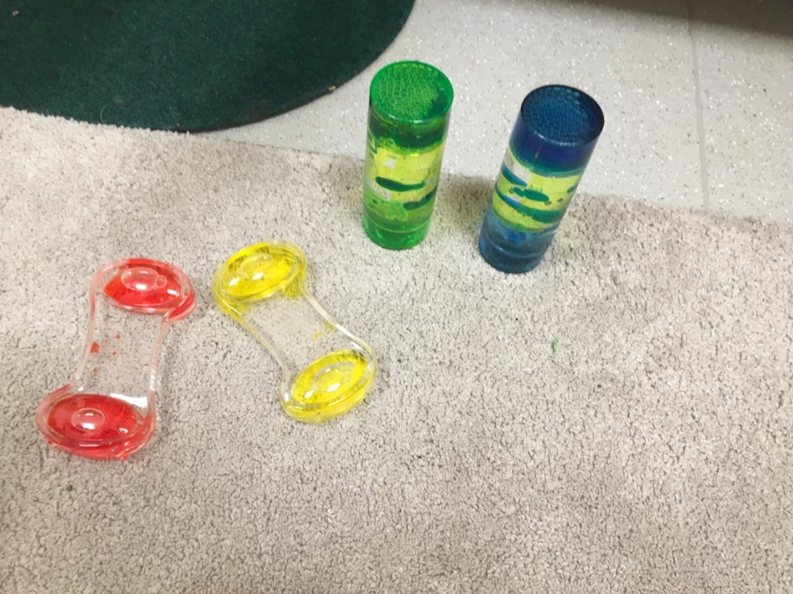
Emotional Literacy: Self awareness, awareness of others and self management
Notes:
Thermometer visuals, time to talk, social stories, using mirrors/ photographs

Slide 33
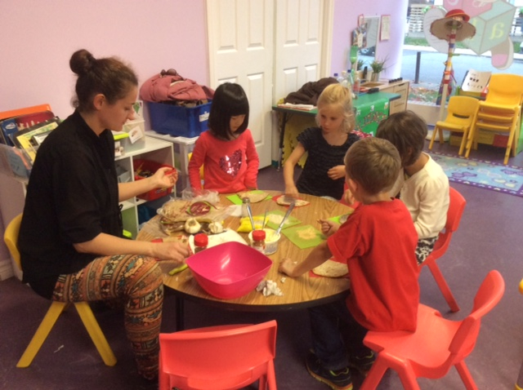
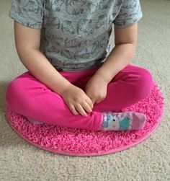
Social Interaction: Social conversations, social conventions, social play, friendships and learning
Social conversations and conventions
Turn taking- sand timer
Creating opportunities through play- i.e having only one preferred item to share
Modelling
Notes:
Using sand timers for taking talking turns or during play to work on turn taking/ sharing
Create opportunities for example to practice waiting

Slide 34
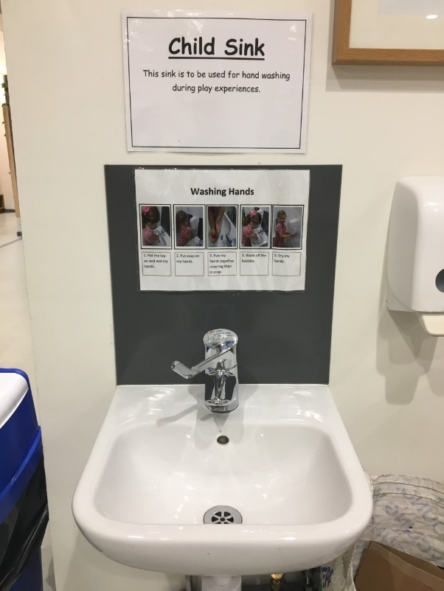
Social Interaction: Social conversations, social conventions, social play, friendships and learning
Visual schedules in the toilets or at the coats

Slide 35
Task: Apply appropriate strategies to your SMART targets
Date | Short term target | Strategies | Evaluation
August – December | I can take turns with another child on some occasions with full adult support | Staff will create opportunities to practice turn taking such as having one toy with 2 children KW will model turn taking Use a timer
January – April | I can take turns during play with another child on most occasions with some adult support | Staff will use a timer to indicate turns during play where necessary and work towards providing only a verbal prompt Staff will try to notice turn taking during free play and provide positive feedback “good sharing” Staff will use a sharing visual
Notes:
Really thinking about what could I do/ what opportunities are there in our setting to work on these skills?

Slide 36
Sample Strategies (Recap)
Timers
Visual Schedule
First and Then
Sensory break/Sensory box/bag
Sitting spot
Visual checklist
Assign a role
Forced choice
Home Link diary
Planned breaks
Social skills group
Visuals to support sentence structure
Transition /new experience preparation
Objects of reference

Slide 37
Questions

