Slide 1
Autism
Chris Atherton
East Renfrewshire Psychological Service

Slide 2
Part 1

Slide 3
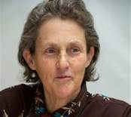
Temple Grandin
‘Fear is the main emotion in autism.’

Slide 4
A Brief History

Slide 5
Autism
A Pervasive Developmental Disorder
Lifelong
More prevalent in males (4:1)
Est 700,000 in the UK (1.1% of population) (NAS)
History:
  Leo Kanner (1943) ‘Autistic disturbances of affective contact.’
    Observation of 11 patients
  Hans Asperger (1944) ‘Autistic Psychopathy in childhood.’
    Observation of 4 patients
Notes:
Francis Happe – Core social and communication problems across a wide spectrum
Two key observations in her work
How hard individuals have to work to accommodate the social conventions and rules of others
How anxious individuals with ASD are.
Dr Bruno Bettelheim
Born in Vienna, Autria-Hungrian
Experienced Nazi concentration camp between 1938 and 1939 before being released during an Amnesty for Hitler’s birthday.
Emigrated to America
Noticed social withdrawal of individuals placed in extreme environments
Psychoanalytics – decided that children must have been in an extreme environment
Experienced mortal fear in response to mother’s unwanting and unloving interaction
Cold refrigerator mother
Dr Bernard Rimland
Twins with Autism
Many examples of only one affected
Contradictes psychoanlaytic theory
Genetical Biological Basis
Dr Nancy Minshew
Clearly a neurological disorder
Brain abnormalities are observable – structural differences
Different regions are not well connected
People experience the world very differently
Dr Matthew Anderson
Genetic Copy Number Variations (eg 15q11-13 duplication of this most common in autistic individuals, deletion of gene causes Angelman Syndrome)

Slide 6
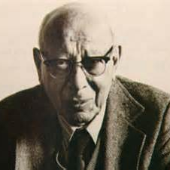
Bruno Bettelheim
Refrigerator Mothers

Slide 7
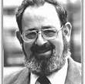
Bernard Rimland
Infantile Autism (1964)

Slide 8
Bernard Rimland
Infantile Autism (1964)
Debunked the refrigerator mother hypothesis
Identified autism as a cognitive dysfunction
‘A single critical disability’ – impaired ability to relate new stimuli to remembered experience
Leads to inability to draw meaning from experience and to integrate sensations into a comprehensible whole
Inspired a generation of research into autistic cognition.
Rimland himself pursued possible links between autism and mercury poisoning through vaccination – debunked.

Slide 9
The MMR
Measles Mumps and Rubella Vaccine
MMR was implicated by Andrew Wakefield in a 1998 medical journal called Lancet. This paper was retracted in 2010, judged to be flawed and fraudulent, and Wakefield was struck off the doctor’s register after he was found guilty of professional misconduct and dishonesty.
Many subsequent large scale studies have failed to link the MMR to autism.
Vaccine rates struggle to reach pre-scare levels (The Psychologist, October 2014).

Slide 10
Autism Prevalence
New prevalence rates emerging
1/100 in United Kingdom
  National Autistic Society
  Five fold increase in the 1990s – plateaued by early 2000s (Taylor et al., 2013)
1/68 in United States
  Centers (sic) for Disease Control March 2014
Lotter 1966 – Presumed prevalence of 0.04%

Slide 11
What is Autism?

Slide 12
Autism Spectrum
Mild
Asperger’s Syndrome & High Functioning Autism
Moderate
Learning Difficulties
Severe
Learning Difficulties

Slide 13
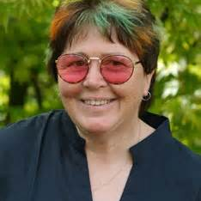
‘We tend to view things differently’
Wendy Lawson

Slide 14
The Autism Spectrum
Heterogeneous
Broadened considerably over time
Geschwind and Levitt (2007) – A collection of autisms that look similar at a superficial level.
Happe – ‘Once you have met one person with autism...’
Focus on specific symptoms rather than syndromes (Happe, et al. 2006)

Slide 15
The Triad of Impairment
Social Interaction
Flexibility of Thought
Language and Communication

Slide 16
Language and Communication
Pragmatic
Literal
Semantic
Notes:
Semantic – the meaning of language
Pragmatic – the functional use of language – how it is used in context.
Literal – not deviating from the exact meaning of language (non figurative / idiomatic / euphemistic)

Slide 17
Language and Communication

Slide 18
Language and Communication
Delay / lack of speech development
Lack of response to other’s speech (including own name)
Stereotyped and repetitive use of language
Pronoun reversal (saying ‘you’ for ‘I’)
Idiosyncratic use of words
Failure to initiate or sustain normal conversation
Abnormalities in speech (pitch, stress, intonation)
Semantic / conceptual difficulties
Abnormal non-verbal communication

Slide 19
Social Interaction
Friendships
Social Cues
Social Conventions
Body Language
Empathy
Notes:
Friendships
Difficulty playing with other children
Rules of social play – ‘The Unwritten Rules’
Lack of innate drive to be a social being
Social Conventions
Inappropriate comments and actions
Difficulty with proximity
Empathy
Doesn’t recognise other people’s feelings
Expects other people to know their thoughts, experiences and feelings.
Social Cues
Poor turn taking in conversations
Poor timing
Body language
Misses the signals
Non-verbal communication

Slide 20
Flexibility of Thought
Interests and Obsessions
Routines
Imagination
Notes:
Imagination
Pretend play
Fiction books
Free choice / Dead time
Creative writing
Interests and Obsessions
All encompassing
May not reflect culturally ‘normal’ interest
Routines
Loves repetition and rules / Hates rules to be broken
Changed routines without warning
Poor organisational skills
Difficulty seeing another person’s point of view

Slide 21
Additional Features
Fine and Gross Motor Skills
Attention and Concentration
Sensory Sensitivity
Specific Learning Needs

Slide 22
Cognitive Theories of Autism
Autism
Executive Functioning
Theory of Mind
Extreme Male Brain
Central Coherence

Slide 23
Cognitive Theories and ASD
Central Coherence (Frith, 1989, 1994)
Theory of Mind (Happé, 1994)
Extreme Male Brain (Baron-Cohen, 2003)
Executive Function (Hill, 2004)

Slide 24
I did not see whole –
I saw hair, I saw eyes, nose, mouth, chin... Not face
(Alex in Williams, Sensory Issues in Autism, East Sussex)

Slide 25
Central Coherence
‘Part of the theory of autism’ Professor Francesca Happe
Leo Kanner - Inability to experience wholes without full attention to constituent parts – Distressed by tiny changes
Difference in central coherence in ASD not a deficit.
Differences found in non-autistic individuals.

Slide 26
What is Weak Central Coherence?
Concerns the ability to pull information together, for higher level cohesion
The inability to draw meaning as a ‘whole’.
Attempt to describe a range of non-social features of autism by proposal of a single cognitive mechanism.
Unusual cognitive strengths suggested by autistic behaviours: restricted interest, repetition, hypersensitivity, savant ability.
Uta Frith’s proposal:
  ‘in an autistic brain, while the ability to discern a wide variety of things about the world is strong, the drive to make these various things cohere is weak.’

Slide 27
Lorna Wing
‘Once you have met one person with Autism, you have met one person with autism’

Slide 28
What is Theory of Mind
Not actually a ‘theory’!
Hugely significant feature of human cognition
Develops by or around the age of 4.
Ability to attribute mental states to others.

Slide 29
Theory of Mind - Importance
Recognition of thoughts and feelings
‘Mentalising’ Frith
Automatic ability to attribute mental states to yourself and other people.
To recognise
To communicate
To influence
Uniquely human?

Slide 30
Social Animals (Uta Frith)
Hunt and flee in packs
Choose mates
Nurture young
Recognise others
Recognise emotions
Recognise status
Make alliances

Slide 31
Social Humans (Frith)
Teach
Tease
Trade
Deceive
Communicate ostensively – e.g. about fear without being afraid
Show complex emotions
Manipulate beliefs
Read others minds
Read own mind
Be self-conscious
Explain and predict the behaviour of others

Slide 32
Development of social behaviours
Development of cultural knowledge
Development in understanding of others beliefs, intentions, desires

Slide 33
Without reference to others psychological states, the behaviour of others becomes puzzling.
Social impairment = Theory of Mind.
False belief task paradigm was established – The Sally Anne Test (Baron-Cohen, Leslie & Frith, 1985).

Slide 34
ASD Traits and Theory of Mind
Egocentrism
Emotional dysregulation (inability to monitor internal mental representations)
Inability to switch between different perspectives
Explains some social impairments - specific and novel predictions derived from lack of intuitive Theory of Mind
Not sufficient to explain social impairments in their entirety.
Not specific to ASD, specific cognitive phenotype that is prevalent in people with ASD.

Slide 35
Sensory Perceptions
Outer and Inner Senses (Shore, 2004)
Vestibular (Inner Ear, Balance)
Proprioceptive (Muscles and joints, Sense of body in space)
Sight
Touch
Smell
Hearing
Taste

Slide 36
Senses and Understanding
Our senses shape our experience, this has an impact on:
  Our experience of the present
  Our developing understanding of the world around us.

Slide 37
Sensory Issues in Autism
Sensory fluctuations are common, as are difficulties with:
  Sensitivity (over or under sensitive)
  Sensory overload
  Gestalt perception
  Fragmented perception
  Delayed perception
  Distorted perception
  Sensory shutdowns
  Compensation

Slide 38
ASD and Sensory Sensitivity
Channel is too open
Desire to avoid or shut out the sense
Distraction / repulsion
Repel away from
Over sensitive
Can be experienced as painful or anxiety provoking
Channel is too closed
Desire to seek out the sense
Distraction / attraction
Drawn towards
Under sensitive
Can be experienced as pleasurable, and / or stimulating
Hypersensitive
Hyposensitive

Slide 39
Hypersensitive responses / Coping Strategies
A person may…
Rock
Swing
Hit their ears
Press their eyes
Twist
Flap
Spin
Why?
These can cause sensations which help block out channels that are too open.

Slide 40
Hyposensitive responses / Coping Strategies
A person may…
Bang objects/doors
Seek out noises – hoover, lawn mower
Seek out smells / colours
Prefer tight clothing
Self injure
Why?
These can cause sensations which help the brain get more information in from outside.

Slide 41
East Renfrewshire Autism support
Pre School
Primary
ASD Advisors
Secondary
Support for Learning Departments
Outreach Support Service
ASD Advisors
IMS Family Centre
PSADU
Outreach Support Service
IMS
CCC
Williamwood Support Service
IMS (& Outreach)

Slide 42
What Can I Do?
Use simple and concise language – avoid overload
Be clear and precise
Be consistent with the language you use
Use concrete terminology
Be explicit in what you mean
Supplement your language with visual cues

Slide 43
What Can I Do?
Begin by using your child’s name.
Allow time for information to be processed – allow up to 10 seconds for a response.
Check for understanding, ask him / her to repeat back in their own words
Visual prompts are always helpful to gain / direct attention and aid comprehension.

Slide 44
WHAT CAN I DO?
Don’t rely on verbal communication
Put it in writing
Use written plans and timetables
Knowing what to do now and what to do next reduces anxiety – use visual timetables
Use photos, symbols and drawings
Give hand signals or picture cues to back up instructions if necessary
Words ‘disappear’ – symbols / pictures can be held on to

Slide 45
What Can I Do?
Always forewarn: -
  Tell the person what to expect
  Give plenty of notice
Allow individuals to unwind
Provide clearly defined breaks between structured activities
Build in planned regular breaks
Use the child's interests as motivators or as reinforcement.

Slide 46
Part 2

Slide 47
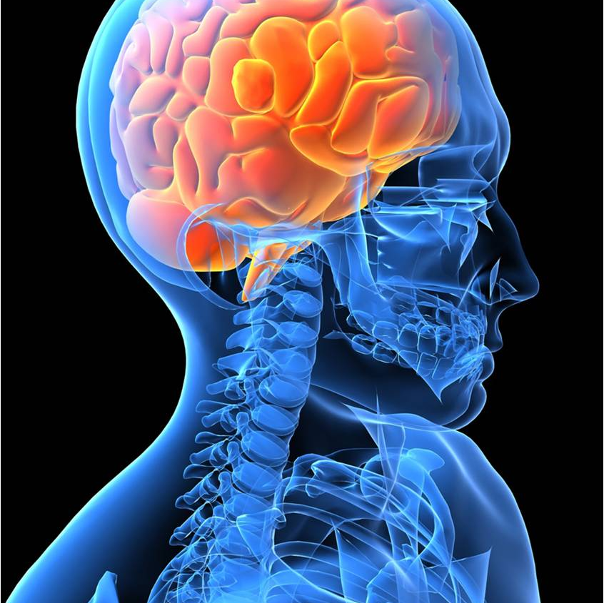
Weak Central Coherence

Slide 48
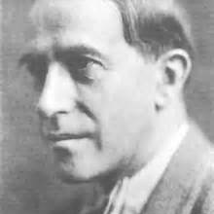
‘The whole is other than the sum of its parts’
Kurt Koffka, Father of Gestalt Psychology

Slide 49
Central Coherence
Hermelin and O’Connor (1970)
‘what to went ship sea.’
‘what ship went to sea.’
Non autistic children made fewer errors if the words made up meaningful sentences. Recall was much better in non autistic children.
Autistic children appeared to repeat the words without considering the meaning.
Unaware of Rimland’s book.
Had a PhD student called Uta Frith...

Slide 50
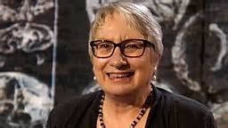
Uta Frith

Slide 51
Frith and Snowling (1983)
Ten homographs
  ‘He played lead guitar’
  ‘The box was made of lead.’
  Children with autism found difficulty in ascribing meaning – identified by consistent pronunciation regardless of whether the sentence suggested crying or ripping. Autistic children tended to say ‘leed’. The early sentence context had not been taken into account. (Replicated by Happe, 1997)
Not an inability to extract meaning.
Notes:
(Words with dual meaning)

Slide 52
Subsequent proposal by Frith (1989) of ‘weak central coherence’ – focus on detail and failure to draw information together to extract meaning.

Slide 53
Block Design (WISC Iv)
Strong coherence can be a hindrance (Shah and Frith, 1993)
Segmented versus un-segmented design
Segmented – Non autistic average 45s
Un-segmented – Non autistic average 95s
Segmented – Autistic average 45s
Un-segmented – Autistic average 65s
Autistic group presented strength in their perceptual reasoning.

Slide 54
What is Weak Central Coherence?
Concerns the ability to pull information together, for higher level cohesion
The inability to draw meaning as a ‘whole’.
Attempt to describe a range of non-social features of autism by proposal of a single cognitive mechanism.
Unusual cognitive strengths suggested by autistic behaviours: restricted interest, repetition, hypersensitivity, savant ability.
Uta Frith’s proposal:
  ‘in an autistic brain, while the ability to discern a wide variety of things about the world is strong, the drive to make these various things cohere is weak.’

Slide 55
Central Coherence
Central coherence is descriptive
Strength:
  Language and Communication
  Social Interaction
    Both are nuanced and contextually dependent
Weakness:
  Not particularly testable / falsifiable
  Not part of mainstream cognitive psychology

Slide 56
Pellicano and Burr 2012
Bayesian Perspective
The reduced influence of prior knowledge.
Information is inherently unreliable and therefore needs to be used in the context of previous knowledge (a mathematical concept applied in statistics)
Used increasingly in the context of perception – sensory information is also ambiguous and inherently unreliable.

Slide 57
Experience determines likelihood
This restricts the possibilities we consider
Bayesian perspective proposes that autistic people have a broader categorisation of prior experience – past experience therefore has a less restrictive influence on perception of the present.

Slide 58
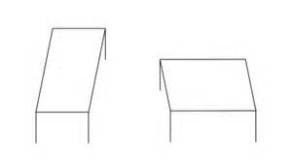
The Shepard Illusion
Notes:
DO NOT ADJUST PICTURE SIZE!!!!!

Slide 59
Mitchell et al., 2010
‘The curse of knowledge.’
Prior knowledge – experience of rectangular shapes in a 3 dimensional world.
People with autism were less susceptible to this effect.

Slide 60
Rimland – Differences in information processing must come from differences in brain functioning
Under-connectivity (Wass, 2011)
Growing evidence for atypical brain connectivity in autism

Slide 61
Predictive Coding
(Friston et al., 2013; van Boxtel & Lu, 2013)
Main purpose of the nervous system is to anticipate what will happen next – survival instinct.
Minimising errors in this purpose is important – we encode how precise our predictions are by comparing our expectations with actual outcomes.

Slide 62
Predictive Coding
Two interpretations:
Friston et al. (2013) – Precision is reduced and therefore prediction is weaker, so perception is dominated by the information at hand.
Van de Cruys et al. (2013) – Precision is heightened in prediction errors – small deviations from expectation becomes a significant error.

Slide 63
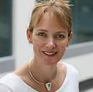
Francesca Happe

Slide 64
Revised concepts of Weak Central Coherence
Francesca Happe (1999)
Proposed a normal distribution of preference or bias.
Two extremes of a continuum:
  Detail focussed strategy
  Opposite preference
Suggestion that typically, detail focus would be typical of the autism phenotype.
Evidence that 50% of fathers, 30% of mothers of autistic children were stronger in detail focussed processing style. Not replicated in a sample of parents of dyslexic children.
Briskman, Happe & Frith 2001; Happe, Briskman & Frith, 2001)

Slide 65
Central Coherence
‘Part of the theory of autism’ Professor Francesca Happe
Leo Kanner - Inability to experience wholes without full attention to constituent parts – Distressed by tiny changes
Difference in central coherence in ASD not a deficit.
Differences found in non-autistic individuals.

Slide 66
I did not see whole –
I saw hair, I saw eyes, nose, mouth, chin... Not face
(Alex in Williams, Sensory Issues in Autism, East Sussex)

Slide 67
Theory of Mind

Slide 68
Activity
Valuable Object

Slide 69
Cognitive Theories and ASD
Theory of Mind (Happé, 1994)
Central Coherence (Frith, 1989, 1994)
Executive Function (Hill, 2004)
Extreme Male Brain (Baron-Cohen, 2003)

Slide 70
Lorna Wing
‘Once you have met one person with Autism, you have met one person with autism’

Slide 71
What is Theory of Mind
Not actually a ‘theory’!
Hugely significant feature of human cognition
Develops by or around the age of 4.
Ability to attribute mental states to others.

Slide 72
Uta Frith
Professor of Cognitive Development London
Mind-blindness
Central Coherence

Slide 73
Theory of Mind - Importance
Recognition of thoughts and feelings
‘Mentalising’ Frith
Automatic ability to attribute mental states to yourself and other people.
To recognise
To communicate
To influence
Uniquely human?

Slide 74
Social Animals (Uta Frith)
Hunt and flee in packs
Choose mates
Nurture young
Recognise others
Recognise emotions
Recognise status
Make alliances

Slide 75
Social Humans (Frith)
Teach
Tease
Trade
Deceive
Communicate ostensively – e.g. about fear without being afraid
Show complex emotions
Manipulate beliefs
Read others minds
Read own mind
Be self-conscious
Explain and predict the behaviour of others

Slide 76
Development of social behaviours
Development of cultural knowledge
Development in understanding of others beliefs, intentions, desires

Slide 77
Mental Representations
Representations can be validated by reference to the world – copies of the world
Representations can be decoupled from the world to become attitudes to the world
‘It is raining’ can be tested
‘John believes it is raining’ – cannot be validated by reference to the world (pointless to try and test this)

Slide 78
Alan Leslie (1987)
Information processing analysis
Mental states are propositional attitudes
Agent
Mother
Sally
Information Relation
pretends
believes
Object
this banana
the marble
Proposition
is a telephone
is in the basket

Slide 79
Mental Representations
Develop at around the age of two
Representation of propositional attitudes must mark
Agent: who has the mental state?
Information Relation: what sort of attitude does the agent have? (belief, hope, pretend, dread)
“Not being able to understand that a person pretends had the same cause as not being able to understand that another person ‘intends’, ‘knows’, or ‘believes’.” (Frith, 2012)

Slide 80
Decoupled Representations
John believes it is raining.
Agent – John
Information relation – belief about the world
Why does this benefit us?
Prediction – John is going to take my umbrella!!!

Slide 81
Without reference to others psychological states, the behaviour of others becomes puzzling.
Social impairment = Theory of Mind.
False belief task paradigm was established – The Sally Anne Test (Baron-Cohen, Leslie & Frith, 1985).

Slide 82
Theory of Mind - Brain
What is the neurological basis?
What if the neural connection was broken or faulty? What would that look like?

Slide 83
False Belief Test
Baron-Cohen, Leslie, Frith (1985)
Sally-Anne Test
http://www.youtube.com/watch?v=qbk3HQ6heGk
Children at age 5 will pass this easily
Happe (1995) – Meta-analysis of false belief tests looking at probability of passing.
Autistic participants showed a 5 year delay, however almost all succeed on this task eventually.
Considerable developmental delay.

Slide 84
Sabotage vs Deception
(Sodian & Frith 1992)
Preventing harm from others
  Physical means
  Mental means

Slide 85
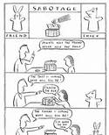

Slide 86
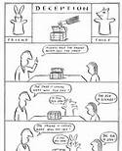

Slide 87
Sabotage – there is a key to lock the box
Deception – there is no key to lock the box
Thief calls from a distance in the deception test – ‘Is that box locked? If it is I’m not going to come all the way over for the sweet’
Many autistic children will fail the deception test and pass the sabotage test.

Slide 88
Frith
(20 years of Mentalizing Research)
Studies generally replicate the findings
Some inconsistencies
Many children with ASD pass ToM tests
Some children with other diagnoses don’t
However:
  Theory of Mind can be learned
  Theory of Mind tests are not pure (can be failed through lack of memory for example)
  Explicit mentalizing can be learned
  Intuitive mentalizing remains impaired
  Non-autism groups may have same social impairment, same cognitive phenotype.
Theory of Mind takes a different developmental course (Frith, 2004)

Slide 89
Theory of Mind - Developmental Milestones (Frith)
Prerequisites for mentalizing
  Interest in social stimuli 0 months
  Can detect animacy (biological motion) 3 months
  Can detect agency (self propulsion, reaching) 6 months
  Representation of goals and means 9 months
History of joint attention:
  Monitoring eye gaze 3 months
  Social referencing 9-12 months
  Proto-declarative pointing 12 months
  Intentional reaching 12 months
  True joint attention (out-with field of vision) 18 months
  (Intuitive mentalisation evident)

Slide 90
Intuitive Mentalizing
From 18 months:
  Pretend play
  Word learning by intention monitoring
  Understanding seeing / knowing
  Deception
  Understanding intention
  Implicit false belief

Slide 91
Explicit Mentalizing
Age 4-6 years
  Justifying false belief by pointing out misleading reasons
  Understanding higher order mental states
Sally Anne Test is a test of Explicit not Intuitive Mentalization
(1 in 5 passed in Baron-Cohen et al 1985)

Slide 92
Baron-Cohen et al 1998
Flexible joint attention
Proto-declarative pointing
Pretend play
Of those children who failed to show these at 18 months:
  80% were diagnosed with Autism at age three

Slide 93
Silent Animation Studies
Castelli, Frith, Happe & Frith 2002
Control Group
ASD Group (Passed Sally Anne Test)
Appropriate intentionality descriptions in control group hardly every replicated in ASD group.
E.g. http://www.youtube.com/watch?v=nSk-KMTqFxY
30minutes.

Slide 94
Neurological Evidence Base
Medial prefrontal cortex
Superior temporal sulcus
Amygdala / Temporal poles
And others...Fusiform gyrus, cerebellum
Components show strong activity in the normal brain and weak connectivity in the ASD brain
  Castelli et al 2000

Slide 95
ASD Traits and Theory of Mind
Egocentrism
Emotional dysregulation (inability to monitor internal mental representations)
Inability to switch between different perspectives
Explains some social impairments - specific and novel predictions derived from lack of intuitive Theory of Mind
Not sufficient to explain social impairments in their entirety.
Not specific to ASD, specific cognitive phenotype that is prevalent in people with ASD.

Slide 96
Additional Findings
Autistic children:
Are capable of sabotage but not deception (Sodian and Frith, 1992)
Show and understand instrumental gestures, not expressive gestures (Attwood, Frith & Hermelin, 1988)
Understand seeing but not knowing (Leslie & Frith, 1988)
Can tell about a fact if asked, but not discriminate whether it was novel or previously know to the listener (Perner, Frith, Leslie & Leekam, 1989)
Can judge what a rotated object will look like, but not what it will look like from another’s point of view (Hamilton, Brindley & Frith, 2009).

Slide 97

Sensory Integration
Exploring the Seven Senses in Autism

Slide 98
Seven Senses
Auditory (Hearing)
Oral (Taste)
Olfactory (Smell)
Proprioceptive (Sense of joints, tendons, muscles in relation to the space around oneself)
Tactile (Touch)
Vestibular (Balance and Movement)
Vision (Sight)

Slide 99
Other ‘Senses’
Our sensory experience and nervous system also allows us to interpret information relating to:
  Pain
  Temperature
We also develop a sense of the passage of time.

Slide 100
Senses and Understanding
Our senses shape our experience, this has an impact on:
  Our experience of the present
  Our developing understanding of the world around us.

Slide 101
Sensory Issues in Autism
Sensory fluctuations are common, as are difficulties with:
  Sensitivity (over or under sensitive)
  Sensory overload
  Gestalt perception
  Fragmented perception
  Delayed perception
  Distorted perception
  Sensory shutdowns
  Compensation

Slide 102
ASD and Sensory Sensitivity
Channel is too open
Desire to avoid or shut out the sense
Distraction / repulsion
Repel away from
Over sensitive
Can be experienced as painful or anxiety provoking
Channel is too closed
Desire to seek out the sense
Distraction / attraction
Drawn towards
Under sensitive
Can be experienced as pleasurable, and / or stimulating
Hypersensitive
Hyposensitive

Slide 103
Hypersensitive responses / Coping Strategies
A person may…
Rock
Swing
Hit their ears
Press their eyes
Twist
Flap
Spin
Why?
These can cause sensations which help block out channels that are too open.

Slide 104
Hyposensitive responses / Coping Strategies
A person may…
Bang objects/doors
Seek out noises – hoover, lawn mower
Seek out smells / colours
Prefer tight clothing
Self injure
Why?
These can cause sensations which help the brain get more information in from outside.

Slide 105
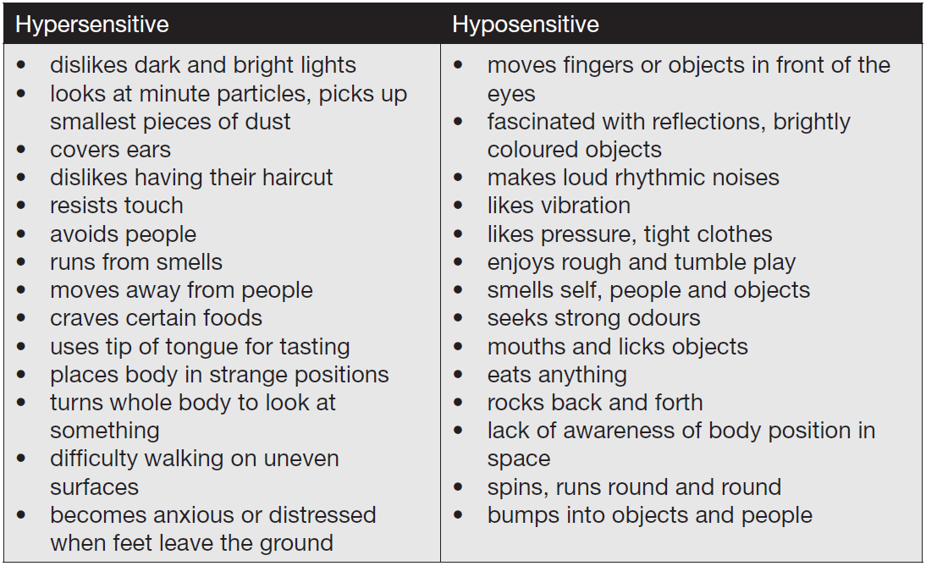
Sensory Issues in Autism – East Sussex County Council

Slide 106
Part 3

Slide 107
Support & Intervention

Slide 108
East Renfrewshire Autism support
Pre School
Primary
ASD Advisors
Secondary
Support for Learning Departments
Outreach Support Service
ASD Advisors
IMS Family Centre
PSADU
Outreach Support Service
IMS
CCC
Williamwood Support Service
IMS (& Outreach)

Slide 109
What Can I Do?
Use simple and concise language – avoid overload
Be clear and precise
Be consistent with the language you use
Use concrete terminology
Be explicit in what you mean
Supplement your language with visual cues

Slide 110
What Can I Do?
Begin by using your child’s name.
Allow time for information to be processed – allow up to 10 seconds for a response.
Check for understanding, ask him / her to repeat back in their own words
Visual prompts are always helpful to gain / direct attention and aid comprehension.

Slide 111
WHAT CAN I DO?
Don’t rely on verbal communication
Put it in writing
Use written plans and timetables
Knowing what to do now and what to do next reduces anxiety – use visual timetables
Use photos, symbols and drawings
Give hand signals or picture cues to back up instructions if necessary
Words ‘disappear’ – symbols / pictures can be held on to

Slide 112
Temple Grandin
I think in pictures...
Words are like a second language to me...
One of the most profound mysteries of autism has been the remarkable ability of most autistic people to excel at visual spatial tasks while performing so poorly at verbal skills

Slide 113
Visual Supports
Real objects
Tactile symbols / object of reference, for example swimming trunks, packaging, food labels.
Photographs
Miniatures of real objects
Coloured pictures
Line drawings
Written words
Visual Supports, NAS , 2013

Slide 114
Visual Supports can help with
Timetables/schedules
Helping with sequencing
Transition and change
Starting and finishing activities
Introduction of new activities or situations – general knowledge, curriculum subjects, news
Instructions/reminders
Choice
Understanding emotions and expressions

Slide 115
Visual Supports can help with
Sharing information
Behaviour – praise, demonstrate what’s appropriate, stop inappropriate behaviour
Behaviour strategies
Social skills
Locating people and places
Safety
Structuring the environment
Independent living skills
Sex education
Health.

Slide 116
Flow Chart
Yes!
No!

Slide 117

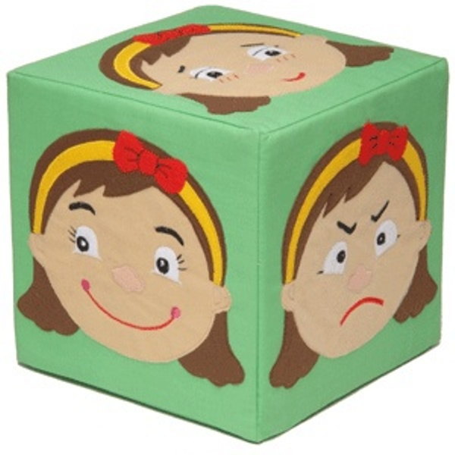
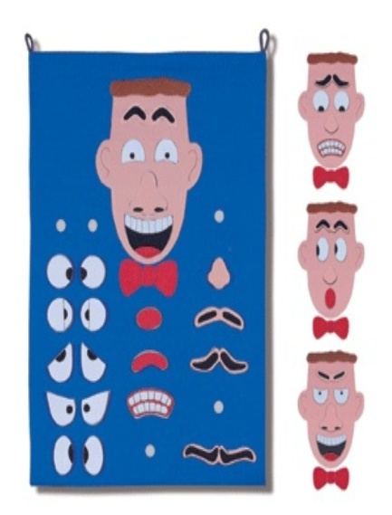

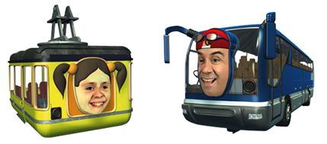
Resources

Slide 118
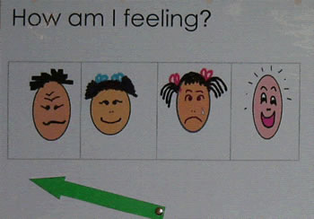
Resources

Slide 119
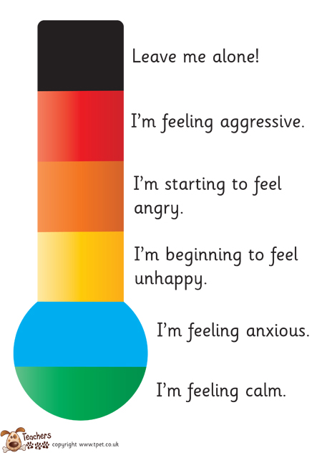

Slide 120
Social Stories
Nightmares.
Sometimes I may have a nightmare when I am sleeping. Nightmares are the same as a dream, but more scary.
Events in nightmares do not really happen. They are like pictures in my mind.
It is all right if I am scared. I may try telling myself it is all in my mind. It is only a dream. Adults can help children with nightmares, too. It is okay to ask an adult for help with nightmares.
When I wake up, I will see that I am all right.
Carol Gray (1994)

Slide 121
Comic Strip Conversations

Slide 122
Story Book Conversations

Slide 123
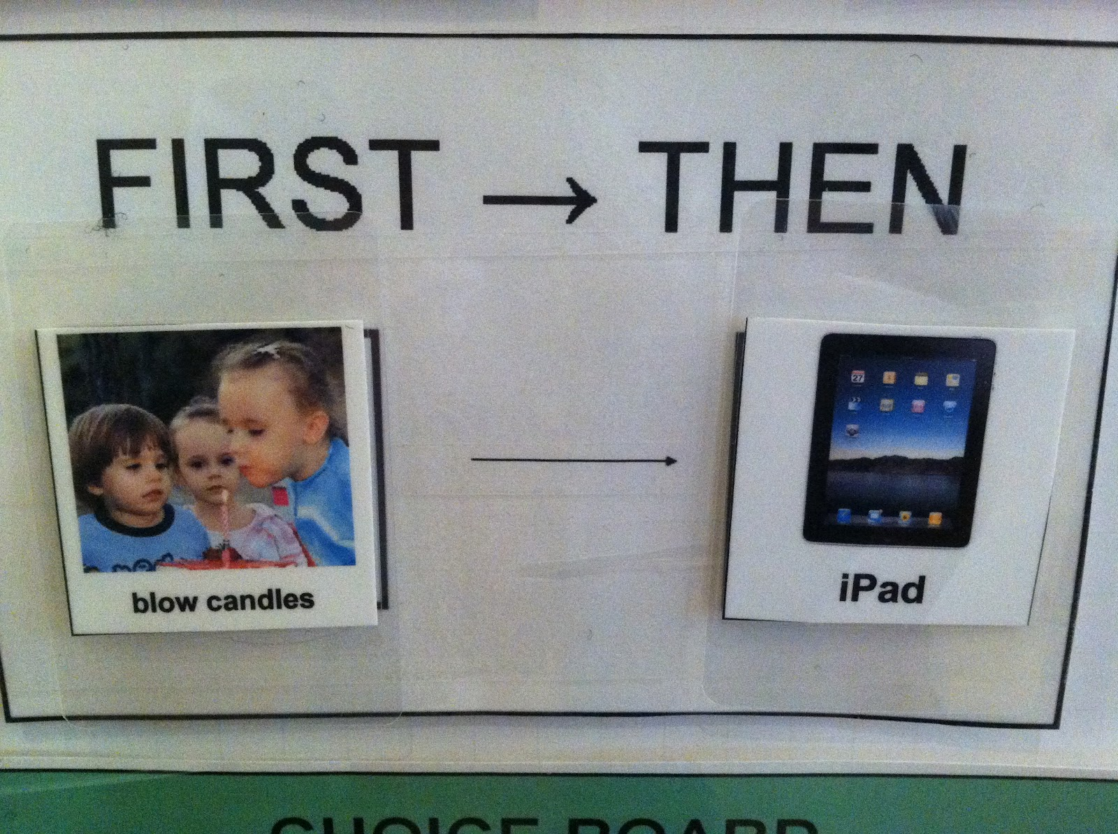
First & Then

Slide 124
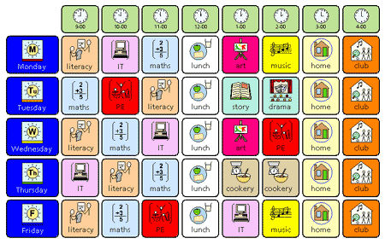
Visual Timetable

Slide 125
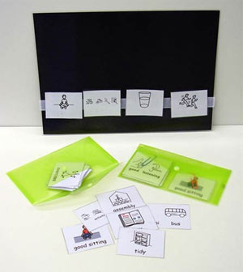

Slide 126
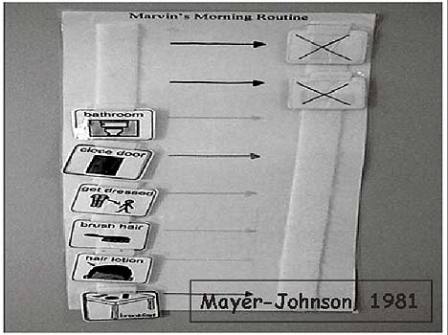

Slide 127
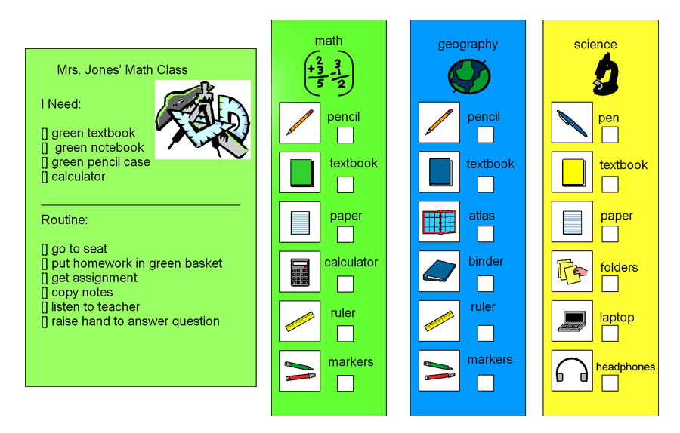

Slide 128
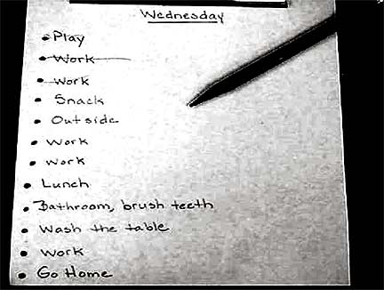

Slide 129
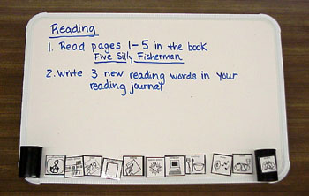

Slide 130
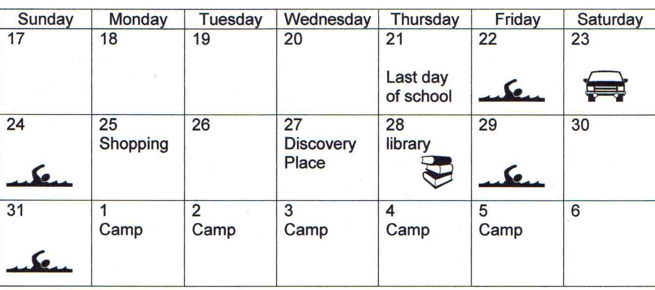

Slide 131
Prepare for Change
Change of activity
  Countdowns
  Egg timers
Change to routine
  Explanations
  Social stories

Slide 132
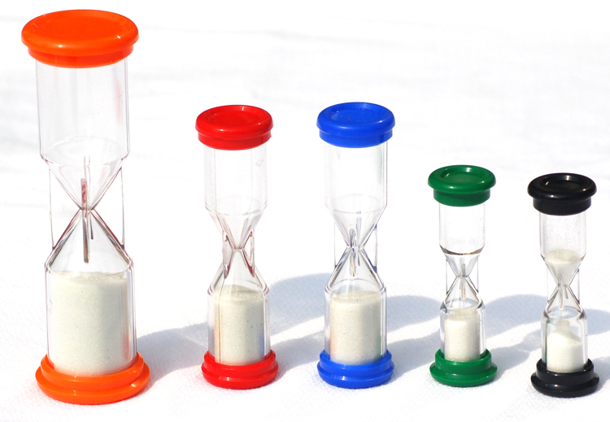

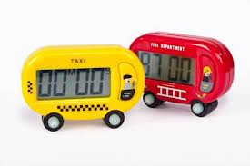
Timers

Slide 133


Surprise

Slide 134
What Can I Do?
Always forewarn: -
  Tell the person what to expect
  Give plenty of notice
Allow individuals to unwind
Provide clearly defined breaks between structured activities
Build in planned regular breaks
Use the child's interests as motivators or as reinforcement.

Slide 135
End
Questions
Evaluation!

