Slide 1
Understanding autism as context blindness is the cornerstone of an autism friendly approach." - Peter Vermeulen Context Blindness is a theory developed by Dr. Peter Vermeulen, a psychologist and the co-director of the Center for Concrete Communication in Belgium.

Slide 2
The human brain is very sensitive to context.
Contextual sensitivity plays a crucial role in many cognitive abilities that are affected in ASD, such as
face perception,
emotion recognition,
the understanding of language and communication,
and problem solving.
Context refers to the circumstances or events that form the environment within which something exists or takes place.
Context reveals and directs our perception and therefore influences and directs our response.

Slide 4
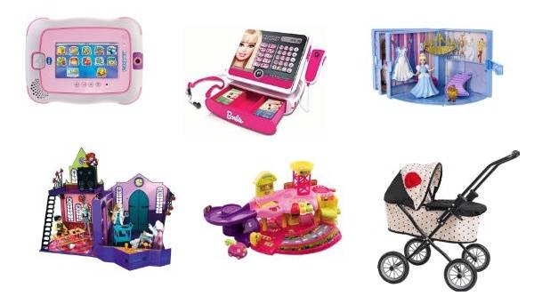
For example, there is no one correct answer to any of these questions: What is a good birthday gift for a friend?
What is the ideal distance between you and another person? What would you tell someone about yourself?

Slide 5
Can you touch someone's hair?

Slide 6
Use contextualized social scripts and stories, e.g.
Welcoming someone an event:
Do you know them?
YES NO
*Hello Mr and Mrs ? … *Hello. Welcome to our party Welcome to our party… Can I ask your name?
I KNOW THEM WELL!
*Hello mum … Welcome to our party…
Are they wearing a coat?
YES NO
“May I take your coat?”.
yes”
“no”,
wait until he/she gives you the coat & hang it
invite him/her to come in. invite him/her to come in.

Slide 7
It all depends on the context.
For example, a young man with an ASD was taken to see an apartment into which he would soon be moving.
The current tenant's furniture and belongings were in the apartment when he viewed it.
After taking a tour he responded that he could not live there.
While this might easily be interpreted as resistance to change or a difficulty with transitions,
after some probing it was discovered that it was the result of him misreading the context.
He thought that he would have to live with someone else's possessions and that there would be no room for his furniture and personal items.
Ensure that we explain our actions and choose words carefully to avoid misunderstanding
Teach emotions in context. We never see facial expressions without the context that helps us to understand them.

Slide 8
When teaching social skills it is not just teaching the what and the how to do it; it's teaching the where and the when to do it.

