Slide 1
Weak Central Coherence
“A reduced ability to draw together diverse information to construct a higher level meaning.”
Tony Attwood

Slide 2
Strength in attending to detail but appear to have considerable difficulty perceiving and understanding the overall picture or gist.
Difficulty in differentiating between what is relevant and redundant.
Difficulty in deciphering the general meaning.

Slide 3
Weak Central Coherence
Noticing patterns not perceived by others.
Originality in problem solving
Walking into a strange room.
Attention to detail in art

Slide 4
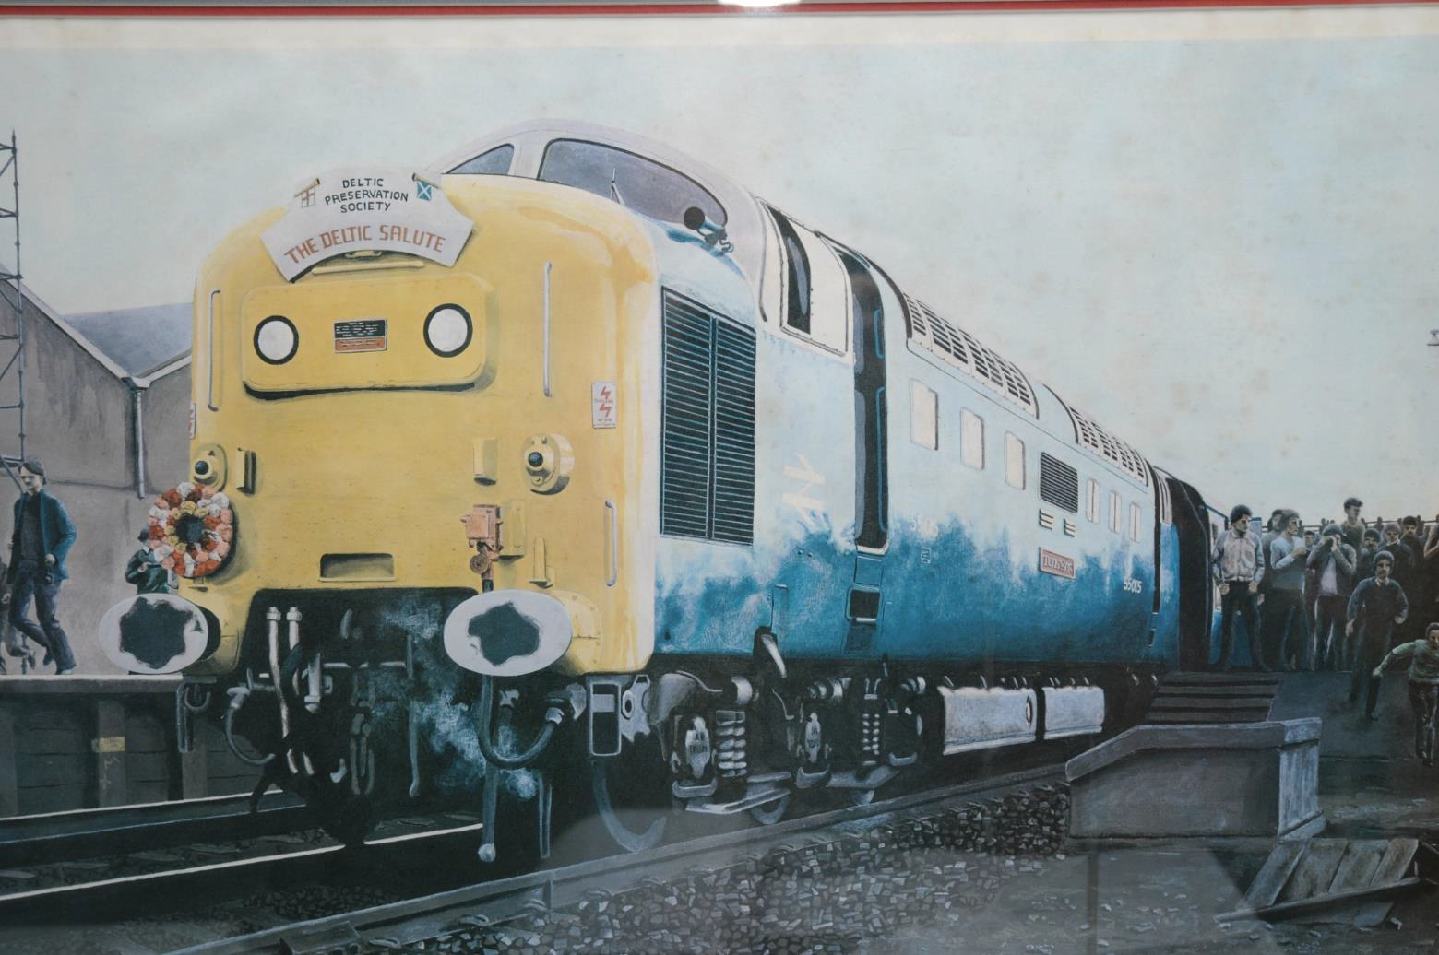
www.janehassall.com

Slide 5
Behaviour : Demand for consistency to try to decipher the pattern.
Incorrect assumptions as to why events occur (Aspie Logic, Red and yellow cars, The Curious Incident of the Dog in the Night Time)
Psychological archaeology for unusual beliefs
Tony Attwood

Slide 6
Effects in Areas of Ability and Behaviour
Non-Verbal Communication: Seeing parts of a face, e.g. frown - anger, worried or old?
Language: Pedantic, an over emphasis on detail, and a problem summarizing.
Social skills : Identifying the relevant social cues
Memory: Knowing what to forget and what to remember
Organizational skills: Problem prioritizing and unconventional organizational systems

