Slide 1
Autism and Cognition
Chris Atherton

Slide 2
Autism Prevalence
New prevalence rates emerging
1/100 in United Kingdom
National Autistic Society
Five fold increase in the 1990s – plateaued by early 2000s (Taylor et al., 2013)
1/68 in United States
Centers (sic) for Disease Control March 2014
Lotter 1966 – Presumed prevalence of 0.04%

Slide 3
The Autism Spectrum
Heterogenous
Broadened considerably over time
Geschwind and Levitt (2007) – A collection of autisms that look similar at a superficial level.
Happe – ‘Once you have met one person with autism...’
Focus on specific symptoms rather than syndromes (Happe, et al. 2006)

Slide 4
Causality
20% have rare genetic differences
Siblings are at higher risk (Ozonoff et al., 2011)

Slide 5
Neurodiversity
Can be celebrated, but there is a reality to be mindful of:
Howlin et al. (2013) 40 year follow up of 45 people with autism who’s IQ was assessed as >70, 83% were not able to live independently

Slide 6
The MMR
Measles Mumps and Rubella Vacccine
MMR was implicated by Andrew Wakefield in a 1998 medical journal called Lancet. This paper was retracted in 2010, judged to be flawed and fraudulent, and Wakefield was struck off the doctor’s register after he was found guilty of professional misconduct and dishonesty.
Many subsequent large scale studies have failed to link the MMR to autism.
Vaccine rates struggle to reach pre-scare levels (The Psychologist, October 2014).

Slide 7
A Brief History

Slide 8
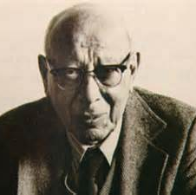
Bruno Bettelheim
Refrigerator Mothers

Slide 9
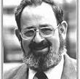
Bernard Rimland
Infantile Autism (1964)

Slide 10
Bernard Rimland
Infantile Autism (1964)
Debunked the refrigerator mother hypothesis
Identified autism as a cognitive dysfunction
‘A single critical disability’ – impaired ability to relate new stimuli to remembered experience
Leads to inability to draw meaning from experience and to integrate sensations into a comprehensible whole
Inspired a generation of research into autistic cognition.
Rimland himself pursued possible links between autism and mercury poisoning through vaccination – debunked.

Slide 11
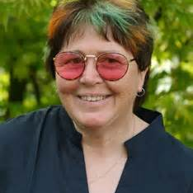
‘We tend to view things differently’
Wendy Lawson

Slide 12
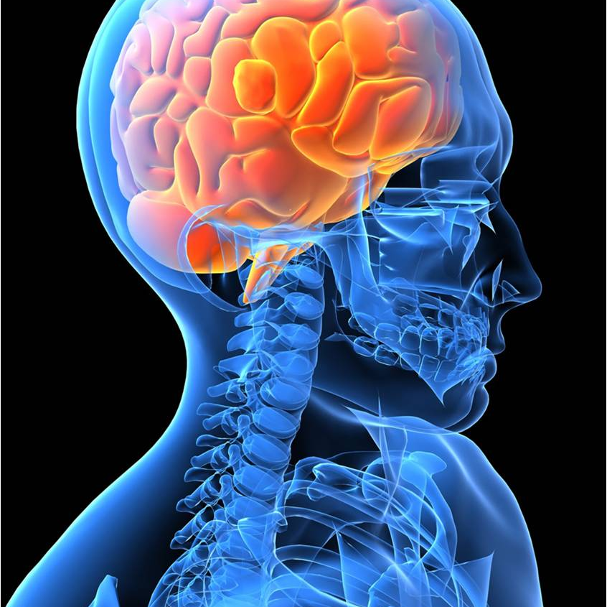
Weak Central Coherence

Slide 13
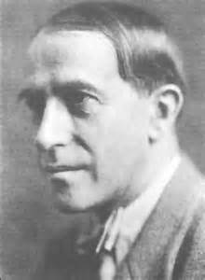
‘The whole is other than the sum of its parts’
Kurt Koffka, Father of Gestalt Psychology

Slide 14
Central Coherence
Hermelin and O’Connor (1970)
‘what to went ship sea.’
‘what ship went to sea.’
Non autistic children made fewer errors if the words made up meaningful sentences. Recall was much better in non autistic children.
Autistic children appeared to repeat the words without considering the meaning.
Unaware of Rimland’s book.
Had a PhD student called Uta Frith...

Slide 15
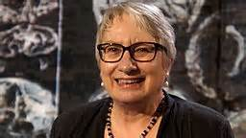
Uta Frith

Slide 16
Frith and Snowling (1983)
Ten homographs
‘He played lead guitar’
‘The box was made of lead.’
Children with autism found difficulty in ascribing meaning – identified by consistent pronunciation regardless of whether the sentence suggested crying or ripping. Autistic children tended to say ‘leed’. The early sentence context had not been taken into account. (Replicated by Happe, 1997)
Not an inability to extract meaning.
Notes:
(Words with dual meaning)

Slide 17
Subsequent proposal by Frith (1989) of ‘weak central coherence’ – focus on detail and failure to draw information together to extract meaning.

Slide 18
Block Design (WISC Iv)
Strong coherence can be a hindrance (Shah and Frith, 1993)
Segmented versus un-segmented design
Segmented – Non autistic average 45s
Un-segmented – Non autistic average 95s
Segmented – Autistic average 45s
Un-segmented – Autistic average 65s
Autistic group presented strength in their perceptual reasoning.

Slide 19
What is Weak Central Coherence?
Concerns the ability to pull information together, for higher level cohesion
The inability to draw meaning as a ‘whole’.
Attempt to describe a range of non-social features of autism by proposal of a single cognitive mechanism.
Unusual cognitive strengths suggested by autistic behaviours: restricted interest, repetition, hypersensitivity, savant ability.
Uta Frith’s proposal:
‘in an autistic brain, while the ability to discern a wide variety of things about the world is strong, the drive to make these various things cohere is weak.’

Slide 20
Central Coherence
Central coherence is descriptive
Strength:
Language and Communication
Social Interaction
Both are nuanced and contextually dependent
Weakness:
Not particularly testable / falsifiable
Not part of mainstream cognitive psychology

Slide 21
Pellicano and Burr 2012
Bayesian Perspective
The reduced influence of prior knowledge.
Information is inherently unreliable and therefore needs to be used in the context of previous knowledge (a mathematical concept applied in statistics)
Used increasingly in the context of perception – sensory information is also ambiguous and inherently unreliable.

Slide 22
Experience determines likelihood
This restricts the possibilities we consider
Bayesian perspective proposes that autistic people have a broader categorisation of prior experience – past experience therefore has a less restrictive influence on perception of the present.

Slide 23
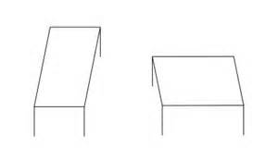
The Shepard Illusion
Notes:
DO NOT ADJUST PICTURE SIZE!!!!!

Slide 24
Mitchell et al., 2010
‘The curse of knowledge.’
Prior knowledge – experience of rectangular shapes in a 3 dimensional world.
People with autism were less susceptible to this effect.

Slide 25
Rimland – Differences in information processing must come from differences in brain functioning
Under-connectivity (Wass, 2011)
Growing evidence for atypical brain connectivity in autism

Slide 26
Predictive Coding (Friston et al., 2013; van Boxtel & Lu, 2013)
Main purpose of the nervous system is to anticipate what will happen next – survival instinct.
Minimising errors in this purpose is important – we encode how precise our predictions are by comparing our expectations with actual outcomes.

Slide 27
Predictive Coding
Two interpretations:
Friston et al. (2013) – Precision is reduced and therefore prediction is weaker, so perception is dominated by the information at hand.
Van de Cruys et al. (2013) – Precision is heightened in prediction errors – small deviations from expectation becomes a significant error.

Slide 28
Francesca Happe

Slide 29
Revised concepts of Weak Central Coherence
Francesca Happe (1999)
Proposed a normal distribution of preference or bias.
Two extremes of a continuum:
Detail focussed strategy
Opposite preference
Suggestion that typically, detail focus would be typical of the autism phenotype.
Evidence that 50% of fathers, 30% of mothers of autistic children were stronger in detail focussed processing style. Not replicated in a sample of parents of dyslexic children.
Briskman, Happe & Frith 2001; Happe, Briskman & Frith, 2001)

Slide 30
Central Coherence
‘Part of the theory of autism’ Professor Francesca Happe
Leo Kanner - Inability to experience wholes without full attention to constituent parts – Distressed by tiny changes
Difference in central coherence in ASD not a deficit.
Differences found in non-autistic individuals.

Slide 31
I did not see whole – I saw hair, I saw eyes, nose, mouth, chin... Not face
(Alex in Williams, Sensory Issues in Autism, East Sussex)

Slide 32
Theory of Mind

Slide 33
Activity
Valuable Object

Slide 34
Cognitive Theories and ASD
Theory of Mind (Happé, 1994)
Central Coherence (Frith, 1989, 1994)
Executive Function (Hill, 2004)
Extreme Male Brain (Baron-Cohen, 2003)

Slide 35
Lorna Wing
‘Once you have met one person with Autism, you have met one person with autism’

Slide 36
What is Theory of Mind
Not actually a ‘theory’!
Hugely significant feature of human cognition
Develops by or around the age of 4.
Ability to attribute mental states to others.

Slide 37
Uta Frith
Professor of Cognitive Development London
Mind-blindness
Central Coherence

Slide 38
Theory of Mind - Importance
Recognition of thoughts and feelings
‘Mentalising’ Frith
Automatic ability to attribute mental states to yourself and other people.
To recognise
To communicate
To influence
Uniquely human?

Slide 39
Social Animals (Uta Frith)
Hunt and flee in packs
Choose mates
Nurture young
Recognise others
Recognise emotions
Recognise status
Make alliances

Slide 40
Social Humans (Frith)
Teach
Tease
Trade
Deceive
Communicate ostensively – e.g. about fear without being afraid
Show complex emotions
Manipulate beliefs
Read others minds
Read own mind
Be self-conscious
Explain and predict the behaviour of others

Slide 41
Development of social behaviours
Development of cultural knowledge
Development in understanding of others beliefs, intentions, desires

Slide 42
Mental Representations
Representations can be validated by reference to the world – copies of the world
Representations can be decoupled from the world to become attitudes to the world
‘It is raining’ can be tested
‘John believes it is raining’ – cannot be validated by reference to the world (pointless to try and test this)

Slide 43
Alan Leslie (1987)
Information processing analysis
Mental states are propositional attitudes
Agent
Mother
Sally
Information Relation
pretends
believes
Object
this banana
the marble
Proposition
is a telephone
is in the basket

Slide 44
Mental Representations
Develop at around the age of two
Representation of propositional attitudes must mark
Agent: who has the mental state?
Information Relation: what sort of attitude does the agent have? (belief, hope, pretend, dread)
“Not being able to understand that a person pretends had the same cause as not being able to understand that another person ‘intends’, ‘knows’, or ‘believes’.” (Frith, 2012)

Slide 45
Decoupled Representations
John believes it is raining.
Agent – John
Information relation – belief about the world
Why does this benefit us?
Prediction – John is going to take my umbrella!!!

Slide 46
Without reference to others psychological states, the behaviour of others becomes puzzling.
Social impairment = Theory of Mind.
False belief task paradigm was established – The Sally Anne Test (Baron-Cohen, Leslie & Frith, 1985).

Slide 47
Theory of Mind - Brain
What is the neurological basis?
What if the neural connection was broken or faulty? What would that look like?

Slide 48
False Belief Test Baron-Cohen, Leslie, Frith (1985)
Sally-Anne Test
http://www.youtube.com/watch?v=qbk3HQ6heGk
Children at age 5 will pass this easily
Happe (1995) – Meta-analysis of false belief tests looking at probability of passing.
Autistic participants showed a 5 year delay, however almost all succeed on this task eventually.
Considerable developmental delay.

Slide 49
Sabtoage vs Deception (Sodian & Frith 1992)
Preventing harm from others
Physical means
Mental means

Slide 50
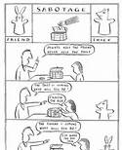

Slide 51
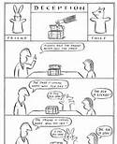

Slide 52
Sabotage – there is a key to lock the box
Deception – there is no key to lock the box
Thief calls from a distance in the deception test – ‘Is that box locked? If it is I’m not going to come all the way over for the sweet’
Many autistic children will fail the deception test and pass the sabotage test.

Slide 53
Frith (20 years of Mentalizing Research)
Studies generally replicate the findings
Some inconsistencies
Many children with ASD pass ToM tests
Some children with other diagnoses don’t
However:
Theory of Mind can be learned
Theory of Mind tests are not pure (can be failed through lack of memory for example)
Explicit mentalizing can be learned
Intuitive mentalizing remains impaired
Non-autism groups may have same social impairment, same cognitive phenotype.
Theory of Mind takes a different developmental course (Frith, 2004)

Slide 54
Theory of Mind - Developmental Milestones (Frith)
Prerequistes for mentalizing
Interest in social stimuli 0 months
Can detect animacy (biological motion) 3 months
Can detect agency (self propulsion, reaching) 6 months
Representation of goals and means 9 months
History of joint attention:
Monitoring eye gaze 3 months
Social referencing 9-12 months
Proto-declarative pointing 12 months
Intentional reaching 12 months
True joint attention (out-with field of vision) 18 months
(Intuitive mentalisation evident)

Slide 55
Intuitive Mentalizing
From 18 months:
Pretend play
Word learning by intention monitoring
Understanding seeing / knowing
Deception
Understanding intention
Implicit false belief

Slide 56
Explicit Mentalizing
Age 4-6 years
Justifying false belief by pointing out misleading reasons
Understanding higher order mental states
Sally Anne Test is a test of Explicit not Intuitive Mentalization
(1 in 5 passed in Baron-Cohen et al 1985)

Slide 57
Baron-Cohen et al 1998
Flexible joint attention
Proto-declarative pointing
Pretend play
Of those children who failed to show these at 18 months:
80% were diagnosed with Autism at age three

Slide 58
Silent Animation Studies
Castelli, Frith, Happe & Frith 2002
Control Group
ASD Group (Passed Sally Anne Test)
Appropriate intentionality descriptions in control group hardly every replicated in ASD group.
E.g. http://www.youtube.com/watch?v=nSk-KMTqFxY
30minutes.

Slide 59
Neurological Evidence Base
Medial prefrontal cortex
Superior temporal sulcus
Amygdala / Temporal poles
And others...Fusiform gyrus, cerebellum
Components show strong activity in the normal brain and weak connectivity in the ASD brain
Castelli et al 2000

Slide 60
ASD Traits and Theory of Mind
Egocentrism
Emotional dysregulation (inability to monitor internal mental representations)
Inability to switch between different perspectives
Explains some social impairments - specific and novel predictions derived from lack of intuitive Theory of Mind
Not sufficient to explain social impairments in their entirety.
Not specific to ASD, specific cognitive phenotype that is prevalent in people with ASD.

Slide 61
Additional Findings
Autistic children:
Are capable of sabotage but not deception (Sodian and Frith, 1992)
Show and understand instrumental gestures, not expressive gestures (Attwood, Frith & Hermelin, 1988)
Understand seeing but not knowing (Leslie & Frith, 1988)
Can tell about a fact if asked, but not discriminate whether it was novel or previously know to the listener (Perner, Frith, Leslie & Leekam, 1989)
Can judge what a rotated object will look like, but not what it will look like from another’s point of view (Hamilton, Brindley & Frith, 2009).

Slide 62
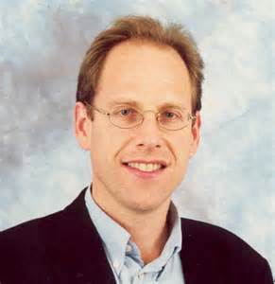
Simon Baron Cohen

Slide 63
References
Attwood, T., Frith, U. & Hermelin, B. (1988). The understanding and use of interpersonal gestures by autistic and Down’s syndrome children. Journal of Autism and Developmental Disorders, 18, 241-257.
Baron-Cohen, S., Leslie, A.M., & Frith, U. (1985). Does the autistic child have a “theory of mind”? Cognition, 21, 37-26.
Baron-Cohen, S., et al (1998)
Baron-Cohen, S. (2003)
Briskman, j., Happe, F., & Frith, U. (2001). Exploring the cognitive phenotype of autism: Weak central coherence in parents and siblings of children with autism: II. Real life skills and preferences. Journal of Child Psychology and Psychiatry, 42, 309-316.
Castelli, F., Frith, C.D., Happe, F., & Frith, U. (2002). Autism, Asperger syndrome and brain mechanisms for the attribution of mental states to animated shapes. Brain, 125, 1839-1849.
Castelli, F., Frith, C.D., Happe, F., & Frith, U. (2000). Movement and mind: A functional imaging study of perception and interpretation of complex intentional movement patters. NeuroImage, 12, 314-325.
Friston, K.J., Lawson, R. & Frith, C.D. (2013). On hyperpriors and hypopriors: Comment on Pellicano and Burr. Trends in Cognitive Sciences, 17, 1.
Frith, U. (1989). Autism: Explaining the enigma. Oxford: Blackwell.
Frith, U. (1994)
Frith, U. & Snowling, M. (1983). Reading for meaning and reading for sound in autistic and dyslexic children. Journal of Developmental Psychology, 1, 329-342.
Frith, U. (2012). Why we need cognitive explanations of autism. The Quarterly Journal of Experimental Psychology 65:11, 2073-2092.

Slide 64
References
Geschwind, D.H. & Levitt, P. (2007). Autism spectrum disorders: Developmental disconnection syndromes. Current Opinion in Neurobiology, 17, 103-111.
Hamilton, A.F., Brindley, R. & Frith, U. (2009) Visual perspective taking impairment in children with autistic spectrum disorder. Cognition, 113, 37-44.
Happe, F., Briskman, J. & Frith, U. (2001). Exploring the cognitive phenotype of autism: Weak central coherence in parents and siblings of children with autism: I. Experimental tests. Journal of Child Psychology and Psychiatry, 42, 299-307.
Happe, F. & Frith, U. (2009). The beautiful otherness of the autistic mind. Philosophical Transactions of the Royal Society B: Biological Sciences, 364(1522), 1345-1350.
Happe, F., Ronald, A. & Plomin, R. (2006). Time to give up on a single explanation for autism. Nature Neuroscience, 9, 1218-1220

Slide 65
References
Happe, F. (1994).
Happe, F. (1997). Central coherence and theory of mind in autism: Reading homographs in context. British Journal of Developmental Psychology, 12, 1-12.
Hermelin, N. & O’Connor, N. (1971). Psychological experiments with autistic children. Oxford: Pergamon Press.
Hill (2004)
Howlin, P.; Savage, S., Moss, P. et al. (2013). Cognitive and language skills in adults with autism: A 40-year follow up. Journal of Child Psychology and Psychiatry, 55(1), 49-58.
Leslie, A.M. (1987). Pretense and representation. The origin of “theory of mind”. Psychological Review, 94, 412-426.

Slide 66
References
Leslie, A.M., & Frith, U. (1988). Autistic children’s understanding of seeing, knowing and believing. British Journal of Developmental Psychology, 6, 315-324.
Lotter, V. (1966) Epidemiology of autistic conditions in young children. Social Psychiatry and Psychiatric Epidemology, 1, 124-135.
Mitchell, P., Mottron, L., Soulieres, I. & Ropar, D. (2010). Susceptibility to the Shepard illusion in participants with autism: Reduced top-down influences within perception? Autism Research, 3, 113-119.
Ozonoff, S., Young, G.S., Carter, A. et al. (2011) Recurrence risk for autism spectrum disorders. Pediatrics. Doi:10.1542/peds. 2010-2825.
Pellicano, E. & Burr, D. (2012). When the world becomes ‘too real’: A Bayesian explanation of autistic perception. Trends in Cognitive Sciences, 16, 504-510.
Perner, J., Frith, U., Leslie, A.M., & Leekam, S. (1989) Explorations of the autistic child’s theory of mind: Knowledge, belief and communication. Child Development, 60, 689-700.
Rimland, B. (1964) Infantile Autism: The syndrome and its implications for a neural theory of behaviour. Chicago: Appelton-Century-Crofts.

Slide 67
References
Shah, a., & Frith, U. (1993). Why do autistic individuals show superior performance on the block design task? Journal of Child Psychology an Psychiatry, 34, 1351-1364.
Sodian, B. & Frith, U. (1992). Deception and sabotage in autistic, retarded and normal children. Journal of Child Psychology and Psychiatry, 33, 591-605.
Taylor, B., Jick, H. & MacLaughlin, D. (2013). Prevalence and incidence rates of autism in the UK. Time trend from 2004-2010 in children aged 8 years. BMJ Open, 3(10), e003219.
Van Boxtel, J.J. & Lu, H. (2013) A predictive coding perspective on autism spectrum disorders. Frontiers in Psychology, 4, 19.
Van de Cruys, S., de-Wit, L., Evers, K. Et al., (2013) Weak priors versus overfitting of predictions in autism: Reply to Pellicano and Burr (TICS, 2012). i-Perception, 4, 95-97.
Wass, S. (2011). Distortions and disconnections: Disrupted brain connectivity in autism. Brain and Cognition, 75, 18-28.
Wing, L. (1996). The autism spectrum: A guide for parents and professionals. London: Constable.

