Slide 1
Statistics
Men/Women ratios from 2:1
Asperger syndrome = behavioural characteristics of men/boys
- thought no women or girls were affected
- clinical evidence later caused him to revise this thinking.
Kanner's - study of a small group of children - four times as many boys as girls.
2015 - ratio of men to women in NAS adult services was approximately 3:1, and use NAS schools it is approximately 5:1.
Notes:
Shown that more men and boys than women and girls have a diagnosis of autism.
Various studies, together with anecdotal evidence have come up with men/women ratios ranging from 2:1 to 16:1.
Hans Asperger diagnostic criteria for Asperger syndrome are based on the behavioural characteristics of men and boys and he thought no women or girls were affected, although clinical evidence later caused him to revise this thinking.
Leo Kanner's 1943 study of a small group of children with autism there were four times as many boys as girls.
1993 study of Asperger syndrome in mainstream schools in Sweden, Ehlers and Gillberg found the same boy to girl ratio of 4:1.

Slide 2
Learning difficulties and autism - the ratio of men/boys to women/girls was closer to 2:1.
Suggested 'high-functioning' women /girls with autism have been underdiagnosed
Increase in the number of women /girls referred for diagnosis
= historic bias towards men/boys
ICD-10 do not give examples of the types of difficulties experienced by women/girls.
Notes:
Learning difficulties and autism - the ratio of men/boys to women/girls was closer to 2:1.
Suggested women and girls are less likely to develop autism, when they do they are more severely impaired.
It could be suggested that 'high-functioning' women and girls with autism have been underdiagnosed, compared to men and boys.
There has been an increase in the number of women and girls referred for diagnosis, which suggests an historic bias towards men and boys in the diagnostic criteria for autism.
The current international diagnostic criteria for autism (in ICD-10) do not give examples of the types of difficulties experienced by women and girls.

Slide 3
Professor Simon Baron Cohen and the Autism Research Institute (ARC) have developed an 'extreme male brain' theory of autism (2002). This relates to thinking about sex differences in general within the dimensions of 'empathising' and 'systemising' and autism as an extreme of the male 'systemising' dimension.
In 1964, Bernard Rimland pointed out that, overall, men and boys tend to be more susceptible to organic damage than women and girls, whether through hereditary disease, acquired infection or other conditions. Since it is now almost universally accepted that there is an organic cause for autism, it should therefore not be surprising that men and boys are more vulnerable to it than girls and women.
David H Skuse 2000 that the gene or genes for autism are located on the X chromosome. Girls inherit X chromosomes from both parents, but boys only inherit one, from their mothers. Skuse's hypothesis is that the X chromosome which girls inherit from their fathers contains an imprinted gene which 'protects' the carrier from autism, making girls less likely to develop the condition than boys.
Asperger's view that autism and Asperger syndrome are at the extreme end of a spectrum of behaviours normally associated with 'maleness'. Such behaviours can be extremely useful in areas of life such as engineering and science, where attention to detail and single-mindedness may be more valuable than social skills.

Slide 4
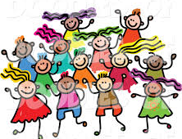
PRESENTATION
Relies on other children (usually girls)
Girls are more able to follow social actions
Girls are often more aware of and feel a need to interact socially.
Many have one special friend.
• 1:1 relationships
Prefer to play with younger children or less able peer
Notes:
Relies on other children (usually girls) to guide and speak for them.
Girls are more able to follow social actions by delayed imitation
Gravitate towards older girls, who tend to mother them and act as a form of social “protection”
Girls are often more aware of and feel a need to interact socially.
They are often led rather than initiating social contact.
= Can socialise, just not for as long.
Have difficulties making or keeping friends
1:1 relationships but are uncomfortable and anxious in large groups
may be socially immature and prefer to play with much younger children who are not challenging and would allow the child with ASD to dominate play. May “adopt” a less able peer, so they are open to being dominated by the child with ASD.

Slide 5
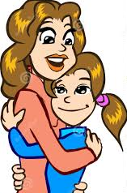
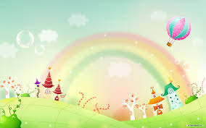
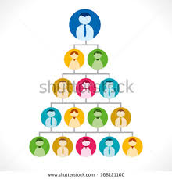
Dependent on their mother (or other primary carer)
= regard as their best friend and confidante
Rich and elaborate fantasy world with imaginary
friends
Passionate interests - quality and intensity
Conversation is restricted to her topics of interest.
Social communication hierarchy can be
problematic
Do not 'do social chit chat'
Notes:
May be unnecessarily dependent on their mother (or other primary carer) whom they regard as their best friend and confidante in a social world which they find challenging and frightening.
Many have a very rich and elaborate fantasy world with imaginary friends, escape into fiction, and some live in another world with, for example, fairies and witches.
"passionate" and limited interests that are very specific and restricted -even if they are age appropriate and are very often similar .
Therefore are not seen as unusual but it is the quality and intensity of these interests.
Eg fascinated by a TV show or pop star and collect facts about the characters or actors, but know little or nothing about the plot or genre of the show or their music.
Conversation is restricted to her topics of interest. She may share her areas of specific and restricted fascination, but have no interest in hearing another person's response.
The idea of a social hierarchy and how one communicates with people of different status can be problematic and get girls into trouble with teachers.
Girls on the spectrum do not 'do social chit chat' or make
'meaningless' comments.

Slide 6
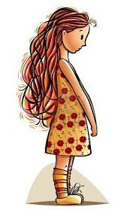
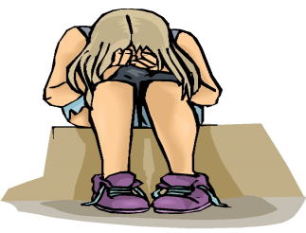
Low frustration level / age-inappropriate "meltdowns."
Depression, anxiety, or moodiness - come to the attention of health professionals
Facial expressions tend to not match their moods.
Anorexia nervosa has been called “female Asperger’s” because around 1/5 of girls who present with anorexia have traits:
Quiet or shy - unusually passive.
High emotional empathy - overwhelmed by feeling others emotions
Appear to be develop fairly typically but social communication increasingly difficult in teen years
Notes:
low frustration level, and finds it difficult to moderate her feelings, having age-inappropriate "meltdowns."
experiences an unusual degree of depression, anxiety, or moodiness.
More likely to come to the attention of health professionals due to difficulties with anxiety, depression, eating disorders, behavioural problems and/or social skills challenges.
Girls facial expressions tend to not match their moods. They may say that are fine, but on the inside they are unhappy, anxious or both.
Anorexia nervosa has been called “female Asperger’s” because around 1/5 of girls who present with anorexia have traits:
around 20 -30% of anorexic patients are perfectionists and demonstrate rigid modes of thinking and behaviour.
Anorexia offers girls with ASD what they perceive to be a positive outcome because lack of nutrition prevents menstruation and physical development.
Described as "quiet" or "shy" in school and other challenging social situations. unusually passive.
Have high emotional empathy - highly sensitive to the emotions of others ‘referred emotion’
When overwhelmed by feeling others emotions they are unable to process or ‘read ‘the subtle social signals = Learn to accept and trust your intuition. Learning a variety of interventions to help manage or cope with high empathy is important.
Appear to be developing fairly typically as a young girl, but finds social communication to be increasingly difficult as she enters her teen years when social expectations become more complex and demanding

Slide 7
Dale Yaull-Smith (2008) - ‘social exhaustion’ from the enormous energy it takes pretending to fit in.
Repetitive questioning
An inability to “move on” - not throwing away old toys/clothes and difficulties with change.
Trying to please – want to be accepted – wanting others to like them
Perfectionist – never gain a sense of satisfaction
Notes:
Dale Yaull-Smith (2008) discusses the ‘social exhaustion’ from the enormous energy it takes pretending to fit in.
= solitude to recharge their batteries to regain energy.
Can engage in repetitive questioning well beyond the age that those who are not on the spectrum would normally do.
An inability to “move on” - not being happy to throw away old toys or clothes and difficulties with change.
Trying to please – want to be accepted – wanting others to like them
Perfectionist – never gain a sense of satisfaction as haven’t got 100%
= social story on making mistakes. Setting goal and marking at achieving 8 / 10

Slide 8
Next Steps….
Much wider perspective
Parents may perceive their daughter as being non-specifically “odd”, but without being able to pinpoint the cause
Likely that the number of girls with autism will appear to rise in the next few years
The question of whether those girls were always there, however, may remain open.
Notes:
It is important to take a much wider perspective regarding the social, communication and imagination dimensions
in addition to the special interests and rigidity of behaviour.
parents may perceive their daughter as being non-specifically “odd”, but without being able to pinpoint the cause
It seems very likely that the number of girls with autism will appear to rise in the next few years
The question of whether those girls were always there, however, may remain open.

