Slide 1
Learning Profiles
Verbalizers and Visualizers (Attwood)

Slide 2
Verbalizer
Strong verbal reasoning skills
Interest in the written word / vocabulary / information
World of emotional literacy - thoughts and feelings
Processing time needed for linguistic, cognitive and social activities
‘If I wait, I'll forget’ – ends up interrupting
Yet – hates being interrupted!
Ask three before me (friends / peers) - doesn't work
Delay in response to an act, reaction might come hours or days later.
Need time to identify internal emotions
Be prepared for a delay in response! Don’t ask again – that resets the process…
Notes:
Hermione Grainger – Typical Aspie girl?

Slide 3
Visualizer
Strong perceptual reasoning skills
More classic ASD profile.
Interest lies in a world with pictures / patterns and logic
Language develops slowly - incompletely
Verbal reasoning skills are weaker
Weak auditory processing – words and meaning disappear
Show me don’t tell me
Emotional vocabulary is limited

Slide 4
Common Triggers and Challenges
Thermometer of distress
Quickly hit the panic button
Intense negative emotional reaction
Giving up quickly ends the pain
Fear of making a mistake
Phobic reaction
If I don't try, I don't make a mistake
Fear of appearing stupid and being ridiculed
Mistakes prove you are stupid (Fixed mindset)
Intellectual arrogance and narcissistic personality (Sherlock syndrome)

Slide 5
Common Triggers and Challenges
Point out errors
Coping with mistakes
Self perception as an adults (don’t differentiate)
One track mind
Do things my way
Last to know and seek help if on the wrong track
Anxiety increases cognitive rigidity
Relaxation

Slide 6
Common Challenges
Phobic reaction to making mistakes
Don’t try, you don’t make a mistake
Fear of appearing stupid and being ridiculed by peers
Mistakes prove you are stupid
Cannot change your mind, as to do so, would be to admit having previously made a mistake
Allergic to errors

Slide 7
Group Discussion
What are you currently doing to support someone with Autism Spectrum Disorder?

Slide 8
What Can I Do?
Be aware of and give personal space
Approach the person slowly and from a visible angle
Begin by using the person’s name
Allow time for information to be processed – allow up to 10 seconds for a response.
Check for understanding, ask him / her to repeat back in their own words
Visual prompts are always helpful to gain / direct attention and aid comprehension.

Slide 9
What Can I Do?
During communication:
Use simple and concise language – avoid overload
Be clear and precise
Be consistent with the language you use
Use concrete terminology
Be explicit in what you mean
Supplement your language with visual cues

Slide 10
What Can I Do?
Model how to cope with frustration
Demonstrate calm and flexible thinking, ask for help yourself
Explain the different ways in which you would approach a problem
When they encounter problems
Ask them to show you, using:
  Pictures from the internet
  Chapters of familiar books or scenes from films
  Songs that describe a thought, a feeling.
Find something that they can relate to
If they are stuck, refusing or struggling, try backward learning – you do 90%, they finish the last 10% (and build from there)

Slide 11
WHAT CAN I DO?
Don’t rely on verbal communication
Put it in writing
Use written plans and timetables
Knowing what to do now and what to do next reduces anxiety – use visual timetables
Use photos, symbols and drawings
Give hand signals or picture cues to back up instructions if necessary
Words ‘disappear’ – symbols / pictures can be held on to

Slide 12
What Can I do?
Motivated by
Completion
No errors
Special interest
‘Intellectual vanity’

Slide 13
http://www.bestautismtherapy.com.au/AppGuide/AppCriteria.php

Slide 14
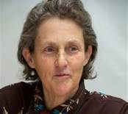
Temple Grandin
I think in pictures...
Words are like a second language to me...
One of the most profound mysteries of autism has been the remarkable ability of most autistic people to excel at visual spatial tasks while performing so poorly at verbal skills

Slide 15
Visual Supports
Real objects
Tactile symbols / object of reference, for example swimming trunks, packaging, food labels.
Photographs
Miniatures of real objects
Coloured pictures
Line drawings
Written words
Visual Supports, NAS , 2013

Slide 16
Visual Supports can help with
Timetables/schedules
Helping with sequencing
Transition and change
Starting and finishing activities
Introduction of new activities or situations – general knowledge, curriculum subjects, news
Instructions/reminders
Choice
Understanding emotions and expressions

Slide 17
Visual Supports can help with
Sharing information
Behaviour – praise, demonstrate what’s appropriate, stop inappropriate behaviour
Behaviour strategies
Social skills
Locating people and places
Safety
Structuring the environment
Independent living skills
Sex education
Health.

Slide 18
Flow Chart
Yes!
No!

Slide 19

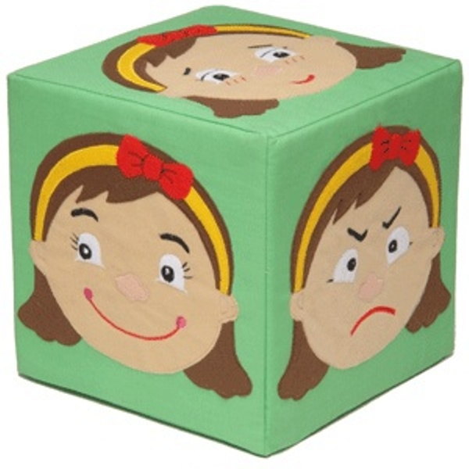
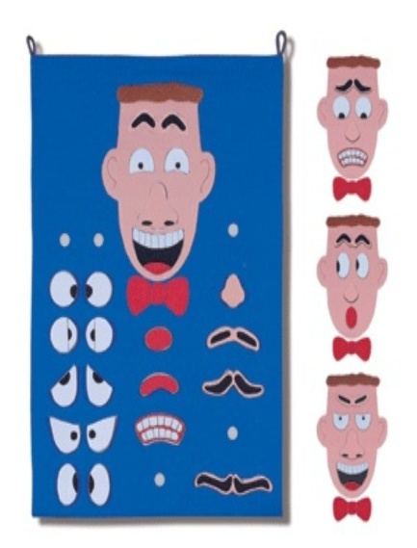

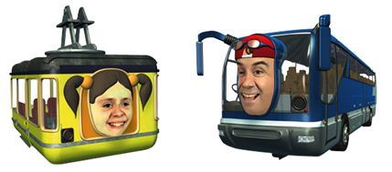
Resources

Slide 20
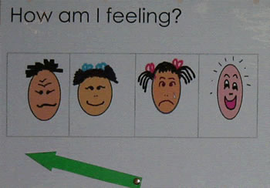
Resources

Slide 21
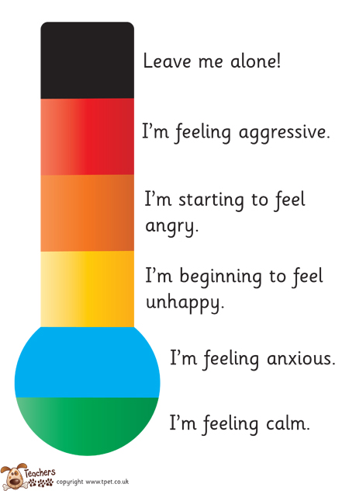

Slide 22
Social Stories
Nightmares.
Sometimes I may have a nightmare when I am sleeping. Nightmares are the same as a dream, but more scary.
Events in nightmares do not really happen. They are like pictures in my mind.
It is all right if I am scared. I may try telling myself it is all in my mind. It is only a dream. Adults can help children with nightmares, too. It is okay to ask an adult for help with nightmares.
When I wake up, I will see that I am all right.
Carol Gray (1994)

Slide 23
Story Book Conversations

Slide 24
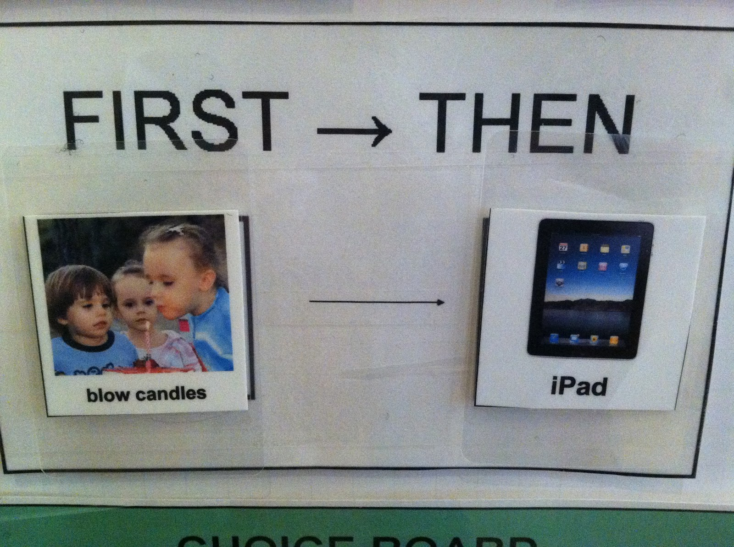
First & Then

Slide 25
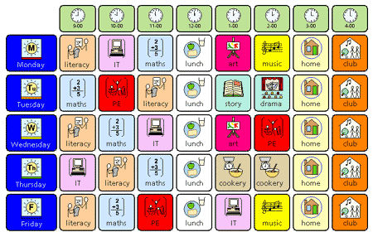
Visual Timetable

Slide 26
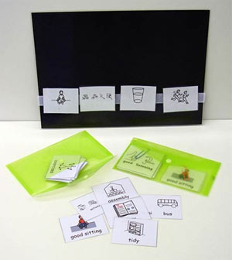

Slide 27
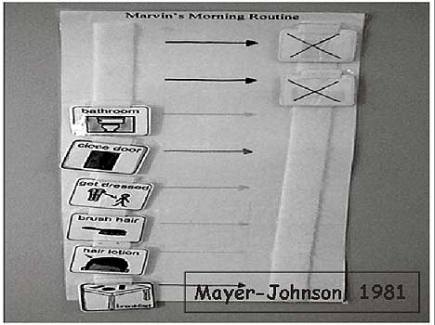

Slide 28
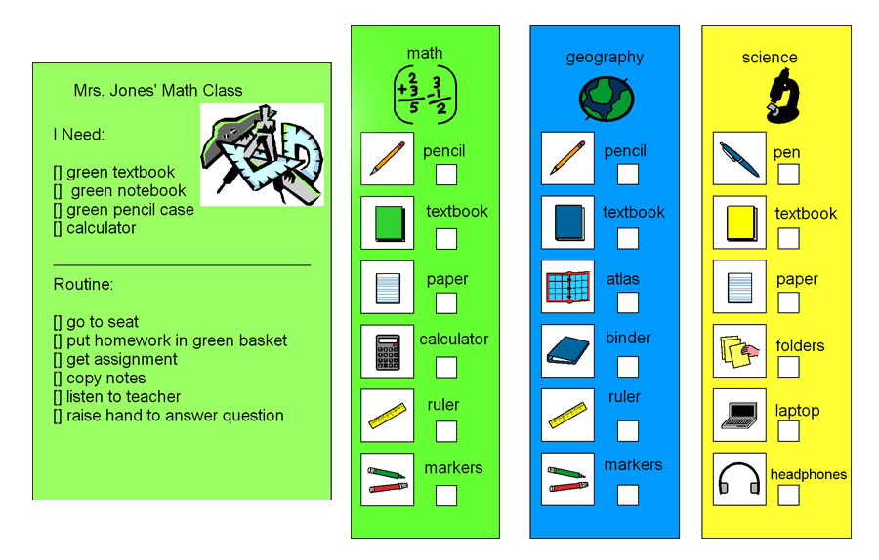

Slide 29
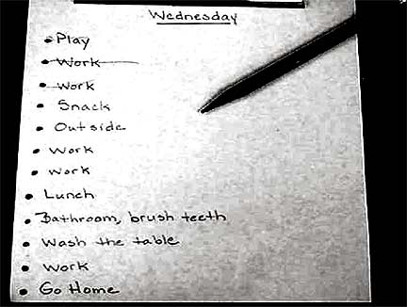

Slide 30
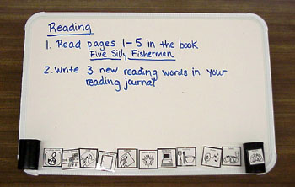

Slide 31
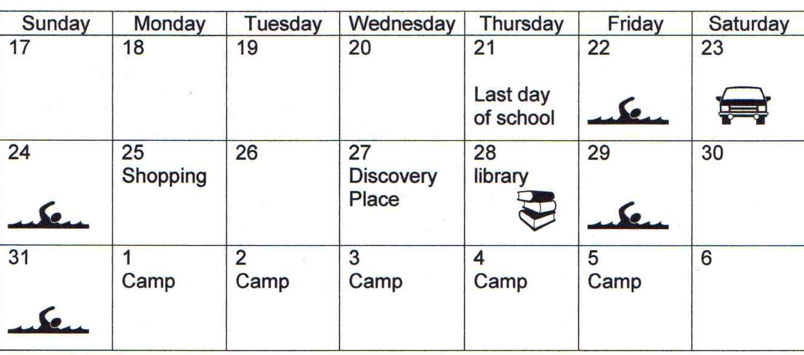

Slide 32
Prepare for Change
Change of activity
  Countdowns
  Egg timers
Change to routine
  Explanations
  Social stories

Slide 33
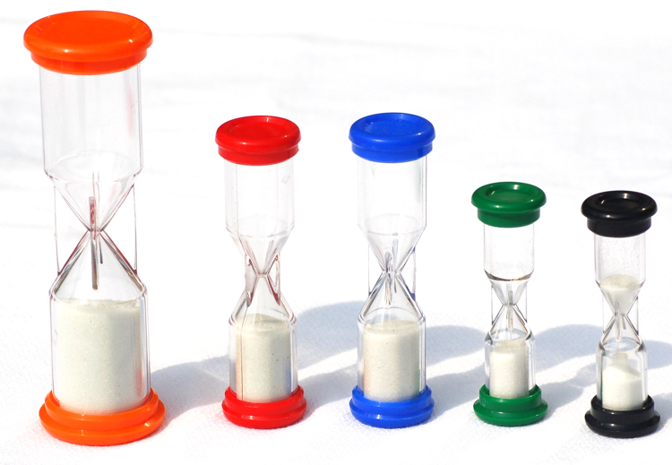

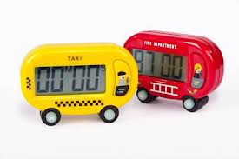
Timers

Slide 34


Surprise

Slide 35
What Can I Do?
Always forewarn: -
  Tell the person what to expect
  Give plenty of notice
Allow individuals to unwind
Provide clearly defined breaks between structured activities
Build in planned regular breaks
Use the child's interests as motivators or as reinforcement.

Slide 36
Fight ASD with ASD
The Energy Bank Account
Energy draining experiences / activities – withdrawals
Energy boosting experiences / activities – deposits
Give a numerical value, maybe out of 100.
Experience might change in value – day by day
Find a way to balance the books!
‘Beating the Blues’ by Tony Attwood

Slide 37
Energising Activities
Might include:
Preferred topics of interest
Stimming
Pattern or sequencing activities
Personal trainer
Physical exercise, walk, run, trampoline
Sport (basket ball, golf, weight lifting) or dancing.
'Running keeps anxiety away'
Creative destruction (recycling bins) - crush destroy collapse

Slide 38
Relaxation Tools
Slow release of emotional energy.
Relaxation training – meditation and mindfulness (not for everyone, but for many)
When you are calm, you are smart. Fitbit - slow your own heart rate.
Solitude – not a social communication deficit when there is no-one around to socialise with
Drawing / painting
Massage
Sleep

Slide 39
One Track Mind
The last to know and seek help if they are on the wrong track.
Lose train of thought if interrupted
Continue using incorrect strategies and not learning from mistakes.
Not listening to advice
Not seeing trains on other tracks
Compulsion for completion (switch tracks)
Anxiety increases cognitive rigidity
Relaxation programs
Be calm–in order to listen, absorb and try an alternative strategy
Tony Attwood Presentation (Glasgow, 15 May 2017)

Slide 40
What Can I Do for Pupils with Demand Avoidant / controlling profiles?
Ask without asking directly
Try to avoid saying:
“It’s time for you to...”
“You’ve got to...”
“You need to...”
“You must...”
Instead try:
“I wonder if we can...”
“Let’s see if we can make something...”
“I can’t see how to make this work...”
“Shall we see if we can beat the clock...”
“Maybe we could investigate…”
“Who do you want to help us today…”

Slide 41
What Can I Do for Pupils with Demand Avoidant / controlling profiles?
Allow time for buy-in
Talk about what you would like to see them achieve, but don’t expect too much too soon
Afford the feeling of control by offering forced choices that you are happy with and have a plan for
Have a strategy for de-escalation that everyone working with the pupil can follow consistently

Slide 42
What Can I Do for Pupils with Demand Avoidant / controlling profiles?
Interests – can be used as motivators, rewards, and ways to engage pupils in non preferred activities / subjects
Humour – can defuse situations and helps to build rapport
Distraction / Thought Blockers – can be helpful in avoiding opportunities for full scale meltdown (e.g. computer time, special interest)

Slide 43
Common Causes of Anxiety in ASD
Change or disruption of routine
Social situations and not knowing social rules
Being bullied and teased
Gelotophobia – the fear of being laughed at
Fear of failure
Sensory experiences
Rules being broken
Intolerance of Uncertainty
Difficulty with creating an internal representation of a new plan
Anxious when required to do something for which they have no plan
Tony Attwood

Slide 44
Additional Factors
Autobiographical memory: Unable to recall past episodes where they have been in similar situations
Act as a policeman to cope with fears and vulnerability and to prevent chaos
Conducting a post-mortem on social performance, before (and preventing) falling asleep
Tony Attwood

Slide 45
Anxiety Reduction
Think ahead:
  What are the triggers?
  What distraction techniques work?
  What interests do they have to redirect attention or motivate?
  What activities can help the person to relax
  Practice and teach coping / relaxation skills on a regular basis
Be flexible in your response / expectation:
  Offer different ‘escape routes’
  Model or discuss what you would do when you are feeling anxious
Pick battles carefully – does it really matter?

Slide 46
The Meltdown
Two types of meltdown
Outward directed and ‘blind rage’, try to strike out and destruction (Explosion)
Inward directed, despondent, a depression ‘attack’ (Implosion)

Slide 47
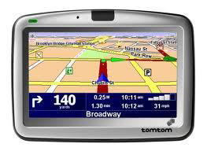
Find your GPS voice
(Calmly redirect the emotion - Sue Larkley)

Slide 48
Physical Activity Tools
Quick release of emotional energy
Personal trainer
Physical exercise, walk, run, trampoline
Sport (Basket Ball, golf, weight lifting) or dancing
“Running keeps anxiety away”
Creative destruction (recycling)

Slide 49
Relaxation Tools
Slow release of emotional energy
Relaxation training.
Solitude.
Drawing
Massage.
Sleep

Slide 50
Relaxation Tools
Time in nature (walking, fishing, camping)
Being with animals (pets, horses, birds, even reptiles and insects)

Slide 51
Awareness Raising Tools
Mindfulness.
Meditation.
Yoga/QiGong/Tai Chi/Tai Kwon Do
Awareness of bodily sensations
Aware of thoughts and feelings

Slide 52
Social Tools
Time with a family member or friend
Disclosure (typing, music, poetry)
Seek advice
Validate feelings
Being with a pet
Approval
Intensity
Duration
“I fail to understand why the exertion of pressure on the human body should be considered comforting."

Slide 53
Cognitive – Thoughts and Perspectives
Support to put the events in perspective.
Imagine what you would like to do or say in situations where triggers are present (Social scripts and stories may help)
Being calm is being smart (appeal to intellectual vanity).
Science – negative emotions decrease flexible / adaptive thinking and behaviour – lowers your intelligence in these moments

Slide 54
Adaptive Thinking
Maladaptive
Self-blame*
Catastrophizing*
Blaming others*
Ruminations*
* characteristic of ASD
Adaptive
Positive refocussing
Positive reappraisal (optimism)
Refocus on planning (flexible thinking)
Putting it in perspective
Self-soothing

