Slide 1
Language and Communication
Pragmatic
Literal
Semantic
Notes:
Semantic – the meaning of language
Pragmatic – the functional use of language – how it is used in context.
Literal – not deviating from the exact meaning of language (non figurative / idiomatic / euphemistic)

Slide 2
Common Triggers and Challenges
Delay / lack of speech development (age and stage)
Lack of response to other’s speech (including own name)
Stereotyped and repetitive use of language
Pronoun reversal (saying ‘you’ for ‘I’)
Idiosyncratic use of words – describing and not naming, own statements
Interpretation of language literally
Failure to initiate or sustain normal conversation including poor turn taking in conversations
Abnormalities in speech (pitch, stress, intonation) and understanding of voice prosody
Semantic / conceptual difficulties
Notes:
Some aspects are developmental and will develop in time eg pronouns
Semantic / conceptual difficulties

Slide 3
Abnormal use of and understanding of non-verbal communication – facial expression, gesture
Lack of motivation and ability to develop and sustain friendships, understanding the social elements of friendships
Inappropriate comments and actions
Difficulty with proximity
Doesn’t recognise or respond to other people’s feelings including the impact of their actions
Expects other people to know their thoughts, experiences and feelings.

Slide 4
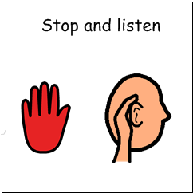
Support and Intervention
Begin by using the person’s name
Explicitly tell the person that they should attend/listen when you say boys and girls etc
Allow time for information to be processed – allow up to 10 seconds for a response.
Check for understanding, ask him / her to repeat back in their own words
Visual prompts are always helpful to gain / direct attention and aid comprehension. Stop and look at my chin…

Slide 5
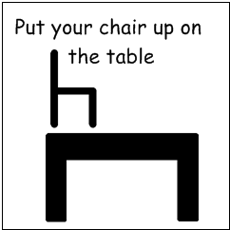
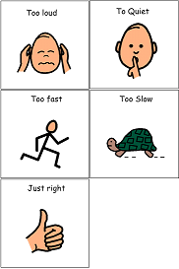
Support and Intervention
Use simple and concise language – avoid overload
Be consistent with the language you use
Supplement your language with visual cues and the written word
Drawing awareness to volume of voice used in contexts
Recording and modelling use of language.

Slide 6
Support and Intervention
Friendship rules

Slide 7
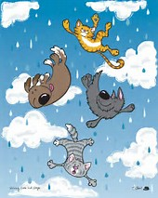
Support and Intervention
Echolalia is multi functional – model responses, sentence openers, allow time to process, thinking about the question
Learning to check what they meaning when phrases/words not typical eg I want red crisps = Doritos… can you show me
Consider how your language / phrases could have been interrupted and check understand
Use concrete terminology / be explicit
Teach to check understanding of phrases eg Its raining cats and dogs…I’m not sure what you mean?

Slide 8



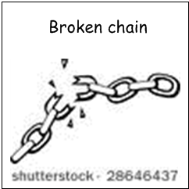
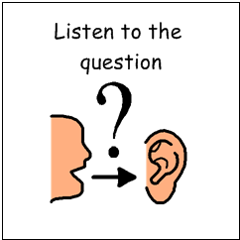
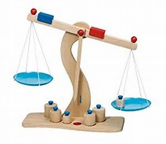
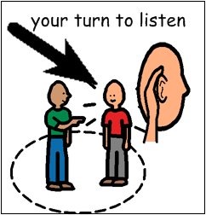
Social awareness of conversational rules to start, interrupt, weight of conversation, remaining on topic conversation, breaks, timers
Highlight that they are invading others’ personal space and explain how someone may feel when you are to close. Make amount of space concrete.

Slide 9
“restricted and repetitive patterns of behaviours, activities or interests”

Slide 10
http://www.bing.com/videos/search?q=fun+with+flags&adlt=strict&view=detail&mid=F69398E6F236F697EE36F69398E6F236F697EE36&FORM=VRDGAR
http://www.bing.com/videos/search?q=sheldon+cooper+routine&adlt=strict&view=detail&mid=B080132947EB01F04E93B080132947EB01F04E93&FORM=VRDGAR

Slide 11
Common Triggers and Challenges
Play and writing often based on re-enacting scripts/films
Requires direction to make choices in activities and mange unstructured time
Interests and Obsessions (often not reflecting peers) may become all encompassing
Hates rules to be broken
Changes to routines / expectations causes anxiety
Poor organisational skills
Difficulty seeing and respecting another person’s point of view

Slide 12
Common Triggers and Challenges
Quickly hit the panic button
Intense negative emotional reaction towards the emotions of others
Giving up quickly ends the pain
Fear of making a mistake / need for perfection - If I don't try, I don't make a mistake. Mistakes prove you are stupid (Fixed mindset) and are ridiculed
Phobic reactions – set mindset
Intellectual arrogance and narcissistic personality (Sherlock syndrome)

Slide 13
Common Triggers and Challenges
Point out errors of others as they have broken the rules
Self perception as an adult (don’t differentiate)
Need / desire to do things my way - predictability
Last to know and seek help if on the wrong track
Anxiety increases cognitive rigidity

Slide 14
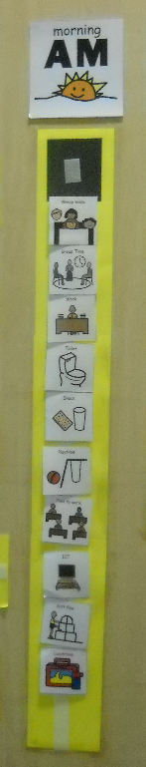
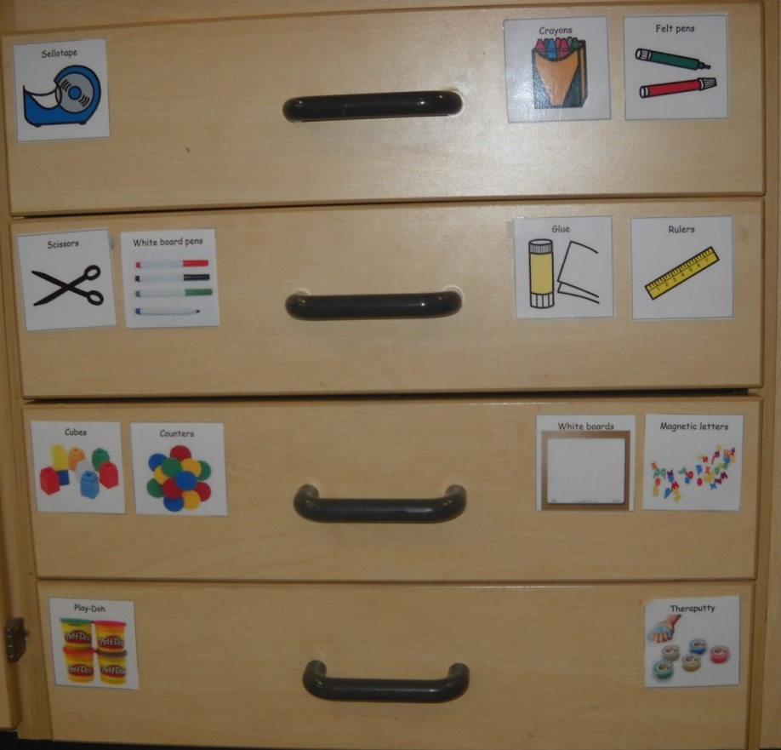
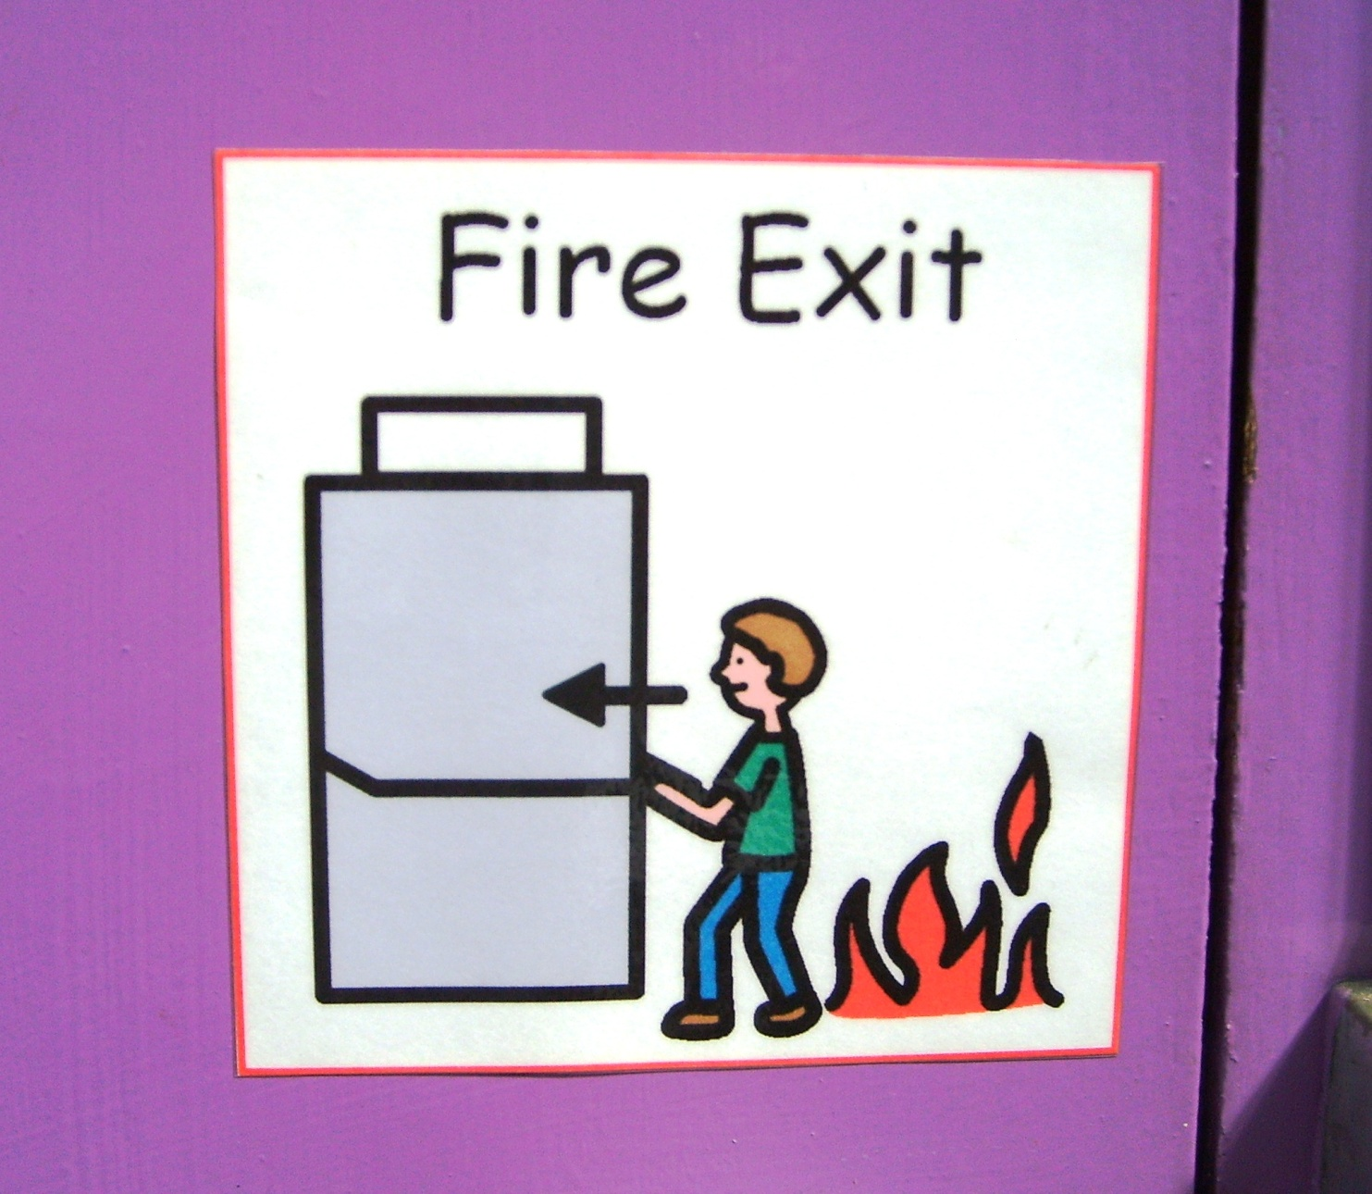
Support and Intervention
Structuring the environment
Use of Timetables/schedules to sequencing

Slide 15
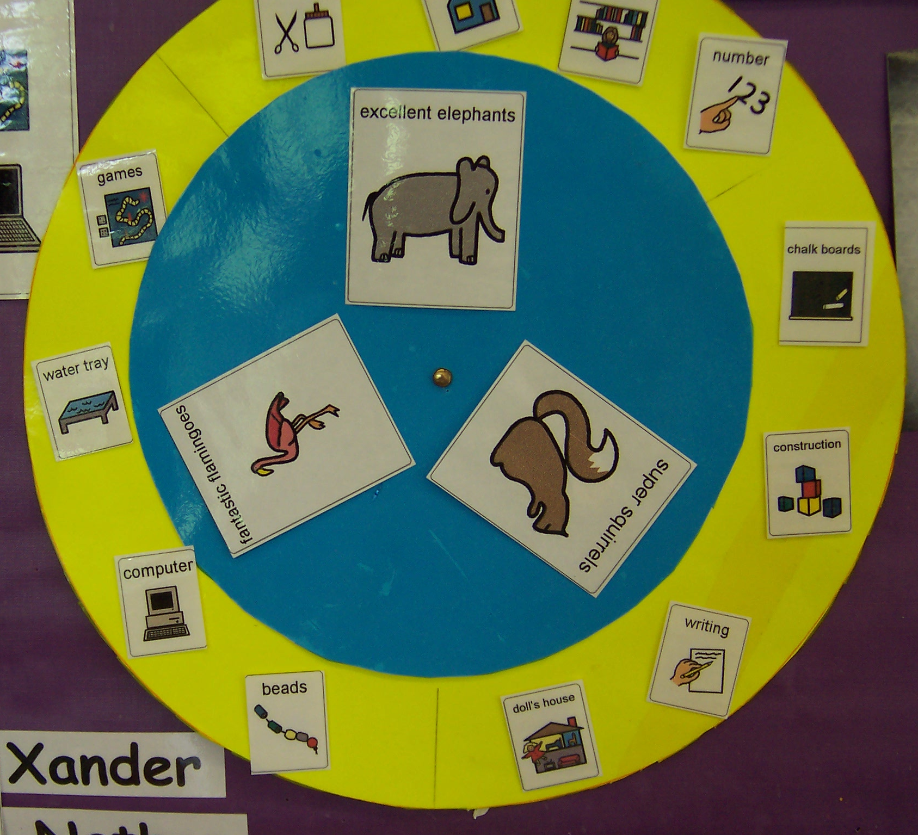
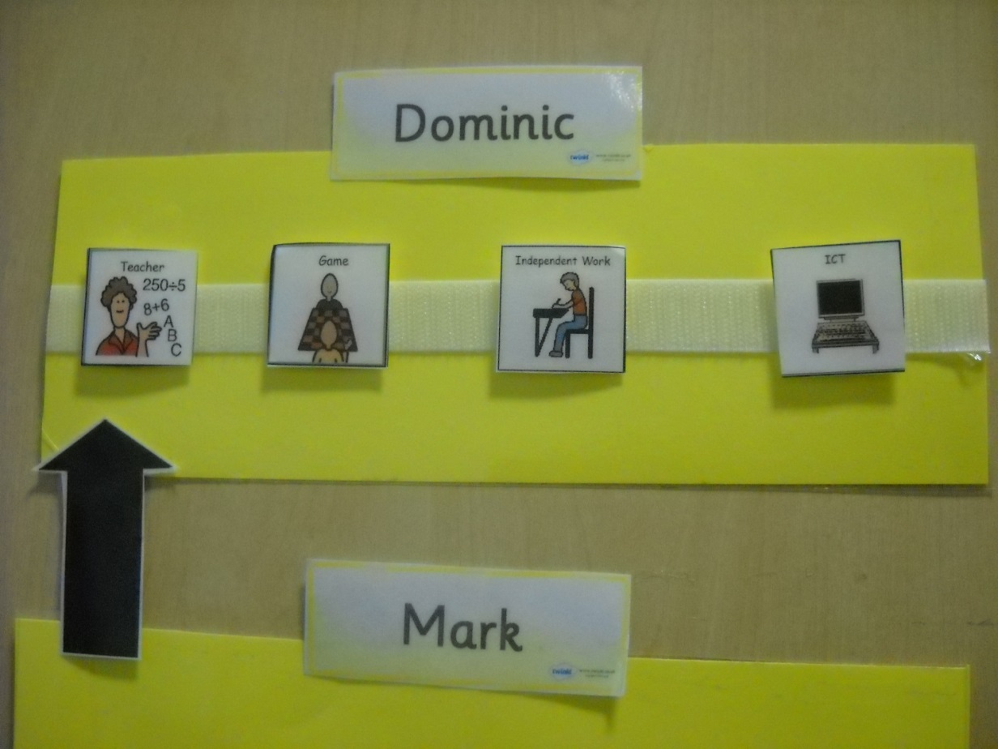

Slide 16
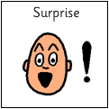
Support and Intervention
Individual arrangements for transitions
Preparation and coping with change in advance
Giving reasoning why you should do something – you will move to a new school – why???
Prepare them for the unknown – going to the dentist – unable to apply previous experience and/or will apply a literal interruption to experiences eg party bags, Mrs X doesn’t do it that way
Plan for flexibility – changing places, involving them in the process

Slide 17
Support and Intervention
Looking for reassurance about routines - constant questioning – ‘you know the answer’, write it down, look at your schedule
Use of starting and finish systems
Presenting instructions/reminders in written / pictorial form – don’t rely on the spoken word
Provide clearly defined breaks between structured activities
Restorative discussion – written and not spoken – use of options and not pick from own thoughts eg what should you do as a consequence

Slide 18
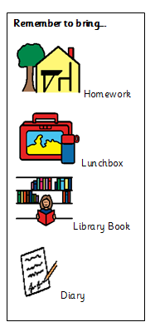
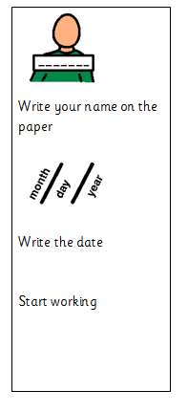
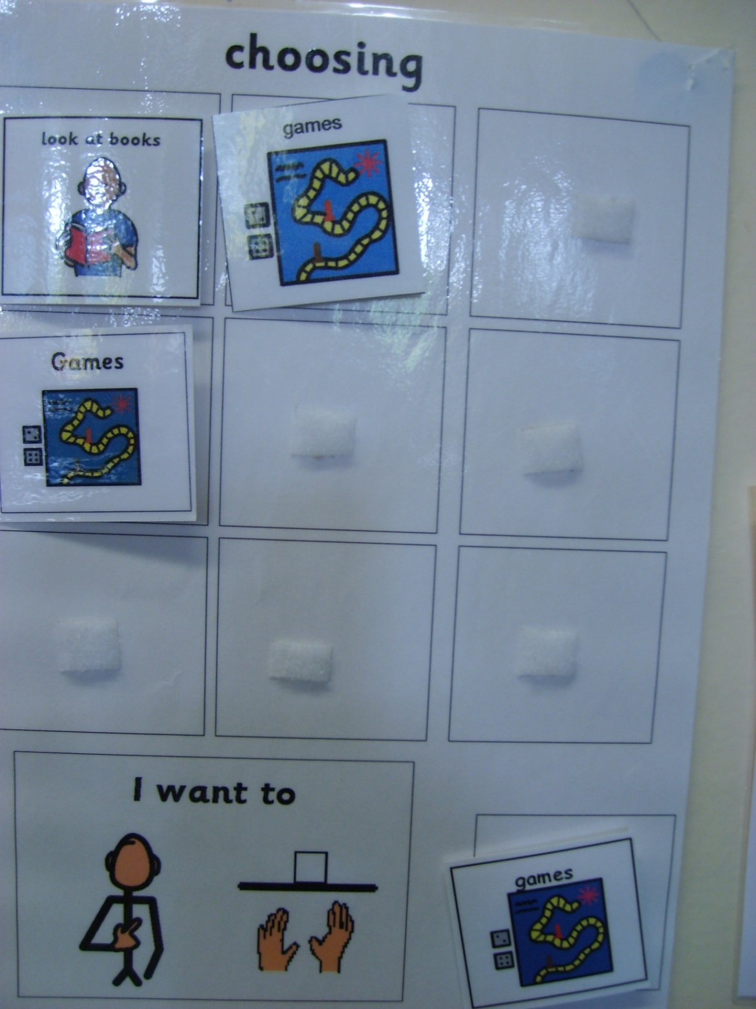
Supporting pupils independence and organisational skills
Respecting and listening to others point of view including why you should!
Offering choices to manage unstructured times

Slide 19
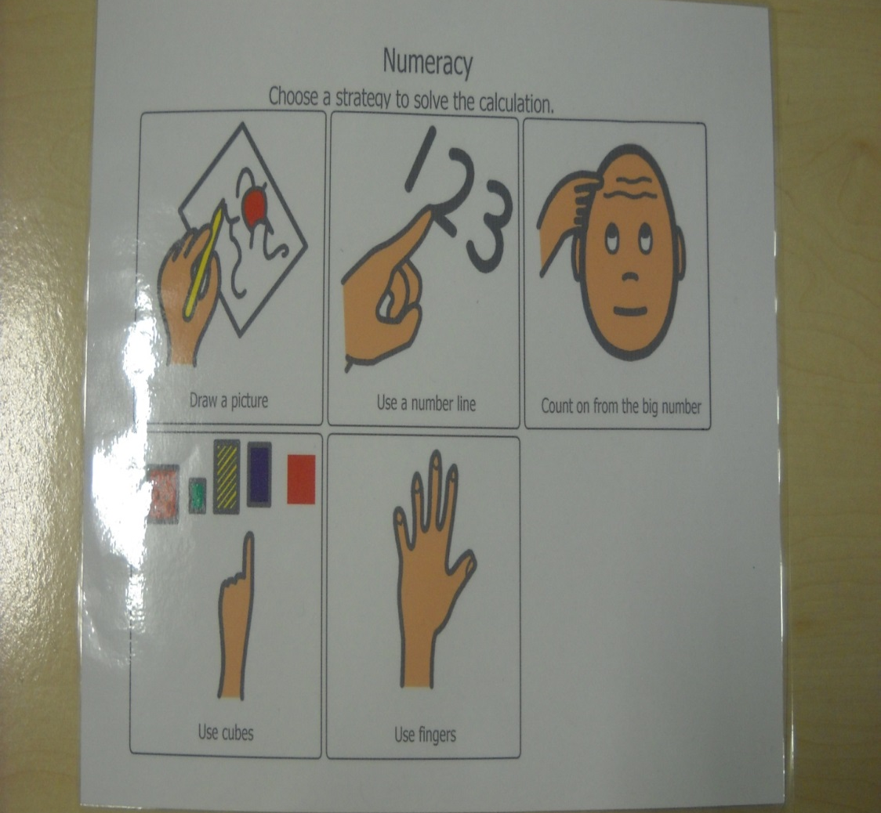
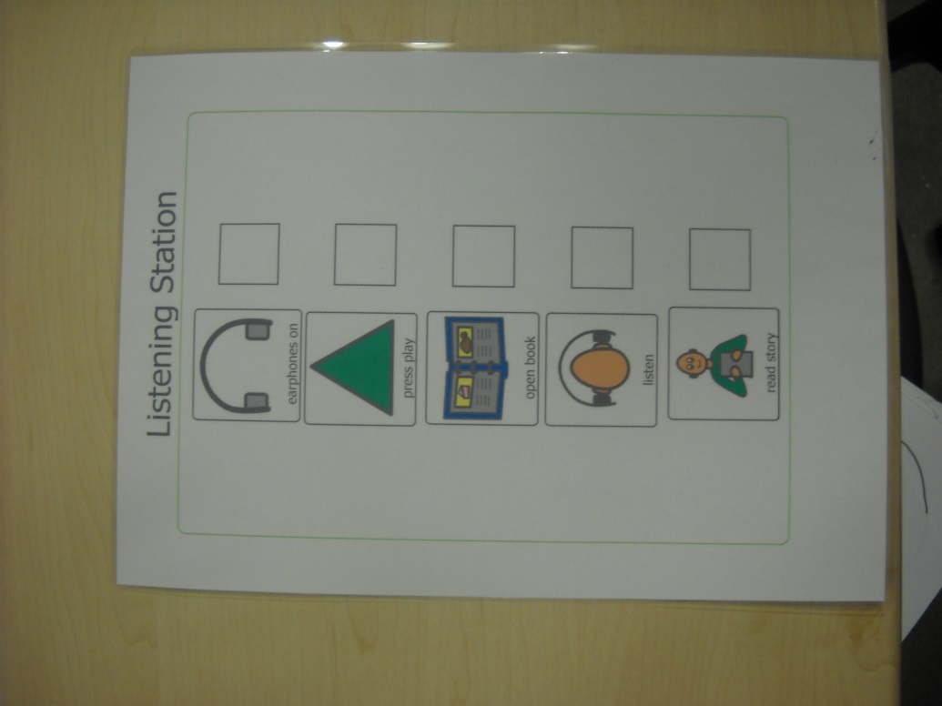
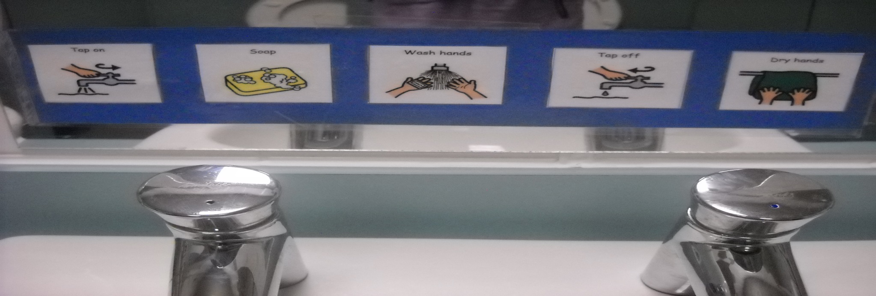

Slide 20
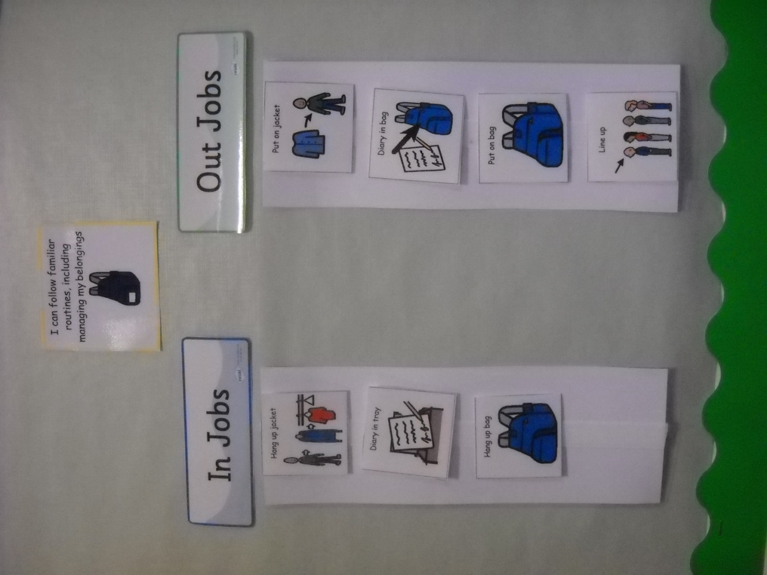
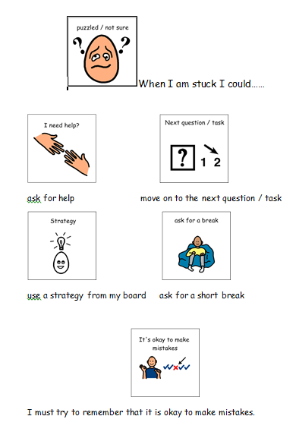

Slide 21


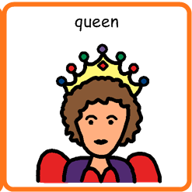
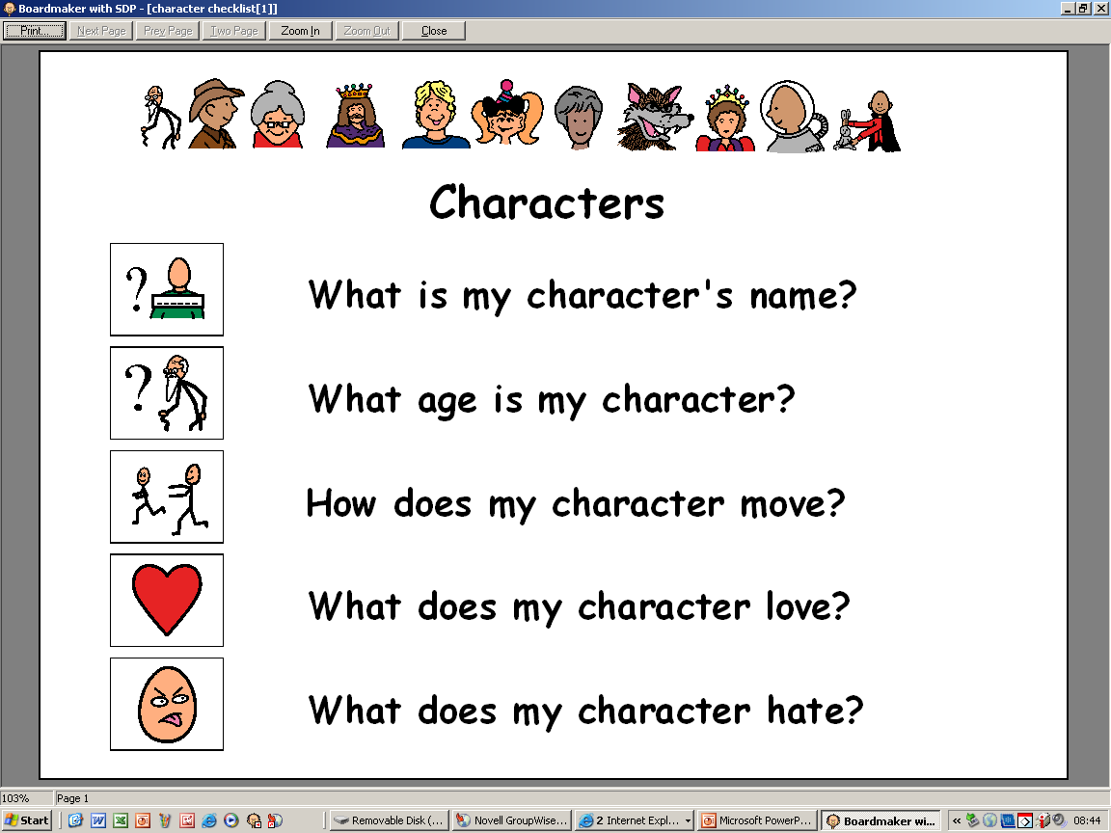
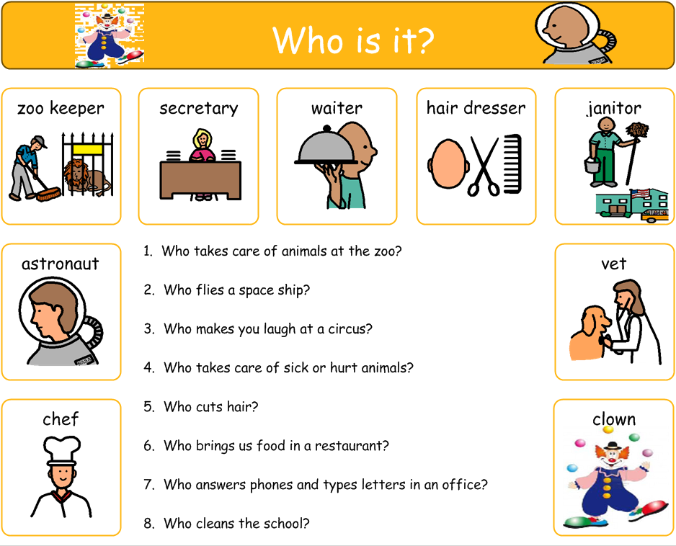
Story planning making use of visuals for options
Organising thoughts and experiences – Coloured semantics
Answering questions – forced choices

Slide 22
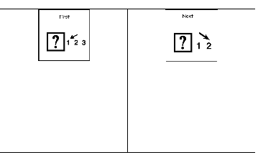
Support and Intervention
Teaching play skills and turn taking, role models
Time limit interests
Use the child's interests as motivators or as reinforcement.

Slide 23
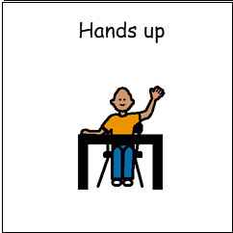
Support and Intervention
Describing, highlighting and drawing attention to own physical feature of emotions of self and others
Encouraging appropriate behaviours

Slide 24
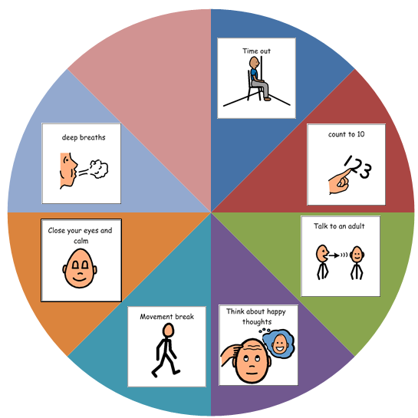
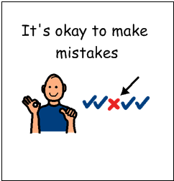
Support and Intervention
Model how you and others have coped with frustration / making a mistake
Teach strategies to deal with emotions
Awareness that their reaction to the emotions of others are real and allow them to withdraw
Encourage them to express their feelings through pictures, books / scenes or music – I feel like…
As something that they can relate to

Slide 25
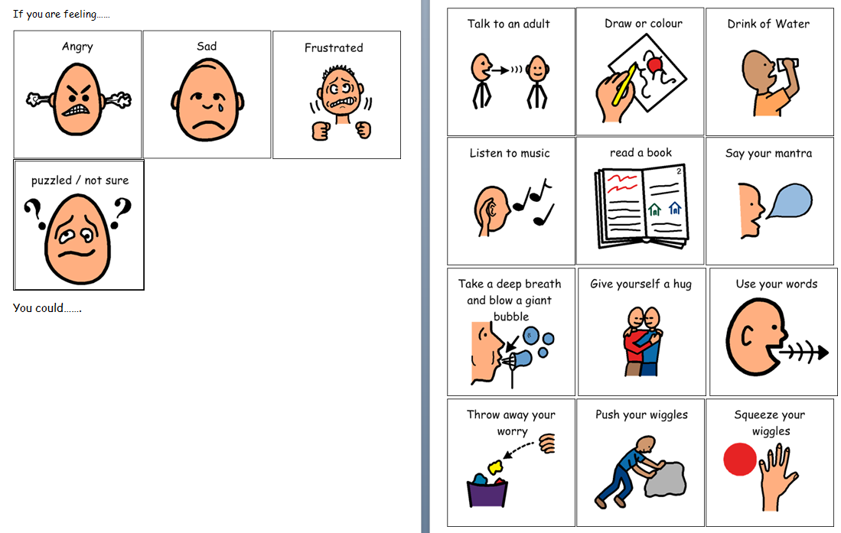

Slide 26
What Can I Do?
Coping with making a mistake
If they are stuck, refusing or struggling, try backward learning – you do 90%, they finish the last 10% (and build from there)
Asking for help including making part of timetabling
Ask for help yourself
Phobic reactions – de-sensitisation programmes, probability, coping strategies
Self perception as an adult – teaching and displaying social behaviours including language/topics

Slide 27
Social Stories
Nightmares.
Sometimes I may have a nightmare when I am sleeping. Nightmares are the same as a dream, but more scary.
Events in nightmares do not really happen. They are like pictures in my mind.
It is all right if I am scared. I may try telling myself it is all in my mind. It is only a dream. Adults can help children with nightmares, too. It is okay to ask an adult for help with nightmares.
When I wake up, I will see that I am all right.
Carol Gray (1994)

Slide 28
Story Book Conversations

Slide 29
The TEACCH Approach
https://www.youtube.com/watch?v=vkymZzmg4jw

Slide 30

‘We tend to view things differently’
Wendy Lawson

Slide 31
(this includes sensory behaviour)

Slide 32

Temple Grandin
‘Fear is the main emotion in autism.’

Slide 33
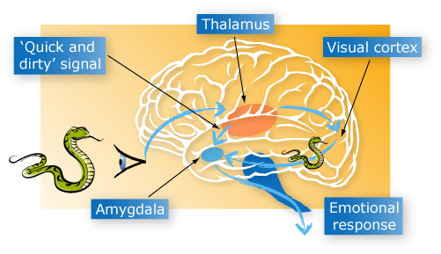
The brain and behaviour: anatomy of a hijack
FIGHT OR FLIGHT, FREEZE, RESPONSE
Heart rate and blood pressure increase.
Large muscles prepare for action

Slide 34
The Escalation
Trigger
Phase
Escalation
Phase
Crisis
Phase
Recovery
Phase
Post Crisis
Phase
Learning
Phase
Outburst
Additional
Incident
A
R
O
U
S
A
L
Aggression
Anger
Anxiety
Baseline Behaviour
Exhaustion
Time
Notes:
Hypervigilant and hyper aroused young people often operate just below the crisis phase

