Slide 1
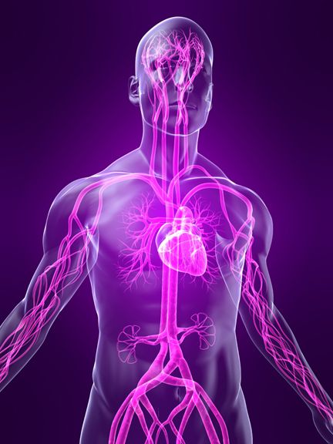
Sensory Integration
Exploring the Seven Senses in Autism

Slide 2
Seven Senses
Auditory (Hearing)
Oral (Taste)
Olfactory (Smell)
Proprioceptive (Sense of joints, tendons, muscles in relation to the space around oneself)
Tactile (Touch)
Vestibular (Balance and Movement)
Vision (Sight)

Slide 3
Other ‘Senses’
Our sensory experience and nervous system also allows us to interpret information relating to:
Pain
Temperature
We also develop a sense of the passage of time.

Slide 4
Senses and Understanding
Our senses shape our experience, this has an impact on:
Our experience of the present
Our developing understanding of the world around us.

Slide 5
Temple Grandin
“I pulled away when people tried to hug me, because being touched sent an overwhelming tidal wave of stimulation through my body.”
“Church was a nightmare because the petticoats and other Sunday clothes itched and scratched. Many behaviour problems in church could have been avoided by a few simple clothing modifications.”

Slide 6
Stephen Shore
“Haircuts were always a major event. They hurt! To try to calm me, my parents would say that hair is dead and has no feeling. It was impossible for me to communicate that the pulling on the scalp was causing the discomfort.”

Slide 7
Sensory Issues in Autism
Sensory fluctuations are common, as are difficulties with:
Sensitivity (over or under sensitive)
Sensory overload
Gestalt perception
Fragmented perception
Delayed perception
Distorted perception
Sensory shutdowns
Compensation

Slide 8
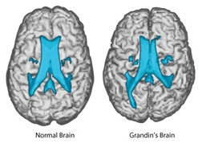

Slide 9
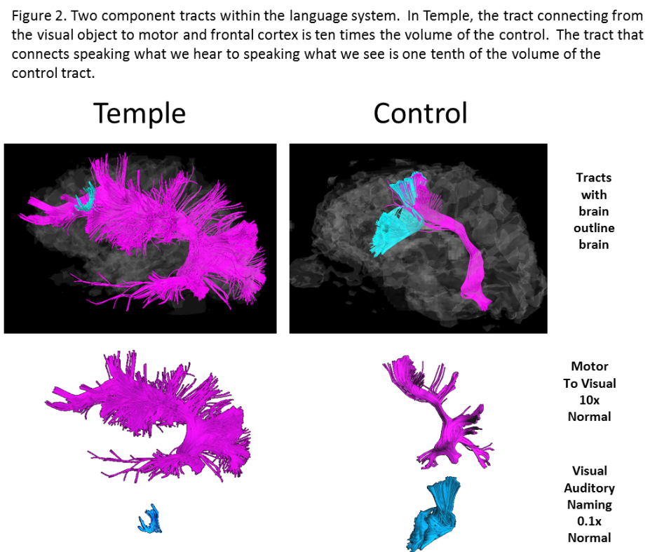

Slide 10
ASD and Sensory Sensitivity
Channel is too open
Desire to avoid or shut out the sense
Distraction / repulsion
Repel away from
Over sensitive
Can be experienced as painful or anxiety provoking
Channel is too closed
Desire to seek out the sense
Distraction / attraction
Drawn towards
Under sensitive
Can be experienced as pleasurable, and / or stimulating
Hypersensitive
Hyposensitive

Slide 11
Hypersensitive responses / Coping Strategies
A person may…
Rock
Swing
Hit their ears
Press their eyes
Twist
Flap
Spin
Why?
These can cause sensations which help block out channels that are too open.

Slide 12
Hyposensitive responses / Coping Strategies
A person may…
Bang objects/doors
Seek out noises – hoover, lawn mower
Seek out smells / colours
Prefer tight clothing
Self injure
Why?
These can cause sensations which help the brain get more information in from outside.

Slide 13
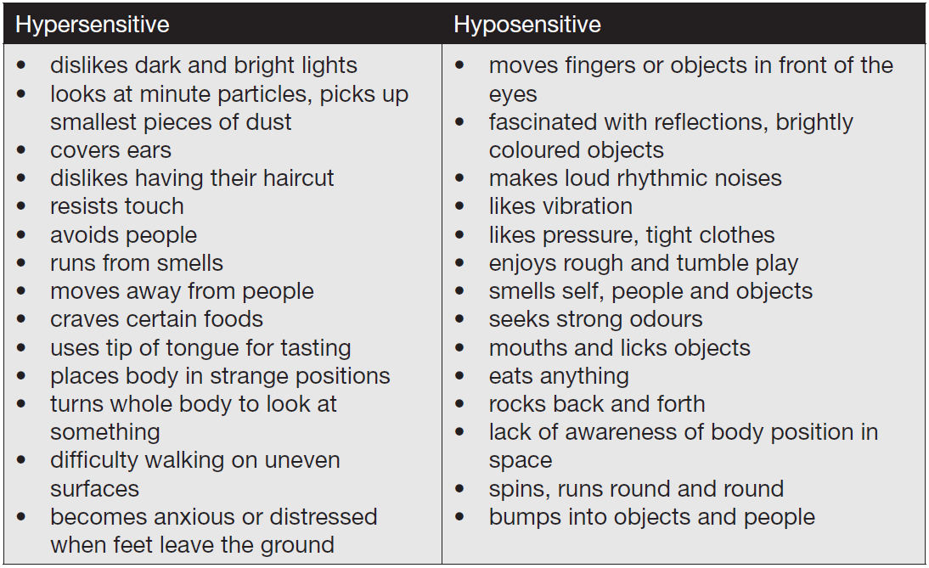
Sensory Issues in Autism – East Sussex County Council

