Slide 1
Autistic Spectrum Disorder
Meeting Learning Needs
NQT Programme
November 2015
East Renfrewshire Psychological Service

Slide 2
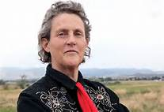
“Fear is the main emotion in autism.”
Dr Temple Grandin
Notes:
Dr Temple Grandin
Born in 1947
Could have been institutionalised.
Learned to talk at 5, after two years of intense speech therapy.
‘Memories play like a movie in my mind.’
‘I just wanted kids to stop teasing me.’
Fear – most of the things I do are designed to avoid emotions.
Highly strung
Always on the lookout for danger, looking for threats
Anti-depressant drugs
Panic and anxiety attacks
Psychoanalysis – useless

Slide 3
Autism
A Pervasive Developmental Disorder
Lifelong
More prevalent in males (4:1)
Est 700,000 in the UK (1.1% of population) (NAS)
History:
Leo Kanner (1943) ‘Autistic disturbances of affective contact.’
  Observation of 11 patients
Hans Asperger (1944) ‘Autistic Psychopathy in childhood.’
  Observation of 4 patients
Notes:
Francis Happe – Core social and communication problems across a wide spectrum
Two key observations in her work
How hard individuals have to work to accommodate the social conventions and rules of others
How anxious individuals with ASD are.
Dr Bruno Bettelheim
Born in Vienna, Autria-Hungrian
Experienced Nazi concentration camp between 1938 and 1939 before being released during an Amnesty for Hitler’s birthday.
Emigrated to America
Noticed social withdrawal of individuals placed in extreme environments
Psychoanalytics – decided that children must have been in an extreme environment
Experienced mortal fear in response to mother’s unwanting and unloving interaction
Cold refrigerator mother
Dr Bernard Rimland
Twins with Autism
Many examples of only one affected
Contradictes psychoanlaytic theory
Genetical Biological Basis
Dr Nancy Minshew
Clearly a neurological disorder
Brain abnormalities are observable – structural differences
Different regions are not well connected
People experience the world very differently
Dr Matthew Anderson
Genetic Copy Number Variations (eg 15q11-13 duplication of this most common in autistic individuals, deletion of gene causes Angelman Syndrome)

Slide 4
The Autism Spectrum
Mild
Asperger’s Syndrome & High Functioning Autism
Moderate
Learning Difficulties
Severe
Learning Difficulties

Slide 5
East Renfrewshire ASD Provision
Pre School
Primary
ASD Advisors
Secondary
Support for Learning Departments
Outreach Support Service
ASD Advisors
IMS Family Centre
PSADU
Outreach Support Service
IMS
CCC
Williamwood Support Service
IMS (& Outreach)

Slide 6
The Triad of Impairment
Social Interaction
Flexibility of Thought
Language and Communication

Slide 7
Language and Communication
Pragmatic
Literal
Semantic
Notes:
Semantic – the meaning of language
Pragmatic – the functional use of language – how it is used in context.
Literal – not deviating from the exact meaning of language (non figurative / idiomatic / euphemistic)

Slide 8
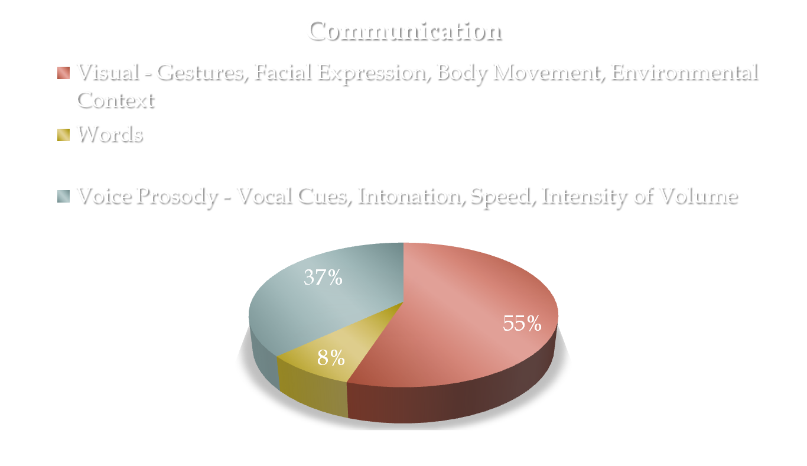
Language and Communication

Slide 9
Language and Communication
http://www.youtube.com/watch?v=raVqiQhU-Fw

Slide 10
Language and Communication
Delay / lack of speech development
Lack of response to other’s speech (including own name)
Stereotyped and repetitive use of language
Pronoun reversal (saying ‘you’ for ‘I’)
Idiosyncratic use of words
Failure to initiate or sustain normal conversation
Abnormalities in speech (pitch, stress, intonation)
Semantic / conceptual difficulties
Abnormal non-verbal communication

Slide 11
What Can I Do?
Language
Clear / Precise / Consistent
Explicit / Concrete
Simple / Concise – avoid overload

Slide 12
What Can I Do?
Ensure that the pupil knows you are speaking to them Ensure you have the child's attention – begin with his/her name.
Clarify that the pupil understands what is required.
If necessary use prompts to gain / direct attention.
Allow time for information to be processed – wait for the answer (10 seconds).

Slide 13
Do Not Rely on Verbal Communication
Put it in writing
Use written plans and timetables
Use photos, symbols and drawings
Give hand signals or picture cues to back up instructions if necessary
All children will benefit from a visual timetable
= knowing what to do and what is next reduces anxiety
Words ‘disappear’ –
symbol / pictures can be held on to.

Slide 14
ASD & Visual Supports
Visuals can help to support communication for children and young people
Verbal language can get ‘lost’
Real objects, symbols (eg. Boardmaker symbols) or photographs depending on the child’s ability to recognise these
Eg. If the child can only recognise items that are personal to them, photographs should be used

Slide 15
Visual Timetables
Can be used to support the communication of routine.
Some children may be able to cope with more information than others
Eg. First, next or first, next, last board
Best to have a limited number of symbols on the one timetable – eg. Symbols for only morning activities during the morning and symbols only for afternoon activities during the afternoon.
Visual timetables can be used for the whole class in a large format that can be seen in a prominent position in the classroom without any other visual distractions next to it.
Visual timetables can also be used individually and can remain on a specific child’s desk.

Slide 16
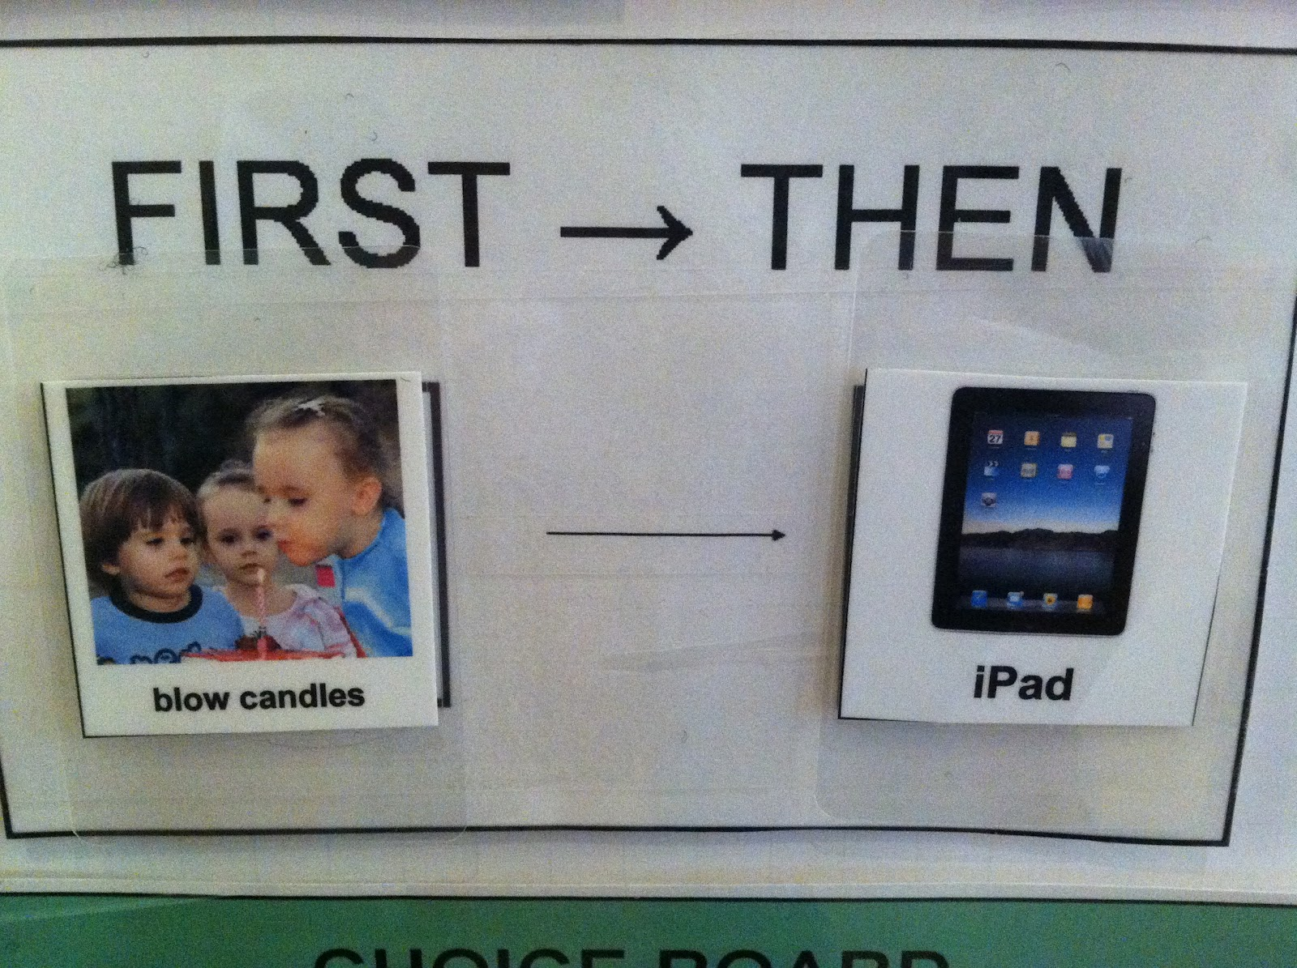
First, then

Slide 17
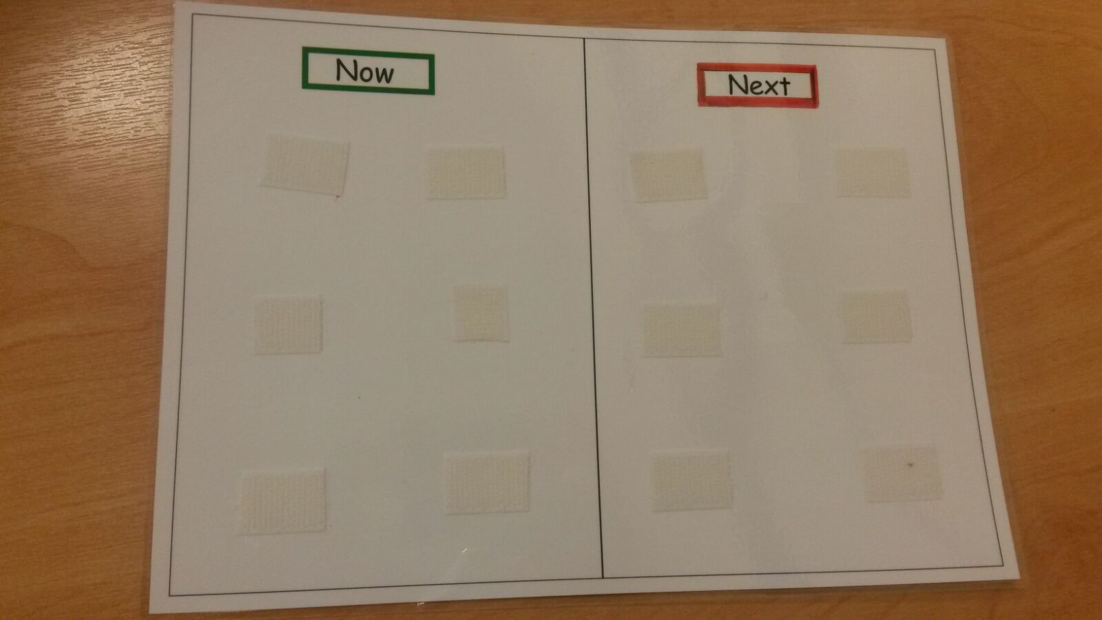
Now & Next

Slide 18

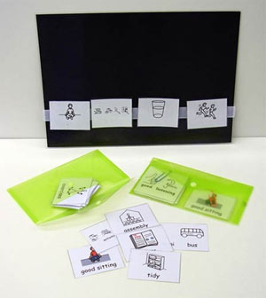

Slide 19
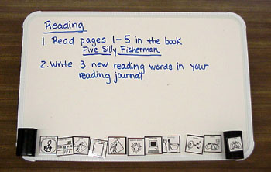

Slide 20
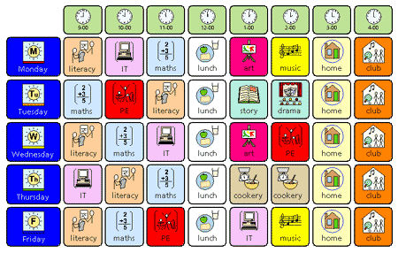

Slide 21
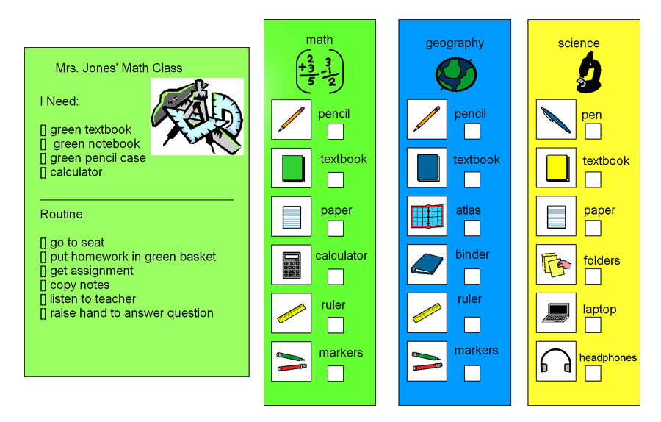

Slide 22
Key rings to support giving instructions
Key rings that are worn on your person can be useful to communicate a message quickly to children
They can be used ‘on the go’. For example, symbols on one of these could include class, home time, stop, quiet voice etc.
When using these symbols, it is useful to get down to the child’s level and show them the symbol whilst saying the word.

Slide 23
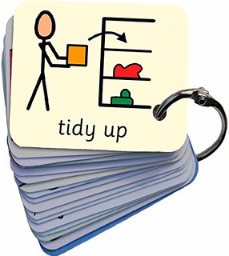
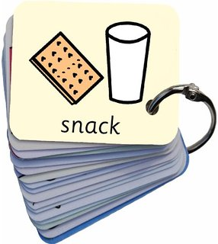

Key rings to support giving instructions

Slide 24
Visuals to communicate emotions
To support children to understand emotions it can be helpful to have symbols to represent these.
Using a key ring for these can also be useful when on the go.
Beneficial to show to a child when they are experiencing different emotions.
Can help to develop emotional literacy.

Slide 25


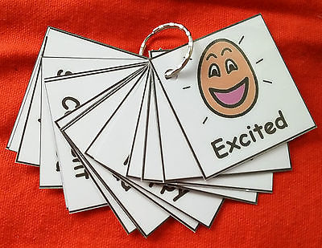
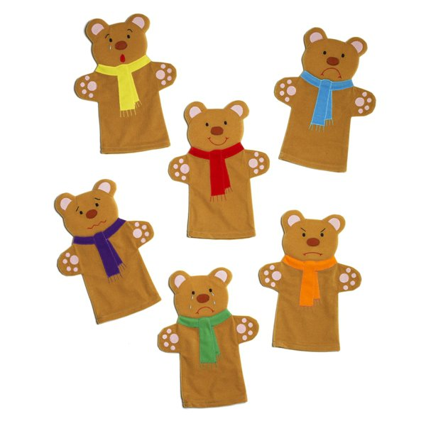
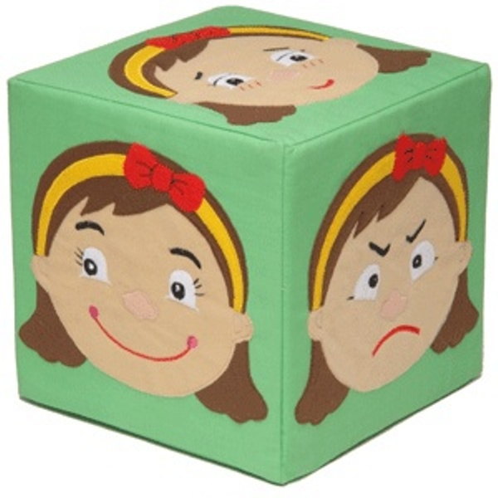
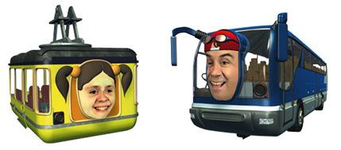
Visuals to communicate emotions

Slide 26
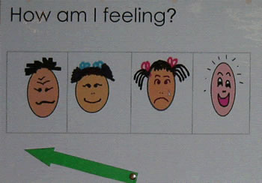
Visuals to communicate emotions

Slide 27
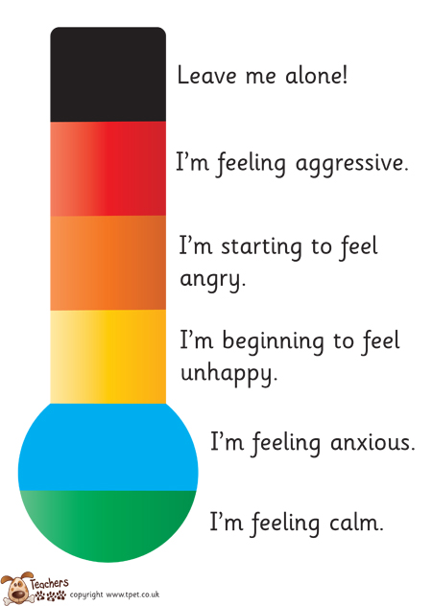
Visuals to communicate emotions

Slide 28
Visual Reward Charts
These can be used to encourage positive behaviour.
May be useful to have an end reward – eg. 5 house points for 5 stars on the chart.
It can be helpful to target a specific behaviour – eg. Staying on seat throughout an activity that requires sitting down.

Slide 29
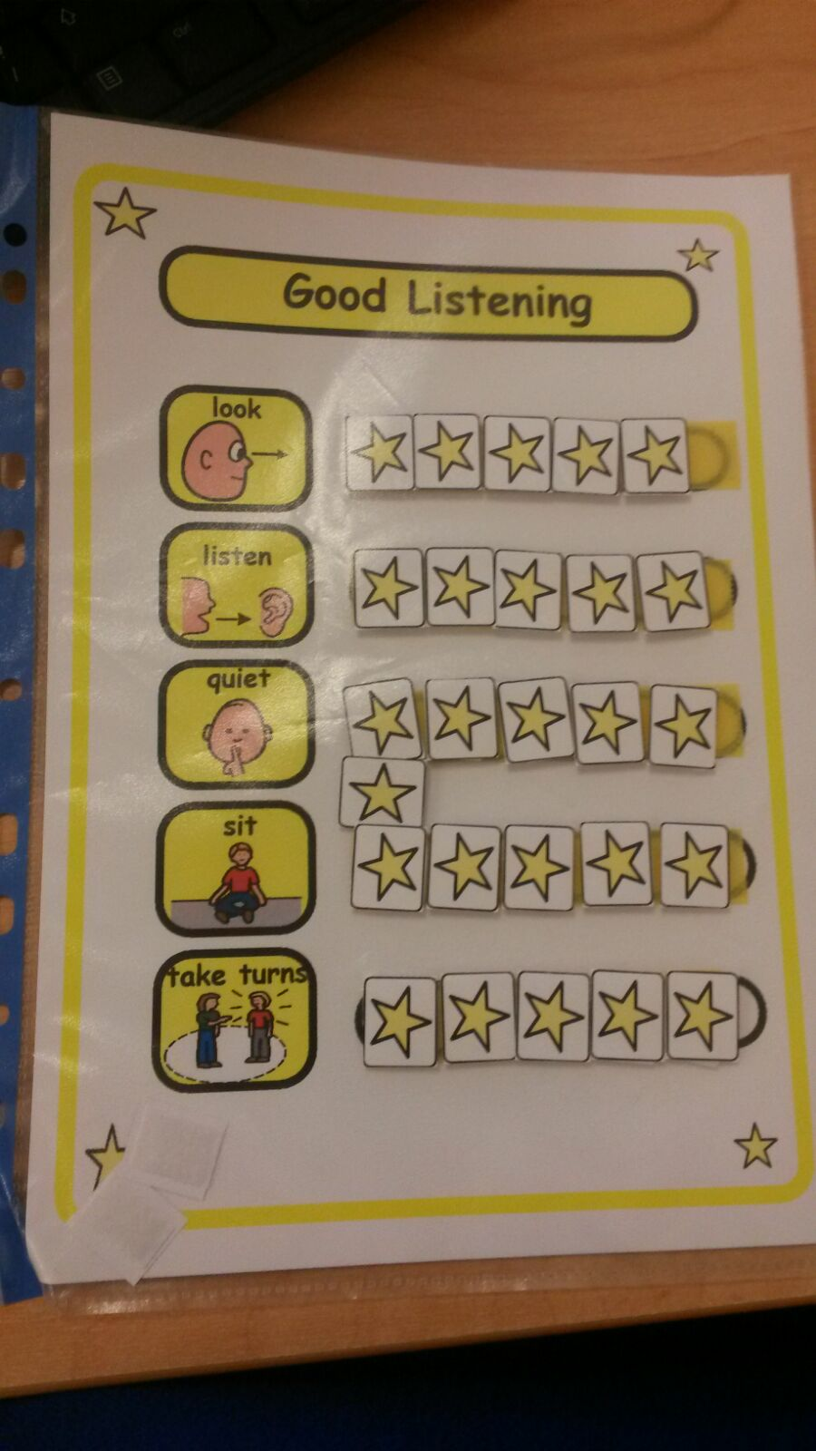
Visual Reward Charts

Slide 30
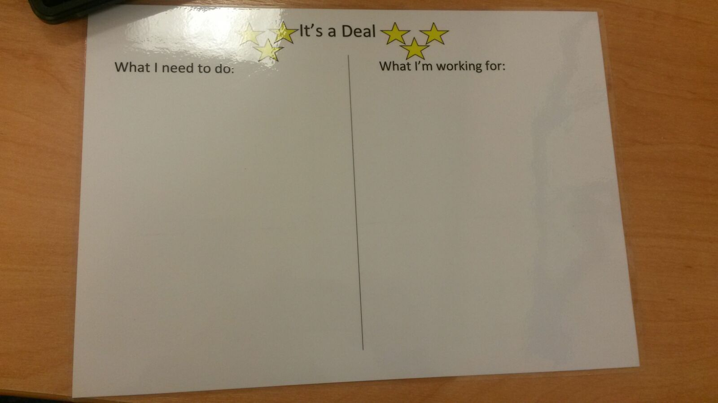
Visual Reward Charts

Slide 31
Flow Charts

Slide 32
Further Information
Follow PDF link:
http://www.autism.org.uk/visualsupports
http://www.talkingpoint.org.uk/teachers/adapting-environment

Slide 33
Social Interaction
Friendships
Social Cues
Social Conventions
Body Language
Empathy
Notes:
Friendships
Difficulty playing with other children
Rules of social play – ‘The Unwritten Rules’
Lack of innate drive to be a social being
Social Conventions
Inappropriate comments and actions
Difficulty with proximity
Empathy
Doesn’t recognise other people’s feelings
Expects other people to know their thoughts, experiences and feelings.
Social Cues
Poor turn taking in conversations
Poor timing
Body language
Misses the signals
Non-verbal communication

Slide 34
Social Interaction
http://www.youtube.com/watch?v=k0xgjUhEG3U

Slide 35
Social Stories
Nightmares.
Sometimes I may have a nightmare when I am sleeping. Nightmares are the same as a dream, but more scary.
Events in nightmares do not really happen. They are like pictures in my mind.
It is all right if I am scared. I may try telling myself it is all in my mind. It is only a dream. Adults can help children with nightmares, too. It is okay to ask an adult for help with nightmares.
When I wake up, I will see that I am all right.
Carol Gray (1994)

Slide 36
Story Book Conversations

Slide 37
Flexibility of Thought
Interests and Obsessions
Routines
Imagination
Notes:
Imagination
Pretend play
Fiction books
Free choice / Dead time
Creative writing
Interests and Obsessions
All encompassing
May not reflect culturally ‘normal’ interest
Routines
Loves repetition and rules / Hates rules to be broken
Changed routines without warning
Poor organisational skills
Difficulty seeing another person’s point of view

Slide 38
Flexibility of Thought
Routine
http://www.youtube.com/watch?v=hAWtL1CeRek
Obssessional Interests
http://www.youtube.com/watch?v=zDn5IlHqlA4

Slide 39
Prepare for Change
Change of activity
  Countdowns
  Egg timers
Change to routine
  Explanations
  Social stories

Slide 40
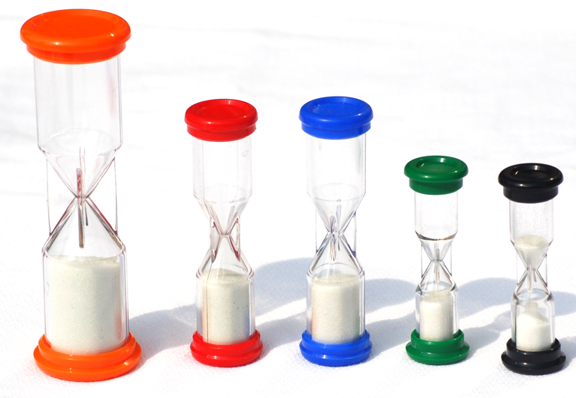

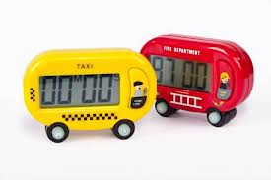
Timers

Slide 41


Surprise

Slide 42
What Can I Do?
Always forewarn: -
  Tell the person what to expect
  Give plenty of notice
Allow individuals to unwind
Provide clearly defined breaks between structured activities
Build in planned regular breaks
Use the child's interests as motivators or as reinforcement.

Slide 43
Additional Features
Fine and Gross Motor Skills
Attention and Concentration
Sensory Sensitivity
Specific Learning Needs

Slide 44
Sensory Perceptions
Outer and Inner Senses (Shore 2004)
Vestibular
(Inner Ear, Balance)
Proprioceptive
(Muscles and Joints, Sense of Body in Space
Sight
Touch
Taste
Smell
Hearing

Slide 45
Cognitive Theories of Autism
Autism
Executive Functioning
Theory of Mind
Central Coherence

Slide 46
End
Questions
Evaluation!

