Slide 1


hEALTHIer
Minds
A Framework for Supporting the Mental Wellbeing for Children and Young People
Kirstie Rees and Chris Atherton
Educational Psychology Service
INCLUSION CONFERENCE
12.9.19

Slide 2
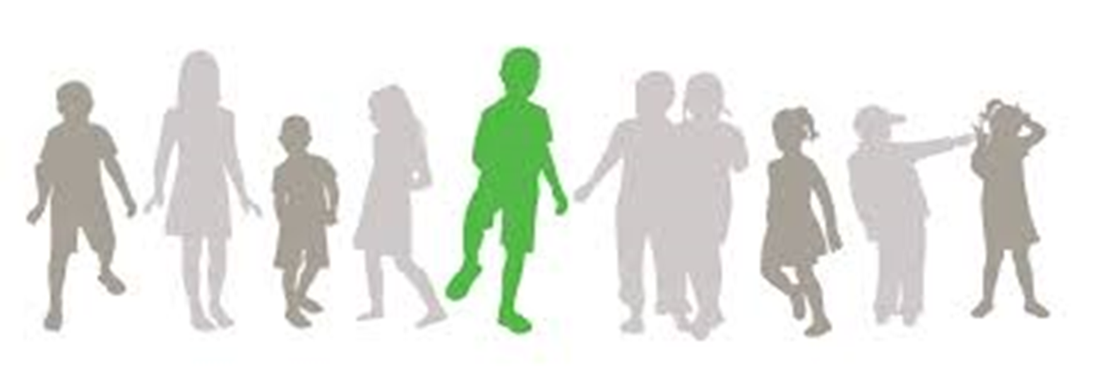
- HealthiER minds Framework
- Statistics
- The World Today/Yesterday
- Current Context
- Mental Health: what’s in a word?
- Activity
- Mental Wellbeing
- Wellbeing Continuum
- Professionals’ Version
- Types of support
- Universal
- Targeted
- Intensive
- Parents’ and Young people’s version
PLAN OF SESSION

Slide 3

HealthIER Minds
HealthiER Minds is a Framework for people working in partnership across services to nurture mental wellbeing in children and young people.
HealthiER Minds outlines ways to support mental wellbeing in a holistic way.
It provides information about services that can help East Renfrewshire’s children, young people and their families

Slide 4
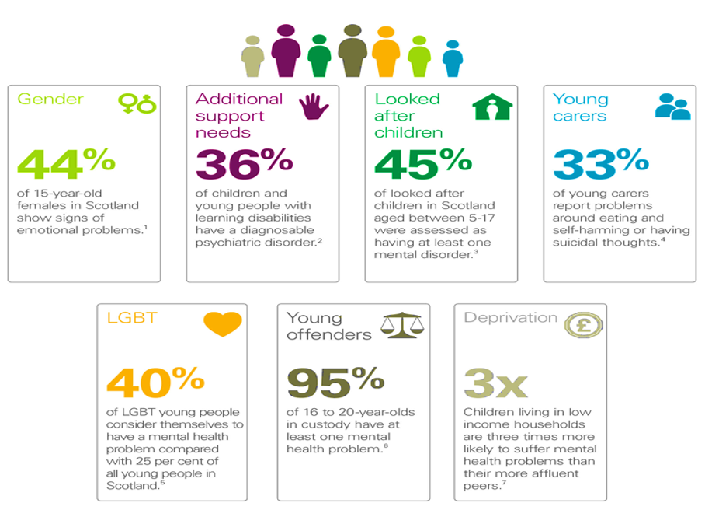
The Statistics

Slide 5

The World Today and yesterday

Slide 6
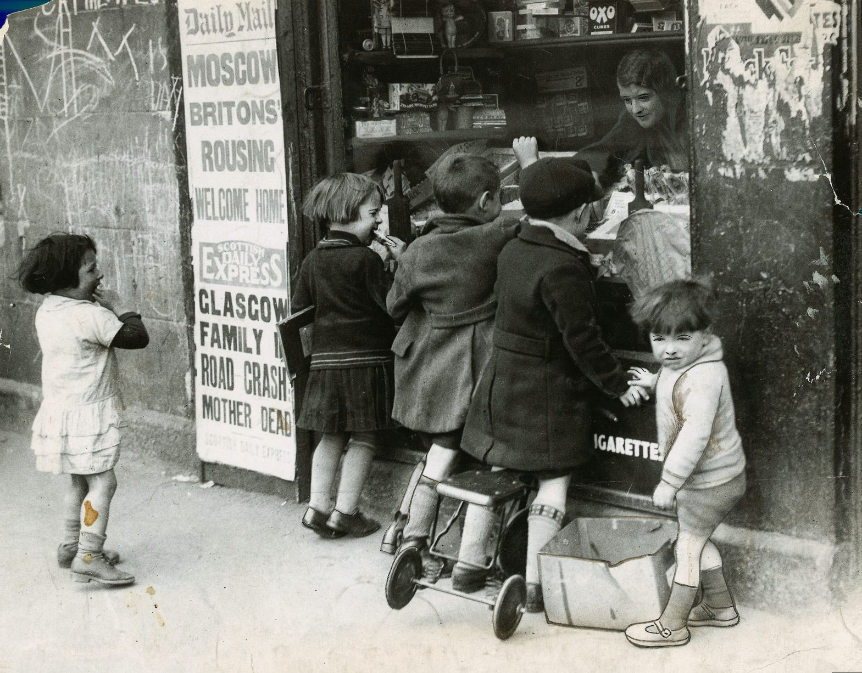
Psychology of Resilience
1933

Slide 7
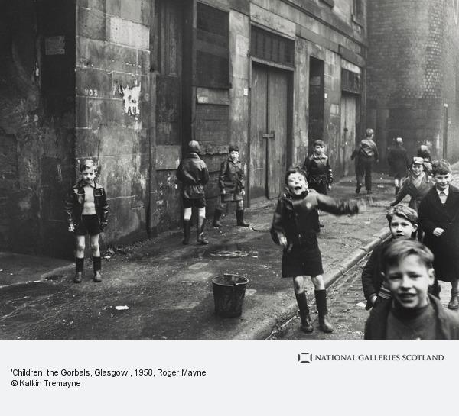
What is Resilience?
1958
Emotional wellbeing against the odds
The ability to bounce back
Adaptability in the face of adversity
Notes:
It’s about the ability to cope with life’s set backs. To cope with everyday adversities and to recover after bigger challenges like bereavement, divorce, job loss etc. About the confidence to open yourself up to new challenges – to reach out so that you can achieve all that you are capable of.
Research indicates that the process that determines our resilience is a dynamic one involving interaction between external and internal factors. But resilience is not fixed. The good news is that resilience is not a trait that people either have or do not have – it involves thoughts, beliefs, attitudes and behaviours that can be learned and developed.
1 Toughing things out is not resilience! Resilient people understand, are comfortable with and express their feelings.
Resilient people experience challenging emotions, recognise them, and move forward with a coping plan.
Not about removing challenging situations from our lives. Resilience is formed as a result of dealing with setbacks. People think that bad feelings don’t have a purpose.
And that bad feelings such as guilt, shame and frustration are only negative. But research shows that bad feelings can encourage us to do things differently: we need them to succeed. Bouncing back means that people can carry on, and even flourish, after setbacks
It is human nature to experience negative emotions. Only dead people don’t. Bad feelings are normal. Learning anything worthwhile requires some frustration
Steve Jobbs – started Apple in his parents garage at the age of 20…in 10 years, grew into a $2 billion company. Very publicly fired by his board of directors. Started over an incredible innovator, inventor, marketer and amazing human being. Known as the Father of the digital revolution.
The beatles – rejected by record labels over and over, told “guitar groups are on the way out” and “the Beatles have no future in show business”. Went on to become the greatest band in history.

Slide 8
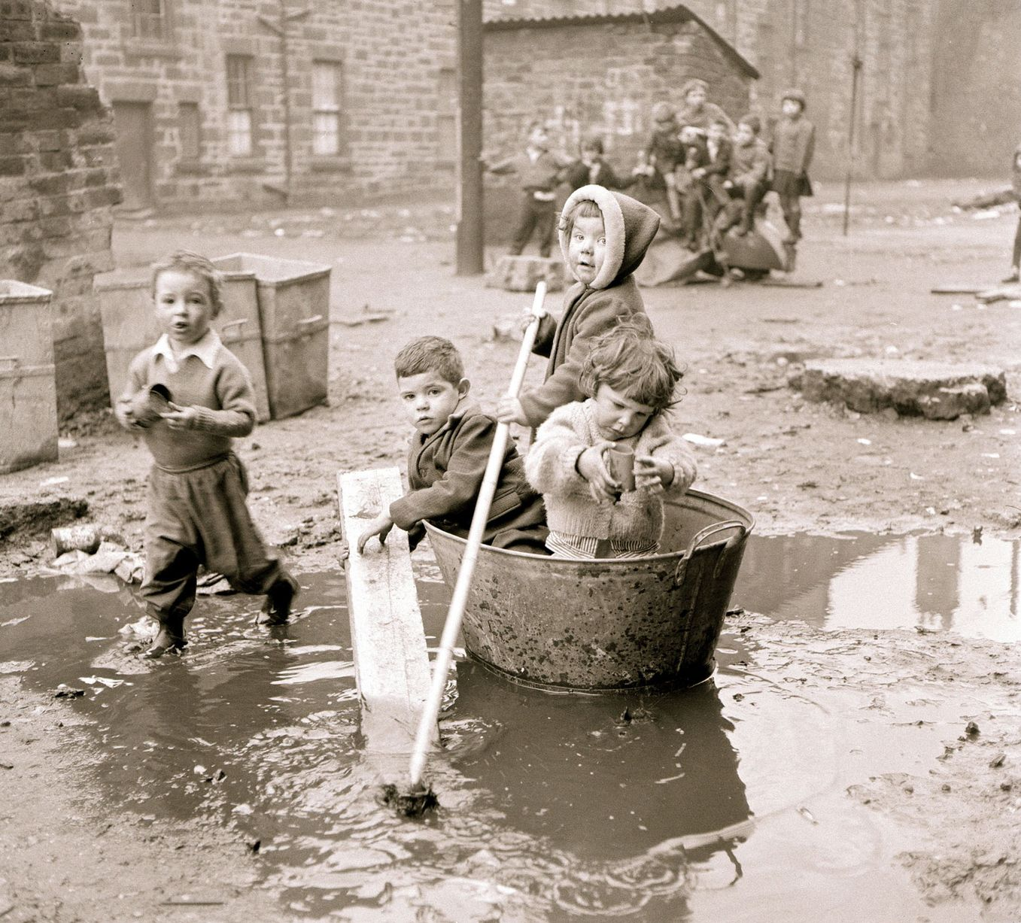
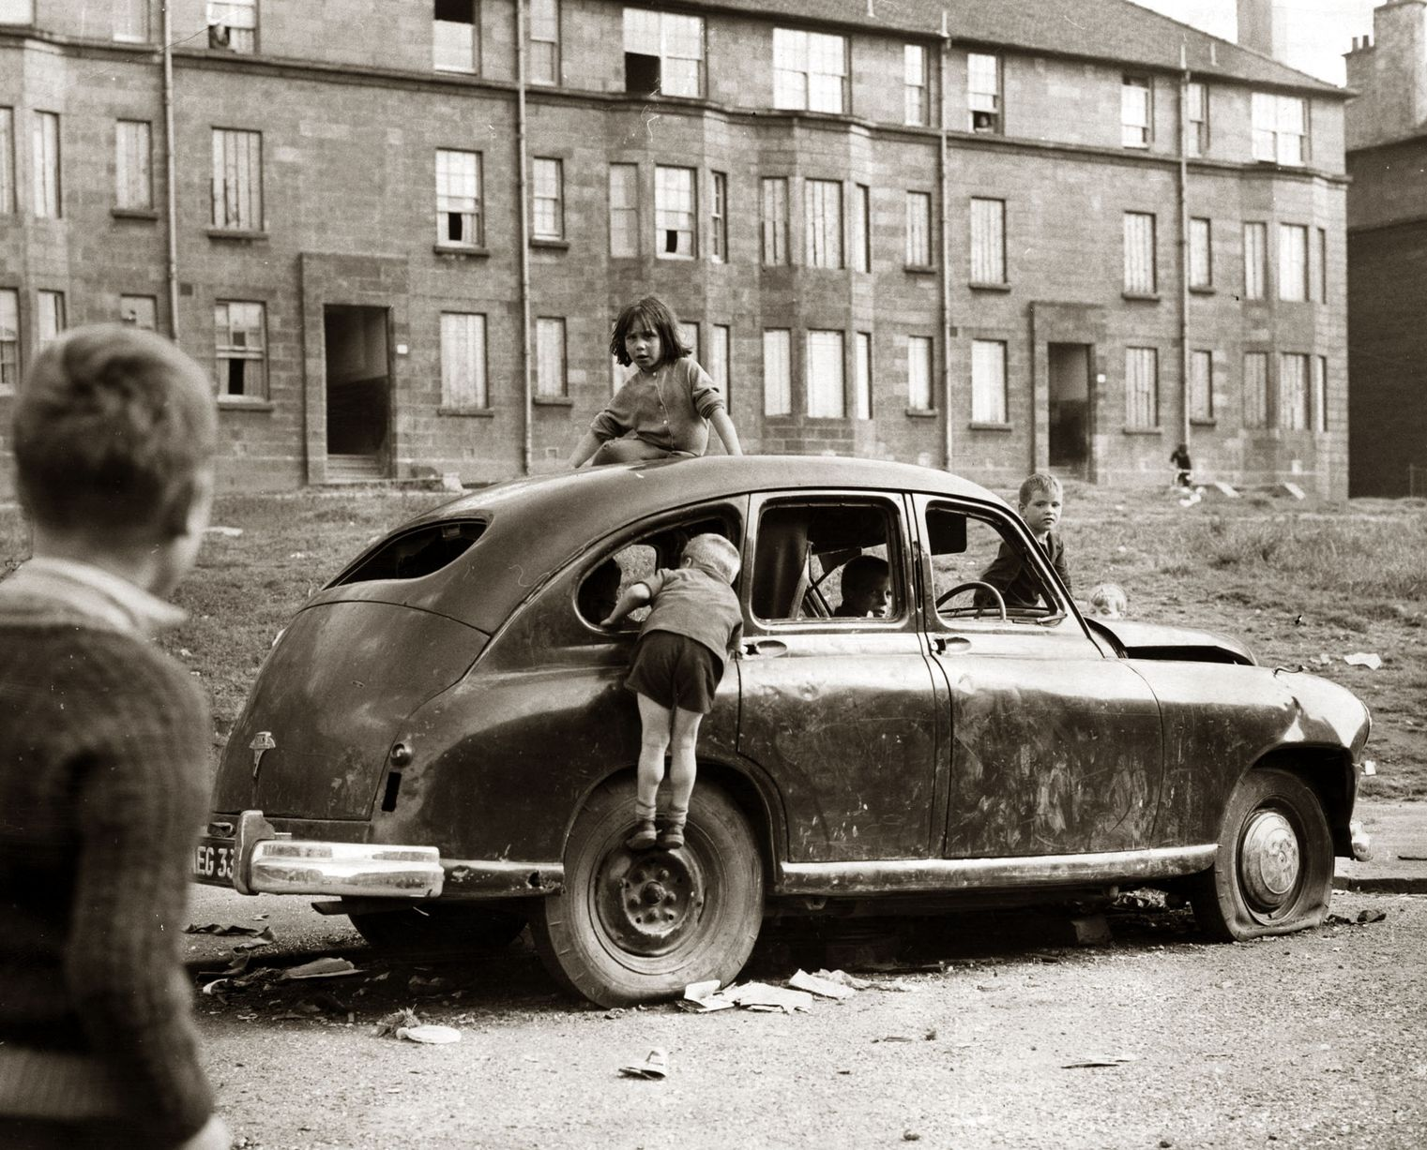
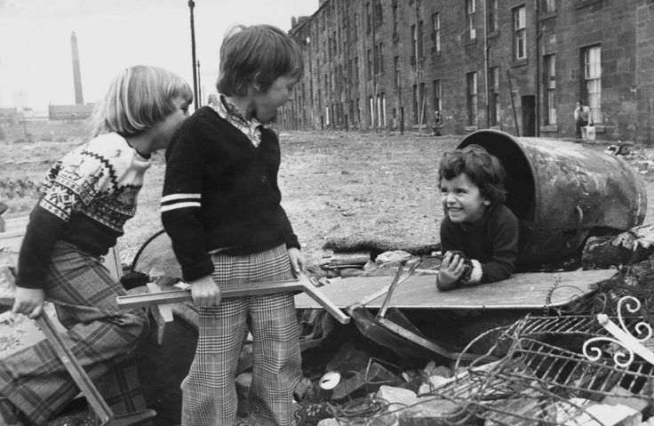
1966
1969
1970s

Slide 9
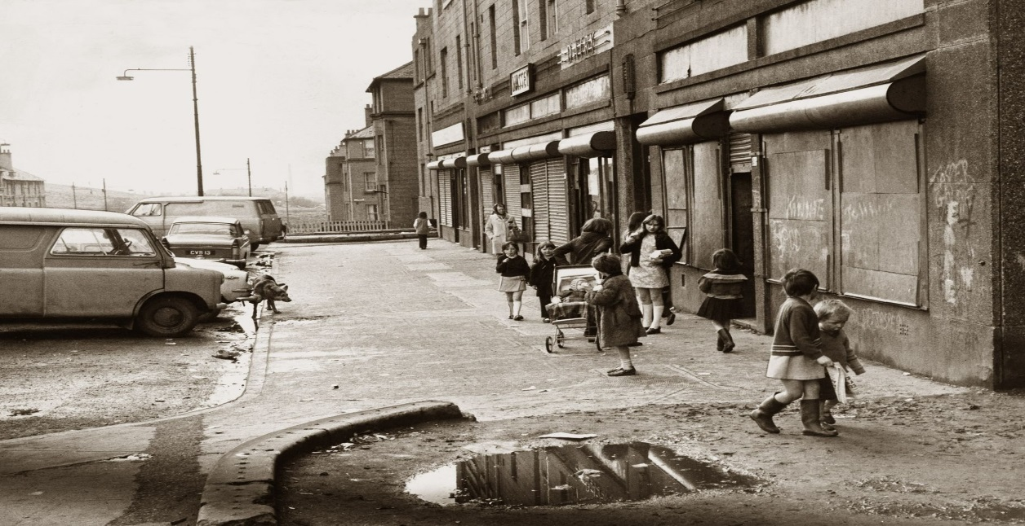
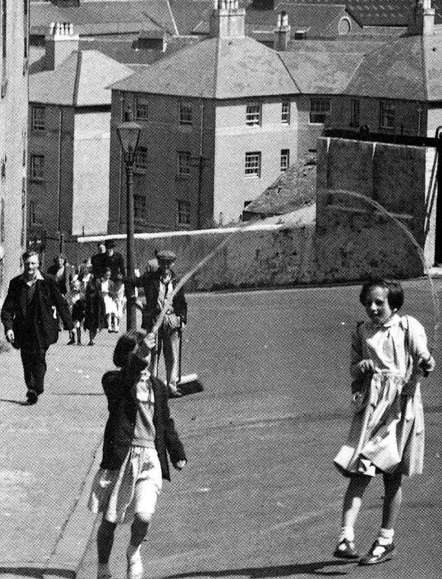
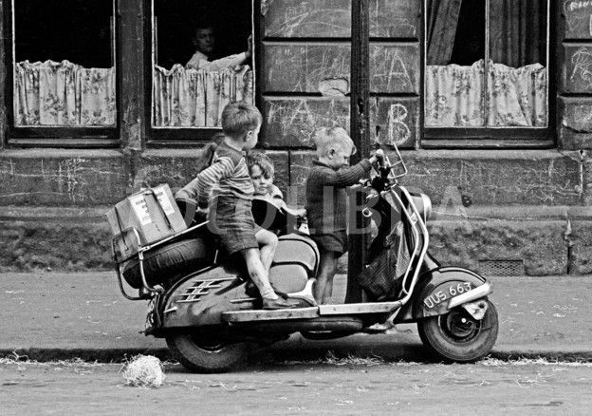

Slide 10
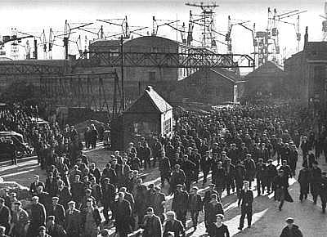
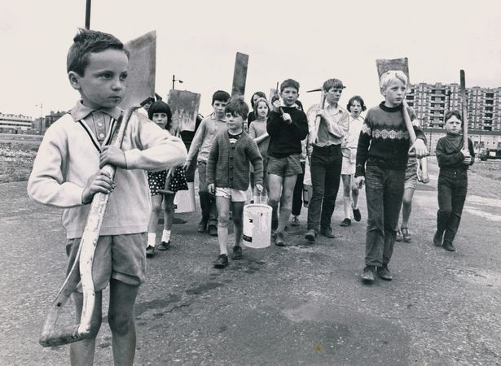
Notes:
Pictures from 1950s
Workers- now think about daily commute- rush hour
Open spaces – people would congregate – housing
Play in streets- study – reduced numbers of children being knocked down by cars but significant increase in MH

Slide 11
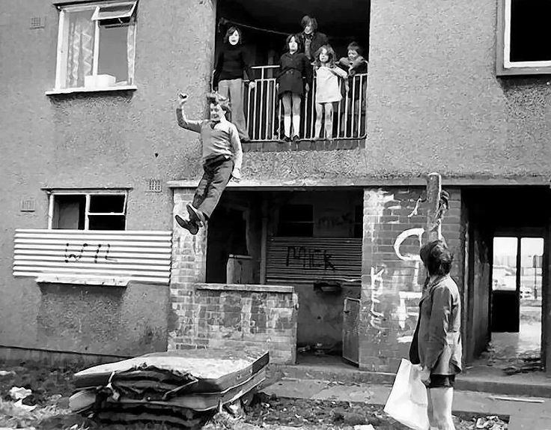

Slide 12



Slide 13
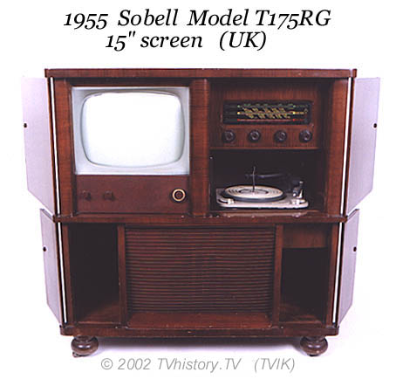

Slide 14

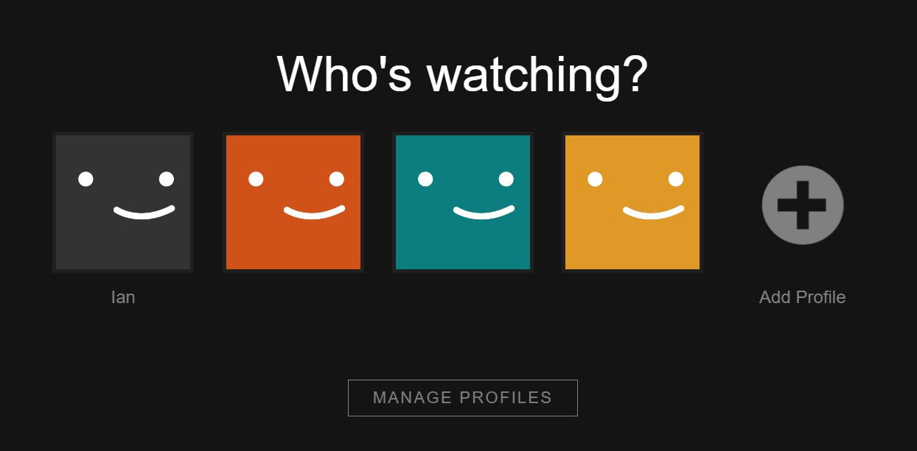

Slide 15
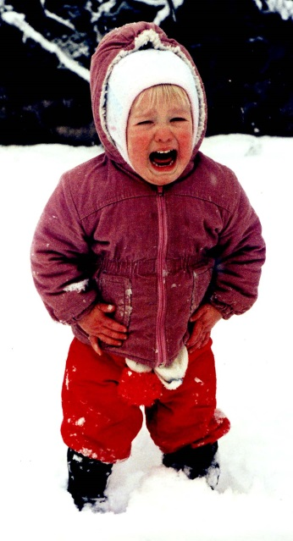

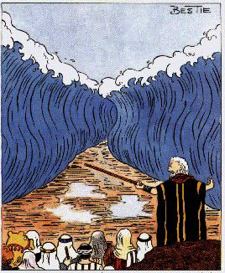
Is modern society eroding young people’s resilience?
Social Media
Celebrity culture
Sense of entitlement
The belief that negative emotions are wrong
Cotton wool effect
High academic expectation
Too much choice
Fear of failure
What do you mean, “it’s a bit muddy?”
Notes:
Aspects of life which are easier but that is not always a good thing; smooth seas do not make skillful sailors
Toxic combination of all of the above – modern life is lived at such a pace that the childhood years are under threat
Teenage brain – period of intense development; prefrontal cortex which in which is responsible for rational thought, decision making, overriding impulse control, empathy still developing – studies have shown particularly that parts of teenage brain which relate to how they interpret social situations are still developing into late adolesence e.g. ability to use other people’s perspectives to guide your ongoing behaviour
1. Cotton wool effect
Parents now do not want their child to have any negative experiences
This means that they try to protect them from life's knocks and blows
Doing this undermines their resilience
2.Treating young people like infants
We often think young people:
Need us do everything for them or it won’t get done
Can’t be trusted to handle responsibility
Will make poor decisions
Aren’t capable thinkers
Are moody and selfish
Are controlled by hormones
Research shows that treating yp people like infants makes them behave like infants
People are frightened of negative emotions
This encourages people to try to supress their emotions
Paradoxically, research shows this causes more of the negative emotions that they didn’t want
People think that bad feelings don’t have a purpose.
And that bad feelings such as guilt, shame and frustration are only negative.
But research shows that bad feelings can galvanise us to do things differently: we need them to succeed.
All or nothing thinking
Our culture views people as fixed entities, which are unchangeable
People are born smart/stupid
This type of thinking exaggerates the significance of failure and difficulties
Inhibits the finding of solutions
GROWTH MINDSET
Celeb culture and entitlement
I want it all NOW
Our society makes people feel that they are entitled
Celebrity culture suggests success should be instant
This makes people think that effort and hard work are not important
This increases self-obsession and undermines resilience
Being perfect
Mass media encourages people to believe that they need to be perfect
This encourages us to feel inadequate and, again, exaggerates our inevitable problems and difficulties
This undermines resilience when the person sees that perfection is not attainable
Mass media encourages us to compare ourselves with the rich and famous
So where did the comparing yourself with others come from? Carl Rogers believed that we arrive in the world with great potential and that gradually over time society gets us to define success in a number of ways. Then….if we don’t meet these ‘conditions of worth’ we feel unhappy. An exaggerated version of this is the media re size and the influence this has on young people…and the forever young syndrome
CHOICE
We now have more choice than ever
Paradoxically this make people
Not choose
Regret their choices
Feel depressed
Overwhelmed

Slide 16
Seven Teachable Skills of Resilience
Emotional awareness and control
Impulse control
Empathy
Realistic optimism
Causal analysis
Self efficacy
Reaching out

Slide 17
Being Well
Sleep
Nutrition
Activity
Resilience
Mindfulness

Slide 18
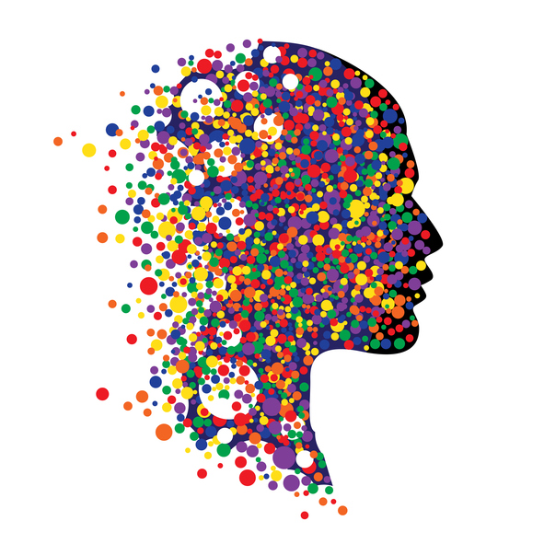
Mental WellbeinG what’s in a word??

Slide 19

MENTAL HEALTH – WHAT’S IN A WORD?
ACTIVITY…

Slide 20
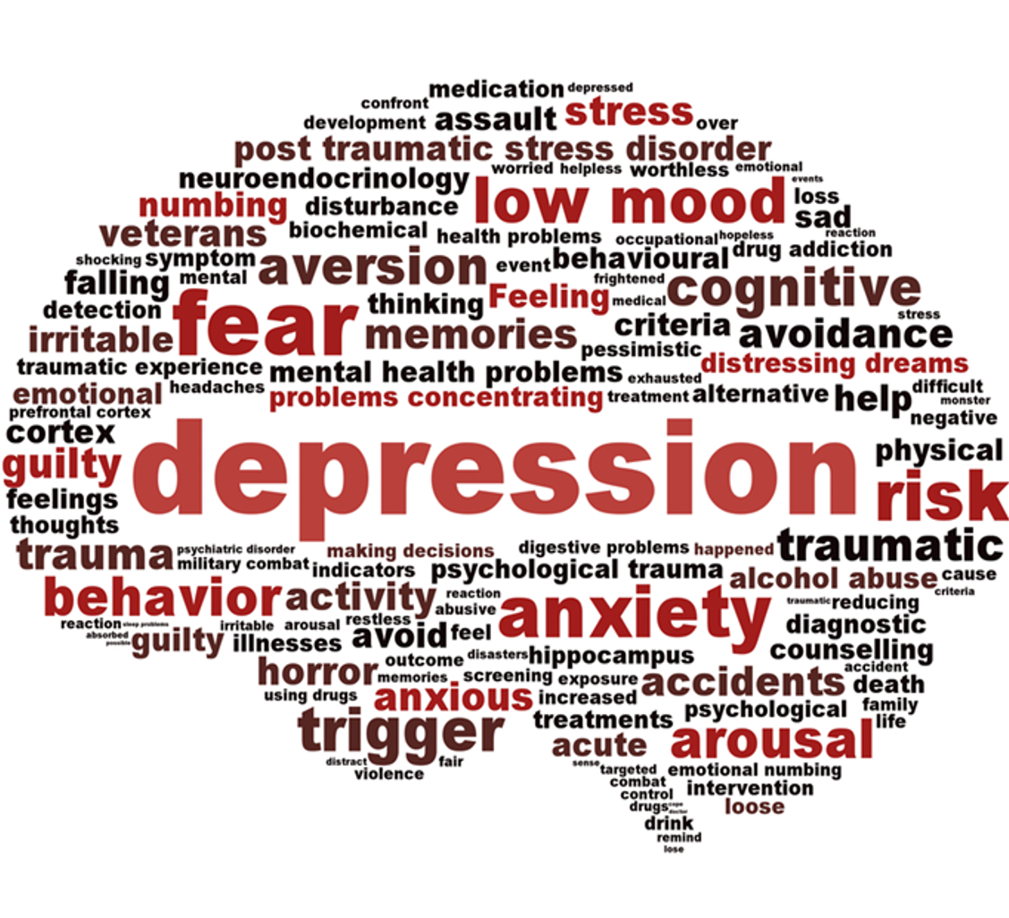
Mental Health
What’s in a Word….
_________
What’s wrong with the child v what’s happened to the child?

Slide 21
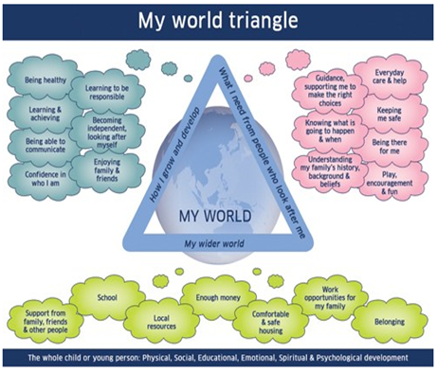
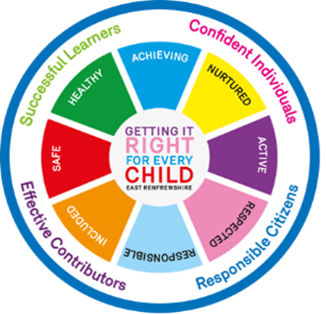
Current Context
GIRFEC (My world triangle)
INLCUSION
COLLABORATIVE WORKING

Slide 22
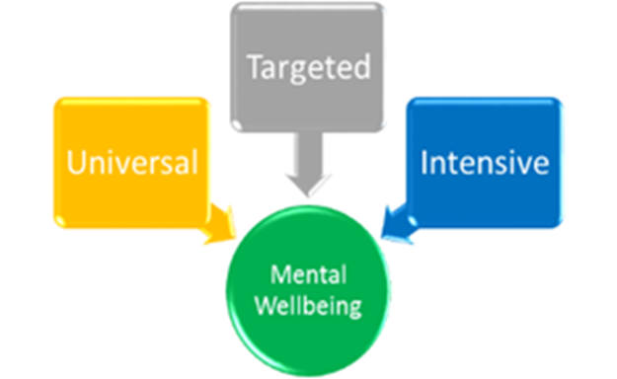

Slide 23

Mental Wellbeing Continuum
Mental Wellbeing Mental Health
+ve -ve

Slide 24
Universal Approaches
Key Adults
Universal Supports in Health and Education
Circle of Support: Universal Support in Education
Useful Resources

Slide 25
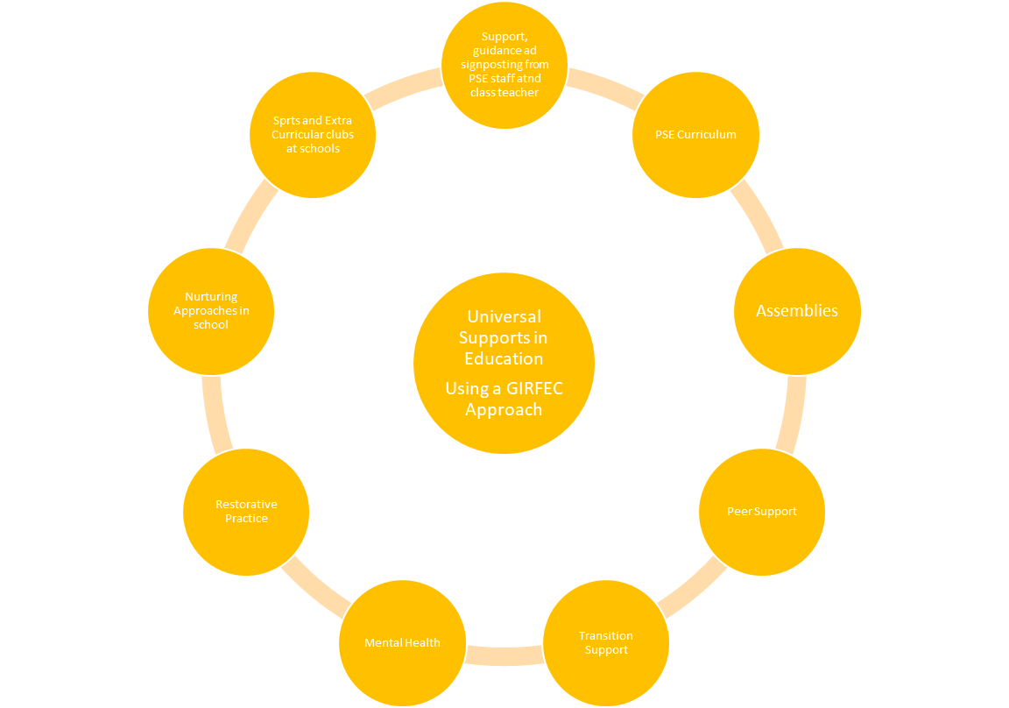
Univeral supports in education

Slide 26
Key Adults and active listening
√
Listen to the child or young person and connect with them
Validate the child or young person’s feelings.
Comment on what you see /paraphrase
Look for exceptions – times when the young people says things are going better.
Encourage the child to focus on these ‘exceptions’ and do more of the things that make them feel better
Help the child or young person to generate their own coping strategies building on things they are doing already.
Be aware of body language and of what this is communicating about how the child or young person is feeling
Encourage the child to be active and to do sport or any kind of exercise that they enjoy

Slide 27
Targeted and intensive support
There may be times when some children and young person will benefit from targeted or intensive from agencies support because they are experiencing more chronic or enduring difficulties. This may be because of factors relating to the child’s development or health, or because of adverse or traumatic experiences such as loss, or physical or emotional abuse.

Slide 28

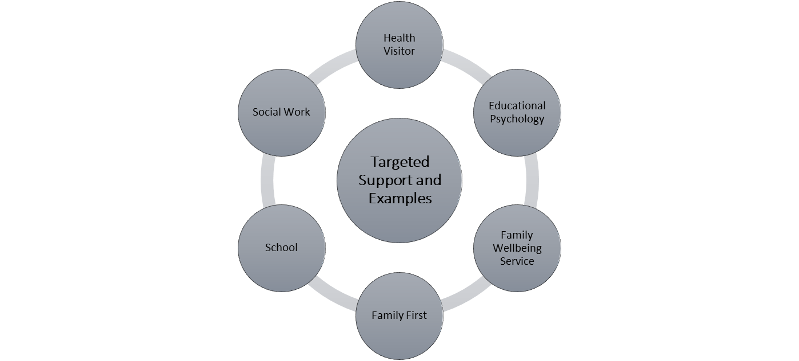

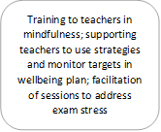
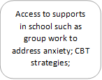
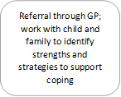

Targeted supports

Slide 29
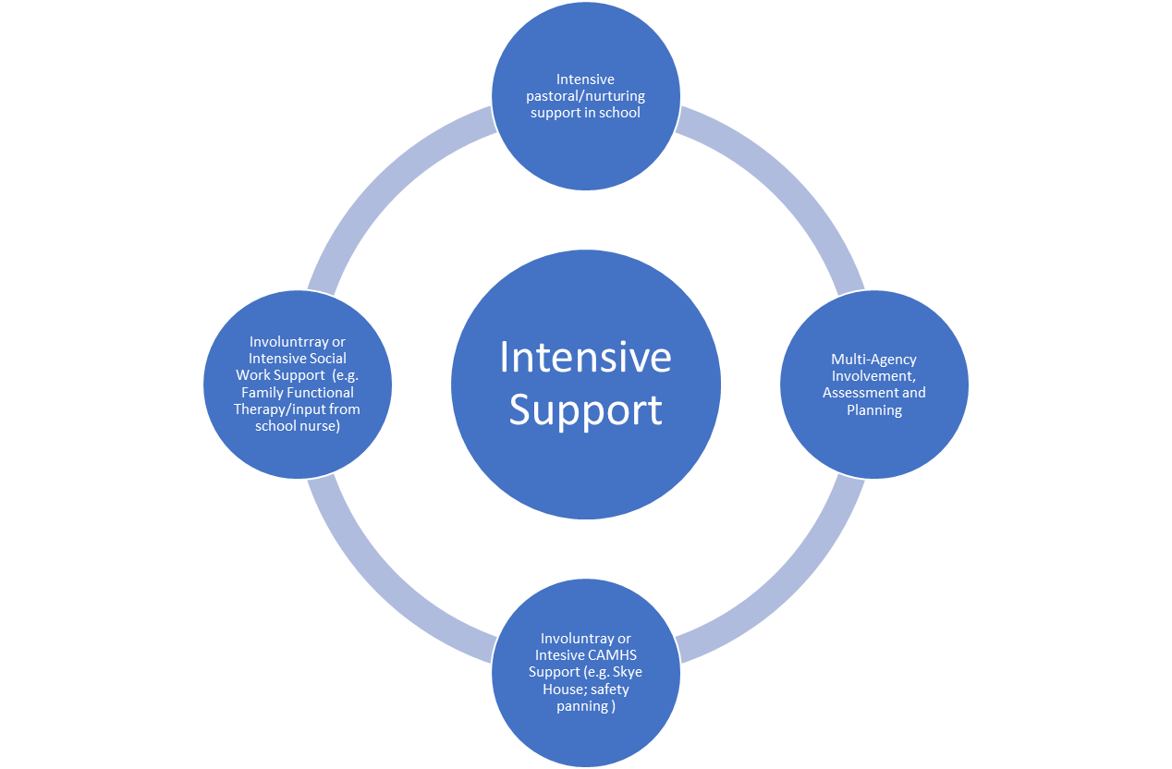
INTENSIVE SUPPORT

Slide 30

CIRCLES OF SUPPORT Universal, Targeted and Intensive Support from Education, Health and Social Care Partnership and Voluntary Agencies

Slide 31
NEXT STEPS
Parent Version
Children and Young People Version
Launch in November
Included in CLPL Programme
Further Information:
ps@eastrenfrewshire.gov.uk

