Slide 1

https://www.youtube.com/watch?v=SGOB3QhGqtA
Notes:
https://www.youtube.com/watch?v=SGOB3QhGqtA
Adversity is not destiny and psychologically informed approaches can support and mitigate against later negative outcomes.

Slide 2

A Framework for Nurturing the Mental Wellbeing of Children and Young People in East Renfrewshire
GIRFEC
HealthiER Minds
Notes:
HealthiER Minds is East Renfrewshire’s framework for Nurturing the Mental Wellbeing of Children and Young People
Here we’ll be looking at the CLPL strand of the of the framework specifically providing information on two of professional learning opportunities for school staff that the Educational Psychology Service will be offering this year.

Slide 3
Compassionate and
Connected Communities
A targeted professional learning resource centred on evidence based practice which complements
nurturing approaches and contributes to staff
understanding and practice around trauma and
adverse early experiences.
The resource uses a model of practitioner enquiry to
enhance reflective practice and practitioners are
encouraged to engage in collaborative action research
between sessions to further develop their knowledge and
skills in supporting children/young people who have
experienced trauma and adversity.
Notes:
Professional learning resource developed by education Scotland which aims to ensure even those hardest to reach children experience compassion and connection at school
Aims to enhance staff knowledge and understanding around attachment, adversity and trauma and critically translate this knowledge into practice through supported action research cycles which include coaching in context.
The model reflects a move away from one off training where one participant hold all the knowledge towards an approach that centres on embedding evidence changes in practice
Participants are also encouraged to undertake further self-directed reading between sessions and key references and links are provided to support this.

Slide 4

Notes:
Most of you have probably seen the original ACES video which documents the staggering proof that the health social and economic risks that result form childhood trauma.
It’s release has brought about a renewed focus on how we respond to ACES and Health Education Scotland have produced a short summary one from the viewpoint of a child which is quite powerful
However education Scotland recognise the progress school have made in nurturing approached and the huge overlap between this and ACEs and trauma informed practice and so the compassionate and connected community resource aims to support practitioners to understand the commonalities and good practice that exists across all approaches.

Slide 5
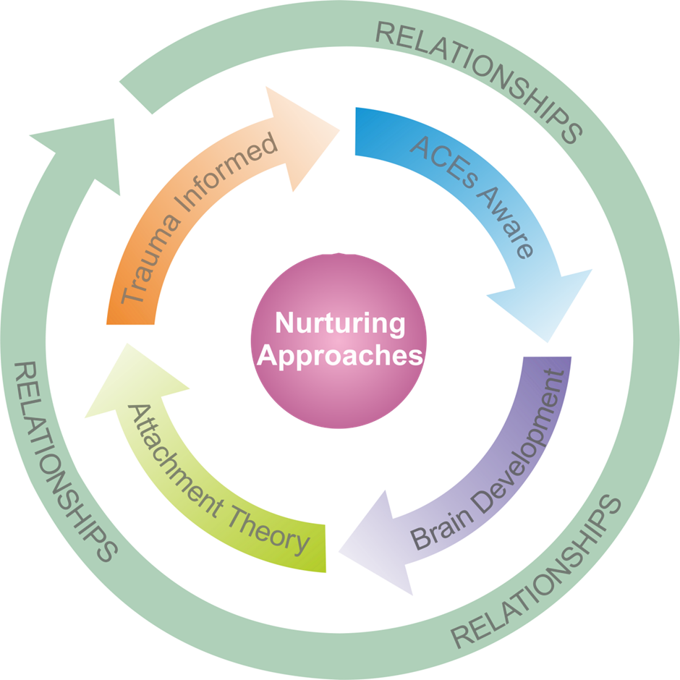
Links: nurture, ACES and trauma informed practice
Poor outcomes are not predetermined and can be ameliorated with
appropriate support.
All recognise the importance of early adverse experiences on developing brain and later outcomes
The central importance of relationships is to buffer the
negative impact of
early adverse experiences
Relationships are at the key to healing and support
Early intervention is
required to prevent and mitigate against later
negative outcomes
psychologically informed
and make use
of research/evidence to
inform practice
the importance of practitioners having an understanding and
awareness of underlying
reasons for behaviour
Notes:
The resource essentially provides an model for integrating these approaches on a practical level

Slide 6
Practitioner Enquiry
“A finding out or an investigation with a rationale and
approach that can be explained or defended”
Action
Reflection
Enhanced doing
(Menter, Elliot, Hulme, Lewin & Lowden, 2011)
Notes:
Participants will develop skills in reflective practice and gain experience in applying action research models as a method for enhancing practice.
Research indicates that practitioner enquiry is likely to impact positively on pupil outcomes, especially if this involves enquiring collaboratively with others (Cordingley & Bell, 2012). The compassionate conncected community sessions will by design create a tight network for professional support with a significant amount of time in each session is protected fro reflection on the previous enquiry cycle.

Slide 7
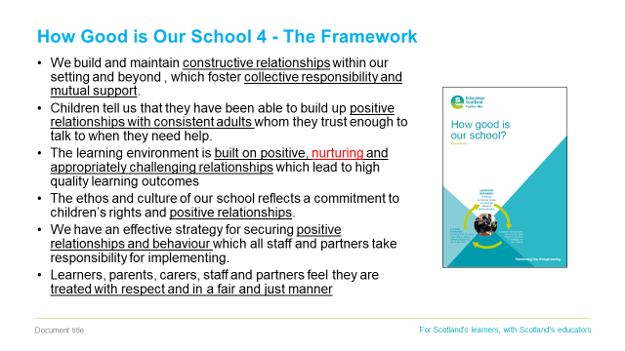
Notes:
The resource provides a valuable CLPL opportunity within the context of HGIOS 4 which puts such emphasis on wellbeing and relationships.
The statements above taken from level 5 illustrations highlight ley features of highly effective practice

Slide 8
Who is the resource for?
Nurture, ACEs, trauma skilled
Staff have more in depth knowledge gained through ongoing professional learning and discussion and apply this through substantial contact with individuals
Nurture, ACEs, trauma informed
Staff have more detailed knowledge of the nurture principles and their application and/or have knowledge and skills/ understanding of ACEs/trauma informed practice)
Awareness of relationship based approaches
(e.g. attachment, rights, nurture, restorative and/or solution oriented approaches)
Nurture, ACEs, trauma enhanced
Staff have more regular and intense contact with individuals and/or direct and manage services
Coaches/facilitators
= trauma skilled
Practitioners
= trauma informed/
relationship
aware
Notes:
Ideally participants would be operating tier two (where they have a knowledge of the nurture principles and trauma/informed practice) but at very least they should have an understanding of the importance of relationships in mitigating negative outcomes for children and young people. Through engagement in the resource and particularly the practitioner enquiry cycles it is hoped participants would develop from being trauma informed practitioners to trauma skilled practitioners who would have a remit for supporting professional learning in their context and the capacity to support the implementation of this resource further in their school.
In line with implementation science there are both whole school and individual readiness tools to support with recruitment and we’re hoping to identify a cohort of 6-8 staff members probably coming from 3-4 schools. It’s quite important that we have more than one staff member per school because we’re trying to build capacity within the school, because although it’s nurture teachers/learning centre teachers who are most likely to have knowledge basis and skillset to get the most out of the resource, we’re trying to embed compassionate and connected practice beyond the nurture room, so we want those with the knowledge basis and the capacity to lead.

Slide 9
Notes:
Resource covers 6 modules but not a series of separate/discrete sessions and that there is an expectation that practitioners will engage in a practitioner enquiry cycles and coaching sessions between sessions
Highlight the staff wellbeing module, recently heard the analogy of when safety message tells you to put on your own gasmask before you do your child’s, because you must look after yourself before you can be in a position to look after others. This resource is aimed a supporting staff to support the most vulnerable and challenging pupils so critically practitioner enquiry will also be undertaken within this module.

Slide 10
Compassionate and Connected Communities in East Renfrewshire: Proposed Implementation

Slide 11
Compassionate and Connected Communities in East
Renfrewshire: Proposed Implementation
Timescale | Coach Activity | Participant Activity
Pilot phase likely to develop across a two-three year timescale, dependent on the needs of context, in order to fully embed resource. Phase two schools will be identified and introduced in to the plan in a flexible manner as the project progresses. | Twilight session to discuss expectations and structures of resource
 | Delivery of Session 1 (Scene Setting) | Attendance and participation in Session 1
 | Provide ongoing coaching and support as required | Staff undertake first practitioner enquiry round
 | Delivery of Session 2 (Prevalence and Impact of Trauma) | Attendance and participation in Session 2
 | Provide ongoing coaching and support as required | Staff undertake second practitioner enquiry round
 | Delivery of Session 3 (Responding to Trauma) | Attendance and participation in Session 3
 | Provide ongoing coaching and support as required | Staff undertake third practitioner enquiry round
 | Delivery of Session 4 (Attachment and Attunement) | Attendance and participation in Session 4
 | Provide ongoing coaching and support as required | Staff undertake fourth practitioner enquiry round
 | Delivery of Session 5 (Self-regulation) | Attendance and participation in Session 5
 | Provide ongoing coaching and support as required | Staff undertake fifth practitioner enquiry round
 | Delivery of Session 6 (Staff wellbeing) | Attendance and participation in Session 6
 | Provide ongoing coaching and support as required | Staff undertake sixth practitioner enquiry round
 | Recruitment of participants for Phase 2, recruitment of coaches from Phase 1 cohort
 | Reflection and maintenance planning

Slide 12
HealthiER Minds:
Promoting Resilience and
Emotional Wellbeing
through Targeted Intervention with Primary Pupils
An Implementation
Science Approach
ALLPPT.com _ Free PowerPoint Templates, Diagrams and Charts

Slide 13

For Primary Age Pupils P4+
Anxiety
Individual
Low Mood
Small Group
Whole Class
Anger
Low self esteem or confidence
Notes:
P4 +
To complement:
Friends
Bounce Back
We Eat Elephants
Living Life to the Full

Slide 14
Promoting Resilience and Emotional Wellbeing
Through Targeted Intervention
Psychoeducation – why do our brains and bodies behave the way they do?
2. 10 Things - we all do great things to keep ourselves well but we don’t always know it
3. Attention – what we focus on is key and the good news is we can control our attention
4. Cognitive Behavioural Strategies – our thoughts, feelings and behaviour all interact to help or hinder us
5. Emotional Regulation – monitoring and taking control of our physiology can be life changing
Notes:
5 topics covered over 3 sessions (twilight)
Final session also covers logistics of setting up a group

Slide 15

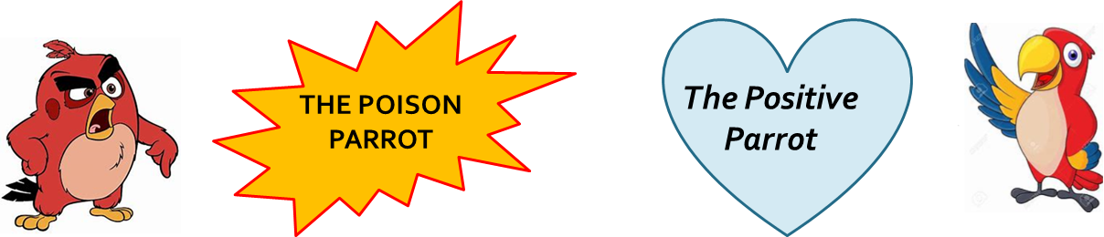
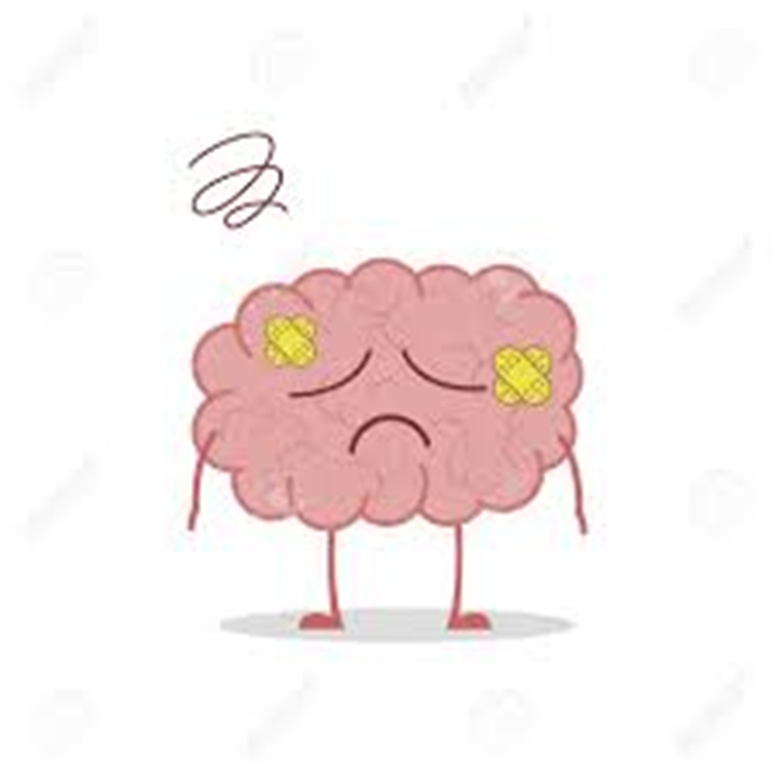
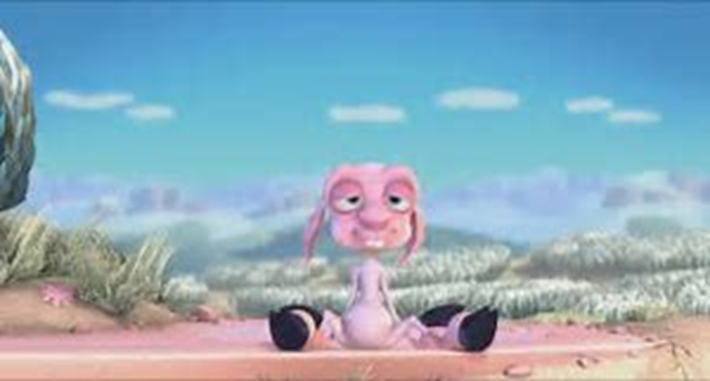

Slide 16

Awareness Training
https://www.youtube.com/watch?v=Ahg6qcgoay4
Notes:
We have a lot of power over what we pay attention to

Slide 17


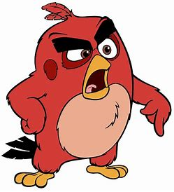
Unhelpful Thoughts
Introducing CBT
Feelings
Behaviours
“She doesn’t want to be your friend”
“You are really rubbish at maths”
“Nobody really likes you”
“You only passed that test because it was easy”
Avoid friends and family
Give up on hobbies and school work
No interest in fun activities
Quiet, withdrawn and disengaged
Notes:
Activity:
Ask children to think about what their poison parrot is whispering? How does that make you feel? What do you do?

Slide 18
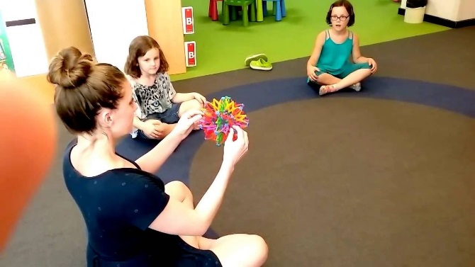
Incorporating Mindfulness
Going on a safari
Musical Statues
Superhero poses
Blowing Bubbles
The breathing ball
Sensory bags/ boxes
Balloons
Notes:
Keep bringing child's awareness to what they are doing and impact on body, thoughts and feelings. Key thing is accepting whatever is in their experience at that time. Just be curious and accept what is.
Blowing Bubbles
Half fill a plastic cup with water and use a straw to blow gentle bubbles in the water. Experiment with what happens if you blow too hard – the water spills out! Practice keeping the water and bubbles in the cup.
Mindful Posing
To get your kids interested, tell them that doing fun poses can help them feel strong, brave, and happy.
Have them go somewhere quiet and familiar, a place they feel safe. Next, tell them to try one of the following two poses:
The Superman: this pose is practiced by standing with the feet just wider than the hips, fists clenched, and arms reached out, stretching the body out as long as possible.
The Wonder Woman: this pose is struck by standing tall with legs wider than hip-width apart and hands or fists placed on the hips
Safari
This activity turns an average, everyday walk outside into an exciting new adventure.
Tell your kids that you will be going on a safari, and their goal is to notice as many birds, bugs, creepy-crawlies, and any other animals as they can. Anything that walks, crawls, swims, or flies is of interest, and they’ll need to focus all of their senses to find them, especially the little ones
Texture bag. Place several small, interestingly shaped or textured objects in a bag, and have each child reach in to touch an object, one at a time, and describe what they are touching. Make sure they don’t take the object out of the bag, forcing them to use only their sense of touch to explore the object.

Slide 19
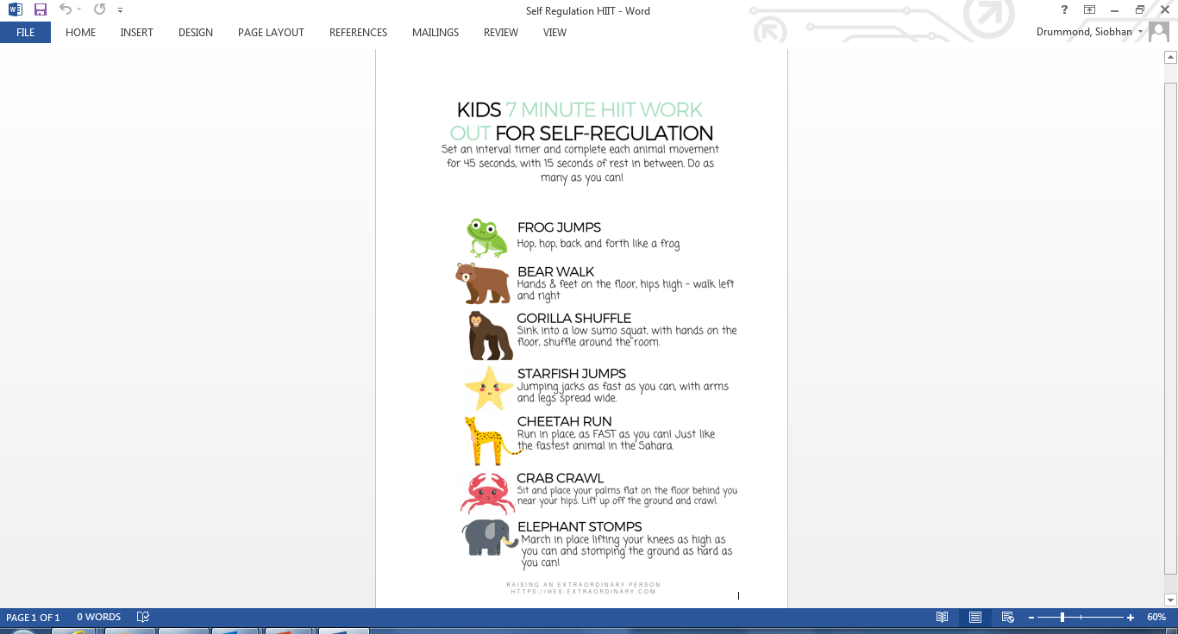
Notes:
Similar to musical statues- learning about muscle control and ability to go up and come down again.
Key teaching points- Keep bringing back to “What's happening in your body when we do this?”

Slide 20
Implementation Science
Cluster 1 Maintenance:
Teams - Online forum for Peer Support and access to resources
Coaching in Context/Supervision
Network Meetings
Support with pre and post evaluation measures
Parent Information Leaflet
Cluster 2 Bids:
How does this approach fit with your school improvement priorities?
Have you considered your research question – what would you hope to achieve with this intervention?
Who can you commit to this approach and how much time?

Slide 21
Feedback So Far…..
I found the course excellent in preparing my skills and knowledge to support a child facing challenges. I particularly liked the input on the different strategies a child can use to calm down and having the range of ideas/resources/videos enable me to find one that best suits the child. Also the course gave me ideas on how to quickly establish a bond and help the child to open up quicker.
I have found that when approaching a situation involving this child where his behaviour had escalated that I was able to take him out of the situation quicker than previously and use the strategies I knew the class teacher had been working on with him and I noticed a quick shift in his body language/overall presentation. He calmed down quicker and was able to open up more about what he was feeling/how his body was responding.

Slide 22
Discussion
How helpful would you find these CLPL opportunities for your staff?
What do you see as the potential strengths/ challenges of the learning models?

