Slide 1
Symbolisation Project
Training session
Jennifer Norval
East Renfrewshire Psychological Service
January 2017

Slide 2
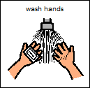
Teaching what Symbols Mean
Matching objects to symbols
Consistency

Slide 3
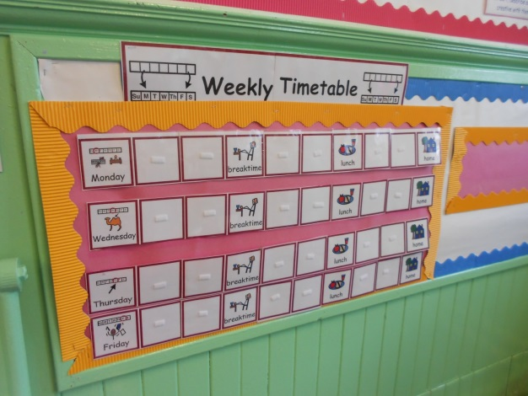
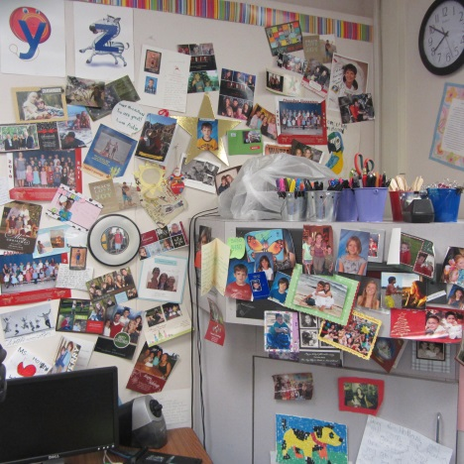
Points to Consider
Can symbols be seen?
Are they in a distraction free area?
Organisation of symbols not in use

Slide 4
Points to Consider
Labelling all areas of the nursery with symbols
Using symbols for:
visual timetables
task checklists
timing activities
symbols key rings
registration for activities – eg. snack
getting ready to go outside
promoting discussion at home

Slide 5
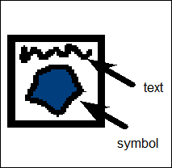
Points to Consider
Always include text with the symbol
Use verbal comments with the symbols - total communication environment

Slide 6
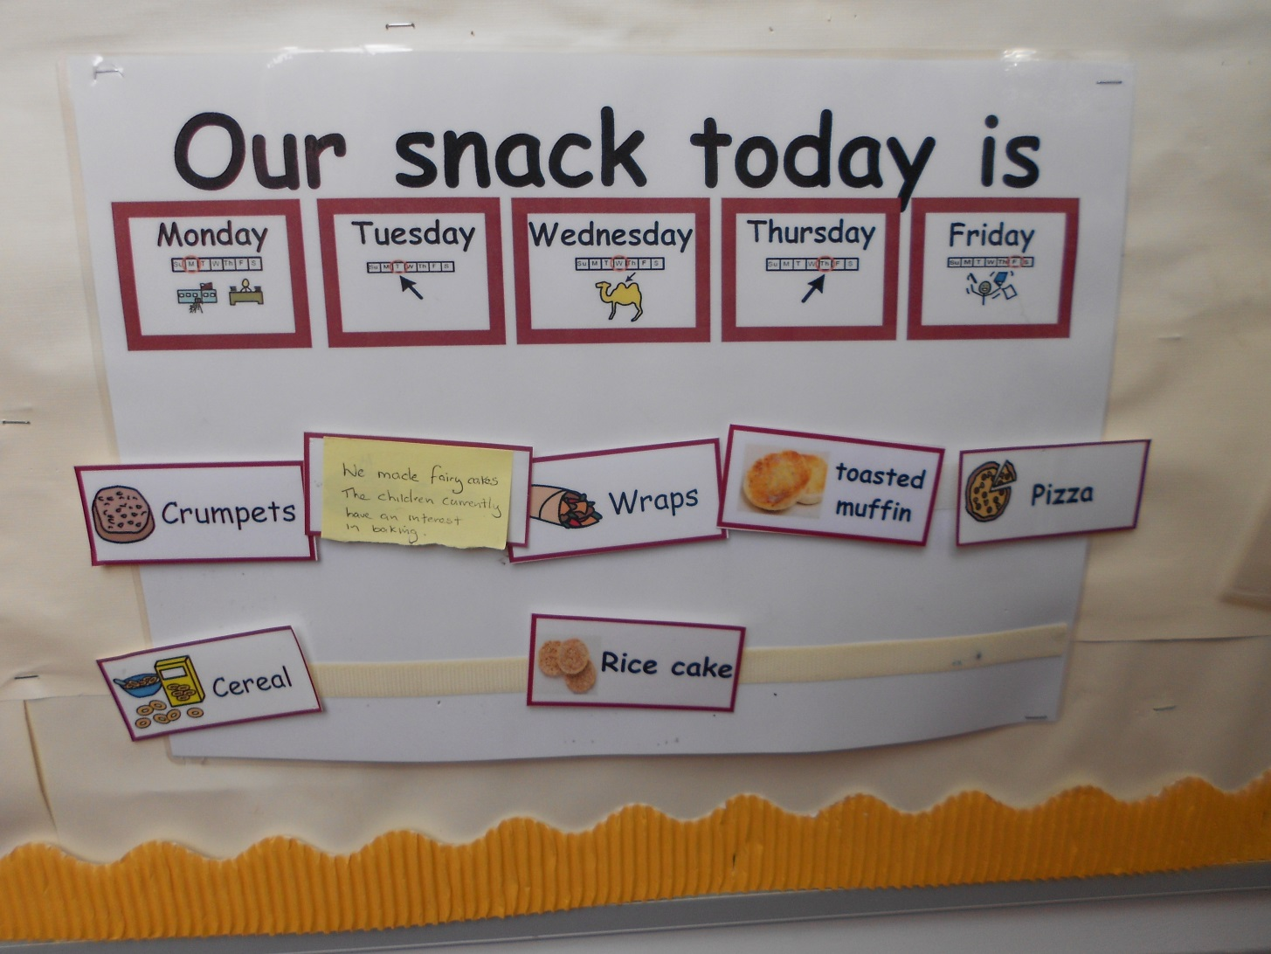
Some Ideas from Fife

Slide 7
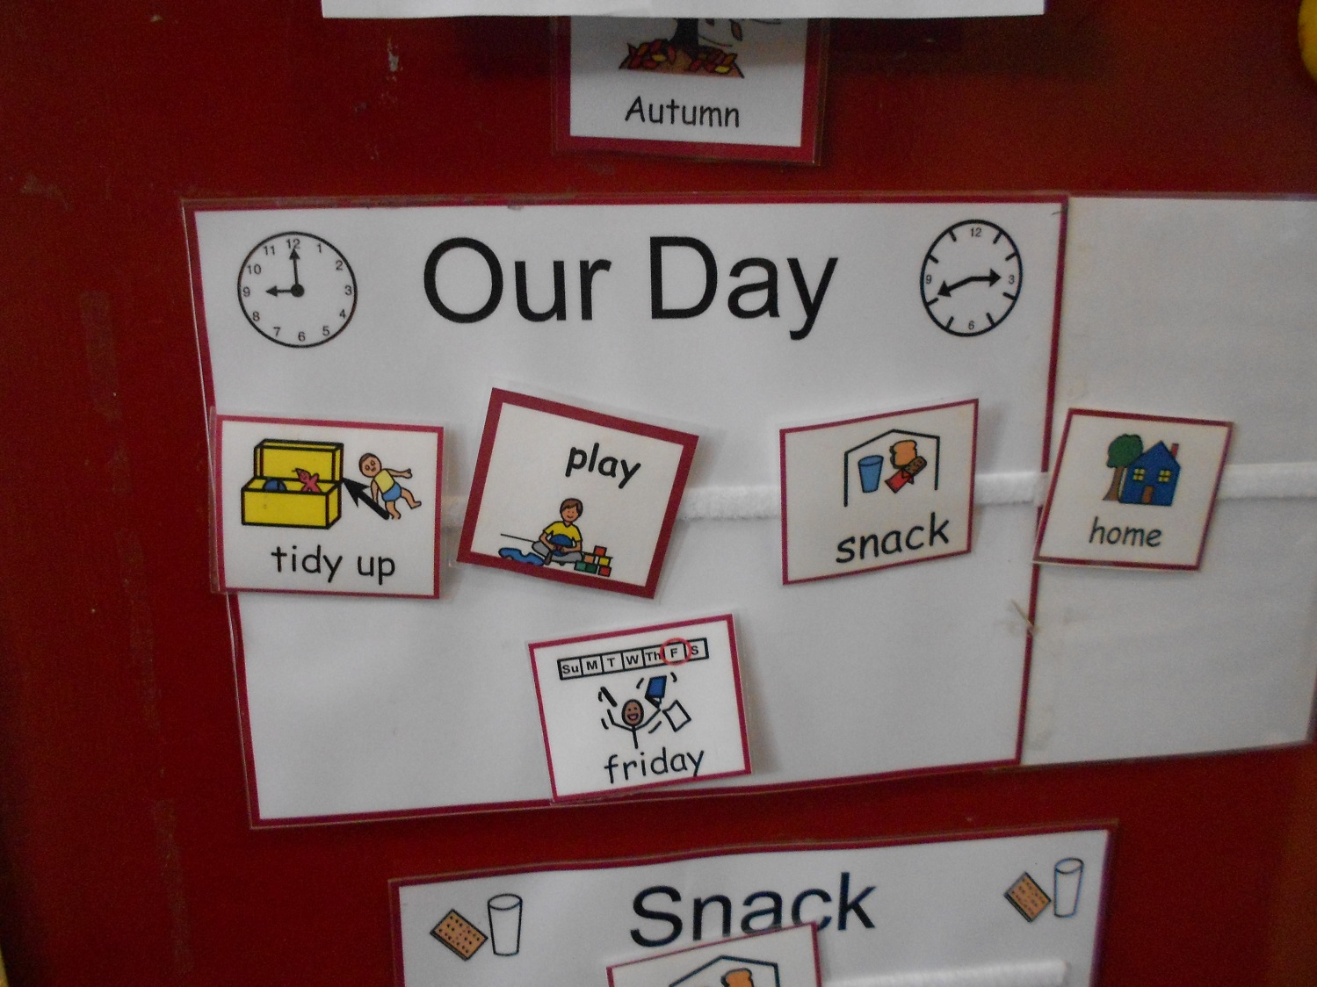
Some Ideas from Fife

Slide 8
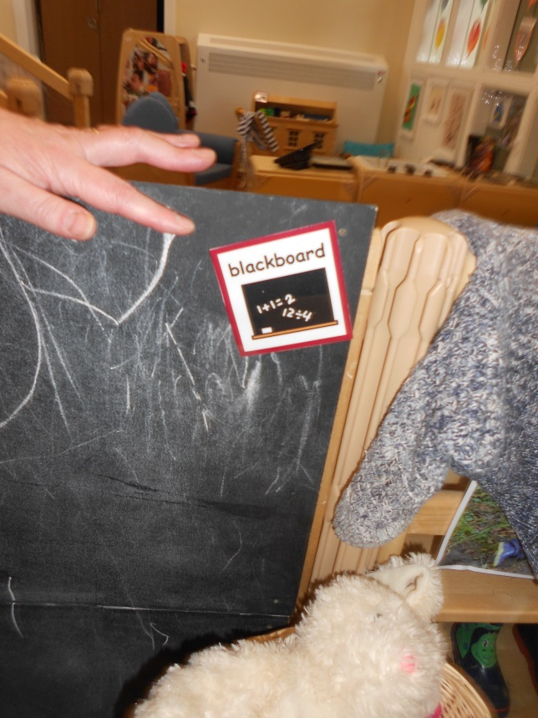
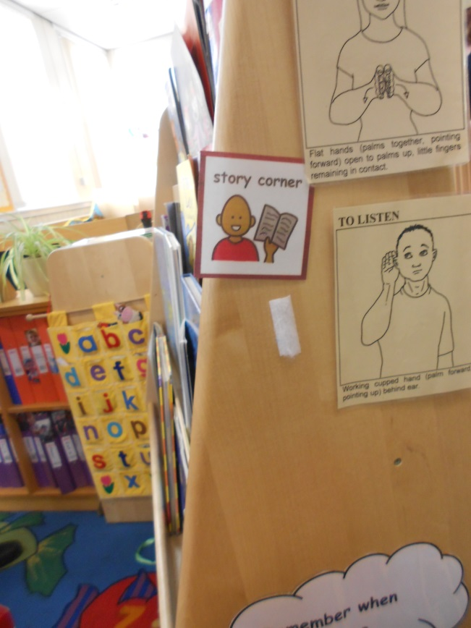
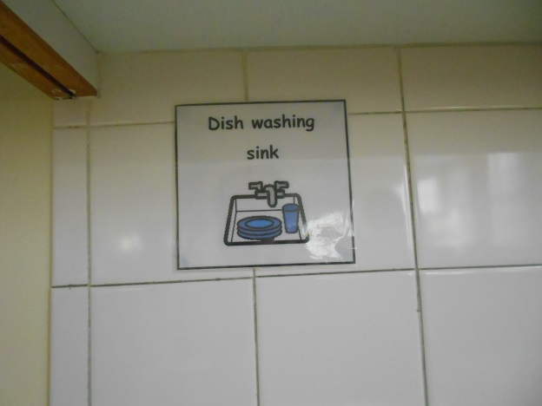
Some Ideas from Fife

Slide 9
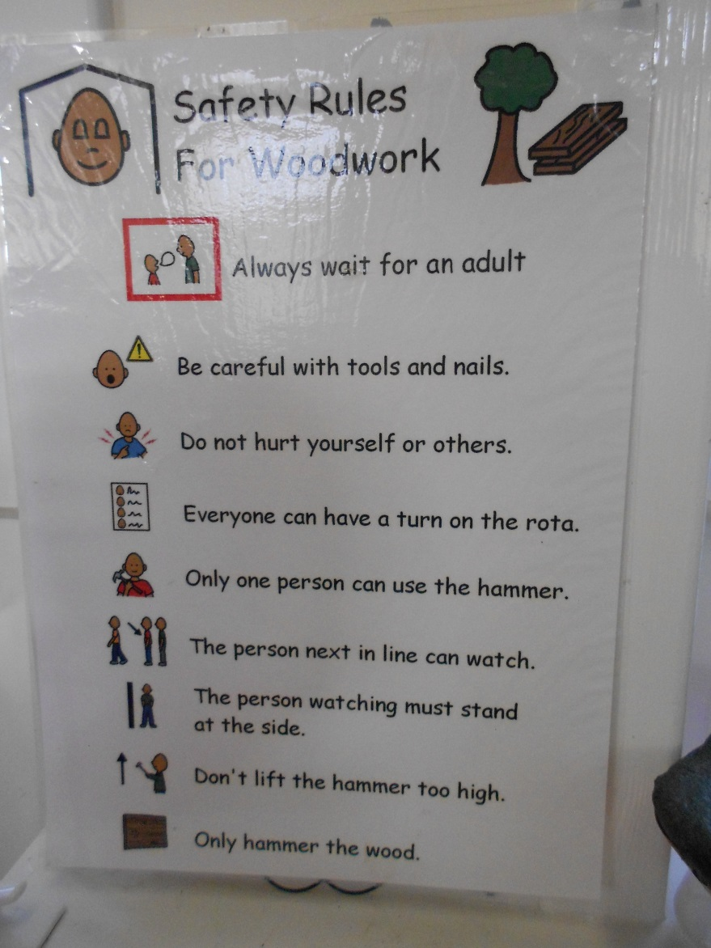
Some Ideas from Fife

Slide 10
Some Ideas from Fife

Slide 11
Questions?

