Slide 1
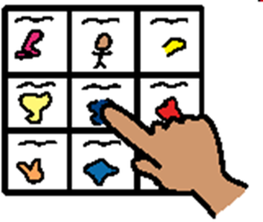
Symbolisation Project
Parents’ Session
Jennifer Norval (Trainee Educational Psychologist)
Lyndsay Dickson (Speech and Language Therapist)
January 2017

Slide 2
Aims of the Session
This session will cover information about:
What symbols are
How they can help children
How best to use symbols at home

Slide 3




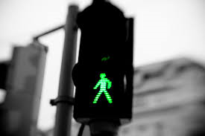
Symbols we use every day
Notes:
Discuss how much we rely on symbols in every day life and why they are effective, eg. If you are in a place where a different language is spoken we still recognise these symbols

Slide 4



Do you recognise these images?
Notes:
Talk about how symbols represent meanings/concepts/words and that we quickly recognise those that are familiar to us – this is helpful for children

Slide 5
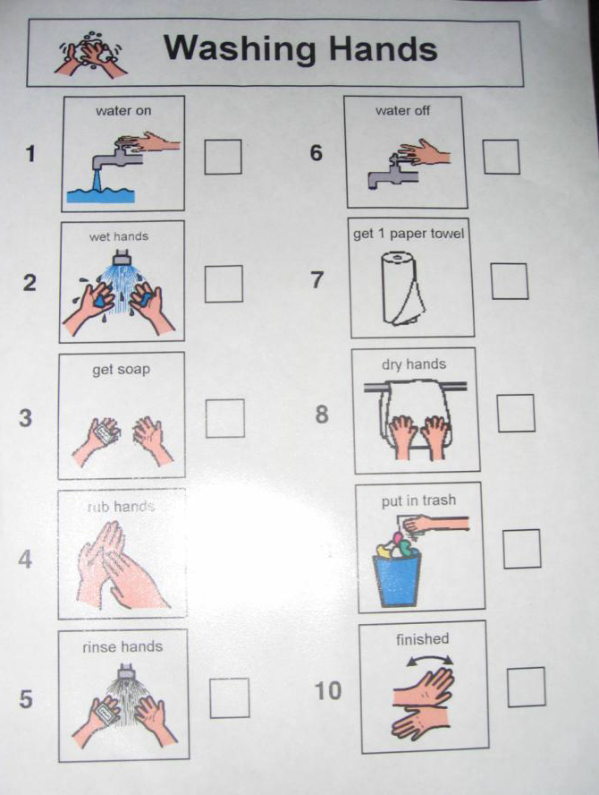
Some Examples
Notes:
Talk through how these can be effective – eg. Support understanding of tasks, transitions, task completion

Slide 6
Some Examples

Slide 7
Why do symbols work well?
Visual information is vital to how we communicate
Visual tools like symbols enhance how we
Receive information
Process information
They can also help with how we get across a message

Slide 8
Why do symbols work well?
Symbols can be used to help with extending both:
Understanding of language (receptive language)
Putting thoughts and concepts into words and sentences (expressive language)

Slide 9
Why do symbols work well?
Symbols can
Provide a concrete source of information regardless of noise levels etc.
Help to break down instructions into manageable chunks of information
Provide a clear message about the daily routine – what there is to look forward to and how many tasks there are left?

Slide 10

Some Perceived Barriers
It might make children “lazy”
Children might not learn to read – they will rely on the pictures instead
Symbols might become a distraction
Notes:
Discuss how looking at both pictures and text is part of the development of literacy skills and so this is in fact useful for learning to read – we would always have the text as well as the symbol
Children often want to know what symbols are and are interested to find out about them as they are something new – over time they become used to using them

Slide 11
How Can Symbols Help at Home?
Talking
Words disappear
Relies on children remembering
Notes:
Spoken word is transient – once something has been said it is gone and relies on our memories, adults often write verbal instructions down for this reason

Slide 12

How Can Symbols Help at Home?
Notes:
When there is too much information, children can struggle to process it and remember it and so may only be able to use some of it. This can be confusing

Slide 13
How Can Symbols Help at Home?
Talking + Symbols
Pictures stay: these are concrete
Children take in information at their own pace
Notes:
Symbols combat this in that they are concrete. Using spoken word and symbols is a multi-sensory approach to communication, children can check back to symbols if they forget or don’t hear some of the instructions

Slide 14
How Can Symbols Help at Home?
Symbols Can:
Be relevant and meaningful to children
Attract and hold their attention
Help to cope and prepare for what’s happening next
Increase independence

Slide 15

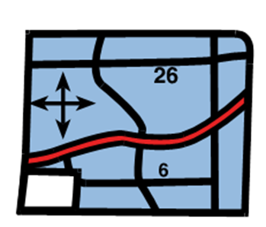
What might a child’s experience of symbols be like?
How do you feel when someone gives you a list of directions?
What might help?
a map?
a map as well as someone giving you directions?

Slide 16




What might a child’s experience of symbols be like?
They might have a better understanding of information and instructions
They will have a better chance of remembering information
This will help them to feel
less anxious
motivated to learn

Slide 17
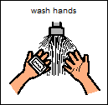

Teaching what Symbols Mean
Matching objects to symbols
Consistency

Slide 18
Points to Consider
Can symbols be seen?
Are they in a distraction free area?
Organisation of symbols not in use

Slide 19
Using Visuals at Home
You may need to start simple and build it up gradually.
Put the symbol at an easily accessible place at child’s eye level.
Talk through the symbols first before you use them.
When the activity is completed your child may enjoy posting the symbol in a finished box.

Slide 20

Questions?

