Slide 1

Symbolisation Project
Training session
Jennifer Norval
East Renfrewshire Psychological Service
November 2016

Slide 2
Aims of the Session
This session will cover information about:
Why symbols work well in school and nursery classes
The benefits to using symbols and the ways in which we know they work well
The Symbolisation project in East Renfrewshire and other areas
Effective ways to use symbols in the classroom

Slide 3



Do you recognise these images?

Slide 4



Why use Picture Communication Symbols from Boardmaker?

Slide 5
Why use Picture Communication Symbols from Boardmaker?
Studies have found that this type of symbol is much more ‘transparent’ than other symbol libraries (Mizuko, 1987)
Concepts and messages are conveyed clearly

Slide 6

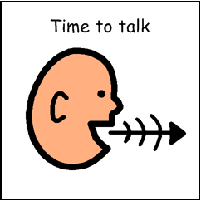




Some Examples

Slide 7
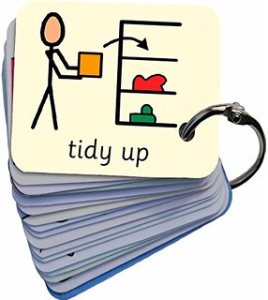
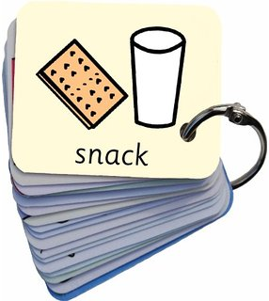

Some Examples

Slide 8
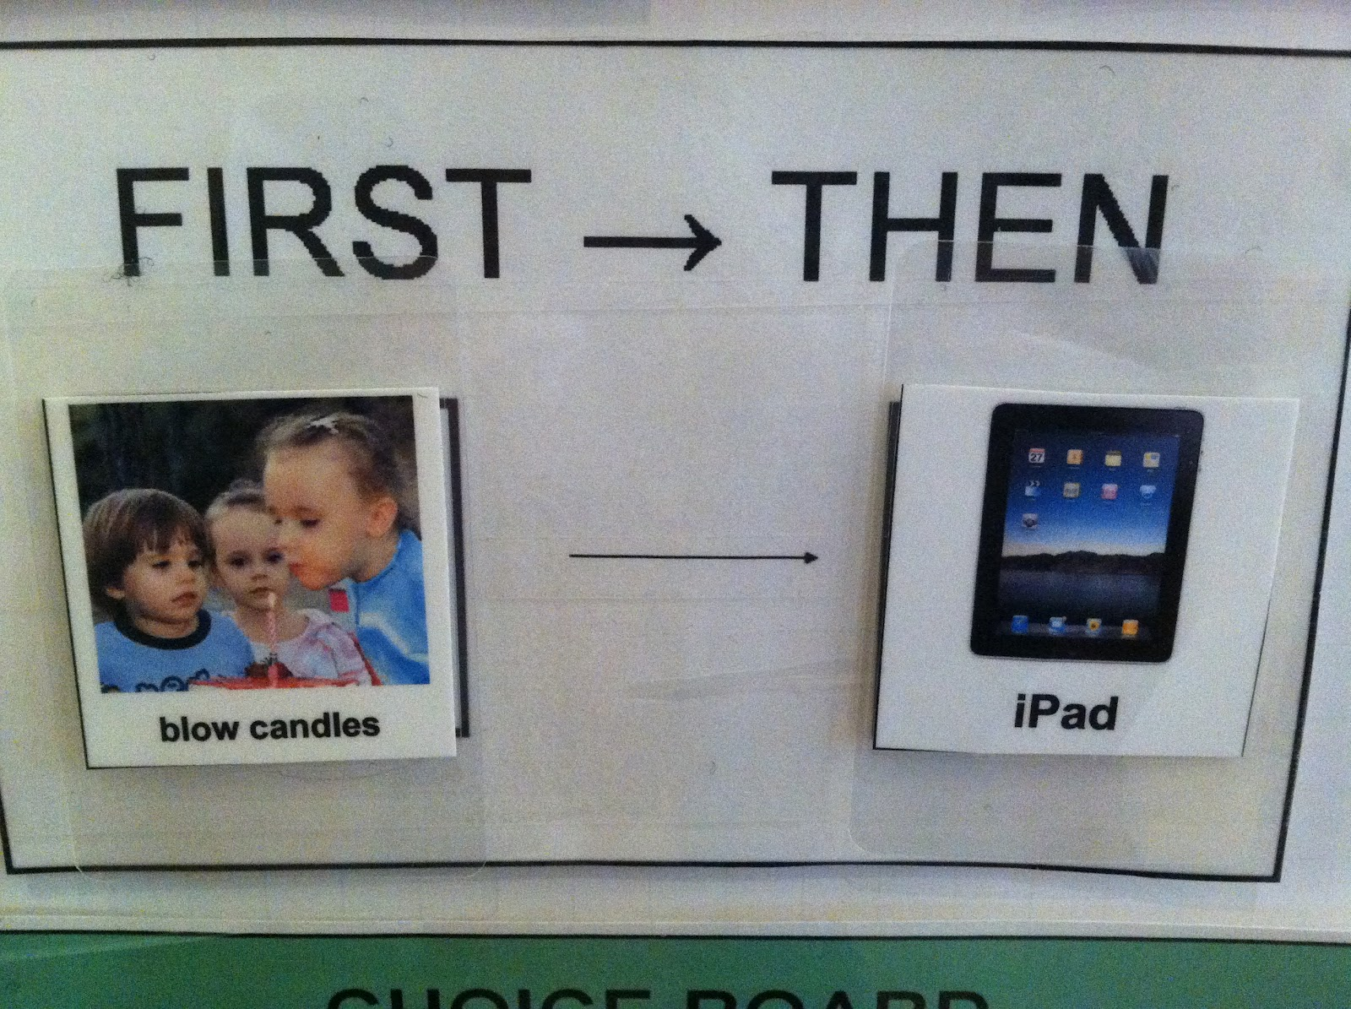
Some Examples

Slide 9
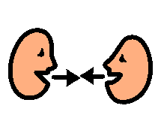
Discussion
What are your experiences of using symbols to support a child/children? How did they help?

Slide 10
Why do symbols work well in schools and nursery classes?
Visual information is vital to how we communicate
Visual tools like symbols enhance how we
Receive information
Process information
They can also help with how we get across a message

Slide 11
Why do symbols work well in schools and nursery classes?
Literacy
Symbols can be used to help with extending both
Understanding of language (receptive language)
Putting thoughts and concepts into words and sentences (expressive language)

Slide 12
Why do symbols work well in schools and nursery classes?
Literacy
Symbols support children to make connections between the images and text
It is recommended that symbols always include text as well the image to promote these connections

Slide 13
Why do symbols work well in schools and nursery classes?
The classroom environment
Can have a lot of background noise
The spoken word is transient - it can get lost
Might require instructions that vary in complexity
Concepts of time and activities can be confusing

Slide 14
Why do symbols work well in schools and nursery classes?
Symbols can
Provide a concrete source of information regardless of noise levels etc.
Help to break down instructions into manageable chunks of information
Provide a clear message about the daily routine – what there is to look forward to and how many tasks there are left

Slide 15

Some Perceived Barriers
It might make children “lazy”
Children might not learn to read – they will rely on the pictures instead
Symbols might become a distraction

Slide 16

Using symbols in schools has been found to:
Reduce pupil anxiety and frustration
Act as a reminder of tasks to be completed and equipment needed
Reduce distractibility
Improve task completion
Improve classroom independence
Support perseverance

Slide 17
Benefits of Using Symbols
Research has shown that using symbols is beneficial to supporting children with ASNs including :
ASD
ADHD
EAL
Using symbols as a whole class approach promotes inclusion and ensures that children with ASNs are not isolated in using symbols
This is why staff began using them with whole classes

Slide 18
Benefits of using symbols
However, several projects have found that using symbols as a whole class and whole school approach have been beneficial for all learners

Slide 19
Symbolisation in East Renfrewshire
Each primary school has access to Boardmaker
An initial pilot study has been carried out in one school. Data gathered from school staff and pupil focus groups have shown positive results of symbolisation in classrooms
Next stage is to carry out the project in additional schools and support school staff to implement symbolisation
Symbols are already widely used in IMS as well as the CCC and the PSADU – aim is to have a bank of symbols that is consistent throughout the LA
Symbols can be accessed via a Glow group and additional symbols can be created on Boardmaker through this forum

Slide 20
Fife
The symbols project
Now been running for ten years but started as a pilot project with 11 schools
FAACT team provide training on symbols and how to use them
Schools are accredited
Consistent approach throughout the schools
Schools share resources through a central point
School staff have reported the benefits for all learners
Project has a very positive reputation throughout the schools – through this, most schools have requested to take part and are now ‘symbolised’

Slide 21
Warwickshire County Council
The symbols inclusion project
Designed to promote inclusion and access to the curriculum
Supports the development of the classroom as a ‘communication friendly environment’
Reports of improvements made by pupils in a range of areas
Staff comments often mention an increase in pupil motivation

Slide 22

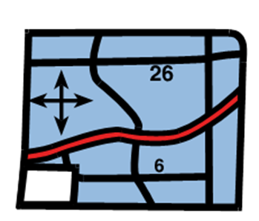
What might a child’s experience of a symbolised environment be like?
How do you feel when someone gives you a list of directions?
What might help?
a map?
a map as well as someone giving you directions?

Slide 23
Discussion
What might a child’s experience of a symbolised environment be like?

Slide 24




What might a child’s experience of a symbolised environment be like?
They might have a better understanding of information and instructions
They will have a better chance of remembering information
This will help them to feel
less anxious
motivated to learn

Slide 25


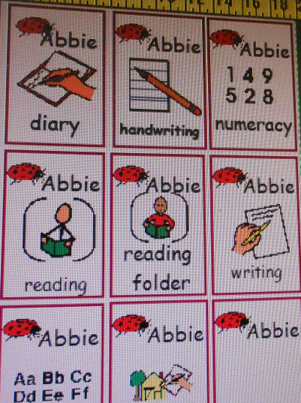
Teaching what Symbols Mean
Matching objects to symbols
Consistency

Slide 26
Points to Consider
Can symbols be seen?
Are they in a distraction free area?
Organisation of symbols not in use

Slide 27
Points to Consider
Labelling all areas of the classroom with symbols
Using symbols for:
name labels
visual timetables
task checklists
timing activities
symbols key rings
registration for activities – eg. lunch

Slide 28
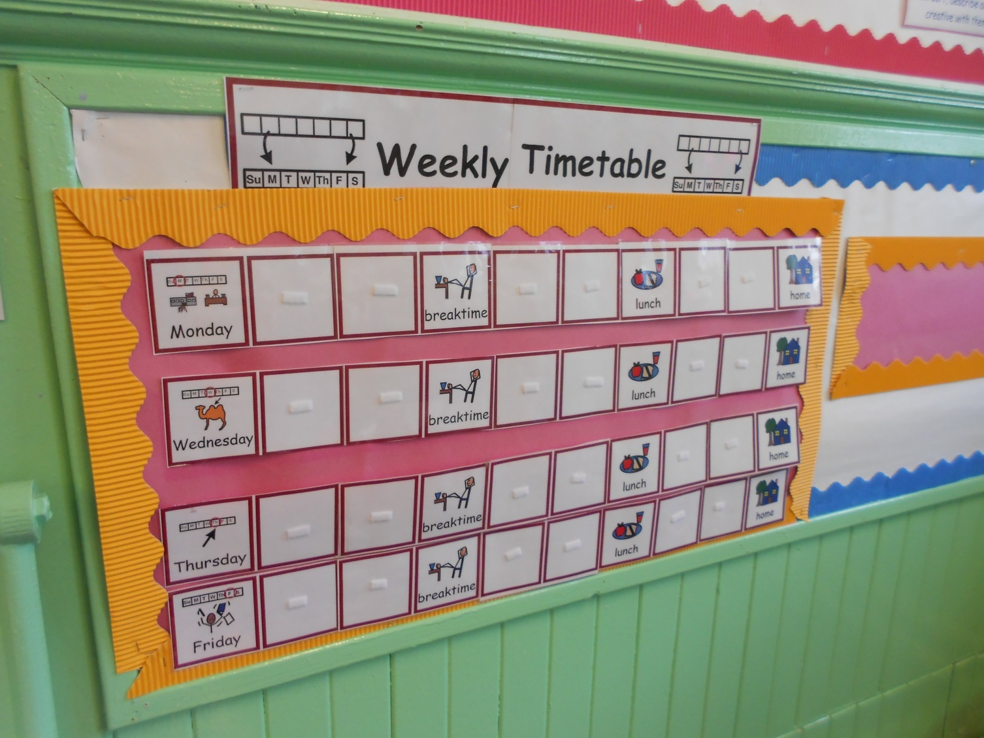

Slide 29
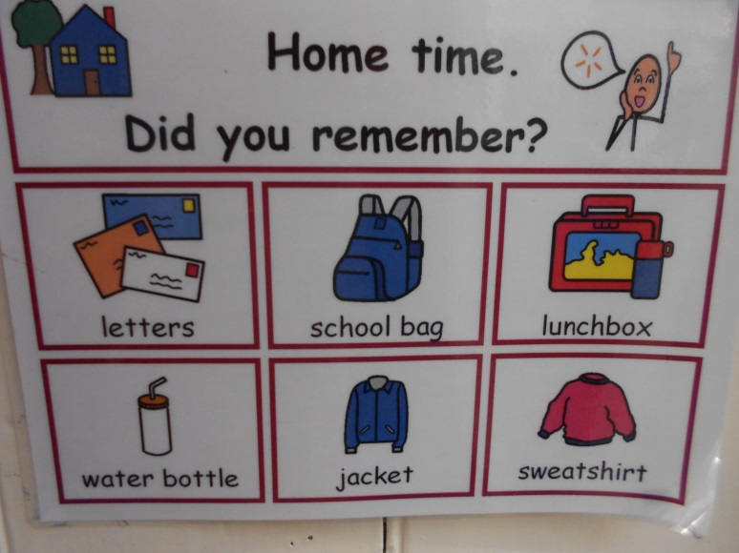
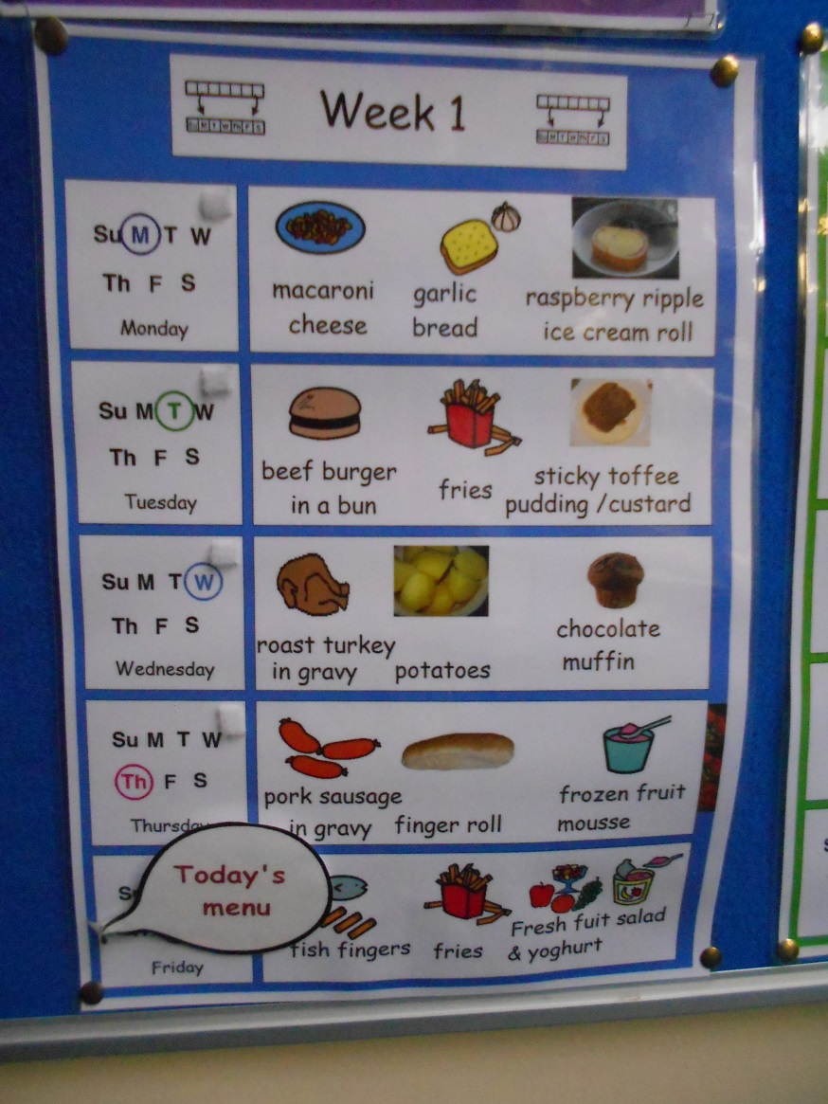
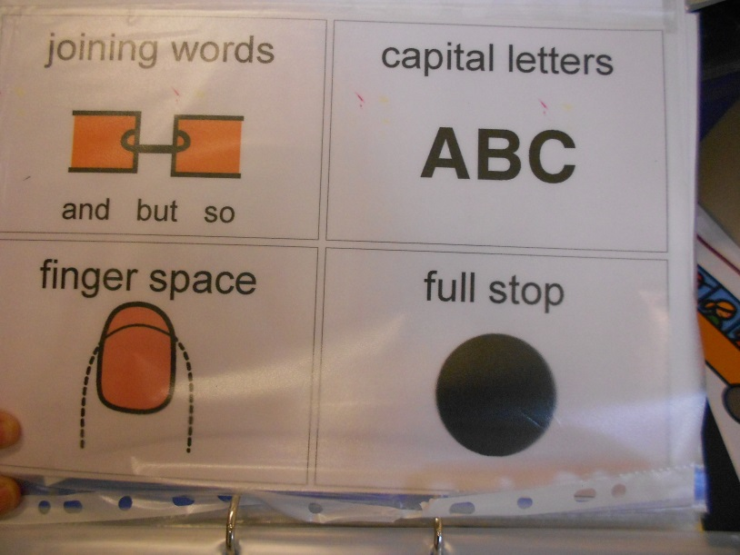

Slide 30
Points to Consider
Always include text with the symbol
Use verbal comments with the symbols - total communication environment

Slide 31

Questions?

