Slide 1
Meet the Teacher
Primary 1
Thursday 25th August 2016

Slide 2
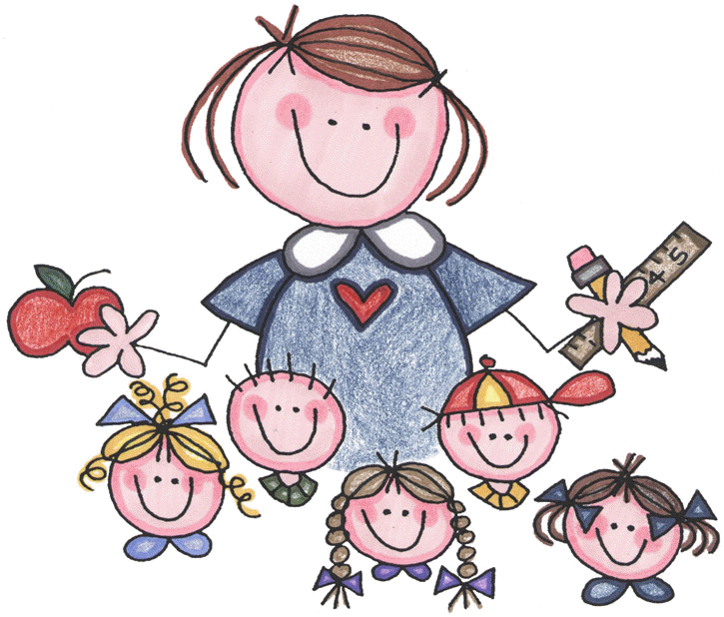
Our Day in Primary 1
Soft Start
Fine Motor Development
Havdallah and Tefilla
Morning prayers led by Mrs Rosenberg
Integrated Learning
Timetabled for P.E, I.C.T, Forest Schools, Fab Friends
Water Bottles in tray
Communication Folders collected
Lunches ordered
Literacy, Numeracy and HWB learning across all curricular areas
Snack and Lunch Time
Please provide a small snack for you child to have at playtime
Lunches are ordered and bands are provided
Miss Dunn settles children / issues meals
Senior Leadership Team supervise lunch in lunch hall
Variety of learning experiences across Early and First Level
Curiosity and exploration nutured

Slide 3
Important Days
Indoor P.E.
Tuesdays and Fridays
T Shirt, Shorts, Gym Shoes
Outdoor P.E.
Thursdays
Jogging Bottoms, Warm Top, Waterproofs, Old Trainers
Forest Schools
Fridays
Warm Clothing, Wellington Boots, Sunscreen
Assembly
Mondays
Kabbalat Shabbat
Fridays 10:30am

Slide 4
Communication
Communication Jotter
Communication Folder
Class Blog
Phone Call
End of the Day

Slide 5
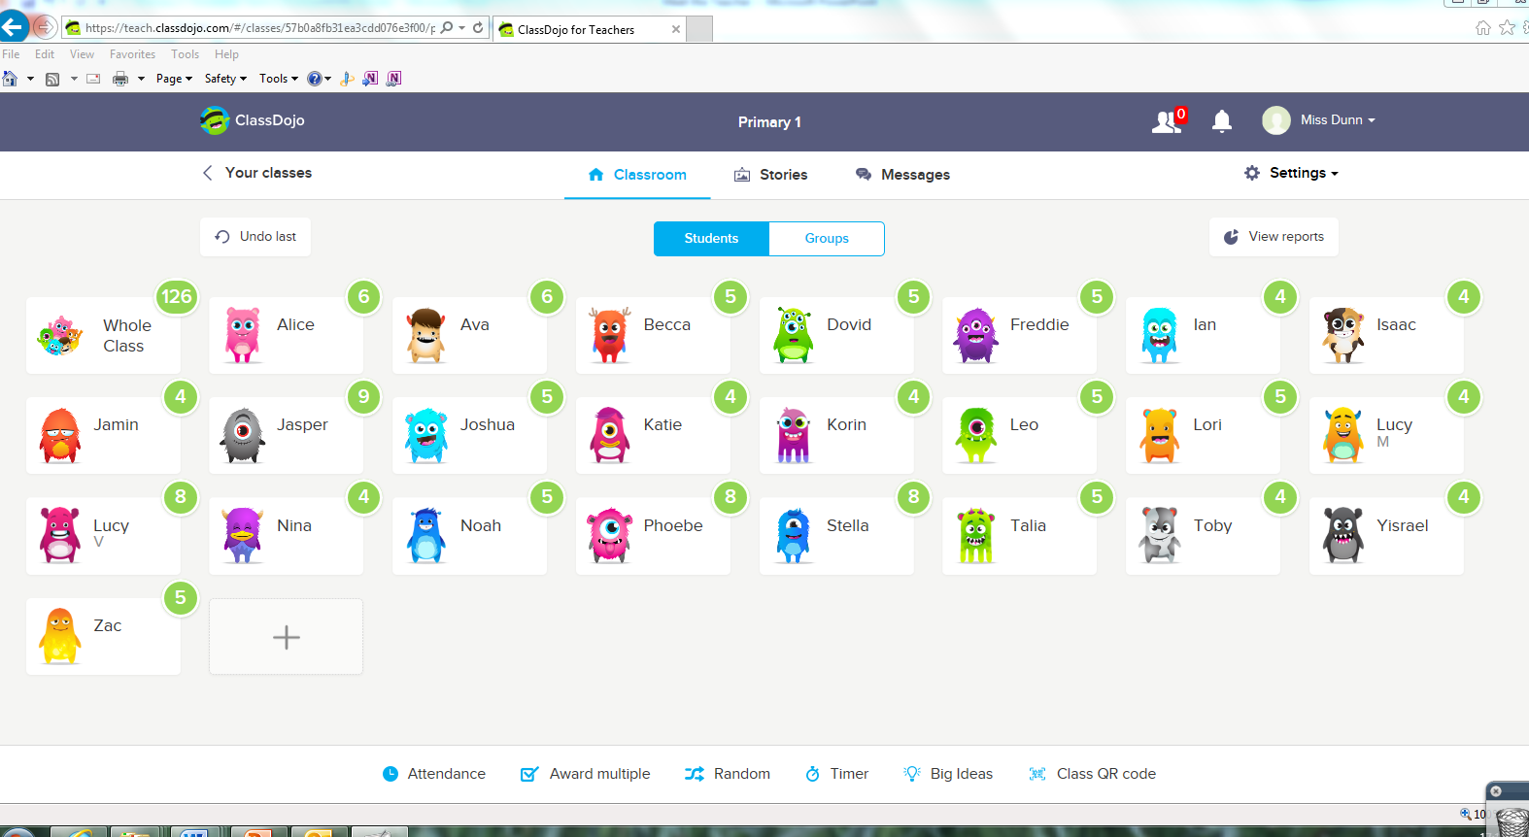
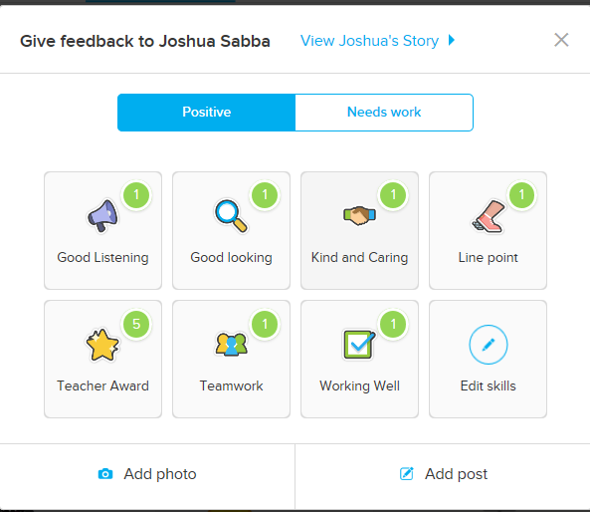
Class Dojo
Class Dojo System
Each child has a Dojo avatar and work to gain points.
Points are reset on a Monday.
5 points: Dojo Sticker
10 points: Famous Face
15 points: Choose Storytime story

Slide 6
Achievements
Ways we celebrate achievements:
Achievements Wall / Proud Cloud
Assembly Certificates
Ask me about stickers

Slide 7
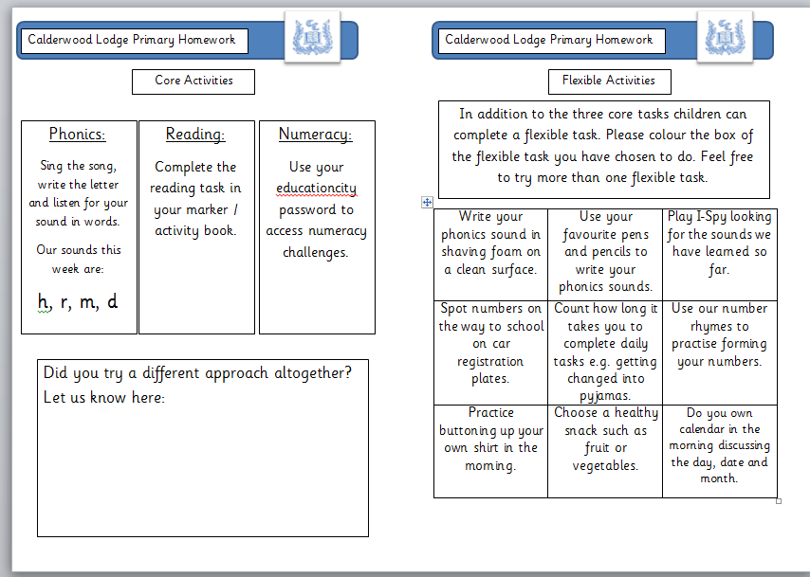
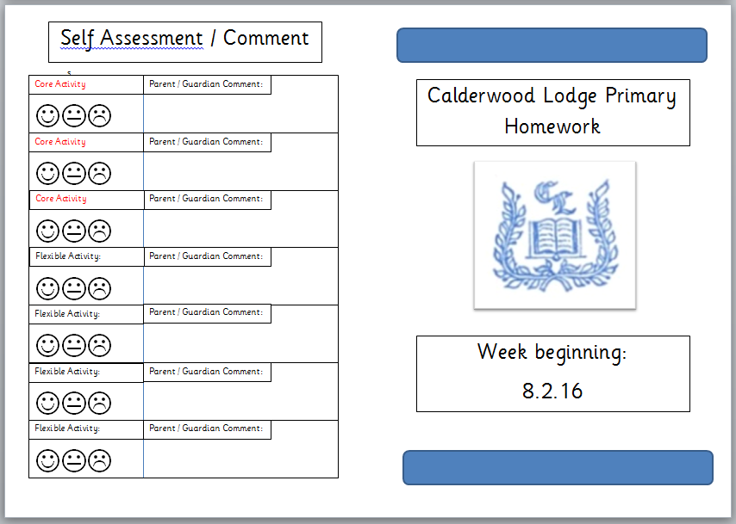
Homework
Homework is issued on a Monday and reviewed the following Monday. This allows for greater flexibility for parent and child.
Homework should take no longer than 15 minutes per day for children in Primary 1.
Feedback is more than marking.
The self assessment and parent comment grid will be reviewed on a Monday.
Core Tasks:
Guided Reading
Phonics
Numeracy and Mathematics
Flexible Tasks:
Grid changes monthly
Choice and Flexibility
Active and Multisensory

Slide 10
Jolly Phonics
Homework is issued on a Monday and reviewed the following Monday. This allows for greater flexibility for parent and child.
The five basic skills for reading and writing are:
Learning the letter sounds
Learning letter formation
Blending
Identifying sounds in words
Spelling the tricky word
In Jolly Phonics the 42 main sounds of English are taught, not just the alphabet.
Children should learn each letter by its sound, not its name. For example, the letter a should be called a (as in a nt) not ai (as in ai m). Similarly, the letter n should be nn (as in n et), not en . This will help in blending.
Blending is the process of saying the individual sounds in a word and then running them together to make the word.
Some words in English have an irregular spelling and cannot be read by blending, such as said, was and one . Unfortunately, many of these are common words. The irregular parts have to be remembered. These are called the ‘tricky words’.
Rhyming games, poems and the Jolly Songs also help tune the ears to the sounds in words
Feedback is more than marking.
The self assessment and parent comment grid will be reviewed on a Monday.
https://www.youtube.com/watch?v=IldcJdPArnM

Slide 11
Developing Reading
A variety of texts are used to support your child’s reading development.
Guided Reading sessions in class will take place three times a week with an unfamiliar text.
A reading book will come home on a Monday. This may be swapped with another text on a Wednesday dependent on level of text.

Slide 12
Time for Coffee!

