Slide 1
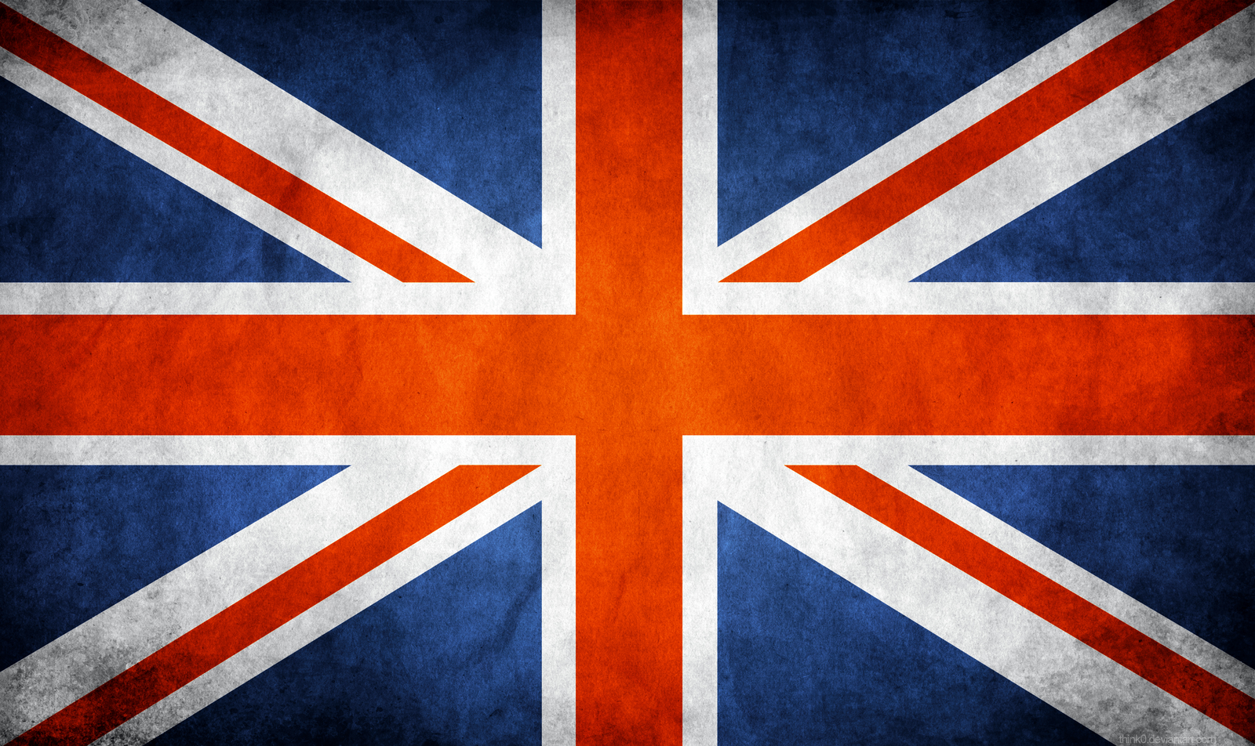

Slide 2
Why/When Did The U.K. Join E.U?
Quick Facts On The U.K.
The Capital City
The Countries That's in it
Flag
Quiz :)
Scotland/Quick Facts
The Capital City

Slide 3
The Queen
Culture
Famous Tourist Attractions
Quiz:)

Slide 4
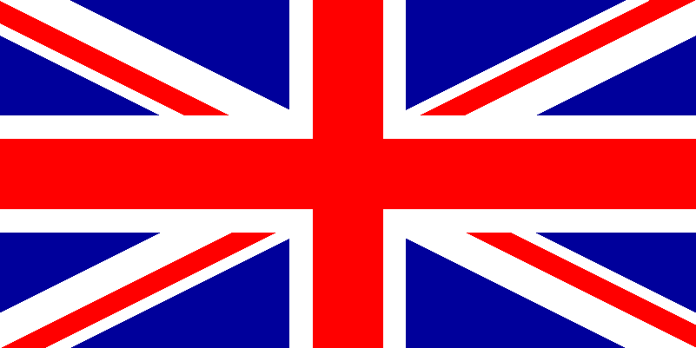
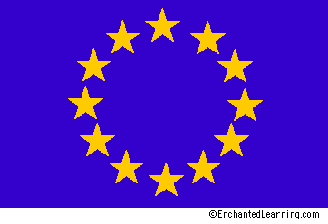
When?
The U.K. joined the European Union on the 1st of January 1973.
Why?
The U.K. joined the E.U. because they wanted to improve on their world matters, the economy, and connect with the countries surrounding it.

Slide 5
The capital city is London.
The United Kingdom is made out of Great Britain and Northern Ireland.
The population 60,837,954
Many people say that the U.K flag should be called the Union Jack.
The United Kingdom is called Great Britain.
The most famous country in the U.K. is England.

Slide 6
The Capital City is London.
London was about to be the world's largest city in 1831 to 1925.
The Royal Family lives in London.
A famous clock called Big Ben is there. London is one of the most popular city of the E.U. It is an expensive city.
London is the only city that hosts Modern Summer Olympic Games.
Its population is 8.308 million .
One of the most best tourist attractions is The London Eye.

Slide 7
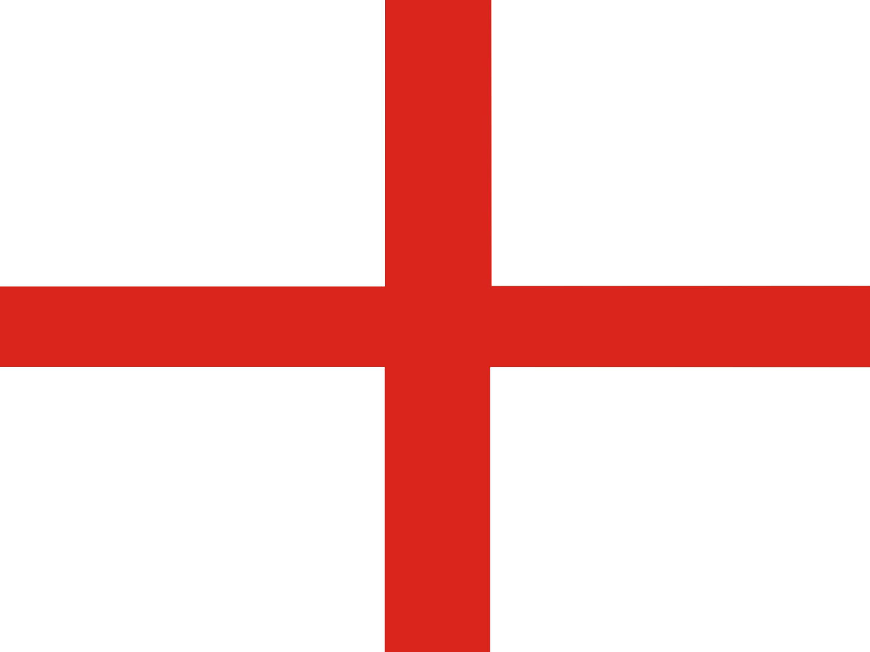
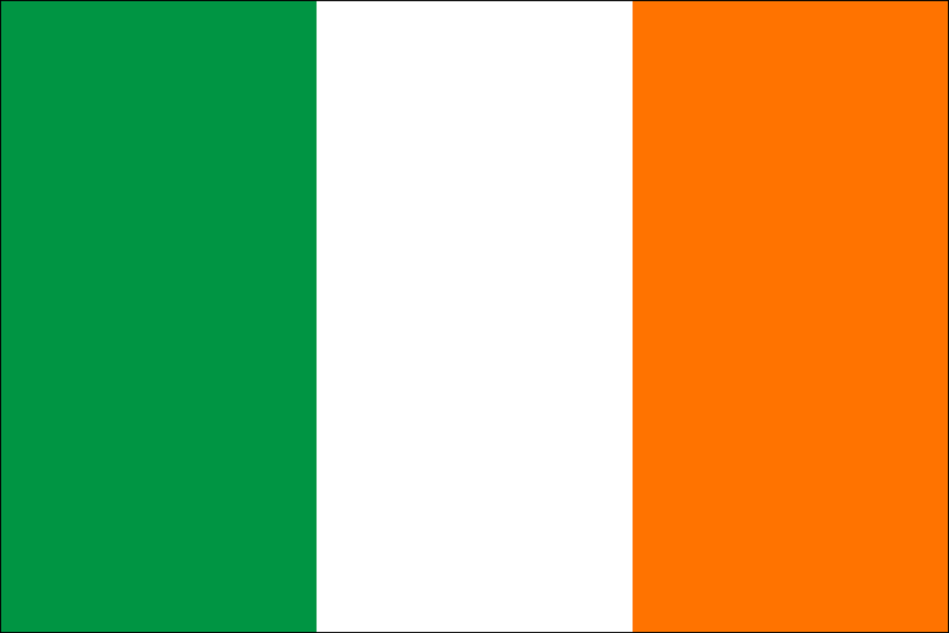
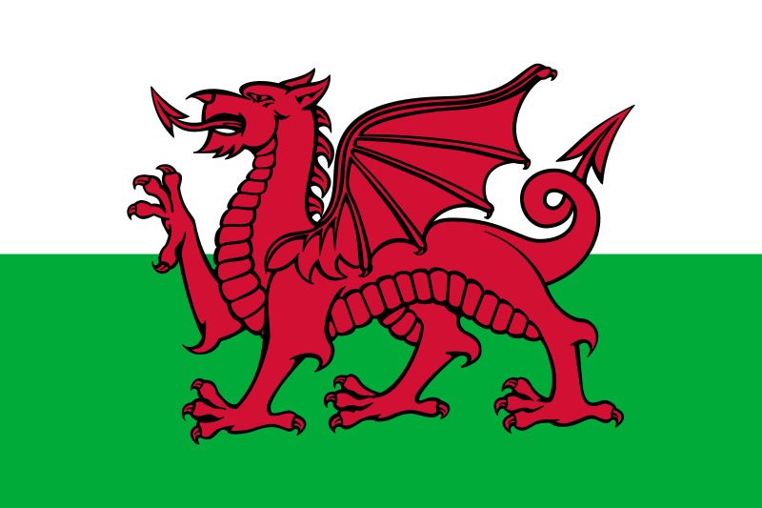
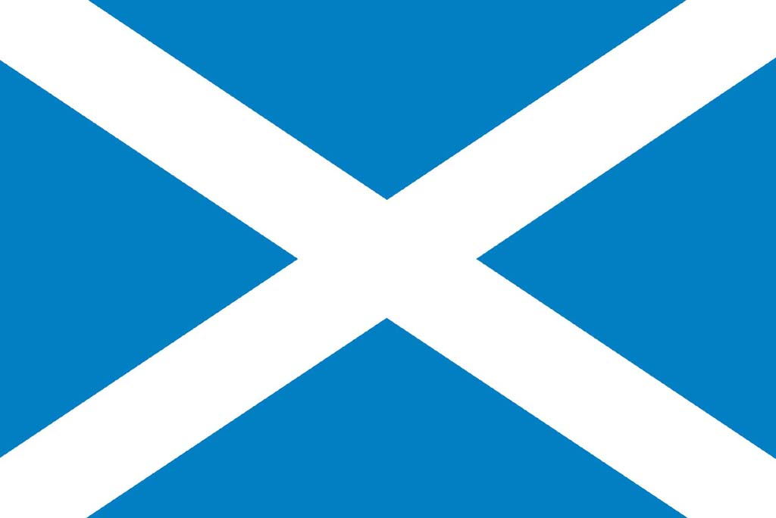
The Countries that are in it are: Scotland Ireland, Wales And England.
England's population is 53.01 million,
Scotland's population is 5.295 million, Ireland's population is 6.378 million, and Wales population is 3.064 million.

Slide 8
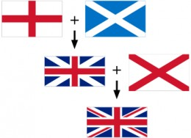
The U.K. Flag is made out of three different Country Flags.
The countries are Scotland, Northern Ireland, and England.
It Is called The Union Jack because it symbolizes the countries
of the United Kingdom.
Here is a diagram of how the flag is made ----->

Slide 9
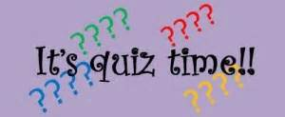
1) In Which Year Did The U.K. Became Part Of The E.U?
2)Which Countries Is The Flag Made Up Of?
3) Name Two Facts About the U.K.
4) What Is The Population?
5) What's The Capital City?

Slide 10
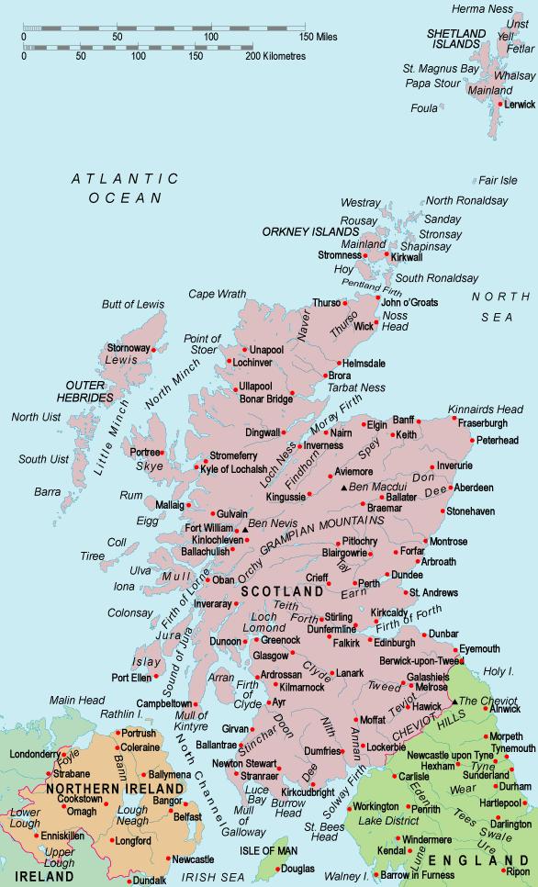
Quick Facts:
The largest city is Glasgow, The capital is Edinburgh, The Official Languages are English, Gaelic, and Scottish.
The Queen is called Queen Elizabeth II. A Famous Poet is called Robert Burns. Ben Nevis is the highest mountain in Scotland.

Slide 11
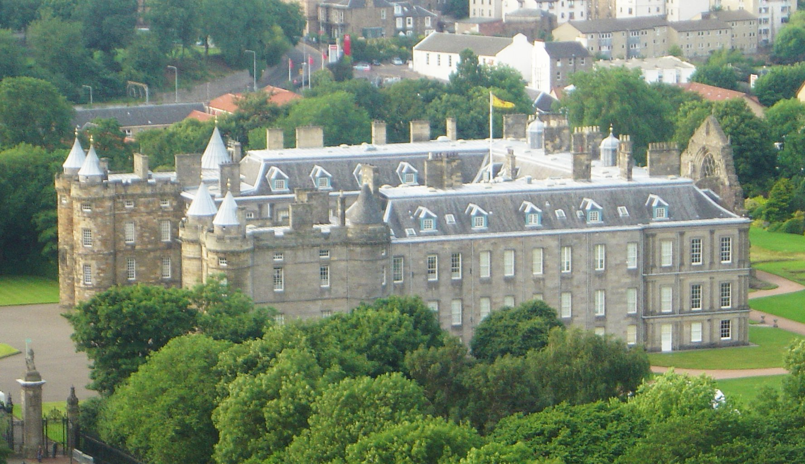
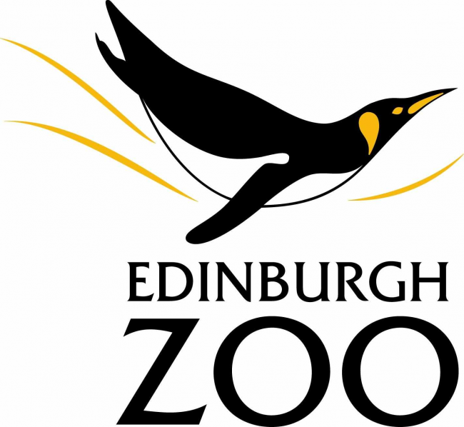
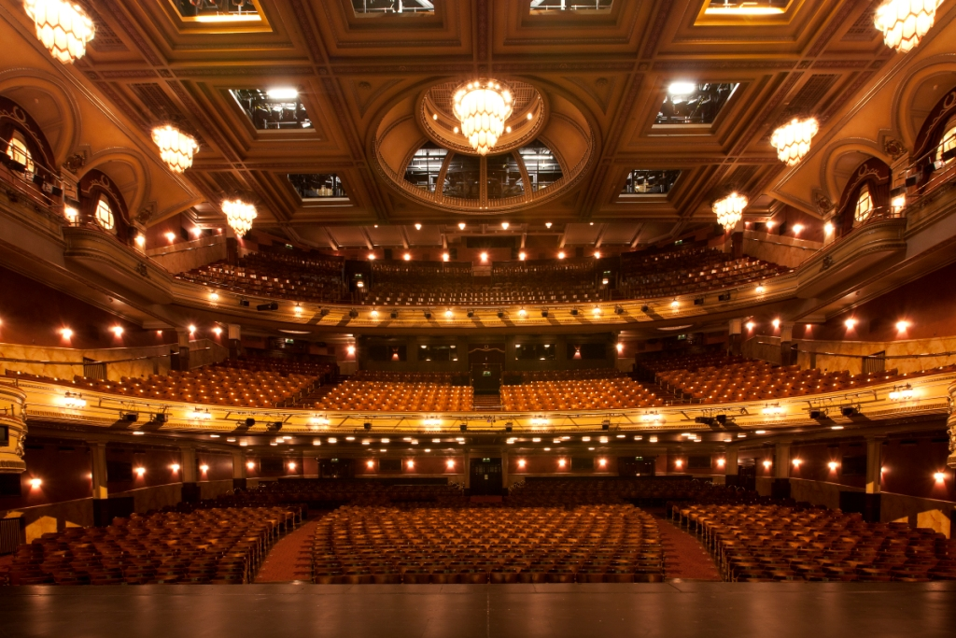
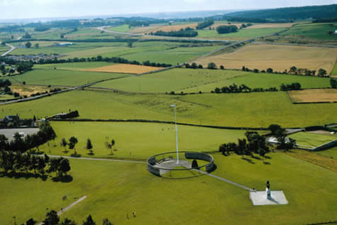
The Capital City is Edinburgh. Its population is 457,800.
Some Famous Tourist Attractions are Edinburgh Zoo, The Festival theatre, The Palace Of Holyrood House, The Lothian's. The Battle Of Bannock Burn took place in Edinburgh.

Slide 12
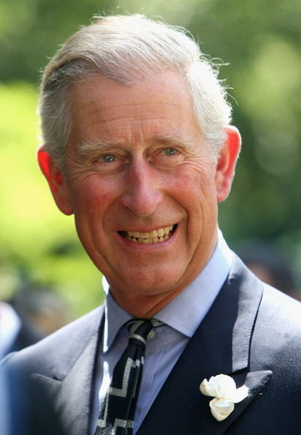
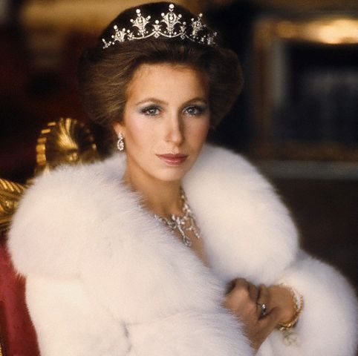
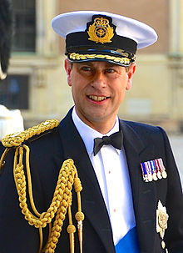
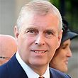
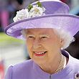
The Queen is called Queen Elizabeth II. She was born 21 April 1926. She was married to Prince Phillip and Duke of Edinburgh. She is part of the royal family. Her children are Charles prince of Wales, Anna Princess Royal, Prince Andrew Duke of York, and Earl of Wessex. She became Queen on June 2nd 1953. Pictures of her and her children:

Slide 13
The bagpipes is a famous icon of the Scottish culture.
For most Scottish people they like to wear the kilt as a Scottish tradition. They also like to play the highland games as a traditional Scottish sport. Here are pictures of the things:

Slide 14
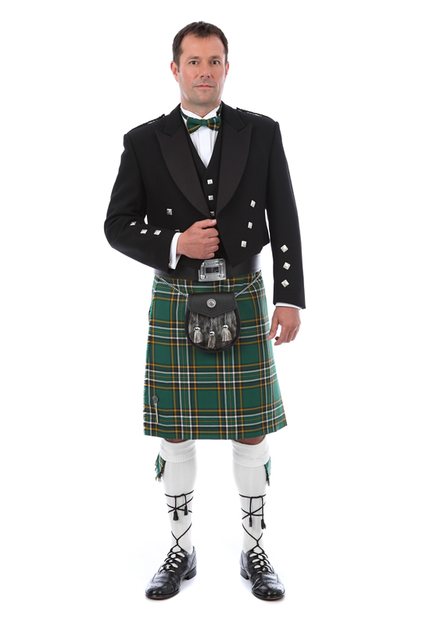
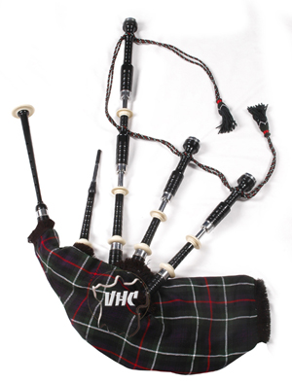
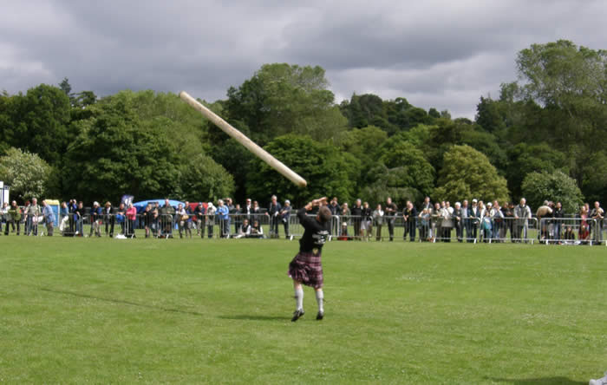

Slide 15
The Helix: The Helix is an exciting parkland with activates such as cycling, walking, watersports and much more.
Loch Ness Lake: Loch Ness Lake is a lake filled with such beauty and the sea monster Loch Ness lives there.
Robert Burns Home: Robert Burns Home is were Robert Burns lived and used to do his poetry there.
Ayr Beach: Ayr Beach is a place to relax and to have fun!

Slide 16
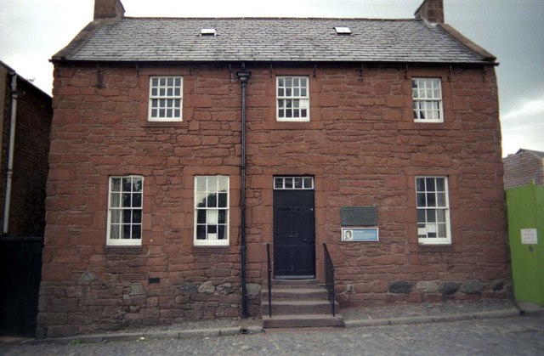
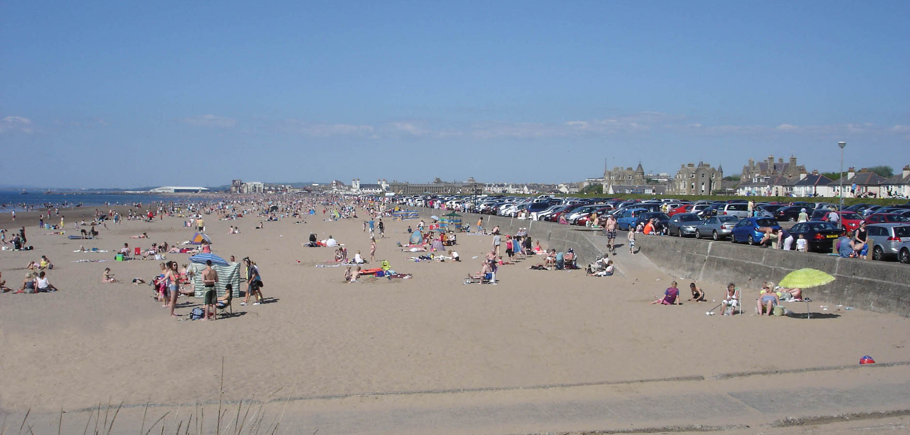
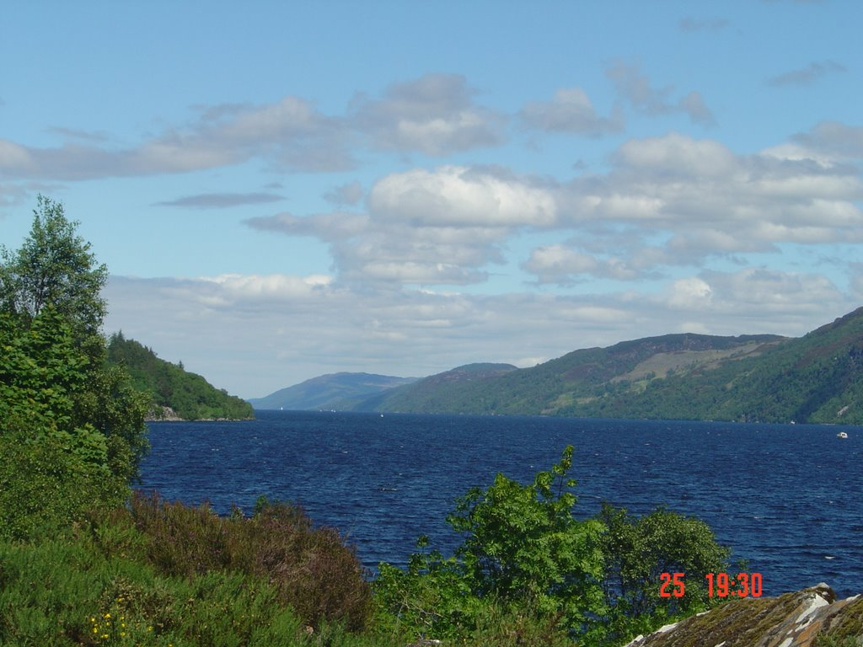
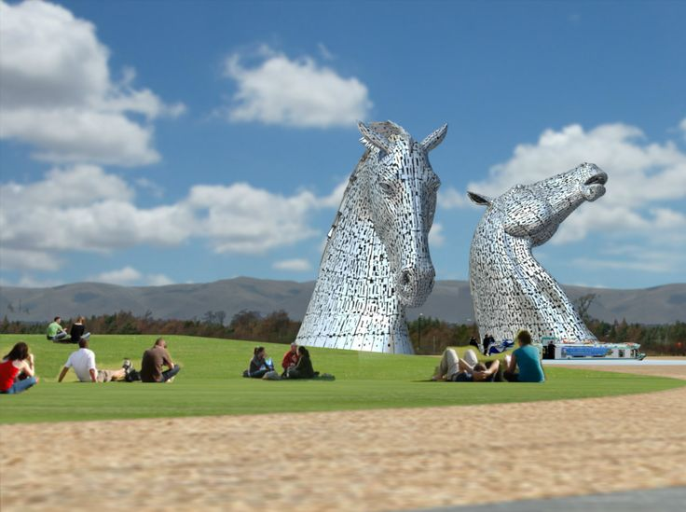

Slide 17
1) Name two tourist attractions in Edinburgh
2)What year was the queen born in?
3) Tell me three facts on Scotland
4) give me all the names of the queens children
5) In which year did the queen become queen?

