Slide 1
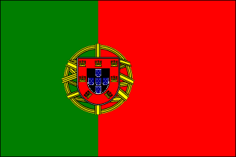
Portugal
Today I will be Teaching you all about Portugal and the people that live there
By Gabby

Slide 2
What Are We Going to Talk About?
Population
Geography
Language
Flag
National food
National Clothing
Currency
Famous Landmarks
And Last but not least Quiz!

Slide 3
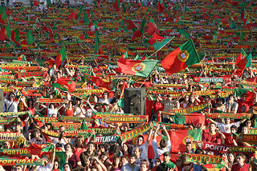
Population
Portugal has approximately 10million people
10,799,270 which was calculated in 2013

Slide 4
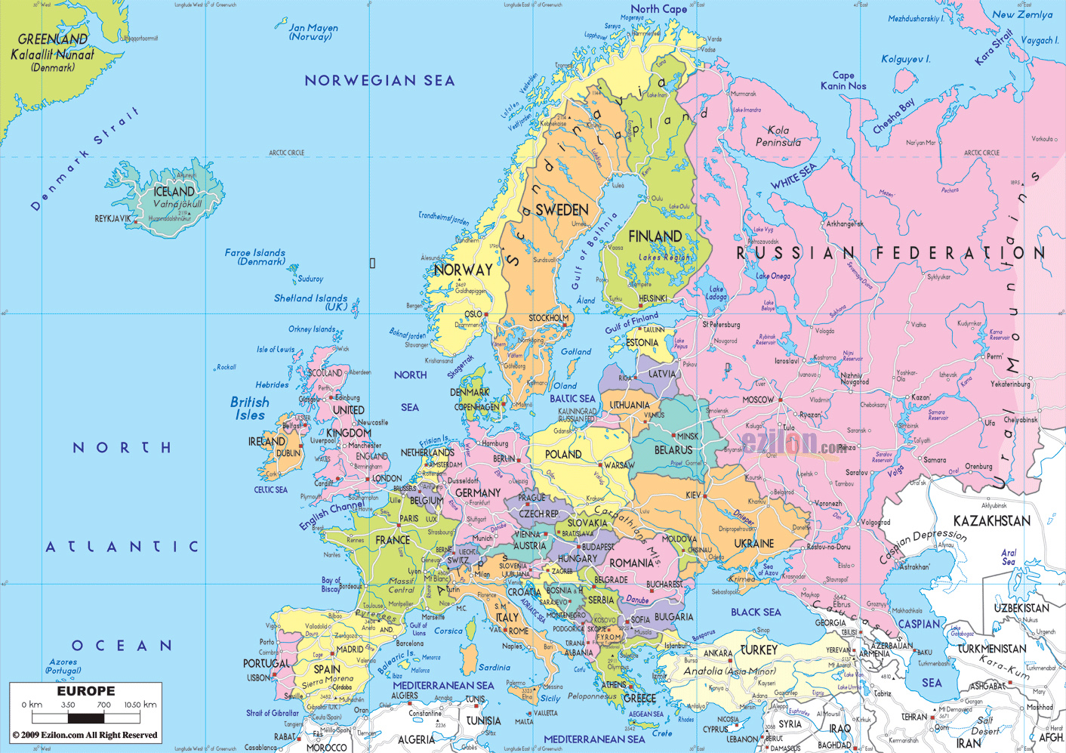
Geography

Slide 5
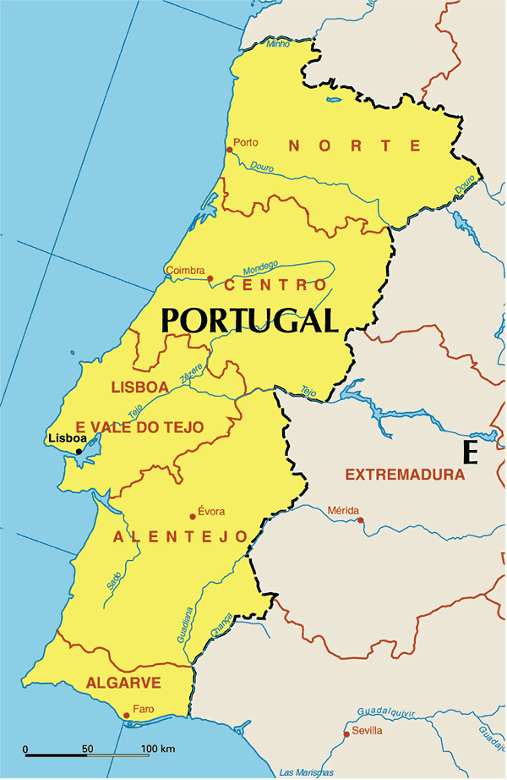
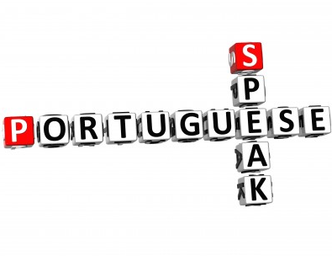
Language
Hello-Olá
Please-por favor
Thank you-obrigado
My name is-Meu nome é
People in Portugal speak Portuguese!

Slide 6
Flag
As you can see this is the flag

Slide 7
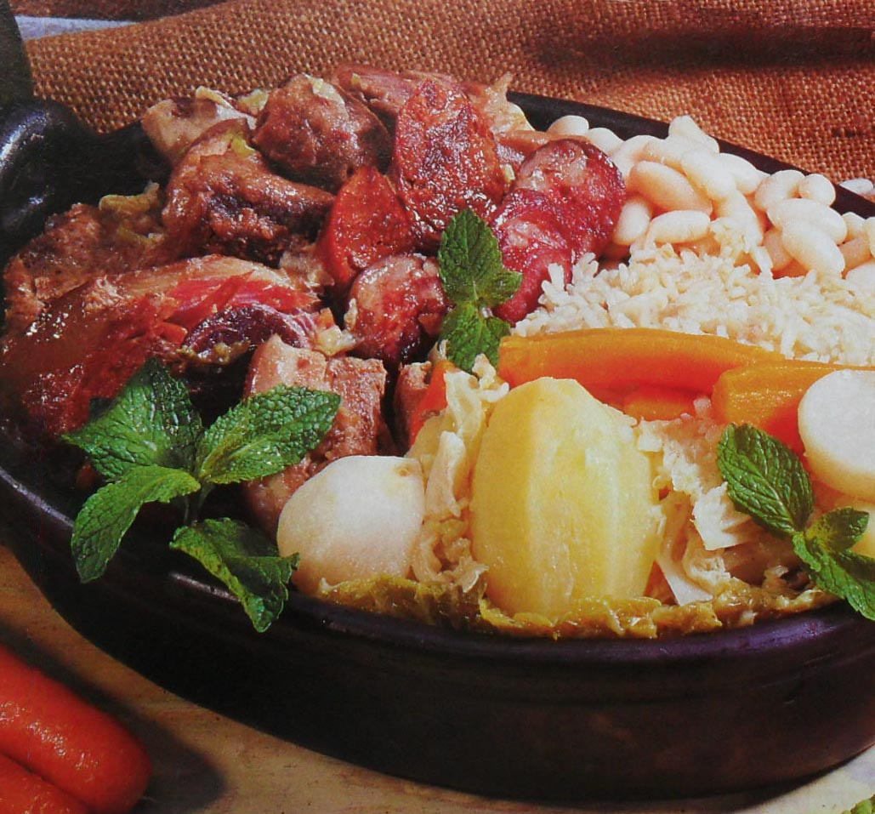
National Food
Portugal's National Food is "Cozido à Portuguesa",. It is a stew made of beef, pork or chicken, served with carrots, cabbage and potatoes or rice.

Slide 8
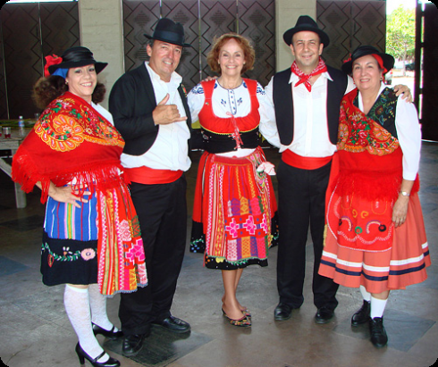
National clothing
Portugal's national Piece of clothing are normally very bright and vivid colours like red green white and a bit of black
The men Normally where a black waist coat, a white shirt, black trousers and a red belt and bowtie
The women where a very full long Dress with white tights or socks and also a white shirt under the dress also last but not least they where a small little hat
The dresses that the women where are mostly striped and a little florel

Slide 9
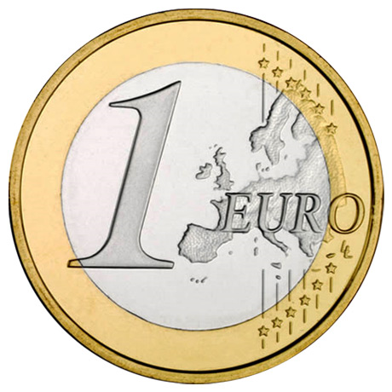
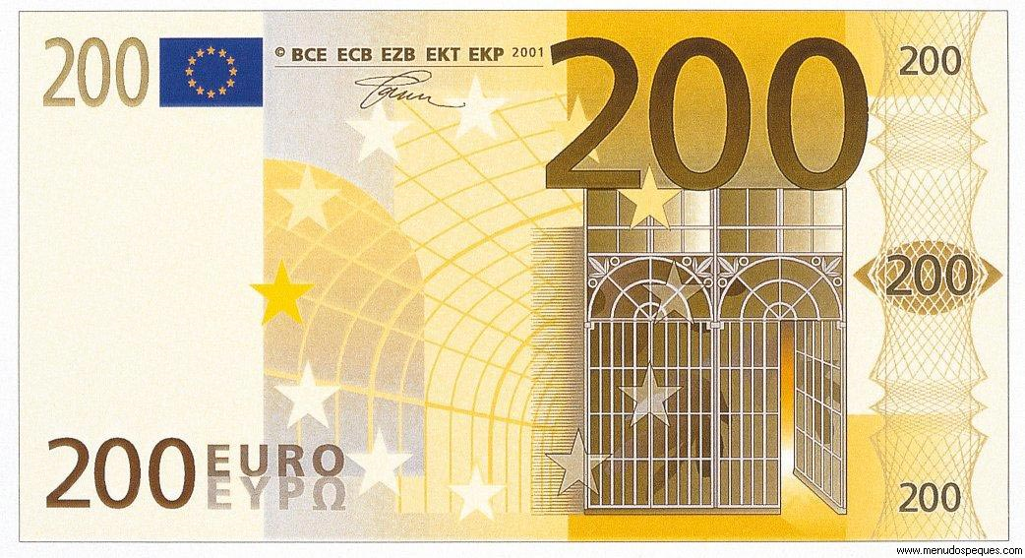
Currency
Portuguese currency is called Euro
Its called a euro because Portugal is a European

Slide 10
Quiz
1)What Continent is Portugal in?

Slide 11
CORRECT

Slide 12
SORRY
The Answer is Europe

Slide 13
Explain 1 meat which is in Portugal's famous Dish

Slide 14
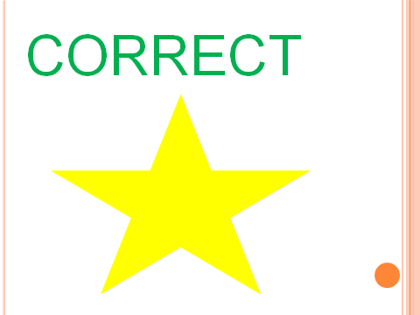

Slide 15
SORRY
The answer was either Beef, pork or chicken

Slide 16
How many people
approximately live in Portugal

Slide 18
SORRY
The answer 10 million people

Slide 19
Last Question
What Colours are the Portuguese flag

Slide 21
SORRY
The Answer was Blue, Red, Yellow and green

Slide 22
Thanks
Thank you for listening and watching my presentation of Portugal and I hope that you learnt a lot☺☺☺☺☺☺☺☺☺☺☺☺☺☺☺☺☺☺☺☺☺☺☺☺☺☺☺☺☺☺☺☺☺☺☺☺☺☺☺☺☺☺☺☺☺☺☺☺☺☺☺☺☺

